Slide 1

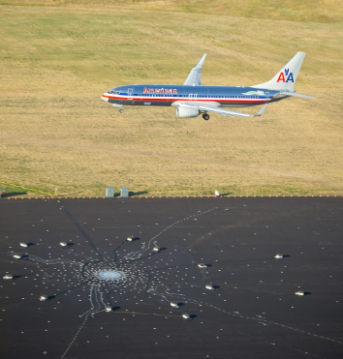
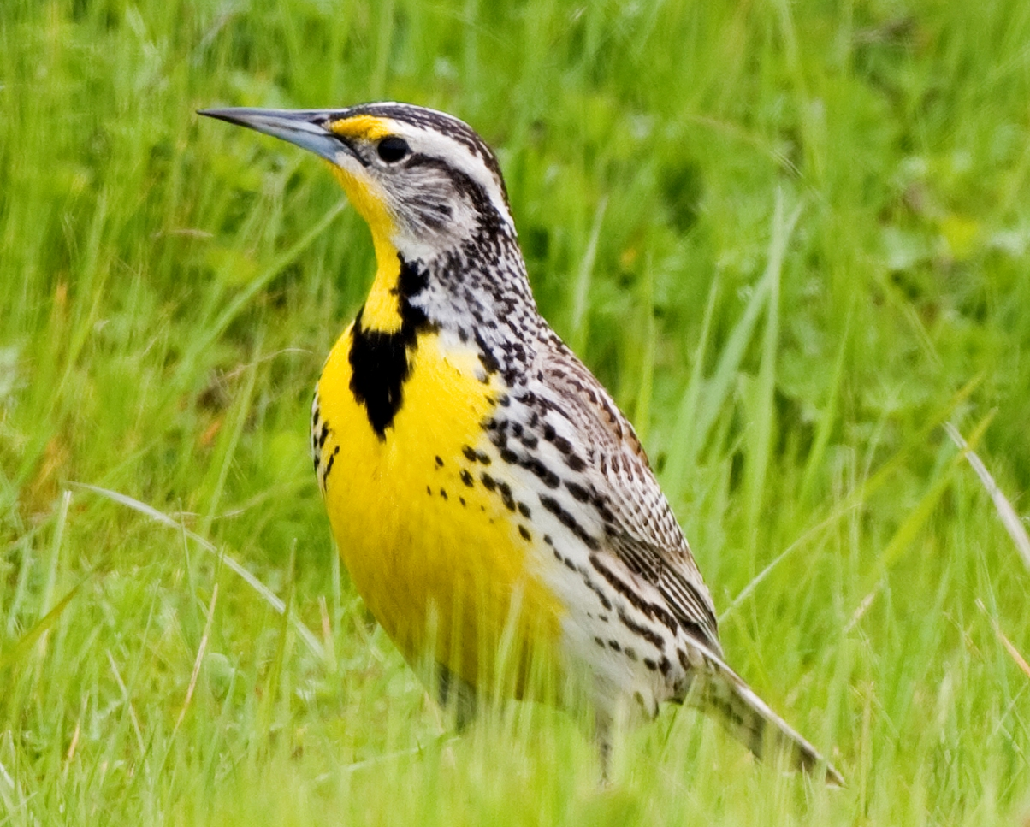
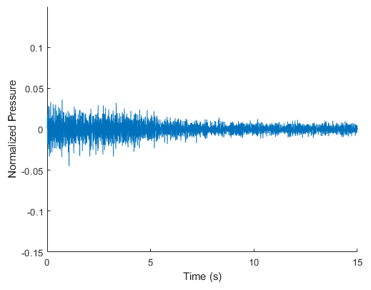
Environmental Noise Contamination Detection
Todd Schultz, Rahul Birmiwal, Sean Miller
Project Overview
Broad Investigation Results
Challenges
Background
Public demand for reduced noise population forcing regulatory agencies to reduce aircraft noise limits
Certification process is expensive
Monitoring personal used to lower risk higher certified noise levels by noise contamination
Contamination sources include birds, insects, livestock, and road traffic
Objective
Research the feasibility of automating the detection of environmental noise contained in acoustic measurements for aircraft community noise testing.
Feature Set | Block Length (s) | Logistic Regression | Fine Tree | Medium Tree | Coarse Tree | Boosted Trees Ensemble | Bagged Trees Ensemble | Linear SVM | Quadratic SVM | Cubic SVM | Fine Gaussian SVM | Medium Gaussian SVM | Coarse Gaussian SVM | Subspace KNN | Neural Net | CNN | LSTM NN
Modified MFCC | 1 | 75.8% | 83.1% | 81.1% | 75.6% | 85.0% | 86.8% | 77.2% | 87.3% | 89.1% | 85.7% | 88.0% | 80.4%
Modified MFCC | 2 | 78.3% | 85.2% | 82.5% | 76.3% | 86.3% | 88.2% | 79.0% | 89.5% | 91.9% | 88.6% | 89.3% | 80.5% |  | 86.7%
Modified MFCC | 1 | 78.0% | 81.8% | 78.9% | 75.6% | 85.0% | 85.5% | 79.0% | 88.8% | 89.7% | 76.3% | 88.1% | 79.7%
Modified MFCC | 2 | 80.2% | 85.2% | 81.4% | 74.3% | 85.9% | 88.3% | 80.4% | 90.7% | 92.8% | 80.9% | 90.3% | 79.7% |  | 92.5% |  | 61.8%
1/3 Octaves | 1 | 70.7% | 83.7% | 80.2% | 75.3% | 85.1% | 89.0% | 70.3% | 77.5% | 81.2% | 71.9% | 75.4% | 70.1%
1/3 Octaves | 2 | 72.8% | 87.5% | 82.8% | 77.3% | 87.5% | 91.9% | 71.7% | 79.7% | 83.8% | 76.6% | 76.5% | 71.5% |  | 71.5%
Octaves | 1 | 67.3% | 82.0% | 79.4% | 72.7% | 82.2% | 86.3% | 66.6% | 76.4% | 80.0% | 78.0% | 75.6% | 66.8%
Octaves | 2 | 67.8% | 84.7% | 80.6% | 73.7% | 84.2% | 89.0% | 66.5% | 77.0% | 81.2% | 81.1% | 76.8% | 66.9% |  | 77.4%
MFCC | 2 | 76.3% | 82.0% | 78.2% | 72.1% | 83.5% | 85.3% | 76.8% | 85.2% | 87.4% | 83.8% | 87.0% | 77.0%
MFCC | 1 | 74.1% | 80.4% | 78.9% | 68.8% | 81.6% | 82.9% | 75.3% | 83.0% | 84.6% | 80.5% | 84.8% | 76.4% |  | 77.5%
FFT (25 Hz resolution) | 0.041 | 61.3% | 78.4% | 75.8% | 70.0%
FFT (100 Hz resolution) | 0.01 | 68.3% | 76.8% | 74.0% | 69.6%
CWT Scalogram | 1 |  |  |  |  |  |  |  |  |  |  |  |  |  |  | 92.9%
CWT Scalogram | 3 |  |  |  |  |  |  |  |  |  |  |  |  |  |  | 85.1%
CWT Scalogram | 5 |  |  |  |  |  |  |  |  |  |  |  |  |  |  | 83.3%
CWT Scalogram Bag of Features | 1 | 81.0% | 75.5% | 74.2% | 73.3% | 82.1% | 82.0% | 83.1% | 86.4% | 87.1% | 60.5% | 86.1% | 79.9%
CWT Scalogram Bag of Features | 3 | 80.7% | 73.2% | 73.7% | 75.3% | 84.8% | 82.7% | 86.7% | 87.7% | 88.6% | 59.1% | 87.9% | 81.6%
CWT Scalogram Bag of Features | 5 | 55.0% | 73.0% | 74.1% | 70.6% | 82.3% | 81.7% | 88.0% | 89.4% | 90.9% | 60.2% | 87.7% | 81.6%
DWT (Coiflet2, 4 levels) | 1 | 70.0% | 90.4% | 88.3% | 78.1% | 91.2% | 93.1% | 80.1% | 86.2% | 88.6% | 84.8% | 82.3% | 76.0% |  | 81.5% |  | 76.4%
DWT (Coiflet2, 4 levels) | 2 | 75.4% | 91.6% | 88.1% | 80.1% | 91.0% | 93.3% | 80.5% | 87.3% | 90.5% | 85.8% | 82.4% | 77.6% |  | 81.5% |  | 78.2%
DWT (Coiflet2, 5 levels) | 2 | 81.5% | 91.7% | 89.1% | 79.3% | 92.3% | 94.2% | 82.1% | 88.0% | 90.6% | 87.2% | 83.5% | 78.8% |  | 82.3%
DWT (Coiflet2, 5 levels, Hampel Filter) | 2 | 81.0% | 91.7% | 88.7% | 79.3% | 92.1% | 94.0% | 82.0% | 88.9% | 91.5% | 87.6% | 83.8% | 76.8% | 76.5% | 84.9%
DWT (Coiflet2, 4 levels, Hampel Filter) | 2 | 70.1% | 92.1% | 88.6% | 80.0% | 91.1% | 93.5% | 80.7% | 87.9% | 90.8% | 86.3% | 82.7% | 77.8% |  | 83.1%
DWT (Coiflet2, 3 levels, Hampel Filter) | 2 | 67.1% | 89.7% | 87.5% | 78.1% | 89.6% | 92.9% | 79.0% | 84.4% | 52.0% | 85.9% | 81.1% | 76.5% | 81.3% | 81.4%
DWT (Debauchies4, 4 levels) | 1 | 64.4% | 90.1% | 86.0% | 81.1% | 88.9% | 91.6% | 77.2% | 80.6% | 51.4% | 81.5% | 77.6% | 66.1% | 71.1%
DWT (Haar, 4 levels) | 1 | 53.8% | 77.0% | 73.1% | 68.7% | 76.4% | 80.5% | 71.5% | 76.4% | 58.7% | 76.1% | 73.9% | 70.4% | 67.1%
DWT (Coiflet2, 4 levels, no entropy) | 2 | 71.6% | 90.6% | 85.7% | 81.6% | 88.3% | 92.1% | 79.2% | 57.1% | 49.9% | 76.3% | 67.9% | 61.0% | 54.1%
DWT (Coiflet2, 2 levels) | 2 | 70.1% | 89.0% | 84.6% | 78.9% | 88.2% | 92.3% | 68.8% | 71.8% | 53.9% | 77.7% | 74.0% | 61.5% | 73.7%
How To Turn Audio Into Features
We separated each audio file up into blocks of an equivalent length and then processed the features for each block. Blocks from which features were generated could contain overlapping audio.
How To Quantify Contamination Levels
The audio recordings that were used only had a single source of noise allowing us to combine aircraft or ambient signals with contamination to create a larger data set than the 66 files. This also allowed us to control the signal-to-noise ratio.
Data
Limitations
Due to the small size of potential contamination audio, the models are not as accurate when classifying new sources of contamination.
One recommendation that we do have at this time is that we suggest that more data is provided to fully enumerate the possible contamination classes that would exist near the test site.
Audio Files
66 Total
Clean Signals
49 Aircraft and Ambient Recordings
Contamination Signals
13 Animal Vocalizations
Process
Aircraft audio file split into blocks
Feature set generated
Contamination audio file chosen and split into blocks
Contamination added to aircraft signal with desired signal-to-noise ratio
Contaminated features generated
Repeated for all aircraft audio files
All generated features combined into set for model training
The three feature set, classifier pairs selected for detailed study are as follows:
Model: Bagged Trees
Wavelets (Coiflet2, 5 level, T=2s)
Best overall with accuracy of 94.2%
Model: Bagged Trees
Wavelets (Coiflet2, 4 level, T=2s)
Accuracy of 93.3%
Model: Cubic SVM
Cepstral (26 feature T=2s)
Best non-NN, non-wavelet performer with accuracy of 92.8%
Results
Wide variety of feature sets and classifiers show potential to achieve an accuracy >90%
Deep neural networks under performed as compared to more traditional classifiers
Computation time of the feature set required for the combination influenced the selection of 3 combinations to optimize
3 optimized feature sets and classifiers achieve >93% cross-validation accuracy
Performance of all 3 degraded when tested against randomized scenarios
Increased fidelity of DWT5 did not out perform DWT4
Deep Investigation Results
Signal-To-Noise Ratio – Parameter Sweeps
Methods
Our investigation into the viability of automated detection of environmental noise contamination is broken into two parts. A broad assessment of feature sets and models followed by a deeper investigation into three of the best performing pairs.
Broad Investigation
Objective: To gain insight to which broad categories of feature sets and model combinations might provide the best prediction accuracy
Signal-to-noise ratio held at 6 dB
Block size limited to only 1 seconds or 2 seconds
Used default hyperparameters and settings when training models
Deep Investigation
Objective: To optimize a limited set of feature set and model combinations for their best performance and subject them to rigorous testing to understand real-world performance
Optimize the models hyperparameters.
Randomize the signal-to-noise ratio.
Randomize the percent of a block that contains contaminated audio.
Randomize which blocks are contaminated.
Vary all of above parameters through Monte-Carlo simulation.
Recommendations
Continue with the DWT4 and CEP26 feature sets and classifiers
Expand the data sets with additional data, more constructed scenarios, and with variation in the signal-to-noise ratio
Development method to compute the effective signal-to-noise ratio for the scenario with a reduction in the proportion of the signal block contaminated
Performance summary of optimized feature set and classifier pairs for detailed study subjected to the randomized signal blocks contaminated
 | F1 score | Accuracy | FNR | FPR
DWT5 | 93.4% | 93.6% | 10.4% | 2.4%
DWT4 | 93.6% | 93.8% | 10.1% | 2.2%
CEP26 | 93.6% | 93.9% | 10.3% | 1.9%
Acknowledgements
We would like to thank our sponsor for the project, Steven Underbrink as well as our Data Science Capstone advisor: Dr. Megan Hazen, University of Washington.

