Slide 1
Click it!
Team 3 Trees
Chung Lau, Anita Miller, Steve Nelson, Todd Schultz, Paul Scarpa, Srinivasa Ramasamy, Naresh Jarugala

Slide 2
Avazu CTR Kaggle competition
Predict whether a mobile ad will be clicked
Scored using a log loss metric
Provided 10 days worth of data for training
Provided 1 days worth of data for testing

Slide 3
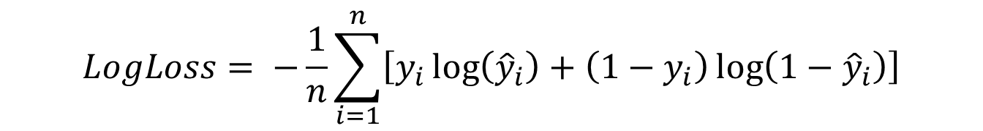
Log loss scoring
$$LogLoss= −\frac{1}{n}\sum_{i=1}^{n}{\left[y_{i}\log\left({\hat{y}}_{i}\right)+\left(1−y_{i}\right)\log\left(1−{\hat{y}}_{i}\right)\right]}$$
Brutal for extreme wrong predictions
Defines critical performance indicator
Can the score be increased without accuracy improvements?

Slide 4
Best Score = 0.3990766
Platform = Azure ML
Algorithm = Boosted decision tree
Maximum leaves per tree = 20
Minimum samples per leaf = 10
Learning rate = 0.2
Number of trees = 100
Entire training set
Random guessing benchmark score = 0.6931472
https://www.kaggle.com/c/avazu-ctr-prediction/leaderboard

Slide 5
Divide, conquer, and ensemble!
Work separately but share results as you go
Each create our own unique models
Ensemble together at the end with a simple average of the probabilities
Strategy determined by demonstrated power of ensembles and the reality of the logistics of organizing the team

Slide 6
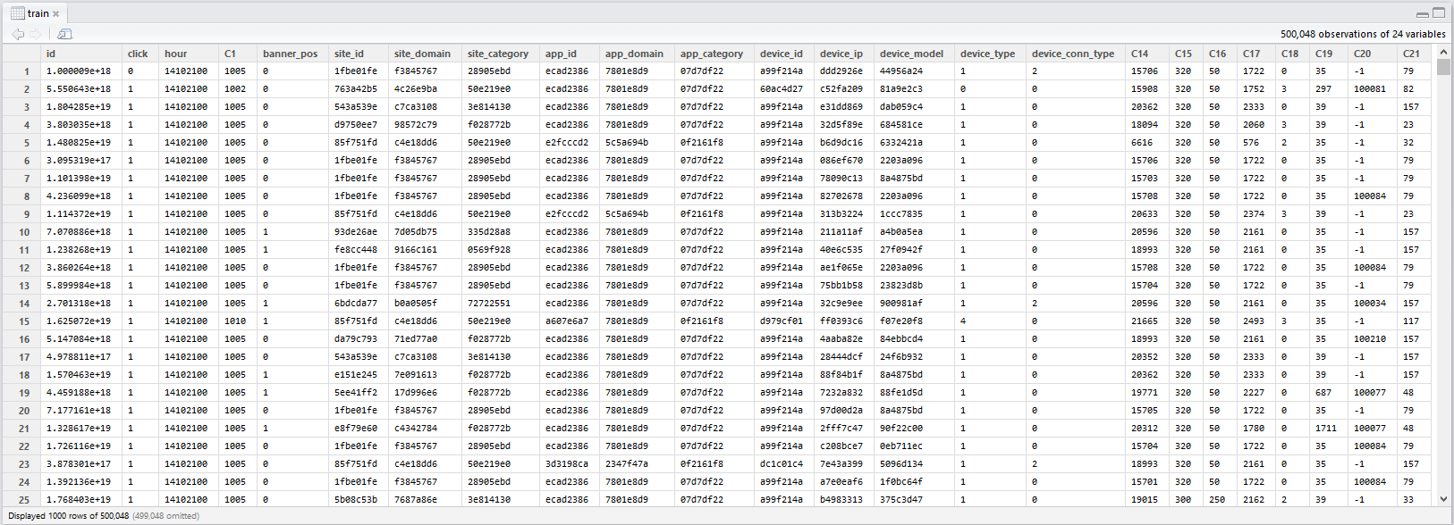
The data

Slide 7
Big data or small computers?
Training set = 10 days of data
5.87 GB comma separated values file (aka a text file)
40,428,967 observations with 24 columns!
All variables are categorical
Test set = 1 day of data
4,577,464 observations
Personal computers faltered with the data
Dual Xeon processors and 48 GB of RAM or Azure didn’t
Down sampled for practicality

Slide 8
What the #@&%?
Most variables were obfuscated
Even missing values were obfuscated
Sample values such as f3845767
No units or descriptions on other values
No information on bounds
Are there proxies such as device ip and device id?
Portion of data that clicked is constant for each hour

Slide 10
The final countdown
Variable | Number of unique categories | Correlation Coefficient with click
'id'
'click' | 2 | 1
'hour' | 240 | -0.00778
'C1' | 7 | -0.03525
'banner_pos' | 7 | 0.025535
'site_id' | 4,737 | -0.01604
'site_domain' | 7,745 | -0.02951
'site_category' | 26 | -0.01854
'app_id' | 8,552 | -0.04409
'app_domain' | 559 | -0.03002
'app_category' | 36 | -0.04555
'device_id' | 2,686,408
'device_ip' | 6,729,486
'device_model' | 8,251 | -0.00359
'device_type' | 5 | -0.03776
'device_conn_type' | 4 | -0.08636
'C14' | 2,626 | -0.06113
'C15' | 8 | -0.0946
'C16' | 9 | -0.13744
'C17' | 435 | -0.06197
'C18' | 4 | 0.021634
'C19' | 68 | -0.03157
'C20' | 172 | -0.07076
'C21' | 60 | -0.07104
Only 6,865,066 or 16.98% clicked the ad
240 unique hour long segments
Many variables with large number of categories

Slide 11
A chip off the old block
Example sampling strategies
Stratified sampling to preserve the click ratio
Stratified to preserve proportion from each hour long segment
Multiple independent samples
Code example-MATLAB
Random observation
“Sampling 50/50 or 83/17? When using 50/50 sample with WEKA-classify-cross validation, I was not able to get ‘correctly classified instances rate’ above 65%. So decided to use the sample with 83/17 split which gets 80%+. I don’t really understanding why.“ Anita Miller

Slide 12
Feature transformations
Eliminated suspected proxy variables
Broke up the data/time variable to day of week and hour of day
Binning or removal of some of the high categorical count variables
Null values-to be or not to be?
Actually tells us something
Need to make predictions where there are missing values
Attribute scaling?
Unsure, technically everything is categorical but…
Can some variables be treated at numerical values instead of categorical?
C15 and C16 are believed to be the dimensions of the ad in pixels

Slide 13
Feature selection
Feature selection using many methods
Group plot matrix
Correlation
Gain ratio
Information gain (via decision trees)
Wrapper methods
ReliefF
SequentialFS (linear classifier + bagged decision trees)
CfsSubsetEval + BestFirst
CfsSubsetEval + Random Search
Infogain + Ranker
Chisquared +Ranker
Gainratio + Ranker
Classifier + Ranker
Tallied votes and picked top performers

Slide 15
And the finalists are…
Banner position
Site domain
Site category
App domain
App category
Device conn type
C14
C16
Hour of the day
Day of the week
Site id
Site domain
Site category
App id
App domain
App category
Device model
Device conn type
C14
C16
C18
C21
Site domain
App domain
C14
C16
C18
C21

Slide 16
Models tried
Logistic regression
Decision trees
Bagged decision trees/Random forests
Boosted decision trees
SVM
Neural networks
And more to come…

Slide 17
Name | Description | Feature Engineering | Score
Random guess benchmark | Random guessing with all predictions set to a probability of 0.5 of clicking the ad | None | 0.6931472
Boosted Tree-10% data | Boosted decision tree from Azure ML with a maximum of 20 leaves per a tree, minimum of 10 samples per leaf, a learning rate of 0.2, the number of trees set to 100, and trained at the entire dataset. | None | 0.3993284
SVM | SVM from Azure ML with only 10% of training data. | None | 0.4352991
Boosted Tree-all data Model A | Boosted decision tree from Azure ML with a maximum of 20 leaves per a tree, minimum of 10 samples per leaf, a learning rate of 0.2, the number of trees set to 100, and trained on the entire dataset. | None | 0.3990766

Slide 18
Name | Description | Feature Engineering | Score
Boosted Tree-all data Model b | Boosted decision tree from Azure ML with a maximum of 40 leaves per a tree, minimum of 100,000 samples per leaf, a learning rate of 0.2, the number of trees set to 100, and trained on the entire dataset. | None | 0.4049064
Random 17% Benchmark | Matching population distribution in sample data, 17% of the test data was randomly selected with a uniform probability and given a 100% probably of clicking the ad, the remaining test data was given a 0% probability of clicking the ad. | None | 9.5526002
Baseline Neural Network | Azure ML default parameters neural network with entire Kaggle dataset | None | 0.4678139
Logistic Regression | Linear logistic regression from R, single predictor banner_pos, 500k sample set | Categorical | 0.4411265

Slide 19
Name | Description | Feature Engineering | Score
Logistic Regression | Linear logistic regression from R, C14 and C16 with interactions only, 500k sample set | None | 0.4361704
Logistic Regression | Linear logistic regression from R, C14 only, 500k sample set | None | 0.4413473

Slide 20
Conclusions
Garage in equals garage out
‘Curated’ data files
Lacking variable descriptions
What’s big?
There are a lot of numbers but it’s really not scary
Just need a little more memory than found in standard consumer computers
Try, try, and try again
Our best score, so far, found out of naïveté
New submissions lead to new understanding

Slide 21
Tools of the trade
MATLAB
R
Weka
Python
Alteryx
Azure ML
Excel

