Slide 1

15 minutes or less!
Todd Schultz, Ph.D.
CC:0 Public Domain Openclipart.org

Slide 2
Who am I?
Ph.D. Mechanical Engineering, University of Florida (2006)
Engineer/Data Analyst at Boeing Test & Evaluation

Slide 3
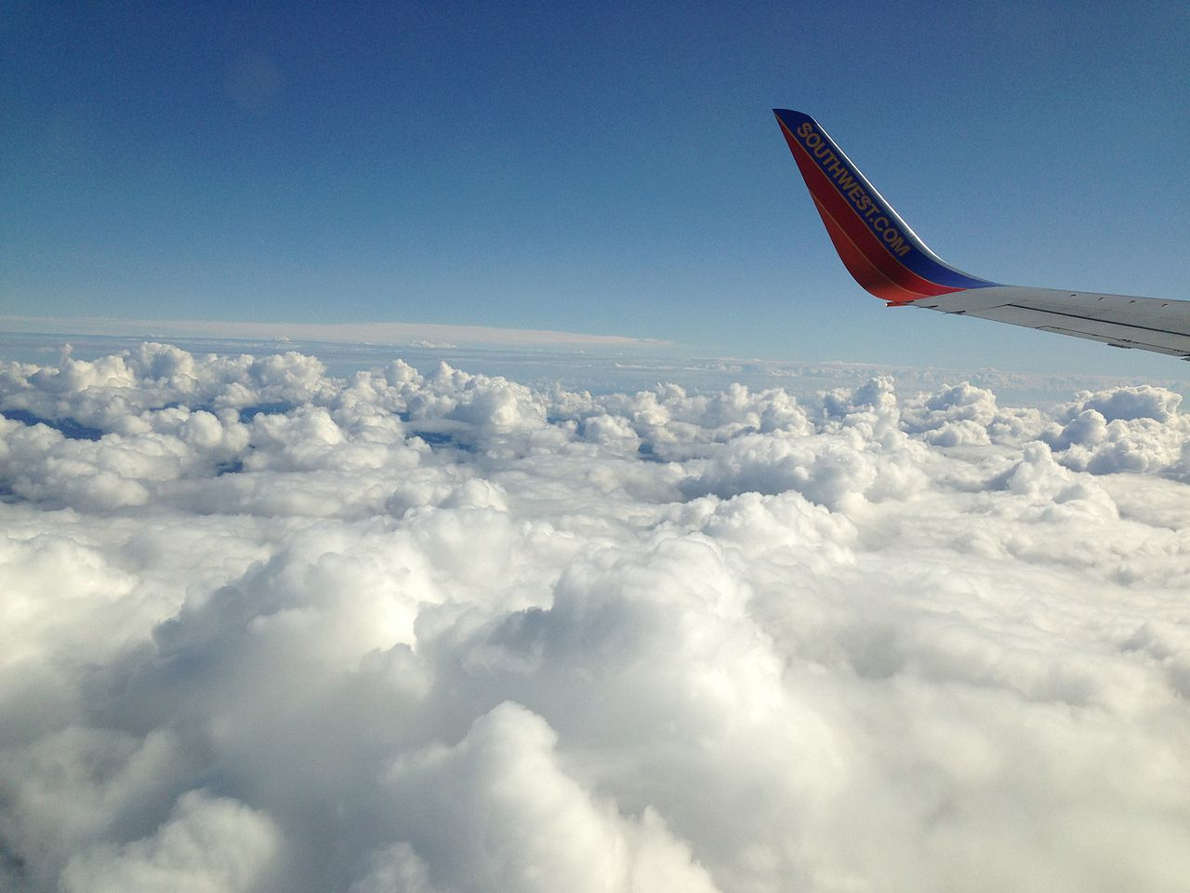
Have you ever traveled by airplane in the USA?
By FASTILY (Own work) [GFDL (http://www.gnu.org/copyleft/fdl.html) or CC BY-SA 3.0 (https://creativecommons.org/licenses/by-sa/3.0)], via Wikimedia Commons

Slide 4
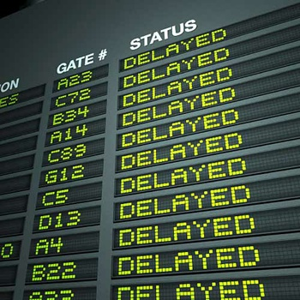
Have you ever had a delayed arrival?
…that caused you to miss a flight?
Belle-Noir Magazine is licensed under a Creative Commons Attribution-NonCommercial-NoDerivs 3.0 Unported License.
CC BY-NC-ND 3.0
This Photo by Unknown Author is licensed under CC BY-NC-ND

Slide 5
Purpose
To determine if there is a statistically significant difference in the proportion of arrival flights delayed and the mean arrival delay between airports servicing the same metropolitan region
New York City
San Francisco Bay Area
Chicago
* Public domain data from Kaggle Dataset entry Kaggle Flight Delays originally from the US Department of Transportation Bureau of Transportation Statistics

Slide 6
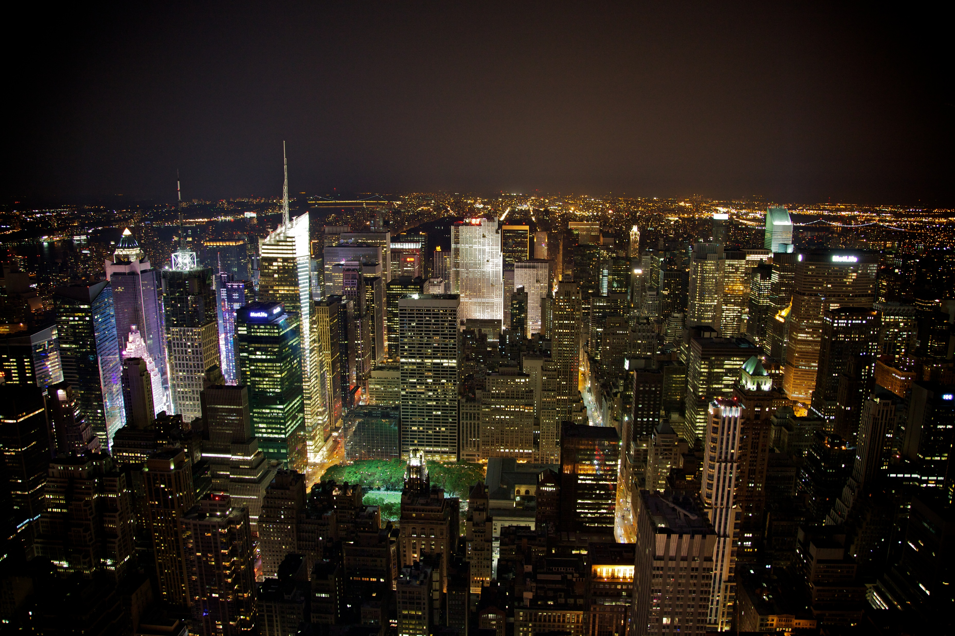
The BIG Apple (NYC)
Creative Commons Attribution-Share Alike
Aurelien Guichard
Airport | Proportion of delayed arrival flights | Mean arrival delay | Maximum arrival delay
John F Kennedy International Airport | 21% | 6.7 min | 1294 min
LaGuardia Airport | 25% | 10.4 min | 1196 min
Newark International Airport | 22% | 7.5 min | 1294 min
This Photo by Unknown Author is licensed under CC BY-SA

Slide 7
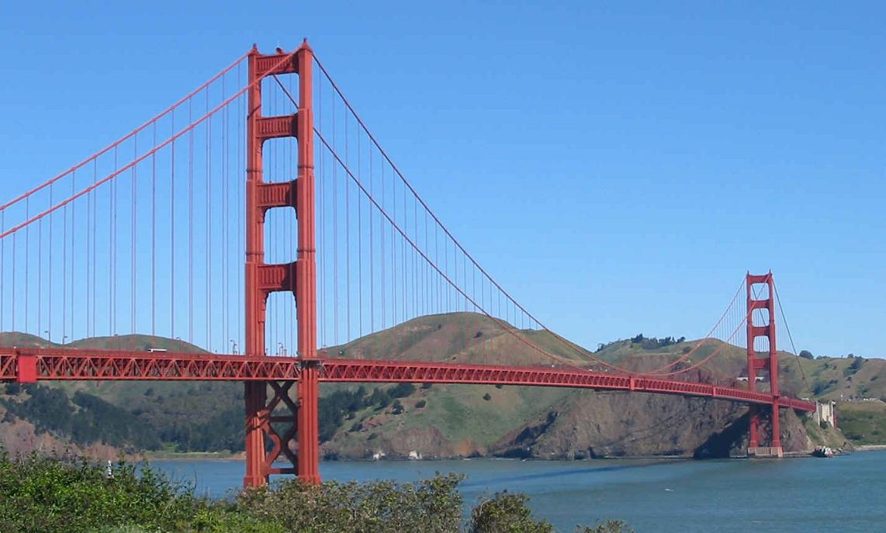
The Bay (SFO/OAK/SJC)
Airport | Proportion of delayed arrival flights | Mean arrival delay | Maximum arrival delay
San Francisco International Airport | 22% | 6.7 min | 1120 min
Oakland International Airport | 18% | 4.7 min | 519 min
Norman Y. Mineta San José International Airport | 17% | 4.2 min | 484 min
This Photo by Unknown Author is licensed under CC BY-SA
Peter Craig
CC:0 public domain

Slide 8
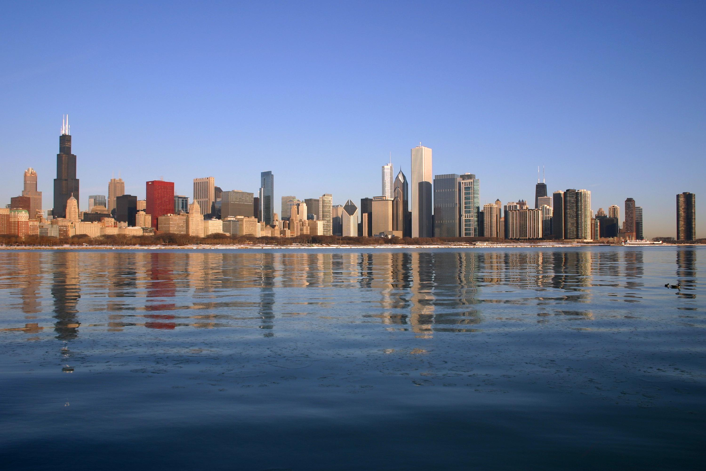
The Windy City (ORD/MDW)
Airport | Proportion of delayed arrival flights | Mean arrival delay | Maximum arrival delay
O'Hare International Airport | 21% | 7.2 min | 604 min
Midway International Airport | 17% | 3.0 min | 1638 min
J. Crocker
CC-BY
This Photo by Unknown Author is licensed under CC BY-SA

Slide 9
And the Winners are…
New York City: JKF
The Bay Area: SJC
Chicago: MDW

Slide 10
Limitations and Future Work
Limitations
Only considered arrival airport
Data limited to 2015
Future work
Expanding to more cities
Increasing the data factors included in the analysis

