Slide 1
Please create a forFLIGHT directory if it does note exist:
cd ~
mkdir forFLIGHT -p

Slide 2
Everything revolves around the contents of ~/forFLIGHT/speed_parameters_version_zero.txt :
#my sensor mac address
E5:97:EE:07:27:F2
#my speed gradient {mph/mi}
12.000000
#my speed delta {mph}
10.000000
#my maximum speed {mph}
23.500000
#latest throttle value
32767
#my preferred unit of length {miles or km}
mi
#my wheel circumference in mm
2096

Slide 3
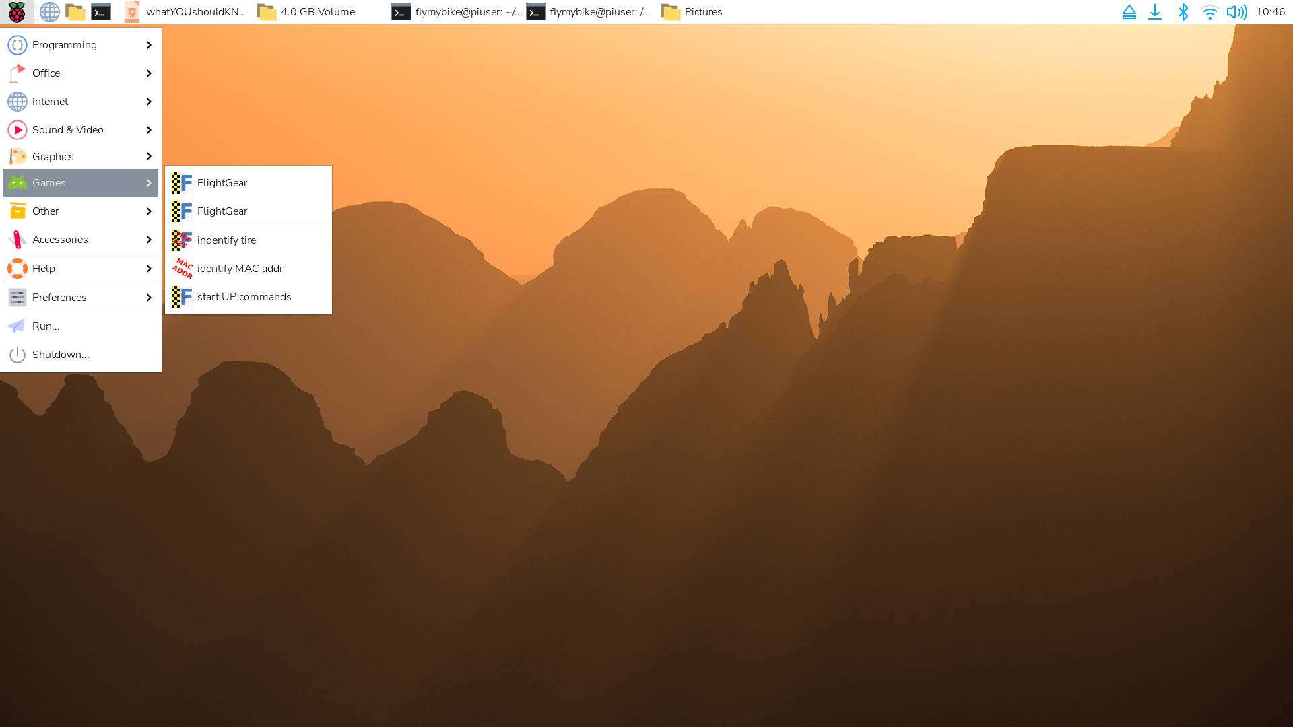
Everything revolves around the contents of ~/forFLIGHT/speed_parameters_version_zero.txt :
#my sensor mac address
E5:97:EE:07:27:F2
I made a script to use bluetoothctl to identify your Wahoo speed sensor MAC address. The bluetoothctl script, expect_script_find_and_trust_sensor, is executed by the program “write_MAC_address_to_speed_parameter.c” This program can be compiled by typing “make” in the /home/flymybike/forFLIGHT directory. Start pedalling your bike, with the speed sensor attached and then execute: “./write_MAC_address_to_speed_parameter” of select “identify MAC address” in the start menu.

Slide 4
Everything revolves around the contents of ~/forFLIGHT/speed_parameters_version_zero.txt :
#my wheel circumference in mm
2096
Execute dialog_to_choose_tire_size located in the /home/flymybike/forFLIGHT directory

Slide 5
Everything revolves around the contents of ~/forFLIGHT/speed_parameters_version_zero.txt :
#my speed gradient {mph/mi}
12.000000
#my speed delta {mph}
10.000000
#my maximum speed {mph}
23.500000
}
Understanding this requires knowledge of differential calculus.
Basically, your top speed {maximum speed} on the trainer if you rode forever, the difference between that speed and the speed you start at {speed delta}, and how quickly you ramp up from start tp your final speed {speed gradient}.

Slide 6
Everything revolves around the contents of ~/forFLIGHT/speed_parameters_version_zero.txt :
#latest throttle value Legacy – when used without sudo -v
32767 this enabled flights with interruptions
#my preferred unit of length {miles or km} Future work – I know not everyone thinks
mi in imperial units
#my wheel circumference in mm Execute “executeDIALOGtoCHOOSEtire”
2096 and you can specify the type of wheel you
use

Slide 7
You modified ~/forFLIGHT/speed_parameters_version_zero.txt with your
bike tire circumference
your speed sensor’s MAD address
your personal speed parameters
Now you can almost fly: Start flightgear
pick an airport to depart from
once at your chosen departure airport
fill the gas tank
enter the airport code of your destination into the GPS
turn on/off the glide slop tunnel as you desire
start the aircraft if not already started
start pedalling your bike to turn speed sensor on
execute “?” to
spawn a virtual joystick controlled by your bike
refresh FlightGear’s joystick

Slide 8
After FlightGear, senses your joystick and your joystick is configured, you should be able to take off

