Slide 1
Solving Recurrences Continued
Lecture 5

Slide 2
Review: Recurrences
In general, a recurrence is based on the three steps of Divide & Conquer paradigm
T(n) = Θ(1) if n<=c
= a T(n/b) + C(n) + D(n) otherwise
where C(n) is time to combine &
D(n) is time to Divide

Slide 3
Review: Methods of Solving Recurrences
Iteration method – Completed
Substitution method - Completed
Recursion Tree
Master method

Slide 4
The recursion-tree method
Convert the recurrence into a tree:
  Each node represents the cost incurred at various levels of recursion
  Sum up the costs of all levels
Used to “guess” a solution for the recurrence

Slide 5
Example 1
T(n) = 2T(n/2) + n²
Subproblem size at level i is: n/2^{i}
Subproblem size hits 1 when 1 = n/2^{i} ⇒ i = lgn
Cost of one node at level i = (n/2^{i})²
No. of nodes at level i = 2^{i}
Total Cost at Level i = 2^{i} (n/2^{i})² = n²/ 2^{i}
Total Cost of leaf nodes = No. of leaf nodes X T(1)
= 2 ^{lg n} T(1) = O(n)
Total cost:
= O(n²)

Slide 6
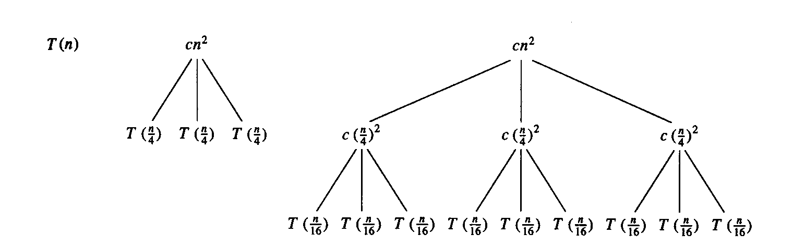
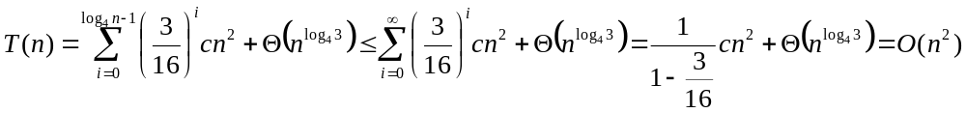
Example 2
T(n) = 3T(n/4) + cn²
Subproblem size at level i is: n/4^{i}
Subproblem size hits 1 when 1 = n/4^{i} ⇒ i = log₄n
Cost of a node at level i = c(n/4^{i})²
Number of nodes at level i = 3^{i} ⇒ last level has 3^{log}₄^{n} = n^{log}₄³ nodes
Total cost:
⇒ T(n) = O(n²)

Slide 7
Example 2 - Substitution
T(n) = 3T(n/4) + cn²
Guess: T(n) = O(n²)
  Induction goal: T(n) ≤ dn², for some d and n ≥ n₀
  Induction hypothesis: T(n/4) ≤ d (n/4)²
Proof of induction goal:
T(n) = 3T(n/4) + cn²
≤ 3d (n/4)² + cn²
= (3/16) d n² + cn²
≤ d n² if: d ≥ (16/13)c
Therefore: T(n) = O(n²)

Slide 8
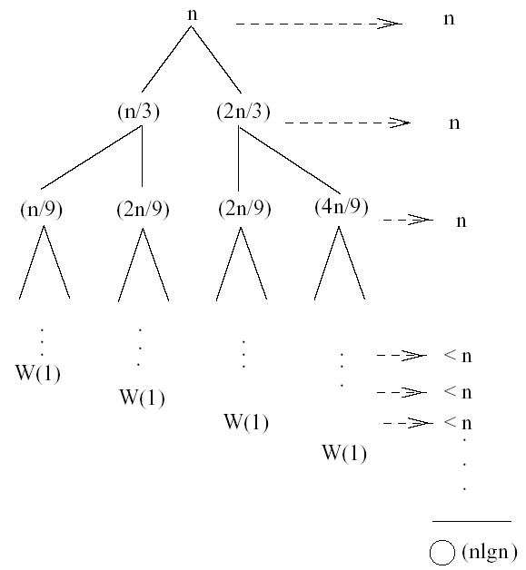
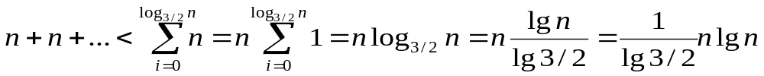
Example 3
W(n) = W(n/3) + W(2n/3) + O(n)
The longest path from the root to a leaf is: n → (2/3)n → (2/3)² n → … → 1
Subproblem size hits 1 when 1 = (2/3)^{i}n ⇔ i=log_{3/2}n
Cost of the problem at level i = n
Total cost:
For all levels
⇒ W(n) = O(nlgn)

Slide 9
Example 3 - Substitution
W(n) = W(n/3) + W(2n/3) + O(n)
Guess: W(n) = O(nlgn)
  Induction goal: W(n) ≤ dnlgn, for some d and n ≥ n₀
  Induction hypothesis: W(k) ≤ d klgk for any K < n (n/3, 2n/3)
Proof of induction goal:
Try it out as an exercise!!
T(n) = O(nlgn)

Slide 10
The Master Theorem
Given: a divide and conquer algorithm
  An algorithm that divides the problem of size n into a subproblems, each of size n/b
  Let the cost of each stage (i.e., the work to divide the problem + combine solved subproblems) be described by the function f(n)
Then, the Master Theorem gives us a cookbook for the algorithm’s running time:

Slide 11
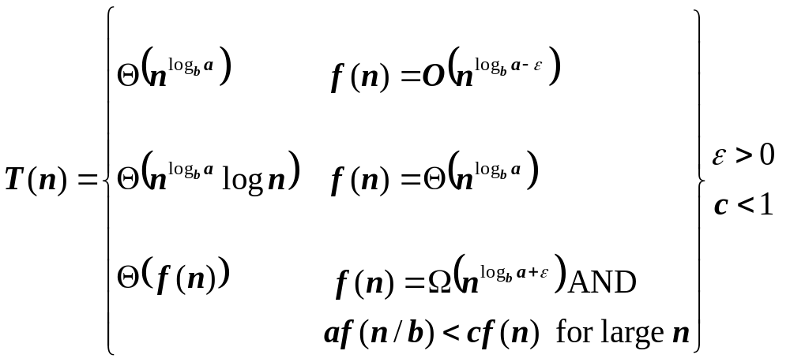
The Master Theorem
if T(n) = aT(n/b) + f(n) then

Slide 12
Using The Master Method
T(n) = 9T(n/3) + n
  a=9, b=3, f(n) = n
  n^{logb a} = n^{log3 9} = Θ(n²)
  Since f(n) = O(n^{log3 9 - ε}), where ε=1, case 1 applies:
  Thus the solution is T(n) = Θ(n²)

Slide 13
Solve using Master’s Method
T(n) = T (2n/3) + 1
  Ans Θ(lg n)
T(n) = 3 T(n/4) + n lg n
  Ans Θ(n lg n)
T(n) = 2 T(n/2) + n lg n
  Master’s theorem can’t be applied

Slide 14
Master’s Theorem Fails when
f(n) is smaller than n^{logb a} but not polynomially smaller &
f(n) is larger than n^{logb a} but not polynomially larger e.g. T(n) = 2 T(n/2) + n lg n
Q. Can you give an example for the first case
Ans. T(n) = 2 T(n/2) + lg n

Slide 15
Up Next
Heap Sort
Analysis of Heap Sort

