Slide 1
HeapSort
Lecture 6

Slide 2
Sorting Revisited
So far we’ve talked about two algorithms to sort an array of numbers
  What is the advantage of merge sort?
  What is the advantage of insertion sort?
Next on the agenda: Heapsort
  Combines advantages of both previous algorithms

Slide 3
Heaps
A heap can be seen as a complete binary tree:
  What makes a binary tree complete?
  Is the example above complete?
16
14
10
8
7
9
3
2
4
1

Slide 4
Heaps
A heap can be seen as a complete binary tree:
  The book calls them “nearly complete” binary trees; can think of unfilled slots as null pointers
16
14
10
8
7
9
3
2
4
1
1
1
1
1
1

Slide 5
Heaps
In practice, heaps are usually implemented as arrays:
16
14
10
A =
16
14
10
8
7
9
3
2
4
1
=
8
7
9
3
2
4
1

Slide 6
Heaps
To represent a complete binary tree as an array:
  The root node is A[1]
  Node i is A[i]
  The parent of node i is A[i/2] (note: integer divide)
  The left child of node i is A[2i]
  The right child of node i is A[2i + 1]
16
14
10
A =
16
14
10
8
7
9
3
2
4
1
=
8
7
9
3
2
4
1

Slide 7
Referencing Heap Elements
So…
  Parent(i) { return ⎣i/2⎦; }
  Left(i) { return 2*i; }
  right(i) { return 2*i + 1; }
An aside: How would you implement this
most efficiently?

Slide 8
The Heap Property
Heaps also satisfy the heap property:
A[Parent(i)] ≥ A[i] for all nodes i > 1
  In other words, the value of a node is at most the value of its parent
  Where is the largest element in a heap stored?
Definitions:
  The height of a node in the tree = the number of edges on the longest downward path to a leaf
  The height of a tree = the height of its root

Slide 9
Heap Height
What is the height of an n-element heap? Why?
  Height of a heap = Θ(lg n)
This is nice: basic heap operations take at most time proportional to the height of the heap

Slide 10
Heap Operations: Heapify()
Heapify(): maintain the heap property
  Given: a node i in the heap with children l and r
  Given: two subtrees rooted at l and r, assumed to be heaps
  Problem: The subtree rooted at i may violate the heap property (How?)
  Action: let the value of the parent node “float down” so subtree at i satisfies the heap property
    What do you suppose will be the basic operation between i, l, and r?

Slide 11
Heap Operations: Heapify()
Heapify(A, i)
{
l = Left(i); r = Right(i);
if (l <= heap_size[A] && A[l] > A[i])
largest = l;
else
largest = i;
if (r <= heap_size[A] && A[r] > A[largest])
largest = r;
if (largest != i)
{Swap(A, i, largest);
Heapify(A, largest);}
}

Slide 12
Heapify() Example
16
4
10
14
7
9
3
2
8
1
A =
16
4
10
14
7
9
3
2
8
1

Slide 13
Heapify() Example
16
4
10
14
7
9
3
2
8
1
A =
16
4
10
14
7
9
3
2
8
1

Slide 14
Heapify() Example
16
4
10
14
7
9
3
2
8
1
A =
16
4
10
14
7
9
3
2
8
1

Slide 15
Heapify() Example
16
14
10
4
7
9
3
2
8
1
A =
16
14
10
4
7
9
3
2
8
1

Slide 16
Heapify() Example
16
14
10
4
7
9
3
2
8
1
A =
16
14
10
4
7
9
3
2
8
1

Slide 17
Heapify() Example
16
14
10
4
7
9
3
2
8
1
A =
16
14
10
4
7
9
3
2
8
1

Slide 18
Heapify() Example
16
14
10
8
7
9
3
2
4
1
A =
16
14
10
8
7
9
3
2
4
1

Slide 19
Heapify() Example
16
14
10
8
7
9
3
2
4
1
A =
16
14
10
8
7
9
3
2
4
1

Slide 20
Heapify() Example
16
14
10
8
7
9
3
2
4
1
A =
16
14
10
8
7
9
3
2
4
1

Slide 21
Analyzing Heapify()
Aside from the recursive call, what is the running time of Heapify()?
How many times can Heapify() recursively call itself?
What is the worst-case running time of Heapify() on a heap of size n?

Slide 22
Analyzing Heapify()
Fixing up relationships between i, l, and r takes Θ(1) time
If the heap at i has n elements, how many elements can the subtrees at l or r have?
Answer: 2n/3 (worst case: bottom row 1/2 full)
So time taken by Heapify() is given by
T(n) ≤ T(2n/3) + Θ(1)

Slide 23
Analyzing Heapify()
So we have
T(n) ≤ T(2n/3) + Θ(1)
Solve using Master Theorem
By case 2 of the Master Theorem,
T(n) = O(lg n)
Thus, Heapify() takes logarithmic time

Slide 24
Heap Operations: BuildHeap()
We can build a heap in a bottom-up manner by running Heapify() on successive subarrays
  Fact: for array of length n, all elements in range
  A[⎣n/2⎦ + 1 .. n] are heaps (Why?)
  So:
    Walk backwards through the array from n/2 to 1, calling Heapify() on each node.
    Order of processing guarantees that the children of node i are heaps when i is processed

Slide 25
BuildHeap()
// given an unsorted array A, make A a heap
BuildHeap(A)
{
heap_size[A] = length[A];
for (i = ⎣length[A]/2⎦ downto 1)
Heapify(A, i);
}

Slide 26
BuildHeap() Example
Work through example
A = {4, 1, 3, 2, 16, 9, 10, 14, 8, 7}
4
1
3
2
16
9
10
14
8
7

Slide 27
Analyzing BuildHeap()
Each call to Heapify() takes O(lg n) time
There are O(n) such calls (specifically, ⎣n/2⎦)
Thus the running time is O(n lg n)
  Is this a correct asymptotic upper bound?
  Is this an asymptotically tight bound?
A tighter bound is O(n)
  How can this be? Is there a flaw in the above reasoning?

Slide 28
Analyzing BuildHeap(): Tight
To Heapify() a subtree takes O(h) time where h is the height of the subtree
  h = O(lg m), m = # nodes in subtree
  The height of most subtrees is small
Fact: an n-element heap has at most ⎡n/2^{h+1}⎤ nodes of height h
We use this fact to prove that BuildHeap() takes O(n) time

Slide 29
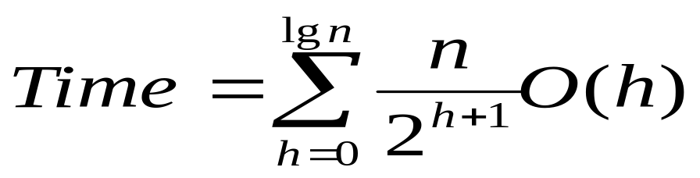
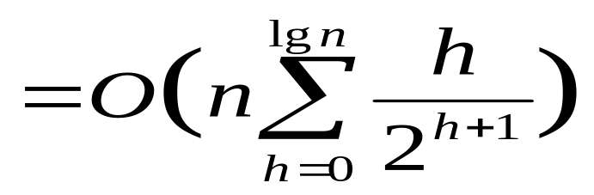
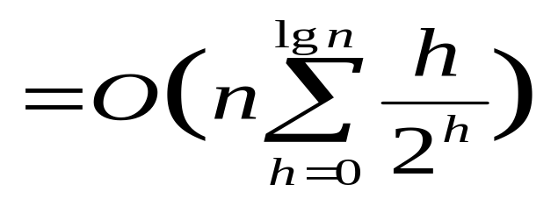
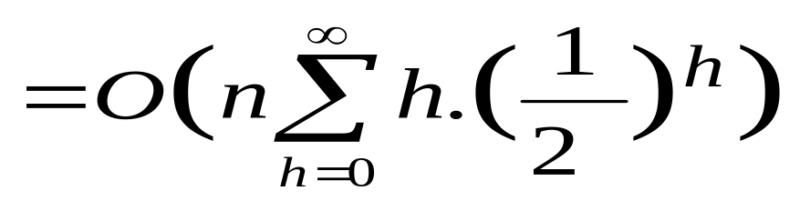
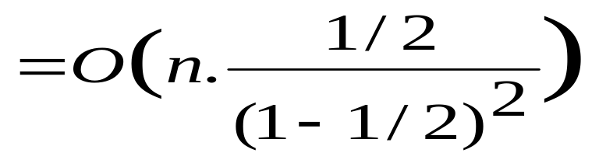
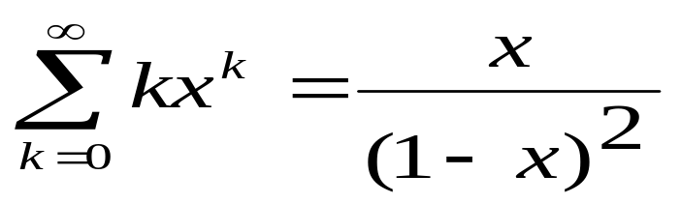
= O(2n) = O(n)

Slide 30
Heapsort
Given BuildHeap(), an in-place sorting algorithm is easily constructed:
  Maximum element is at A[1]
  Discard by swapping with element at A[n]
    Decrement heap_size[A]
    A[n] now contains correct value
  Restore heap property at A[1] by calling Heapify()
  Repeat, always swapping A[1] for A[heap_size(A)]

Slide 31
Heapsort
Heapsort(A)
{
BuildHeap(A);
for (i = length(A) downto 2)
{
Swap(A[1], A[i]);
heap_size[A] = heap_size[A]-1;
Heapify(A, 1);
}
}

Slide 32
Heapsort Example
Apply BuildHeap
4
14
12
24
19
15

Slide 33
Heapsort Example
Heapify on n/2=3
4
14
15
24
19
12

Slide 34
Heapsort Example
Heapify on n/2-1=2
4
14
15
24
19
12

Slide 35
Heapsort Example
Swap
4
24
15
14
19
12

Slide 36
Heapsort Example
Heapify on 1
4
24
15
14
19
12

Slide 37
Heapsort Example
Swap
24
19
15
14
4
12

Slide 38
Heapsort Example
After Buildheap
24
19
15
14
4
12

Slide 39
Heapsort Example
Swap A[1] with A[6] and decrement heapsize by 1
[………………..24]
12
19
15
14
4
24

Slide 40
Heapsort Example
Heapify on A[1]
[………………,24]
19
12
15
14
4

Slide 41
Heapsort Example
Again swap on A[2]
[………………,24]
19
14
15
12
4

Slide 42
Heapsort Example
Swap A[1] with A[5] and decrement heapsize by 1
[………………19,24]
4
14
15
12

Slide 43
Heapsort Example
Heapify on A[1]
[………………19,24]
15
14
4
12

Slide 44
Heapsort Example
Swap A[1] with A[4] and decrement heapsize by 1
[………………15,19,24]
Process continues
12
14
4
15

Slide 45
Analyzing Heapsort
The call to BuildHeap() takes O(n) time
* When taking tight bound else it is O(nlgn)
Each of the n - 1 calls to Heapify() takes O(lg n) time
Thus the total time taken by HeapSort()
= O(n) + (n - 1) O(lg n)
= O(n) + O(n lg n)
= O(n lg n)

Slide 46
Priority Queues
Heapsort is a nice algorithm, but in practice Quicksort (coming up) usually wins
But the heap data structure is incredibly useful for implementing priority queues
  A data structure for maintaining a set S of elements, each with an associated value or key
  Supports the operations Insert(), Maximum(), and ExtractMax()
  What might a priority queue be useful for?

Slide 47
Priority Queue Operations
Insert(S, x) inserts the element x into set S
Maximum(S) returns the element of S with the maximum key
ExtractMax(S) removes and returns the element of S with the maximum key
How could we implement these operations using a heap?

Slide 48
Up Next
Quick Sort

