Slide 1
Unit 2
Red Black Trees
B Trees
Binomial Heaps
Amortized Analysis (Not mentioned in syllabus, but required for Fibonacci Heaps)
Fibonacci Heaps
Disjoint Sets Data Structures (Not mentioned in syllabus, but required for Graph algorithms)
Tries
Skip Lists

Slide 2
Red-Black Trees
Lecture 10

Slide 3
Red-Black Trees
Red-black trees:
  Binary search trees augmented with node color
  Operations designed to guarantee that the height
  h = O(lg n)
First: describe the properties of red-black trees
Then: prove that these guarantee h = O(lg n)
Finally: describe operations on red-black trees

Slide 4
Red-Black Properties
The red-black properties:
  1. Every node is either red or black
  2. Every leaf (NULL pointer) is black
    Note: this means every “real” node has 2 children
  3. If a node is red, both children are black
    Note: can’t have 2 consecutive reds on a path
  4. Every path from node to descendent leaf contains the same number of black nodes
  5. The root is always black

Slide 5
Example: RED-BLACK-TREE
26
17
41
NIL
NIL
30
47
38
NIL
50
NIL
NIL
NIL
NIL
NIL
For convenience we use a sentinel NIL[T] to represent all the NIL nodes at the leafs
  NIL[T] has the same fields as an ordinary node
  Color[NIL[T]] = BLACK
  The other fields may be set to arbitrary values

Slide 6
Black-Height of a Node
26
h = 4
bh = 2
h = 1
bh = 1
h = 3
bh = 2
17
41
NIL
NIL
h = 2
bh = 1
h = 2
bh = 1
30
47
h = 1
bh = 1
38
50
h = 1
bh = 1
NIL
NIL
NIL
NIL
NIL
NIL
Height of a node: the number of edges in a longest path to a leaf
Black-height of a node x: bh(x) is the number of black nodes (including NIL) on the path from x to leaf, not counting x

Slide 7
Height of Red-Black Trees
black-height: # black nodes on path to leaf
A height-h node has black-height ≥ h/2
Theorem: A red-black tree with n internal nodes has height h ≤ 2 lg(n + 1)

Slide 8
RB Trees: Proving Height Bound
Prove: n-node RB tree has height h ≤ 2 lg(n+1)
Claim: A subtree rooted at a node x contains at least 2^{bh(x)} - 1 internal nodes
  Proof by induction on height h
  Base step: x has height 0 (i.e., NULL leaf node)
    What is bh(x)?

Slide 9
RB Trees: Proving Height Bound
Prove: n-node RB tree has height h ≤ 2 lg(n+1)
Claim: A subtree rooted at a node x contains at least 2^{bh(x)} - 1 internal nodes
  Proof by induction on height h
  Base step: x has height 0 (i.e., NULL leaf node)
    What is bh(x)?
    A: 0
    So…subtree contains 2^{bh(x)} - 1
    = 2⁰ - 1
    = 0 internal nodes (TRUE)

Slide 10
RB Trees: Proving Height Bound
Inductive proof that subtree at node x contains at least 2^{bh(x)} - 1 internal nodes
  Inductive step: x has positive height and 2 children
    Each child has black-height of bh(x) or bh(x)-1
    The height of a child = (height of x) - 1
    So the subtrees rooted at each child contain at least
    2^{bh(x) - 1} - 1 internal nodes
    Thus subtree at x contains
    (2^{bh(x) - 1} - 1) + (2^{bh(x) - 1} - 1) + 1
    = 2•2^{bh(x)-1} - 1 = 2^{bh(x)} - 1 nodes

Slide 11
RB Trees: Proving Height Bound
Thus at the root of the red-black tree:
  n ≥ 2^{bh(root)} - 1
  n ≥ 2^{h/2} - 1
  lg(n+1) ≥ h/2
  h ≤ 2 lg(n + 1)
  Thus h = O(lg n)

Slide 12
RB Trees: Worst-Case Time
So we’ve proved that a red-black tree has
O(lg n) height
These operations take O(lg n) time:
  Minimum(), Maximum()
  Successor(), Predecessor()
  Search()
Insert() and Delete():
  Will also take O(lg n) time
  But will need special care since they modify tree

Slide 13
Red-Black Trees: An Example
Color this tree
7
7
5
5
9
9
12
12
Red-black properties:
1. Every node is either red or black
2. Every leaf (NULL pointer) is black
3. If a node is red, both children are black
4. Every path from node to descendent leaf
contains the same number of black nodes
5. The root is always black

Slide 14
Red-Black Trees:
The Problem With Insertion
Insert 8
  Where does it go?
7
5
9
12
1. Every node is either red or black
2. Every leaf (NULL pointer) is black
3. If a node is red, both children are black
4. Every path from node to descendent leaf
contains the same number of black nodes
5. The root is always black

Slide 15
Red-Black Trees:
The Problem With Insertion
Insert 8
  Where does it go?
  What color
  should it be?
7
5
9
8
12
1. Every node is either red or black
2. Every leaf (NULL pointer) is black
3. If a node is red, both children are black
4. Every path from node to descendent leaf
contains the same number of black nodes
5. The root is always black

Slide 16
Red-Black Trees:
The Problem With Insertion
Insert 8
  Where does it go?
  What color
  should it be?
7
5
9
8
12
1. Every node is either red or black
2. Every leaf (NULL pointer) is black
3. If a node is red, both children are black
4. Every path from node to descendent leaf
contains the same number of black nodes
5. The root is always black

Slide 17
Red-Black Trees:
The Problem With Insertion
Insert 11
  Where does it go?
7
5
9
8
12
1. Every node is either red or black
2. Every leaf (NULL pointer) is black
3. If a node is red, both children are black
4. Every path from node to descendent leaf
contains the same number of black nodes
5. The root is always black

Slide 18
Red-Black Trees:
The Problem With Insertion
Insert 11
  Where does it go?
  What color?
7
5
9
8
12
11
1. Every node is either red or black
2. Every leaf (NULL pointer) is black
3. If a node is red, both children are black
4. Every path from node to descendent leaf
contains the same number of black nodes
5. The root is always black

Slide 19
Red-Black Trees:
The Problem With Insertion
Insert 11
  Where does it go?
  What color?
    Can’t be red! (#3)
7
5
9
8
12
11
1. Every node is either red or black
2. Every leaf (NULL pointer) is black
3. If a node is red, both children are black
4. Every path from node to descendent leaf
contains the same number of black nodes
5. The root is always black

Slide 20
Red-Black Trees:
The Problem With Insertion
Insert 11
  Where does it go?
  What color?
    Can’t be red! (#3)
    Can’t be black! (#4)
7
5
9
8
12
11
1. Every node is either red or black
2. Every leaf (NULL pointer) is black
3. If a node is red, both children are black
4. Every path from node to descendent leaf
contains the same number of black nodes
5. The root is always black

Slide 21
Red-Black Trees:
The Problem With Insertion
Insert 11
  Where does it go?
  What color?
    Solution:
    recolor the tree
7
5
9
8
12
11
1. Every node is either red or black
2. Every leaf (NULL pointer) is black
3. If a node is red, both children are black
4. Every path from node to descendent leaf
contains the same number of black nodes
5. The root is always black

Slide 22
Red-Black Trees:
The Problem With Insertion
Insert 10
  Where does it go?
7
5
9
8
12
11
1. Every node is either red or black
2. Every leaf (NULL pointer) is black
3. If a node is red, both children are black
4. Every path from node to descendent leaf
contains the same number of black nodes
5. The root is always black

Slide 23
Red-Black Trees:
The Problem With Insertion
Insert 10
  Where does it go?
  What color?
7
5
9
8
12
11
1. Every node is either red or black
2. Every leaf (NULL pointer) is black
3. If a node is red, both children are black
4. Every path from node to descendent leaf
contains the same number of black nodes
5. The root is always black
10

Slide 24
Red-Black Trees:
The Problem With Insertion
Insert 10
  Where does it go?
  What color?
    A: no color! Tree
    is too imbalanced
    Must change tree structure
    to allow recoloring
  Goal: restructure tree in
  O(lg n) time
7
5
9
8
12
11
10

Slide 25
RB Trees: Rotation
Our basic operation for changing tree structure is called rotation:
Does rotation preserve inorder key ordering?
What would the code for rightRotate() actually do?
y
x
rightRotate(y)
x
C
A
y
leftRotate(x)
A
B
B
C

Slide 26
RB Trees: Rotation
Answer: A lot of pointer manipulation
  x keeps its left child
  y keeps its right child
  x’s right child becomes y’s left child
  x’s and y’s parents change
What is the running time?
y
x
rightRotate(y)
x
C
A
y
A
B
B
C

Slide 27
Rotation Example
Rotate left about 9:
7
5
9
8
12
11

Slide 28
Rotation Example
Rotate left about 9:
7
5
12
9
8
11

Slide 29
Red-Black Trees: Insertion
Insertion: the basic idea
  Insert x into tree, color x red
  Only r-b property 3 might be violated (if p[x] red)
    If so, move violation up tree until a place is found where it can be fixed
  Total time will be O(lg n)

Slide 30
rbInsert(T, x)
{treeInsert(T, x);
color[x] = RED;
while (color[p[x]] == RED)
{
if (p[x] == left[p[p[x]]])/*if x’s parent is a left child*/
{y = right[p[p[x]]]; /*y is x’s uncle */
if (color[y] == RED)
{ color[p[x]] = BLACK;
color[y] = BLACK;
color[p[p[x]]] = RED;
x = p[p[x]];}
else
{if (x == right[p[x]]) /* x is a right child*/
{x = p[x];
leftRotate(x);}
color[p[x]] = BLACK;
color[p[p[x]]] = RED;
rightRotate(p[p[x]]);}}
else
{(same as above, but with “right” & “left” exchanged)}
}
color[root[T]] = BLACK;
}
Case 1: Uncle is RED
Case 2: Uncle is BLACK & x is right child
Case 3: Uncle is BLACK & x is left child

Slide 31
RB Insert: Case 1
Case 1: “uncle” is red
In figures below, all Δ’s are equal-black-height subtrees
if (color[y] == RED)
{ color[p[x]] = BLACK;
color[y] = BLACK;
color[p[p[x]]] = RED;
x = p[p[x]];}
C
C
new x
case 1
A
D
y
A
D
Δ
B
x
Δ
Δ
Δ
B
Δ
Δ
Δ
Δ
Δ
Δ
Change colors of some nodes, preserving #4: all downward paths have equal b.h.
The while loop now continues with x’s grandparent as the new x

Slide 32
RB Insert: Case 2
Case 2:
  “Uncle” is black
  Node x is a right child
Transform to case 3 via a left-rotation
{if (x == right[p[x]]) {x = p[x];
leftRotate(x);}
// continue with case 3 code
C
C
case 2
A
Δ
y
B
Δ
y
Δ
B
x
A
x
Δ
Δ
Δ
Δ
Δ
Transform case 2 into case 3 (x is left child) with a left rotation
This preserves property 4: all downward paths contain same number of black nodes

Slide 33
RB Insert: Case 3
Case 3:
  “Uncle” is black
  Node x is a left child
Change colors; rotate right
color[p[x]] = BLACK;
color[p[p[x]]] = RED;
rightRotate(p[p[x]]);
C
B
case 3
B
Δ
y
x
A
C
A
x
Δ
Δ
Δ
Δ
Δ
Δ
Δ
Perform some color changes and do a right rotation
Again, preserves property 4: all downward paths contain same number of black nodes

Slide 34
RB Insert: Cases 4-6
Cases 1-3 hold if x’s parent is a left child
If x’s parent is a right child, cases 4-6 are symmetric (swap left for right)

Slide 35
Analysis of Insertion
Insertion consists of two phases
  First phase – goes down the tree– O(lg n)
  Second phase – goes up the tree fixing things
    While loop repeats only in case 1 – moving the pointer up by two levels – O(lg n)
    The most no of rotations performed are two – O(1)
Total time = O(lg n)

Slide 36
Examples
Insert the following keys into an initially empty RB Tree
41, 38, 31, 12, 19, 8
2, 1, 4, 5, 9, 3, 6, 7
8, 19, 12, 31, 38, 41

Slide 37
Example
Insert 41
Insert 38 No case
Insert 31
Case 3 Recolor and Rotate right at p(p(z))
Color root as black
41
41
41
38
41
38
31

Slide 38
Example
Insert 12
Case 1 applies, uncle is black
38
31
41
12

Slide 39
Example
Color root as black
38
31
41
12

Slide 40
Example
38
31
41
12

Slide 41
Example
Insert 19
Uncle is black
38
31
41
12
19

Slide 42
Example
Case 2 applies
38
31
41
19
12

Slide 43
Example
Recolor
38
31
41
19
12

Slide 44
Example
Rotate right
38
19
41
12
31

Slide 45
Example
Insert 8
Case 1 applies
38
19
41
12
31
8

Slide 46
Example
Final tree
38
19
41
12
31
8

Slide 47
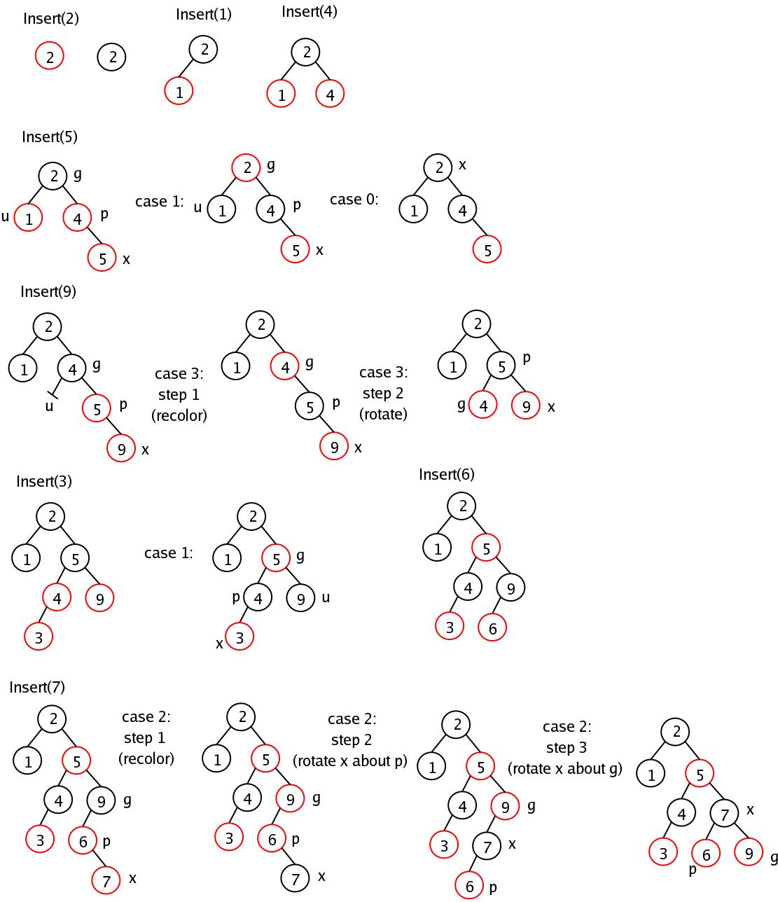
RB-Tree Insert Example

