Slide 1
Quicksort
Lecture 7

Slide 2
Quicksort
Another divide-and-conquer algorithm
  The array A[p..r] is partitioned into two possibly empty subarrays A[p..q-1] and A[q+1..r]
    Invariant: All elements in A[p..q] are less than all elements in A[q+1..r]
  The subarrays are recursively sorted by calls to quicksort
  Unlike merge sort, no combining step: two subarrays form an already-sorted array

Slide 3
Quicksort
Quicksort(A, p, r)
{
if (p < r)
{
q = Partition(A, p, r);
Quicksort(A, p, q-1);
Quicksort(A, q+1, r);
}
}
Initial call is quicksort(A, 1, length[A])

Slide 4
Partition
Clearly, all the action takes place in the partition() function
  Rearranges the subarray in place
  End result:
    Two subarrays
    All values in first subarray ≤ all values in second
  Returns the index of the “pivot” element separating the two subarrays
How do you suppose we implement this?

Slide 5
Partition (in Book)
PARTITION(A, p, r )
{
x ← A[r ]
i ← p − 1
for j ← p to r − 1
{ if A[ j ] ≤ x
then
{i ← i + 1
exchange A[i ] ↔ A[ j ]
}
}
exchange A[i + 1] ↔ A[r ]
return i + 1
}

Slide 6
Partition In Words
(Alternative Approach)
Partition(A, p, r):
  Select an element to act as the “pivot” (which?)
  Grow two regions, A[p..i] and A[j..r]
    All elements in A[p..i] <= pivot
    All elements in A[j..r] >= pivot
  Increment i until A[i] >= pivot
  Decrement j until A[j] <= pivot
  Swap A[i] and A[j]
  Repeat until i >= j
  Return j
Note: slightly different from book’s partition()

Slide 7
Partition Algorithm (Horner’s rule)
Partition(A, p, r)
{x = A[p];
i = p - 1;
j = r + 1;
while (TRUE)
repeat
j--;
until A[j] <= x;
repeat
i++;
until A[i] > x;
if (i < j)
Swap(A, i, j);
else
return j;
}
Illustrate on
A = {5, 3, 2, 6, 4, 1, 3, 7};
What is the running time of partition()?

Slide 8
Partition Code
Partition(A, p, r)
x = A[p];
i = p - 1;
j = r + 1;
while (TRUE)
repeat
j--;
until A[j] <= x;
repeat
i++;
until A[i] >= x;
if (i < j)
Swap(A, i, j);
else
return j;
partition() runs in O(n) time

Slide 9
Quicksort Example
1 | 2 | 3 | 4 | 5 | 6
5 | 2 | 6 | 1 | 3 | 4
repeat
j--;
until A[j] <= x;
repeat
i++;
until A[i] > x;
x
1 | 2 | 3 | 4 | 5 | 6
5 | 2 | 6 | 1 | 3 | 4
If (3<6) swap (A,3,6)
i
i
j

Slide 10
Cont…
1 | 2 | 3 | 4 | 5 | 6
5 | 2 | 4 | 1 | 3 | 6
i
j

Slide 11
Cont..
1 | 2 | 3 | 4 | 5 | 6
5 | 2 | 4 | 1 | 3 | 6
j i

Slide 12
Cont..
1 | 2 | 3 | 4 | 5 | 6
5 | 2 | 4 | 1 | 3 | 6
j
i

Slide 13
Cont..
Pivot is fixed after partition
Apply quicksort recursively on A(1,4)
And A(6,6)
1 | 2 | 3 | 4 | 5 | 6
3 | 2 | 4 | 1 | 5 | 6

Slide 14
Analyzing Quicksort
What will be the worst case for the algorithm?
  Partition is always unbalanced
What will be the best case for the algorithm?
  Partition is perfectly balanced
Which is more likely?
  The latter, by far
Will any particular input elicit the worst case?
  Yes: Already-sorted input

Slide 15
Analyzing Quicksort
In the worst case:
Array is sorted or in reverse order
Example: 1 2 3 4 5 or 5 4 3 2 1
  T(n) = T(n - 1) + T(0) + Θ(n)
  = T(n - 1) + Θ(n)
Works out to
T(n) = Θ(n²)

Slide 16
Analyzing Quicksort
In the best case: Balanced partitioning
Example: 2 1 3 5 4
  T(n) = 2T(n/2) + Θ(n)
What does this work out to?
  T(n) = Θ(n lg n)

Slide 17
Analyzing Quicksort: Balanced Partitoning
Assuming random input, average-case running time is much closer to O(n lg n) than O(n²)
First, a more intuitive explanation/example:
  Suppose that partition() always produces a 9-to-1 split. This looks quite unbalanced!
  The recurrence is thus:
  T(n) = T(9n/10) + T(n/10) + cn
  How deep will the recursion go? (draw it)
Use n instead of O(n)
for convenience (how?)

Slide 18
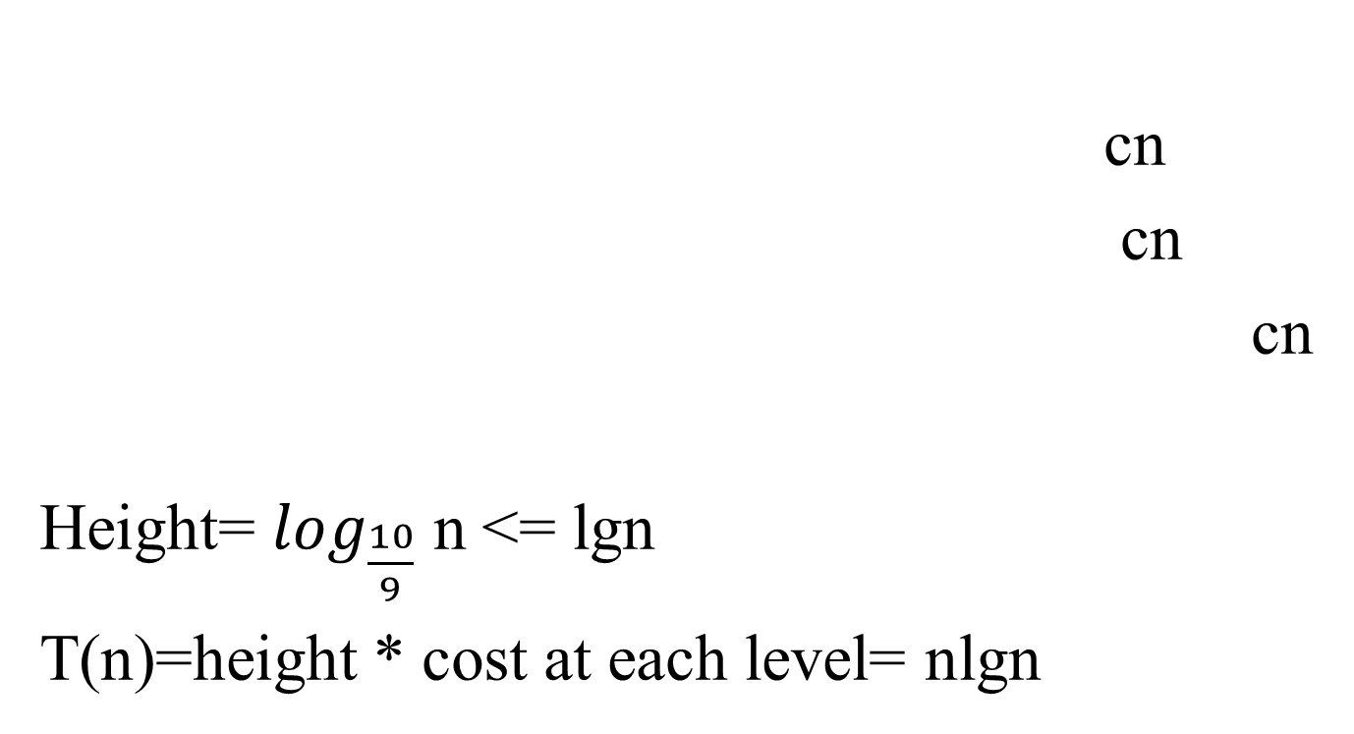
Cont…
n
n/10
9n/10
n/100
9n/100
9n/100
81n/100

Slide 19
Analyzing Quicksort: Average Case
Intuitively, a real-life run of quicksort will produce a mix of “bad” and “good” splits
  Randomly distributed among the recursion tree
  Pretend for intuition that they alternate between best-case ((n/2 : n/2) and worst-case (n-1 : 0)
  What happens if we bad-split root node, then good-split the resulting size (n-1) node?

Slide 20
Analyzing Quicksort: Average Case
Intuitively, a real-life run of quicksort will produce a mix of “bad” and “good” splits
  Randomly distributed among the recursion tree
  Pretend for intuition that they alternate between best-case (n/2 : n/2) and worst-case (n-1 : 1)
  What happens if we bad-split root node, then good-split the resulting size (n-1) node?
    We fail English

Slide 21
Analyzing Quicksort: Average Case
Intuitively, a real-life run of quicksort will produce a mix of “bad” and “good” splits
  Randomly distributed among the recursion tree
  Pretend for intuition that they alternate between best-case (n/2 : n/2) and worst-case (n-1 : 1)
  What happens if we bad-split root node, then good-split the resulting size (n-1) node?
    We end up with three subarrays, size 0, (n-1)/2 - 1, (n-1)/2
    Combined cost of splits = Θ (n) + Θ( n –1) = Θ(n)
    No worse than if we had good-split the root node!

Slide 22
Analyzing Quicksort: Average Case
Intuitively, the Θ(n) cost of a bad split
(or 2 or 3 bad splits) can be absorbed
into the O(n) cost of each good split
Thus running time of alternating bad and good splits is still Θ(n lg n), with slightly higher constants
How can we be more rigorous?

Slide 23
Improving Quicksort
The real liability of quicksort is that it runs in O(n²) on already-sorted input
Book discusses two solutions:
  Randomize the input array, OR
  Pick a random pivot element
How will these solve the problem?
  By insuring that no particular input can be chosen to make quicksort run in O(n²) time

Slide 24
Randomize Quicksort
Random Sampling:- instead of always using A[r] as pivot, use a randomly chosen element from the subarray A[p..r] as pivot
Randomized_Partition( A, p, r)
{ i = random(p,r)
exchange(A[r], A[i])
return partion(A, p, r)
}

Slide 25
Randomized Quicksort
Randomized_Quicksort(A, p, r)
{
if (p < r)
{
q = Randomized_Partition(A, p, r);
Randomized_Quicksort(A, p, q-1);
Randomized_Quicksort(A, q+1, r);
}
}

Slide 26
Up Next
Sorting in Linear Time
  Counting Sort
  Radix Sort
  Bucket Sort

