Slide 1
Linear-Time Sorting Algorithms
Lecture 8

Slide 2
Sorting So Far
Insertion sort:
  Easy to code
  Fast on small inputs (less than ~50 elements)
  Fast on nearly-sorted inputs
  O(n²) worst case
  O(n²) average (equally-likely inputs) case
  O(n²) reverse-sorted case

Slide 3
Sorting So Far
Merge sort:
  Divide-and-conquer:
    Split array in half
    Recursively sort subarrays
    Linear-time merge step
  O(n lg n) worst case
  Doesn’t sort in place

Slide 4
Sorting So Far
Heap sort:
  Uses the very useful heap data structure
    Complete binary tree
    Heap property: parent key > children’s keys
  O(n lg n) worst case
  Sorts in place
  Fair amount of shuffling memory around

Slide 5
Sorting So Far
Quick sort:
  Divide-and-conquer:
    Partition array into two subarrays, recursively sort
    All of first subarray < all of second subarray
    No merge step needed!
  O(n lg n) average case
  Fast in practice
  O(n²) worst case
    Naïve implementation: worst case on sorted input
    Address this with randomized quicksort

Slide 6
How Fast Can We Sort?
Observation: all of the sorting algorithms so far are comparison sorts
  The only operation used to gain ordering information about a sequence is the pairwise comparison of two elements
  Theorem: all comparison sorts are Ω(n lg n)

Slide 7
Decision Trees
Decision trees provide an abstraction of comparison sorts
  A decision tree represents the comparisons made by a comparison sort. Every thing else ignored
What do the leaves represent?
How many leaves must there be?

Slide 8
Decision Trees
Decision trees can model comparison sorts. For a given algorithm:
  One tree for each n
  Tree paths are all possible execution traces
What is the asymptotic height of any decision tree for sorting n elements?
Answer: Ω(n lg n) (now let’s prove it…)

Slide 9
Lower Bound For
Comparison Sorting
Thm: Any decision tree that sorts n elements has height Ω(n lg n)
What’s the minimum # of leaves?
What’s the maximum # of leaves of a binary tree of height h?
Clearly the minimum # of leaves is less than or equal to the maximum # of leaves

Slide 10
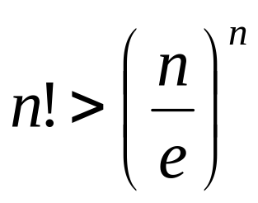
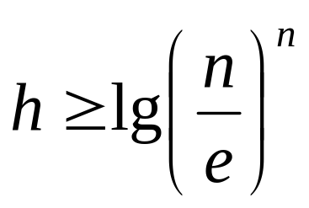
Lower Bound For
Comparison Sorting
So we have…
n! ≤ 2^{h}
Taking logarithms:
lg (n!) ≤ h
Stirling’s approximation tells us:
Thus:

Slide 11
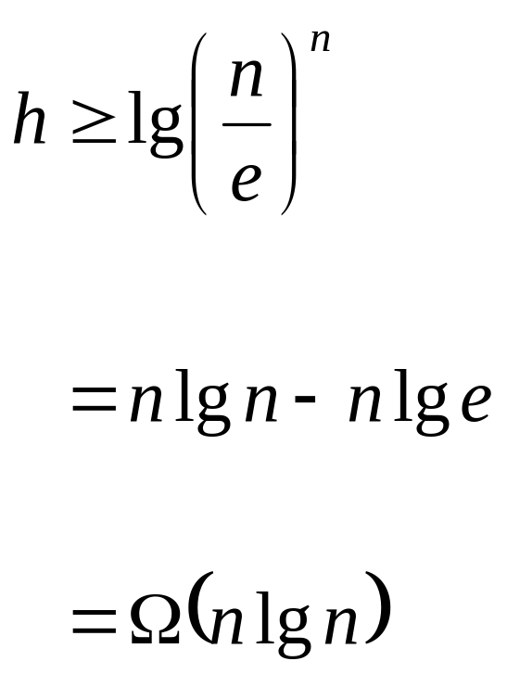
Lower Bound For
Comparison Sorting
So we have
Thus the minimum height of a decision tree is Ω(n lg n)

Slide 12
Lower Bound For
Comparison Sorts
Thus the time to comparison sort n elements is Ω(n lg n)
Corollary: Heapsort and Mergesort are asymptotically optimal comparison sorts
But the name of this lecture is “Sorting in linear time”!
  How can we do better than Ω(n lg n)?

Slide 13
Sorting In Linear Time - Counting Sort
Counting sort
  No comparisons between elements!
  But…depends on assumption about the numbers being sorted
    We assume numbers are in the range 0.. k
  The algorithm:
    Input: A[1..n], where A[j] ∈ {0,1, 2, 3, …, k}
    Output: B[1..n], sorted (notice: not sorting in place)
    Also: Array C[0..k] for auxiliary storage

Slide 14
Counting Sort
1 CountingSort(A, B, k)
2 for i=0 to k
3 C[i]= 0;
4 for j=1 to length[A]
5 C[A[j]] = C[A[j]] +1;
6 for i=1 to k
7 C[i] = C[i] + C[i-1];
8 for j= length[A] downto 1
9 B[C[A[j]]] = A[j];
10 C[A[j]] = C[A[j]] -1;
Work through example: A={4 1 3 4 3}, k = 4

Slide 15
Counting Sort
1 CountingSort(A, B, k)
2 for i=0 to k
3 C[i]= 0;
4 for j=1 to n
5 C[A[j]] += 1;
6 for i=1 to k
7 C[i] = C[i] + C[i-1];
8 for j=n downto 1
9 B[C[A[j]]] = A[j];
10 C[A[j]] -= 1;
Takes time O(k)
Takes time O(n)
What will be the running time?

Slide 16
Counting Sort
Total time: O(n + k)
  Usually, k = O(n)
  Thus counting sort runs in O(n) time
But sorting is Ω(n lg n)!
  No contradiction--this is not a comparison sort (in fact, there are no comparisons at all!)
  Notice that this algorithm is stable

Slide 17
Example on Counting sort
2 | 5 | 3 | 0 | 2 | 3 | 0 | 3
K=5
C
After cumulative addition
0 | 1 | 2 | 3 | 4 | 5
2 | 0 | 2 | 3 | 0 | 1
0 | 1 | 2 | 3 | 4 | 5
2 | 2 | 4 | 7 | 7 | 8
 |  |  |  |  |  | 3
0 | 1 | 2 | 3 | 4 | 5
2 | 2 | 4 | 6 | 7 | 8

Slide 18
Cont..
2 | 5 | 3 | 0 | 2 | 3 | 0 | 3
 | 0 |  |  |  |  | 3
0 | 1 | 2 | 3 | 4 | 5
1 | 2 | 4 | 6 | 7 | 8

Slide 19
Cont..
2 | 5 | 3 | 0 | 2 | 3 | 0 | 3
 | 0 |  |  |  | 3 | 3
0 | 1 | 2 | 3 | 4 | 5
1 | 2 | 4 | 5 | 7 | 8

Slide 20
Cont..
2 | 5 | 3 | 0 | 2 | 3 | 0 | 3
 | 0 |  | 2 |  | 3 | 3
0 | 1 | 2 | 3 | 4 | 5
1 | 2 | 3 | 5 | 7 | 8

Slide 21
Cont..
2 | 5 | 3 | 0 | 2 | 3 | 0 | 3
0 | 0 |  | 2 |  | 3 | 3
0 | 1 | 2 | 3 | 4 | 5
0 | 2 | 3 | 5 | 7 | 8

Slide 22
Cont..
2 | 5 | 3 | 0 | 2 | 3 | 0 | 3
0 | 0 |  | 2 | 3 | 3 | 3
0 | 1 | 2 | 3 | 4 | 5
0 | 2 | 3 | 4 | 7 | 8

Slide 23
Cont..
2 | 5 | 3 | 0 | 2 | 3 | 0 | 3
0 | 0 |  | 2 | 3 | 3 | 3 | 5
0 | 1 | 2 | 3 | 4 | 5
1 | 2 | 3 | 5 | 7 | 7

Slide 24
Cont..
2 | 5 | 3 | 0 | 2 | 3 | 0 | 3
0 | 0 | 2 | 2 | 3 | 3 | 3 | 5
0 | 1 | 2 | 3 | 4 | 5
1 | 2 | 2 | 4 | 7 | 7

Slide 25
Counting Sort
Cool! Why don’t we always use counting sort?
Because it depends on range k of elements
Could we use counting sort to sort 32 bit integers? Why or why not?
Answer: no, k too large (2³² = 4,294,967,296)

Slide 26
Radix Sort
How did IBM get rich originally?
Answer: punched card readers for census tabulation in early 1900’s.
  In particular, a card sorter that could sort cards into different bins
    Each column can be punched in 12 places
    Decimal digits use 10 places
  Problem: only one column can be sorted on at a time

Slide 27
Radix Sort
Intuitively, you might sort on the least significant digit, then the second lsd, etc.
Problem: lots of intermediate piles of cards (read: scratch arrays) to keep track of
Key idea: sort the least significant digit first
  RadixSort(A, d)
  for i=1 to d
  StableSort(A) on digit i

Slide 28
Radix Sort
Can we prove it will work?
Sketch of an inductive argument (induction on the number of passes):
  Assume lower-order digits {j: j<i}are sorted
  Show that sorting next digit i leaves array correctly sorted
    If two digits at position i are different, ordering numbers by that digit is correct (lower-order digits irrelevant)
    If they are the same, numbers are already sorted on the lower-order digits. Since we use a stable sort, the numbers stay in the right order

Slide 29
Radix Sort
What sort will we use to sort on digits?
Counting sort is obvious choice:
  Sort n numbers on digits that range from 1..k
  Time: O(n + k)
Each pass over n numbers with d digits takes time O(n+k), so total time O(dn+dk)
  When d is constant and k=O(n), takes O(n) time
How many bits in a computer word?

Slide 30
Radix Sort
Problem: sort 1 million 64-bit numbers
  Treat as four-digit radix 2¹⁶ numbers
  Can sort in just four passes with radix sort!
Compares well with typical O(n lg n) comparison sort
  Requires approx lg n = 20 operations per number being sorted
So why would we ever use anything but radix sort?

Slide 31
Radix Sort
In general, radix sort based on counting sort is
  Fast
  Asymptotically fast (i.e., O(n))
  Simple to code
  A good choice
To think about: Can radix sort be used on floating-point numbers?

Slide 32
Bucket Sort
Bucket sort
  Assumption: input is n reals from [0, 1)
  Basic idea:
    Create n linked lists (buckets) to divide interval [0,1) into subintervals of size 1/n
    Add each input element to appropriate bucket and sort buckets with insertion sort
  Uniform input distribution → O(1) bucket size
    Therefore the expected total time is O(n)

Slide 33
Algorithm
BUCKET_SORT (A)
{
n ← length [A]
For i = 1 to n do
Insert A[i] into list B[floor(nA[i])]
For i = 0 to n-1 do
Sort list B[i] with Insertion sort
Concatenate the lists B[0], B[1], . . B[n-1] together in order.
}

Slide 34
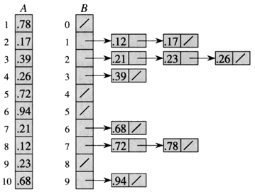
Example

Slide 35
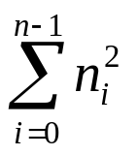
Analysis of Bucket Sort
T(n) = time to insert n elements in array B + time to go through auxiliary array B[0 . . n-1 + Time to Sort by INSERTION_SORT
= O(n) +
= O(n) + n O (2-1/n)
= O(n)

