Slide 1
Red-Black Trees (Continued)
Lecture 11

Slide 2
RBT – Deletion of a Node
Use BST deletion to delete the node.
Case 1: If node z that is to be deleted has no child just remove it
Case 2:If node z that is to be deleted has single child, then child of z replaces it
Case 3: If node z that is to be deleted has two children, then find its tree successor y and replace z’s value with y’s key value

Slide 3
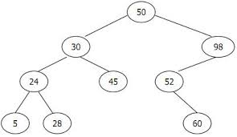
Cont…
z
y
Tree Successor y has no left child and is the value next to z

Slide 4
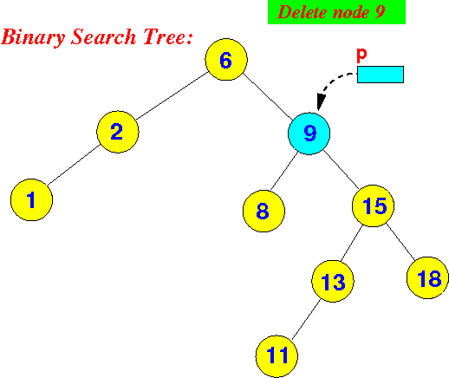
Cont…
z
y

Slide 5
Cont…
If node being deleted is Red, no properties are being violated.
If node being deleted is black with a Red child, recolor the child Black.
The complex case is when both the node being deleted and its child are black.

Slide 6
Why Fixup called when node is black?
If y is the root and red child becomes root, Property 2 violates
If both p[y] and x were red, Property 4 violates
If y’s removal causes any path that contained y to have few black node, then Property 5 violates

Slide 7
RBT_Delete(T, z)
y is the node which is actually deleted
  y and z are same in when z has no children or single child
x is left child of y if y has a left child else x is right child of y
x is attached as left child of p[y] if y was a left child else x is attached as right child of p[y]
If color[y] = Black,
call RB_Delete_Fixup(T,x)

Slide 8
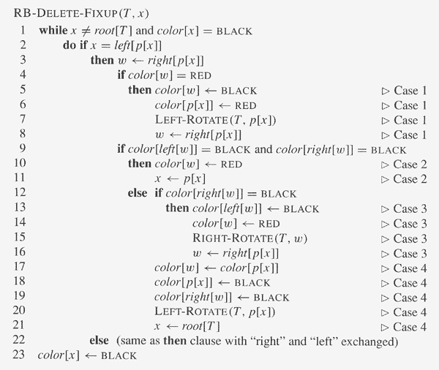

Slide 9
Case1: w is Red
Exchange colors of w & p[w]
Left Rotate around p[x]
Convert to case 2,3 or 4
60
40
40
70
X
W
New W
X
20
60
20
50
50
70

Slide 10
Case 2: w is Black & both of w’s children are black
color[w] = Red
Since all paths through p[w] now have one less black node continue another iteration of the while loop with x=p[x]
New X
c
c
40
40
X
W
W
20
60
20
60
50
70
70
50

Slide 11
Case 3: w is Black, its left child is Red & its right child is black
color[left[w]] = Black
color[w]=Red
Convert to Case 4
c
c
40
40
New w
X
W
50
20
60
X
20
60
50
70
70

Slide 12
Case 4: w is Black, w’s right child is Red
color[w] = color[p[x]]
color[p[x]]=Black
color[right[w]]= Black
LeftRotate(T,p[x])
New x=Root[T]
60
c
c
40
40
70
c’
X
W
50
20
60
X
20
c’
50
70

Slide 13
Example 1
Delete 10 from this RB Tree
15
6
17
12
20
3
16
10
13
18
23
7

Slide 14
Example 1 solution
15
6
17
Case 0
12
20
3
16
7
13
18
23
x
w
15
6
17
12
20
3
16
7
13
18
23
x
w

Slide 15
Example 2
Delete 10 from this RB Tree
15
6
17
12
20
3
16
2
4
10
13
15
6
17
12
20
3
16
2
4
13
x
w
Case 2

Slide 16
Example 2 (cont’d)
15
6
17
w
x
12
20
3
16
Case 2
2
4
13
15
x
6
17
12
20
3
16
2
4
13
Case 0

Slide 17
Example 2 solution
15
6
17
12
20
3
16
2
4
13

Slide 18
Example 3
Delete 10 from this RB Tree
15
10
5
12
3
7
11
13
Valid and unaffected Right subtree
2
4
6
9
Replace the key 10(z) by key 11(y) (successor of 10 in an inorder traversal)
Delete y from RBT

Slide 19
Example 3 (cont’d)
15
11
5
12
Case 2
3
7
13
x
w
15
2
4
6
9
11
w
12
5
x
3
7
13
2
4
6
9
Case 1

Slide 20
Example 3 (cont’d)
15
11
RightRotate(T,11)
5
w
x
12
3
7
13
2
4
6
9
15
5
11
3
x
12
2
4
7
w
13
6
9
Case 2

Slide 21
Example 3 (cont’d)
15
5
3
x
11
Case 0
7
12
2
4
6
9
13

Slide 22
Example 3 Solution
15
5
11
3
7
12
2
4
6
9
13

Slide 23
Example 4
38
19
41
12
31
8
Delete 8,12,19,31,38,41 successively from this RB Tree

Slide 24
Example 4 Cont..
38
19
41
12
31
Delete 8
As y is red , no case

Slide 25
Example 4 Cont..
38
19
41
y
12
31
Delete 12, y is black and x is black
So check for w

Slide 26
Example 4 Cont..
38
19
41
x
NIL
31
w
As w is black and children also black
So case 2 applies

Slide 27
Example 4 Cont..
38
New x
19
41
31
w
Assign w as Red and x is parent of x
As x is red, color[x] =Black and stop

Slide 28
Example 4 Cont..
38
y
19
41
31
x
Delete 19

Slide 29
Example 4 Cont..
38
31
41
As x is Red , color[x]=Red and stop

Slide 30
Example 4 Cont..
38
y
31
41
x
Delete 31, y and x both are black
Check w

Slide 31
Example 4 Cont..
38
x
41
w
W is black and both its children are black
Color[w]= red, x=p[x] which is root so stop

Slide 32
Example 4 Cont..
x
38
41
w
Delete 38

Slide 33
Example 4 Cont..
x
38
41
w
W is black and both its children are black
Color[w]= red, x=p[x] which is root so stop

Slide 34
Example 4 Cont..
41
x
W is black and both its children are black
Color[w]= red, x=p[x] which is root so stop

Slide 35
Analysis of Deletion
Consists of two phases
Time taken by first phase = O(lg n)
Cases 1, 3, 4 terminate after performing a constant no. of color changes & at most 3 rotations – O(1)
Case 2 is the only one in which while loop repeats, and then the pointer moves up the tree – O(lg n)
Total time = O(lg n)

