Slide 1
What’s the big deal with Scala?
praful@thoughtworks.com

Slide 2
As expressive as Ruby, As performant as Java
Why am I comparing with Ruby and Java?
Notes:
The general perception is that Ruby is a concise, expressive language than most of the languages we work on here at ThoughtWorks and similarly Java is performant. The objective is to provide Scala as a viable option when you pick your next language.

Slide 3
Disclaimer
Professionally a Ruby and Java developer
Haven’t worked with Scala on a “real” project
Based on my experience working with the Credit Union Findr

Slide 4
Why Expressiveness?
Not just pretty
Reduces boilerplate code
Less code to deal with & maintain
Notes:
* focus on DRYness - reducing boilerplate code
** less wordy - simple for loop doesn't require type and also val

Slide 5
Ruby class definition
Notes:
Not to look down upon any language.

Slide 6
Scala class definition

Slide 7
Scala case class definition

Slide 8
Closures & Higher-Order Functions
Closures are blocks of code that can be passed around as parameters
Higher-Order Functions are functions that either input or output functions.
Notes:
In Ruby, blocks cannot live on their own. They need to be converted to Procs using Proc.new or lambda, which is a shorthand for Proc.new with subtle difference like lambda checks for number of arguments.

Slide 9
Closures (in Ruby)

Slide 10
Closures (in Scala)

Slide 11
Higher-Order Function - Ruby

Slide 12
Higher-Order Functions - Scala

Slide 13
Ruby monkey patching

Slide 14
Scala implicit conversions
Notes:
Consistency: Language itself uses implicit conversions

Slide 15
Performance
Notes:
* focus on DRYness - reducing boilerplate code
** less wordy - simple for loop doesn't require type and also val

Slide 16
Tail recursion

Slide 17
Parallel collections

Slide 18
Actors

Slide 19
Criticism
Slow compiler
Too many features
Many different ways to call a method

Slide 20
Other items of interest
REPL

Slide 21
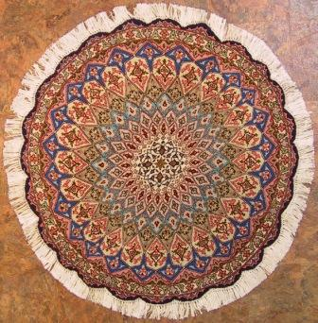
Functional yet beautiful
http://www.orientalpersianrug.com/qum_persian_rugs.html
Notes:
I visited the Met a couple of months ago and I saw this intricately hand woven Persian rug. What caught my eye was this phrase “Functional yet beautiful”. I like how the attribute of being functional came before beautiful. Something has to be functional first before being beautiful. And just because it is functional does not mean it has to be any less beautiful. And that is what Scala means to me. Functional (pun intended), performant yet beautiful.

