Slide 1
What’s the big deal with Scala?
praful@thoughtworks.com

Slide 2
As expressive as Ruby, As performant as Java
Why am I comparing with Ruby and Java?
Notes:
The general perception is that Ruby is a concise, expressive language than most of the languages we work on here at ThoughtWorks and similarly Java is performant. The objective is to provide Scala as a viable option when you pick your next language.

Slide 3
Disclaimer
Professionally a Ruby and Java developer
Haven’t worked with Scala on a “real” project
Based on my experience working with the Credit Union Findr

Slide 4
Why Expressiveness?
Not just pretty
Reduces boilerplate code
Less code to deal with & maintain
Notes:
* focus on DRYness - reducing boilerplate code
** less wordy - simple for loop doesn't require type and also val

Slide 5
Ruby class definition
Notes:
Not to look down upon any language.

Slide 6
Scala class definition

Slide 7
Scala case class definition

Slide 8
Function closures

Slide 9
Ruby monkey patching

Slide 10
Scala implicit conversions

Slide 11
Performance
Notes:
* focus on DRYness - reducing boilerplate code
** less wordy - simple for loop doesn't require type and also val

Slide 12
Tail recursion

Slide 13
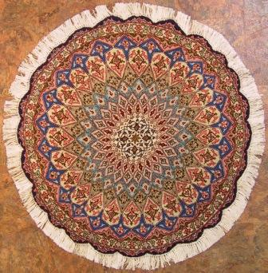
Functional yet beautiful
http://www.orientalpersianrug.com/qum_persian_rugs.html
Notes:
I visited the Met a couple of months ago and I saw this intricately hand woven Persian rug. What caught my eye was this phrase “Functional yet beautiful”. I like how the attribute of being functional came before beautiful. Something has to be functional first before being beautiful. And just because it is functional does not mean it has to be any less beautiful. And that is what Scala means to me. Functional (pun intended), performant yet beautiful.

