Slide 1
What’s the big deal with Scala?
praful@thoughtworks.com

Slide 2
As expressive as Ruby, As performant as Java
Why am I comparing with Ruby and Java?
Notes:
The general perception is that Ruby is a concise, expressive language than most of the languages we work on here at ThoughtWorks and similarly Java is performant. The objective is to provide Scala as a viable option when you pick your next language.

Slide 3
Disclaimer
Professionally a Ruby and Java developer
Haven’t worked with Scala on a “real” project
Based on my experience working with the Credit Union Findr

Slide 4
Why Expressiveness?
Not just pretty
Reduces boilerplate code
Less code to deal with & maintain
Elegant solution
Notes:
* focus on DRYness - reducing boilerplate code
** less wordy - simple for loop doesn't require type and also val

Slide 5
Ruby class definition
Notes:
Not to look down upon any language.

Slide 6
Scala class definition

Slide 7
Scala case class definition

Slide 8
Closures
Closures are blocks of code that can be passed around as parameters
Closures “close over” variables outside of its scope
Notes:
When I first came to Ruby, the thing that really impressed me was closures. I was thinking this is great. Clean and concise.
In Ruby, blocks cannot live on their own. They need to be converted to Procs using Proc.new or lambda, which is a shorthand for Proc.new with subtle difference like lambda checks for number of arguments.

Slide 9
Closures in Ruby

Slide 10
Closures in Scala
Notes:
val would not let you reassign the “from” variable thus avoiding surprises

Slide 11
Higher-Order Functions
Higher-Order Functions are functions that either input or output functions.

Slide 12
Higher-Order Functions in Ruby

Slide 13
Higher-Order functions in Scala

Slide 14
Ruby monkey patching

Slide 15
Scala implicit conversions
Notes:
Consistency: Language itself uses implicit conversions

Slide 16
Performance
Notes:
* focus on DRYness - reducing boilerplate code
** less wordy - simple for loop doesn't require type and also val

Slide 17
Tail recursion

Slide 18
Parallel collections

Slide 19
Actors

Slide 20
Criticism
Slow compiler
Too many features
Many different ways to call a method

Slide 21
Other items of interest
REPL

Slide 22
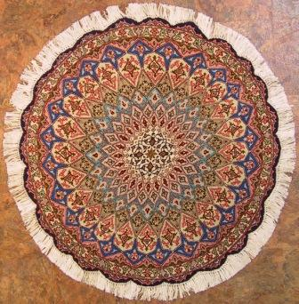
Functional yet beautiful
http://www.orientalpersianrug.com/qum_persian_rugs.html
Notes:
I visited the Met a couple of months ago and I saw this intricately hand woven Persian rug. What caught my eye was this phrase “Functional yet beautiful”. I like how the attribute of being functional came before beautiful. Something has to be functional first before being beautiful. And just because it is functional does not mean it has to be any less beautiful. And that is what Scala means to me. Functional (pun intended), performant yet beautiful.

