Slide 1
The perfect Sneaker
Using machine learning to find the shoes you need

Slide 2
Hypothesis
Retail price of sneakers can be predicted based on brand, colorways, and target group
Brand being: Nike, Adidas, Reebok, etc.
Target group being: Men’s, Women’s, Youth, etc.

Slide 3
The Sneaker Database
Data was provided by the Sneaker Database powered by TG4 Solutions
This database provides an API containing information on over 50,000 shoes
It is includes for each shoe elements such as brand, colorway, images, gender(target group), release date, and shoe title
Link to Database: https://thesneakerdatabase.com/
Link to the API: https://app.swaggerhub.com/apis-docs/tg4solutions/the-sneaker-database/1.0.0#/

Slide 4
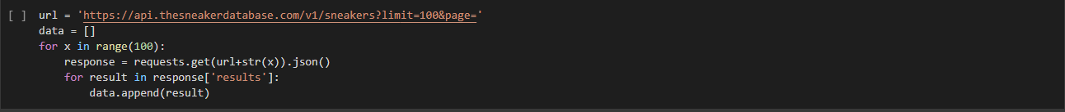
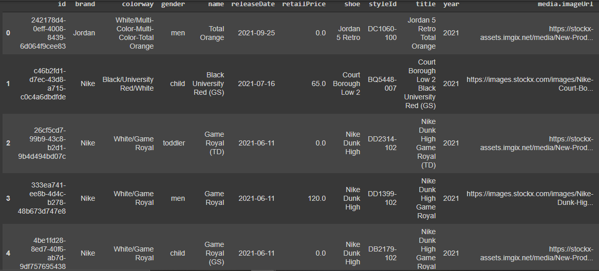
Getting the data

Slide 5
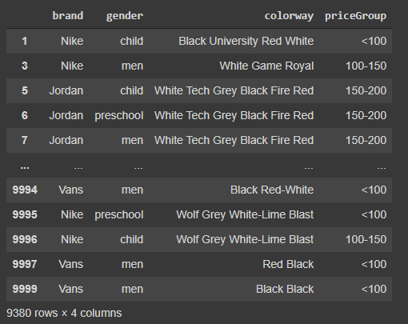
Cleaning for neural network

Slide 6

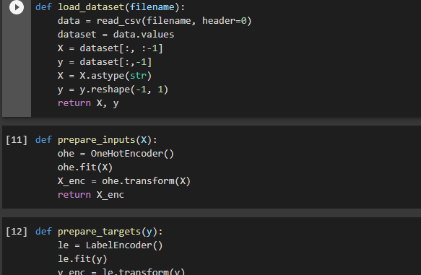
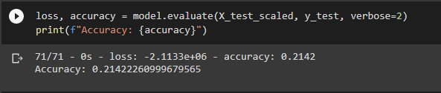
Neural Network

Slide 7
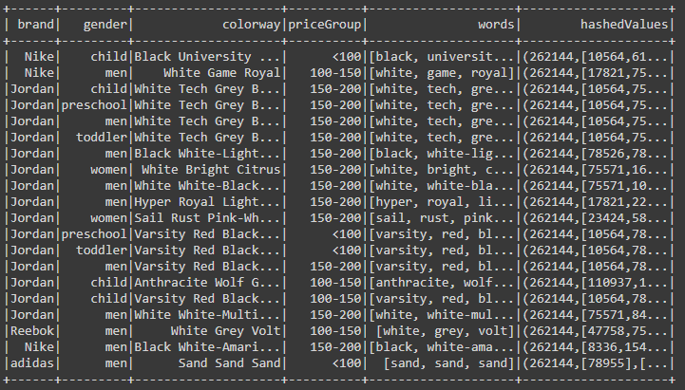
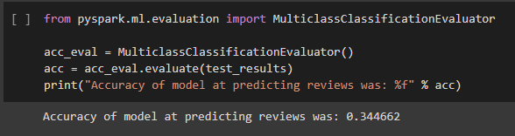
PySpark

Slide 8
CNN
download-images.ipynp
Sorted images into men’s shoes with available images
Download images to separate Google Drive folders based on brands
Separates images into train, test, validation folders
cnn.ipynb
Attempting to get images into correct shape for algorithm to be able to predict brand of shoe based off an image

