Slide 1

Chat with Your Data:
A Hands-On Introduction to Retrieval-Augmented Generation (RAG)
Dr. Aygul Zagidullina
Dr. Elena Nazarenko

Slide 2
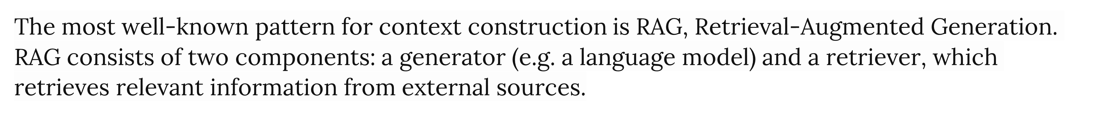
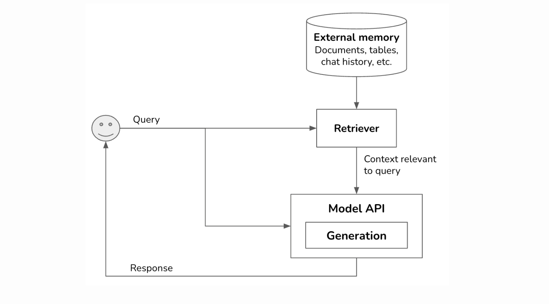
Retrieval-Augmented Generation
Note: Retrieval isn’t unique to RAGs. It’s the backbone of search engines, recommender systems, log analytics, etc. Many retrieval algorithms developed for traditional retrieval systems can be used for RAGs.

Slide 3
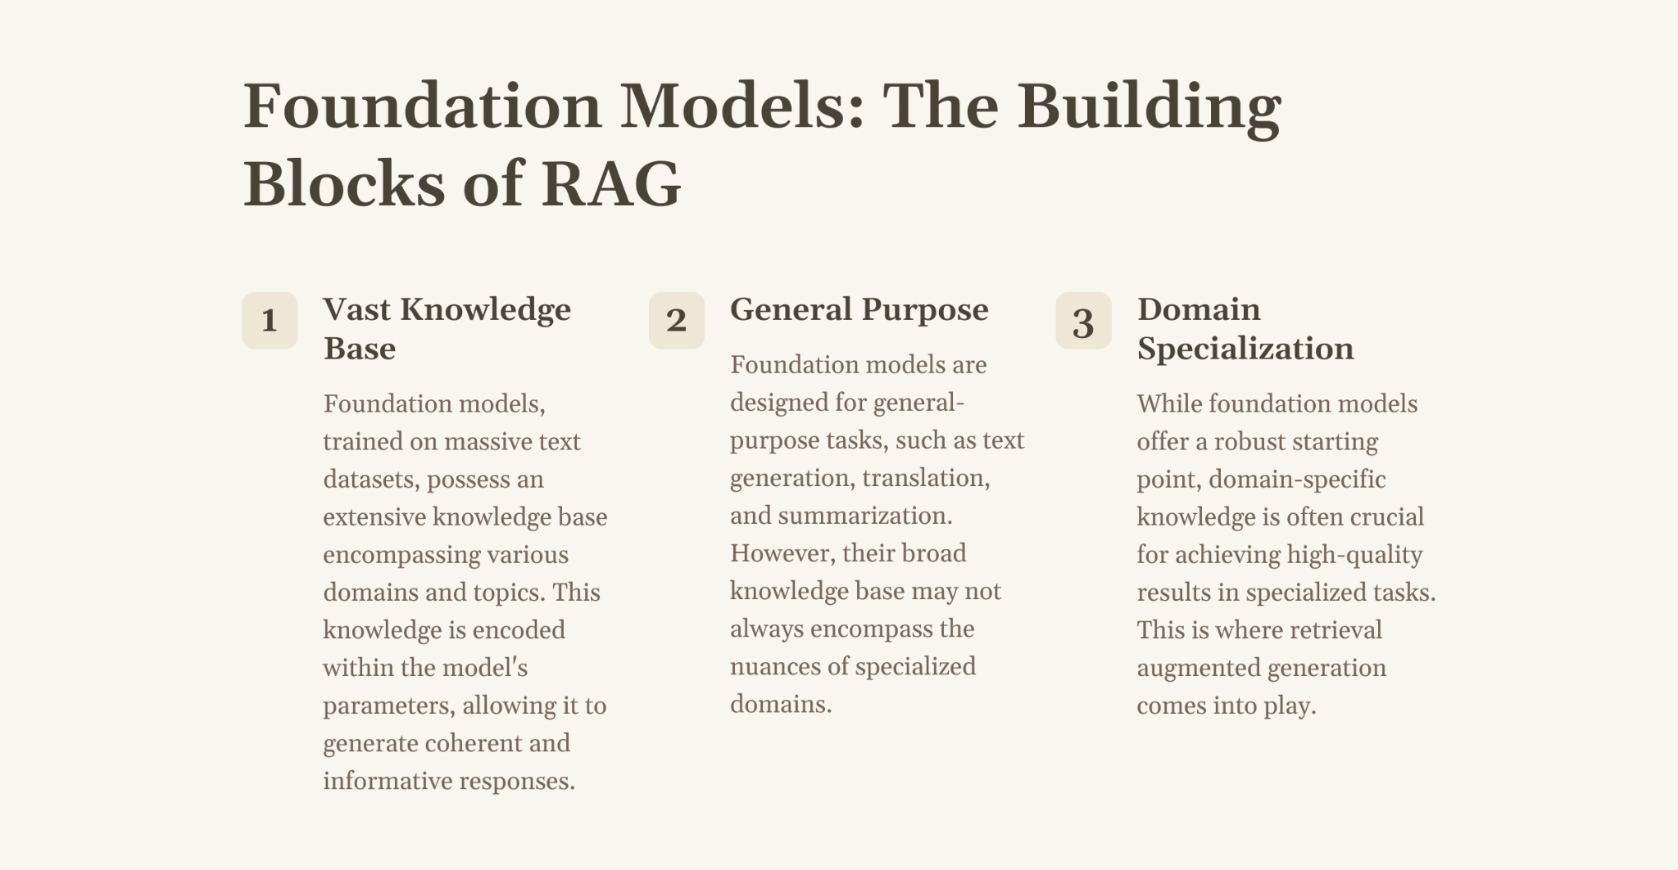

Slide 4
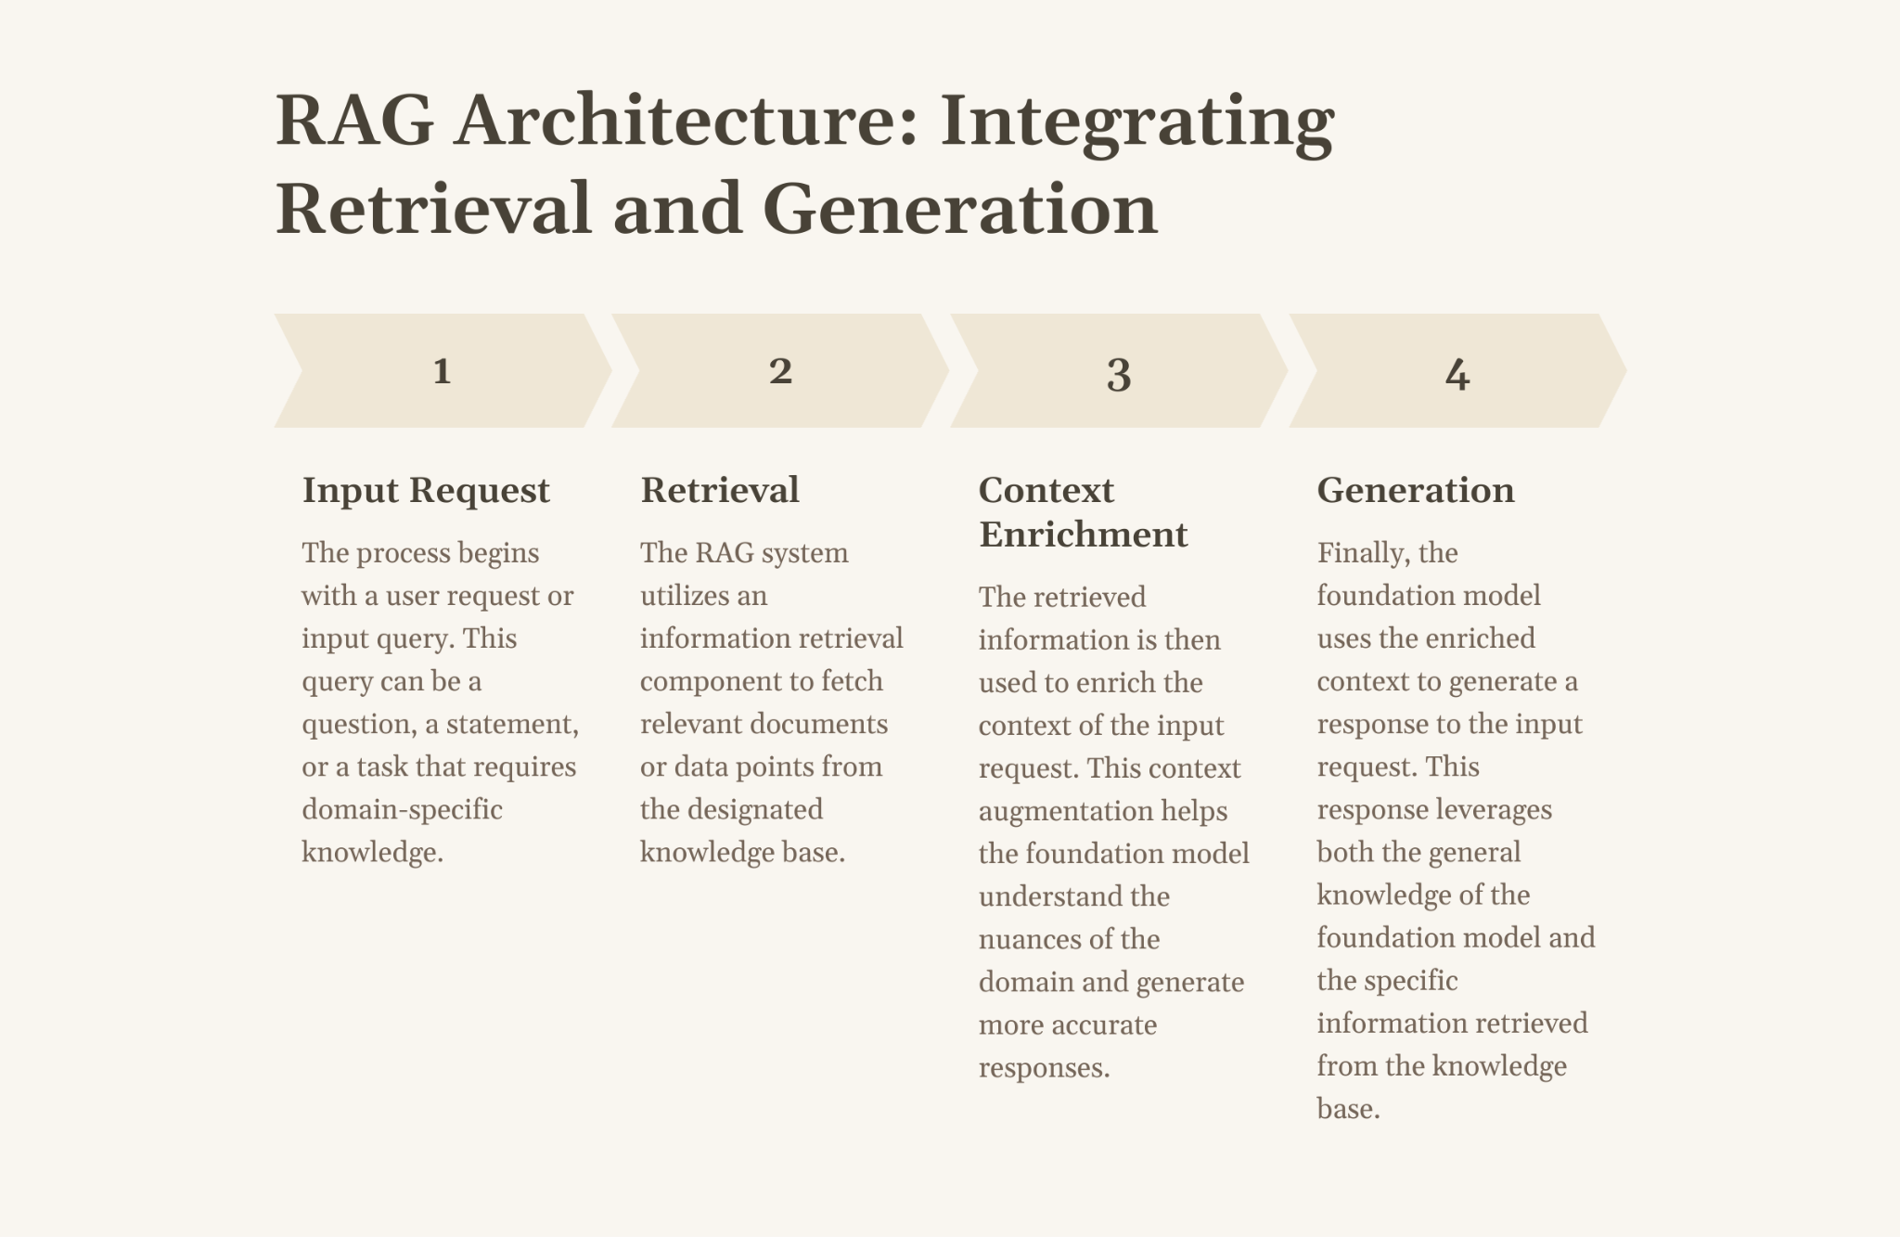

Slide 5
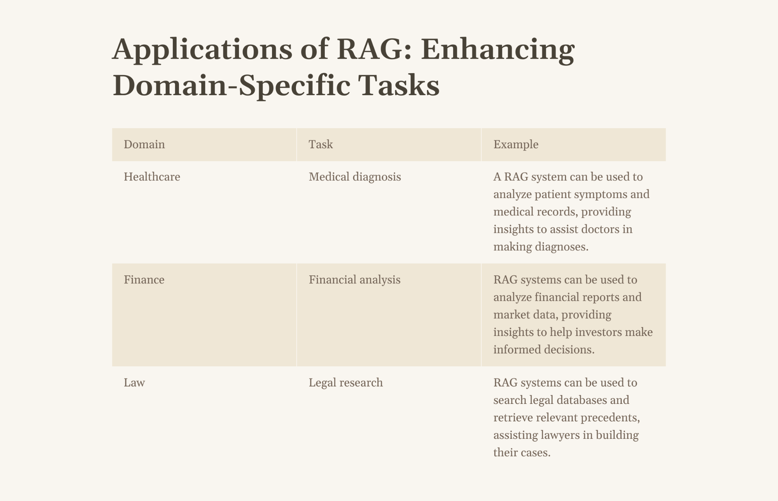

Slide 6
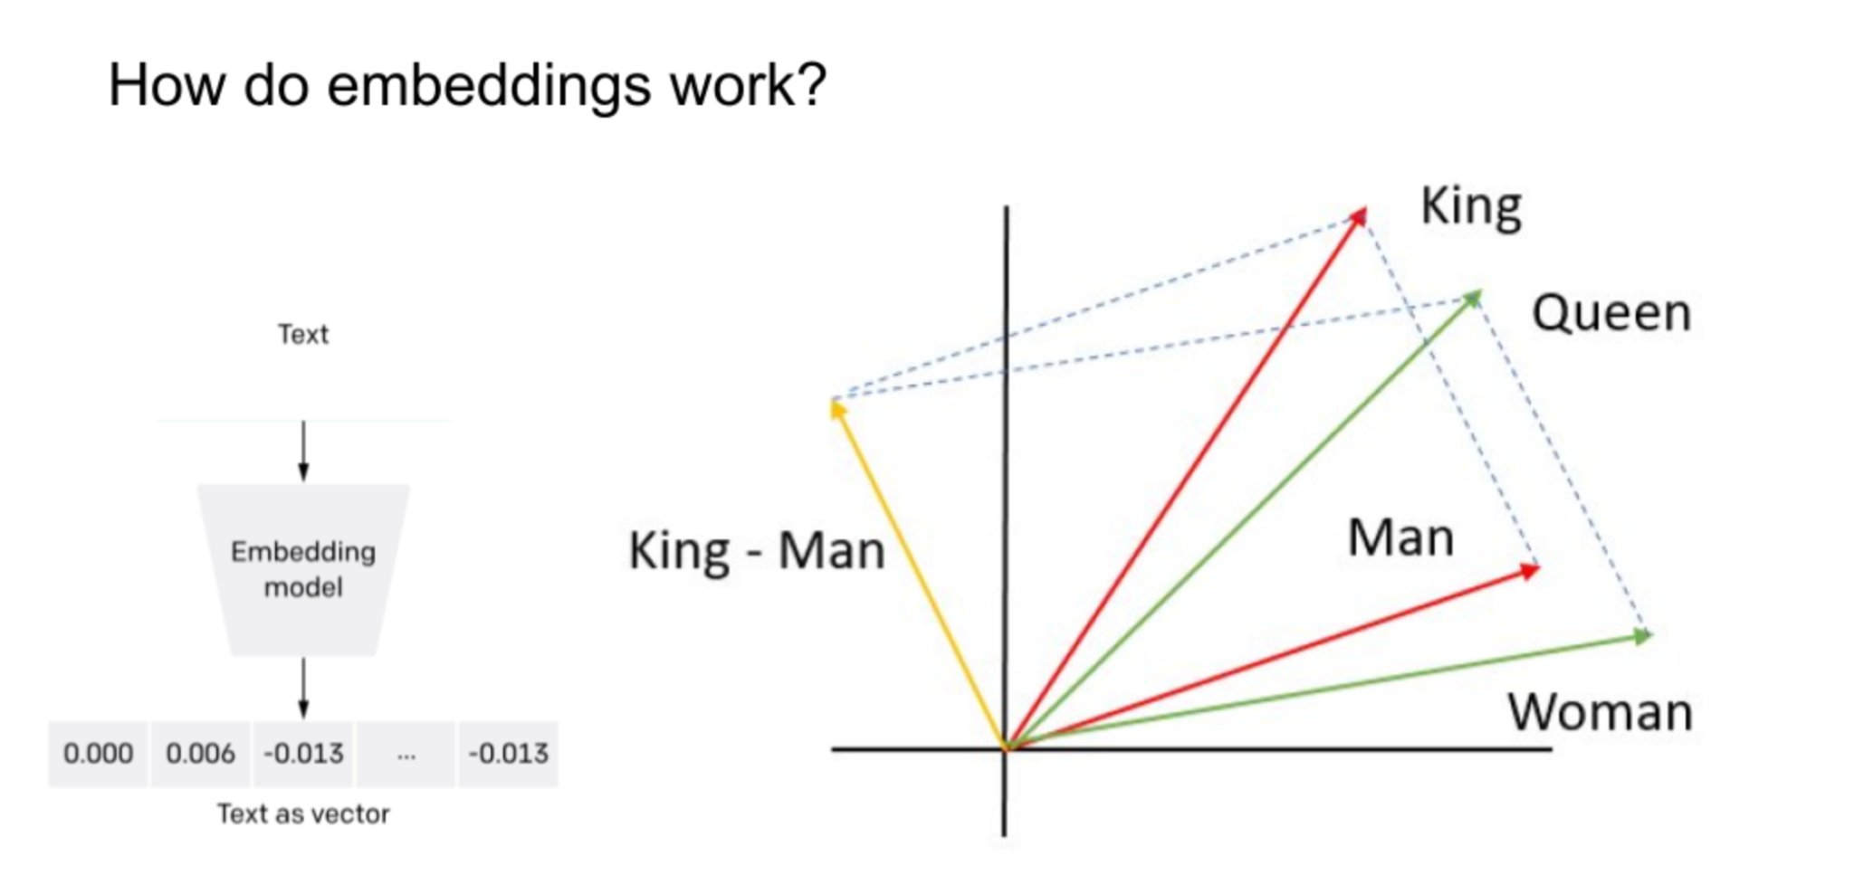
How does it work? You need an embedding model

Slide 7
Embed your data
Convert your data into chunks.
Then run it through an embedding model. (This is expensive since it calls an LLM)
Store the embedding vectors in an index (e.g. a list)
Compute the embedding of your query.
Look up most relevant matches in the index.
Insert them into the prompt.

Slide 8
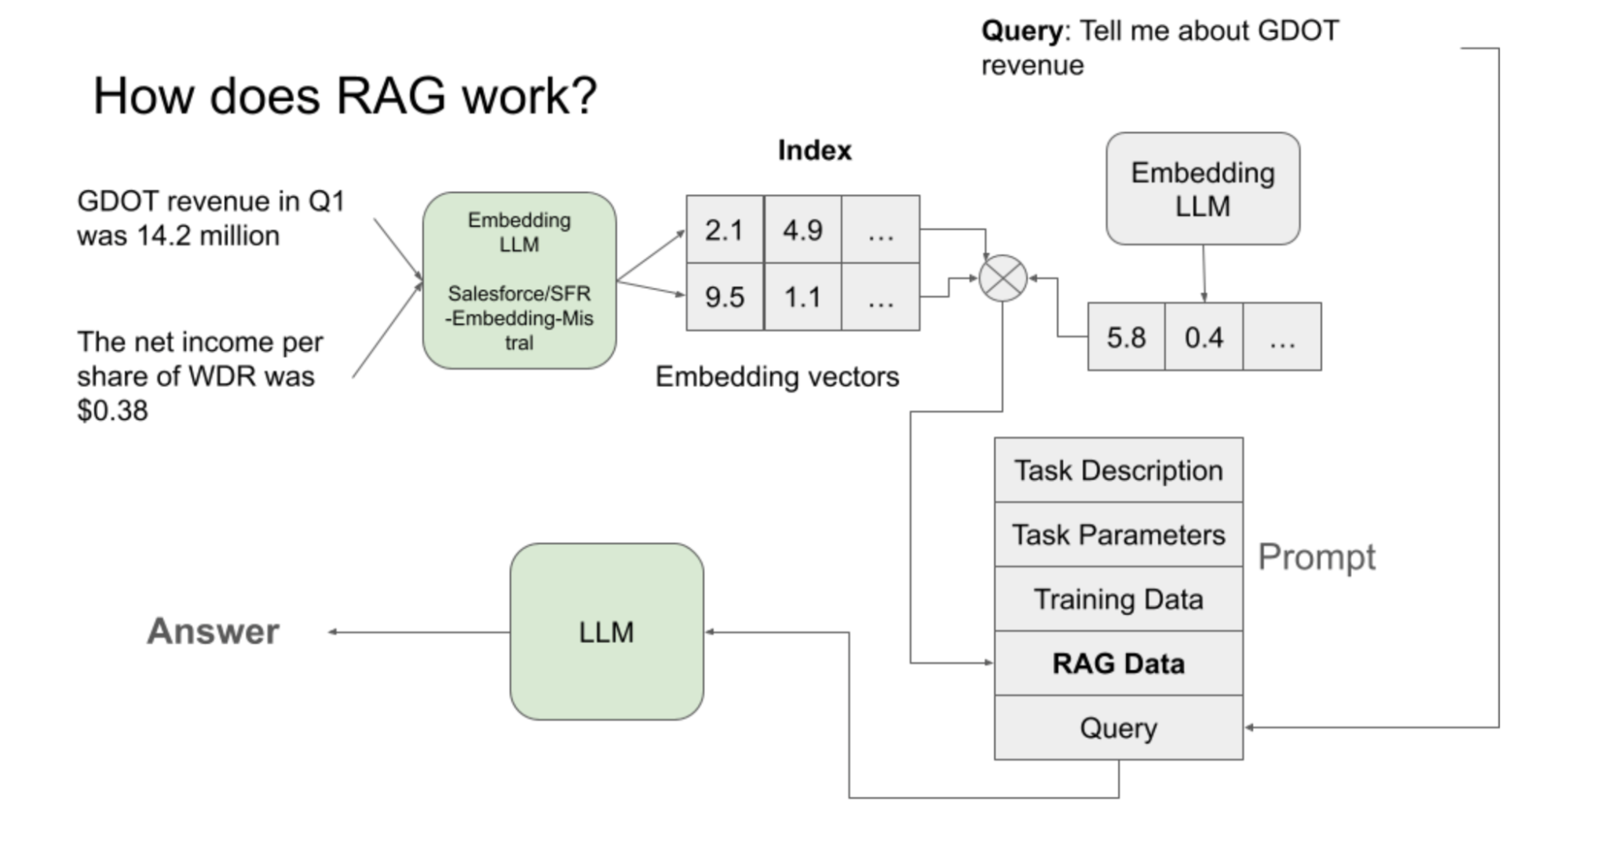

Slide 9
Overview of Tools for RAG
LlamaIndex:
https://www.llamaindex.ai/
Framework for building LLM applications
Robust data handling and retrieval capabilities
Perfect for data-centric applications like RAG
Efficient indexing and retrieval methods
Better chunking strategies
Multimodality
Free
LangChain:
https://www.langchain.com
Provides a balance of customization and ease of use
Ideal for developers seeking flexibility in their LLM interactions
Free
OpenAI Assistants (GPTs):
https://platform.openai.com/docs/assistants/overview
Accessible and quick-to-deploy option
Suitable to integrate LLMs without deep technical expertise
To create quick proofs of concepts
Paid

Slide 10
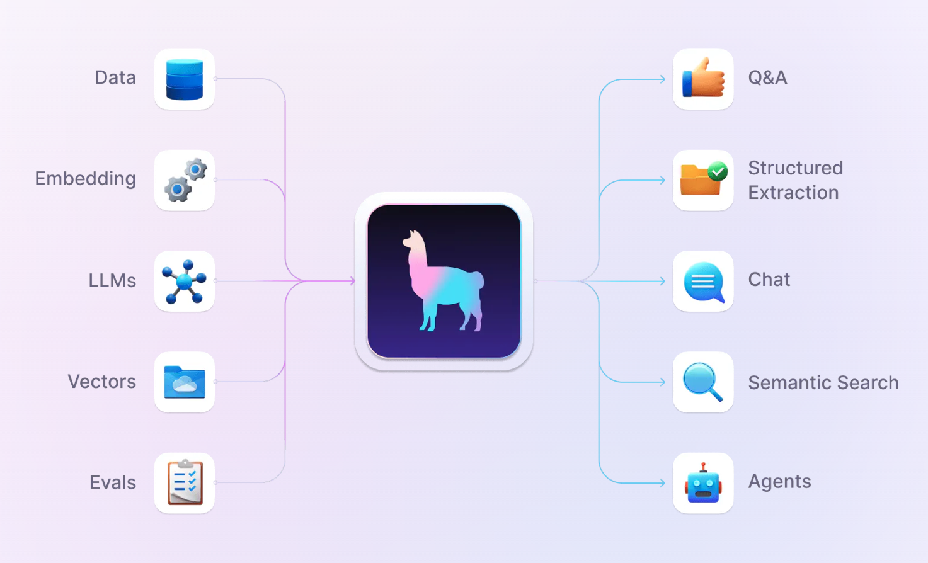
LlamaIndex
Go-to for a RAG-based application
Offers Fine-Tuning and Embedding optimizations
Free
Open-Source
Continually Developed
https://www.llamaindex.ai/

Slide 11

OpenAI GPTs & assistants
Using OpenAI GPTs & assistants
Pro:
Streamlined experience
User-friendly interface
Cons:
Dependent on OpenAI (problems with data privacy and safety)
Not enough unique value
https://platform.openai.com/docs/assistants/overview
Notes:
If you need something more tailored than RAG solutions yet not as time-intensive as building from scratch, this is where LanChan and LlamaIndex come into play.

Slide 12
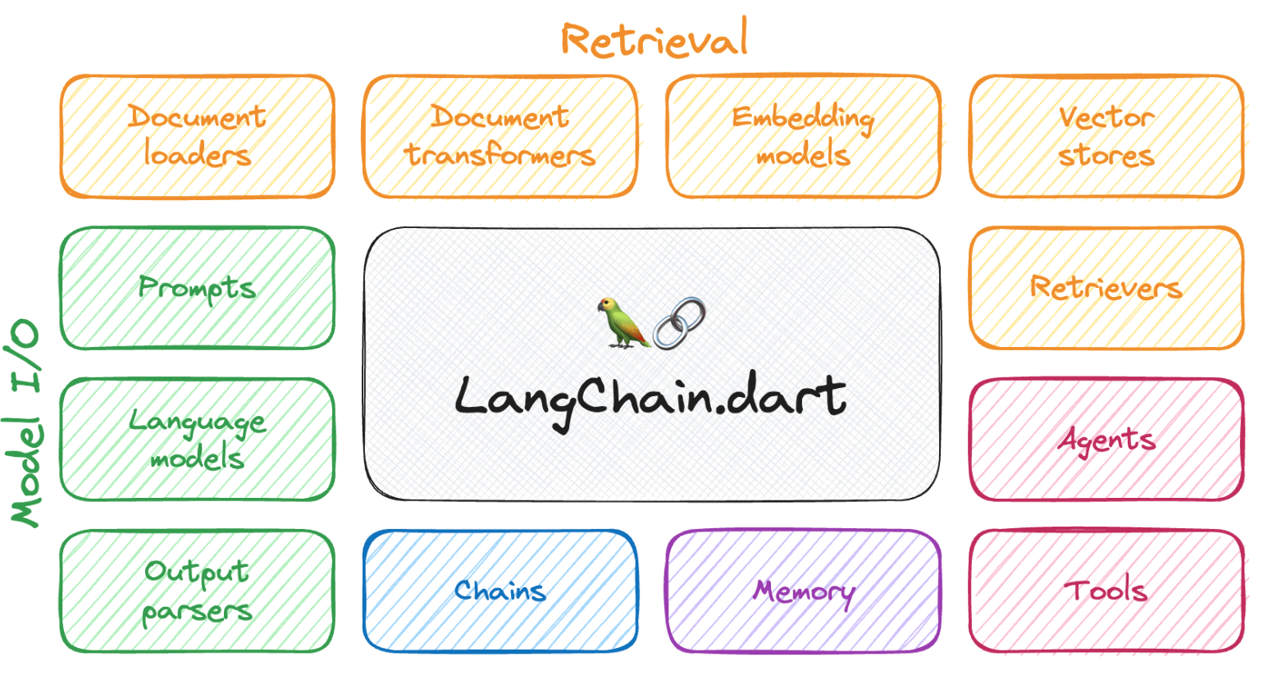
LangChain
Powerful and flexible framework for building applications with LLMs
Stands out for its ability to integrate seamlessly with various LLM providers like OpenAI, Cohere, HuggingFace.
Mostly used to create applications that can process user input text and retrieve relevant responses leveraging the latest NLP.
Key advantages:
Support for prompt engineering (provides prompt templates).
Structured output from LLMs (for example, JSON objects).
Nice middle ground for a balance between customization and ease of use.
Source
https://www.langchain.com/

Slide 13
LangChain - Chains
A chain is an end-to-end wrapper around multiple individual components executed in an order.
Chains are one of the core concepts of LangChain. Chains allow us to go beyond just a single API call to a language model and instead chain together multiple calls in a logical sequence.
They allow us to combine multiple components to create a coherent application.
Some reasons to use chains:
To break down a complex task into smaller steps that can be handled sequentially by different models or utilities. This allows us to leverage the different strengths of different systems.
To add state and memory between calls. The output of one call can be fed as input to the next call to provide context and state.
To add additional processing, filtering or validation logic between calls.
For easier debugging and instrumentation of a sequence of calls.

Slide 14
LangChain - Chains
🦜 LLMChain is the most commonly used type of chain.
The LLMChain consists of a PromptTemplate, a language model, and an optional output parser.
The main differences between using an LLMChain versus directly passing a prompt to an LLM are:
With LLMChain, one can break down a complex prompt into multiple more straightforward prompts and chain them together.
LLMChain maintains state and memory between prompts. The output of one prompt can be fed as input to the following prompt to provide context. Directly passing prompts lack this memory.
LLMChain makes adding preprocessing logic, validation, and instrumentation between prompts easier. This helps with debugging and quality control.

Slide 15
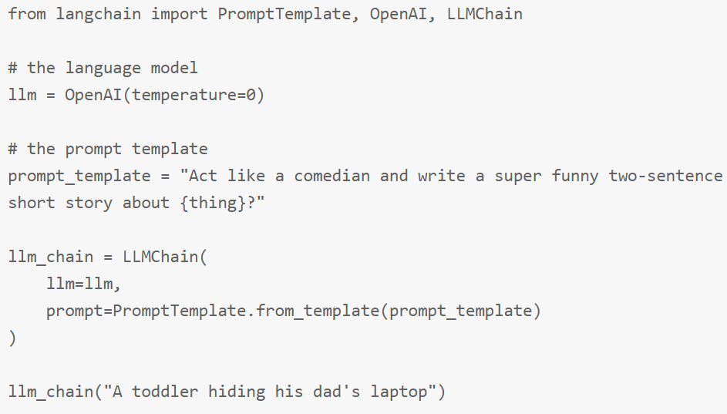
LangChain - Chains
Seite <number>

Slide 16
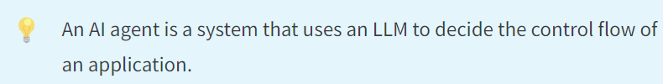
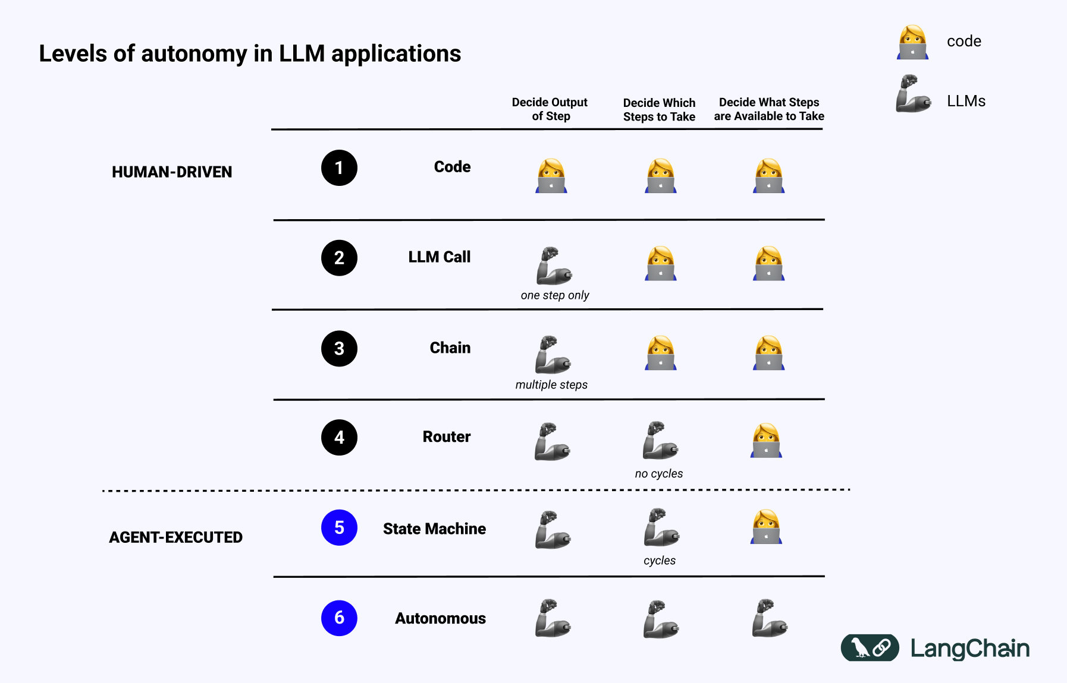
Agents

