Slide 1

Covid
Data
Pipeline

Slide 2
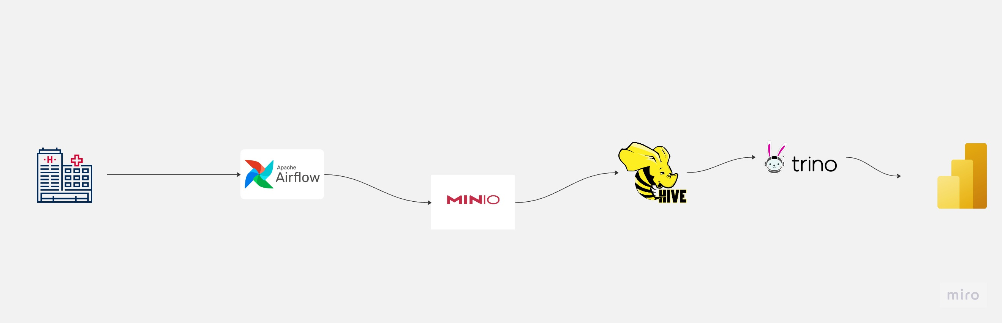

Slide 3
How It works?
It uses a google collab project for importing covid data from different sources
Using Airflow to automate google scripts for data importing
And ingesting data into S3 bucket (minio –local version of aws S3)
Hive for querying the data from S3
Trino a distributed SQL engine for an easy connection to Hive
Customize Trino connector for linking PowerBi to Trino
PowerBi for visualizing the incoming data

Slide 4
Google Open Covid Project
You will find under ./openCovid19/src/scripts
fetch_automatic_downloads.py : customized for the project and will be used to fetch data from different sources
export_data.py: transform -gather- downloaded data into single csv file located in ./ openCovid19/data/exports/cc_by/ aggregated_cc_by.csv which will be only used for now

Slide 5
Airflow
Will be used to automate openCovid19 scripts within dags
Will be connected to minio S3 –specifically C19 Bucket-
Will export aggregated_cc_by.csv into c19 bucket

Slide 6
Hive
Will be used as querying tool for data of S3 and sensor for the new file

Slide 7
Trino
Will be used as external SQL querying engine instead of going through the complication of connect to Hive
Trino connector will be used as customized connector for PowerBi

Slide 8
PowerBi
Will be used to visualize static data from a predefined dataset downloaded from Kaggle
And for Realtime data from the configured pipeline

Slide 9
Implementing steps

Slide 10


docker
A pre-configured docker and docker compose is required

Slide 11
Running Containers
Go to project folder ./
Run the following command
sudo docker compose -f docker-compose.yaml up –d
Please make sure the required ports is available
8082 : for Airflow
8085 : for Trino
3306 : for Mariadb
9083 : Hive metastore
9095 : Minio

Slide 12
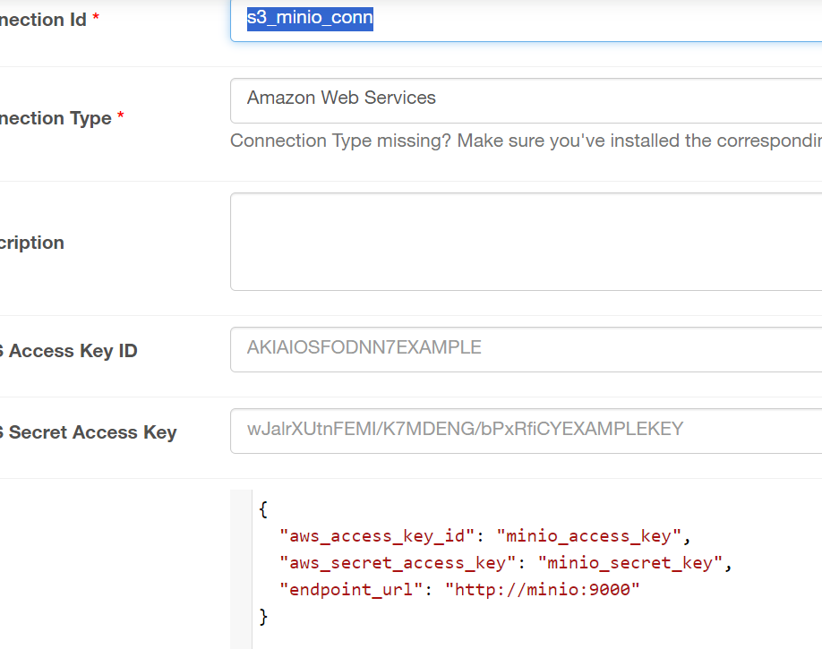
Airflow
Go to Airflow Localhost:8082
Username: airflow
Password: airflow
Go to Admin tab → Connections
Add Connection Id: s3_minio_conn
Fill Extra field with:
{
"aws_access_key_id": "minio_access_key",
"aws_secret_access_key": "minio_secret_key",
"endpoint_url": "http://minio:9000"
}

Slide 13
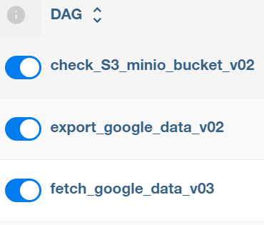
Airflow
Run the following Airflow dags to start data ingestion and wait for the dags to finish running

Slide 14

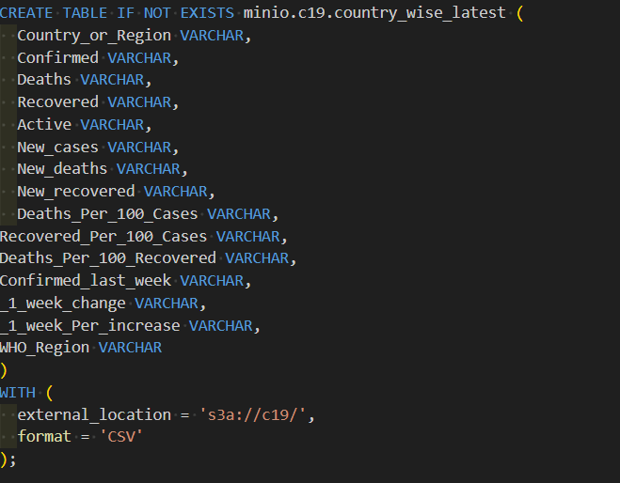
Trino
From project path run SQL query commands
./Create schema.sql
then run
./ Create table.sql
To create tables in Hive store

Slide 15
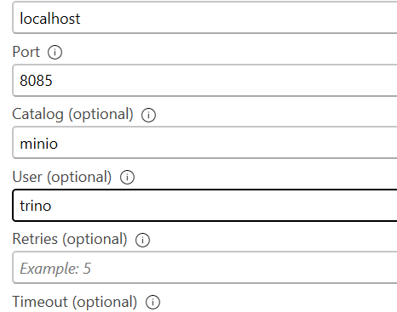
PowerBi
From project folder copy
./TrinoConnector/Trino/bin/Debug/Trino.mez
into newly created folder in the same exact path
Documents/Power BI Desktop/Custom Connectors/
And then you will find a new connector called Trino(beta) located in Database connectors when you click on Get Data button in Home tab in powerBi
Fill the connection info as per the screenshot
Now, you are connected to live database

Slide 16
Now you are connected, Whatever data you change in S3 bucket it will be reflected to the PowerBi instantly

