Slide 1
TomCoin
Thomas Pedersen, MAY 8th 2019

Slide 2
Idea
Based on Bitcoin Lite homework project
Add Minting Eligibility - Novelty
Add Coin-Age – based on PeerCoin

Slide 3

Minting Eligibility
Each miner has to be eligible to mint a coin
Minting – submitting proof of work of a block
Eligibility determined by comparing hashes of miners UTXO to the previous blocks hash.
If the first N bits of the hashes match, the miner is eligible to mint
If not, miner waits and tries again in 10 seconds. The N value will be lowered by 1 after 10 seconds.
Means $2^{−N}$ of the miners will be able to mine initially on average. This ratio will eventually reach 1 over time, allowing all miners to mint.

Slide 4

Providing Coin-Age
$Coin Age per coin=\text{⌊}max⁡\{0, \left(\frac{coinValue}{1000}\right)∗(coinChainLevel−headChainLevel−2)\}⌋$
$Total CoinAge=\text{⌊}min⁡\{4, \sum{Individual coinAge}\}⌋$
Miner creates a coin-age transaction and sends it to self before starting to look for a proof
This depletes the coin age of the coins picked.
The coin-age determines the difficulty of the PoW.
Coins with chain age of less than 2 will not be used as they don’t contribute to the coin-age value
Improvement – Only pick enough coins to reach max coin-age

Slide 5
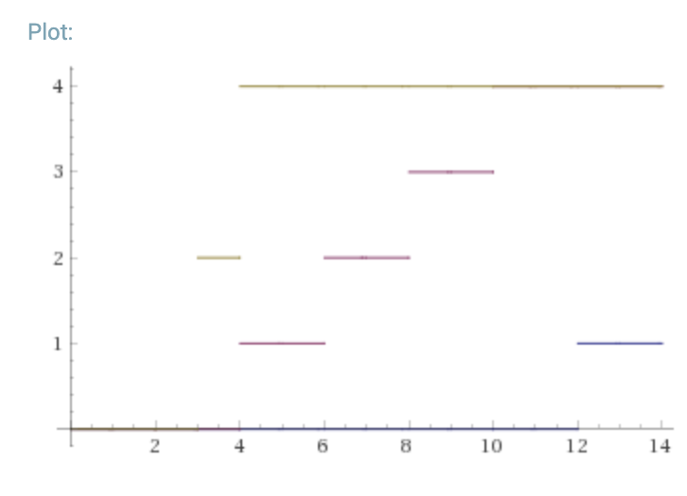
Coin-Age comparison with different coin amounts
2000 coins
Coin Age
500 coins
100 coins
Chain Age

Slide 6
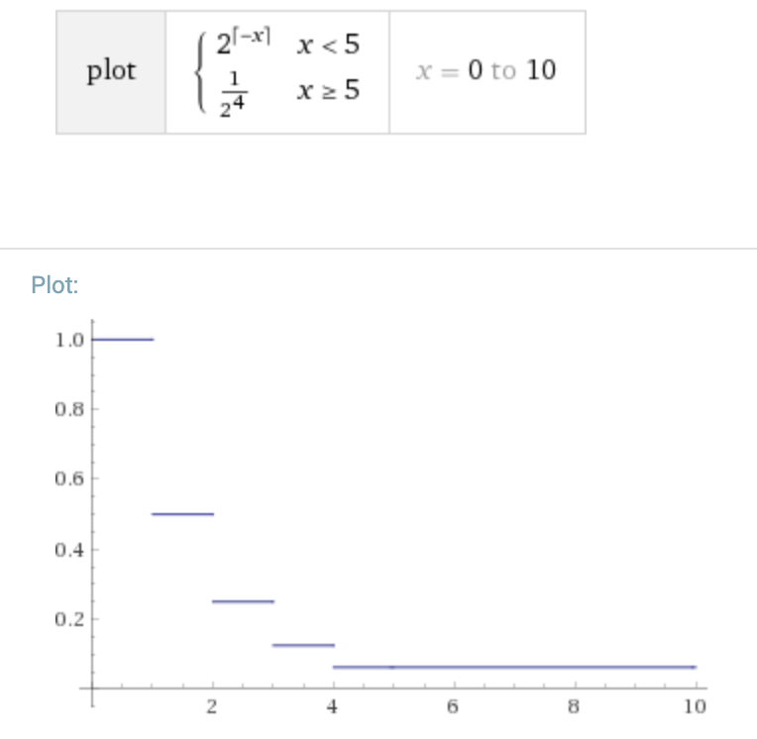
Proof of Work
Same concept as Bitcoin
PoW requirement depends on coin-age of miner.
Max difficulty handicap of 1/16th
Allows for users will less computational power to win sometimes
Default difficulty for coin age 0 is 20 zeros in hash
Difficulty is halved for each coin-age value up to 4.
PoW difficulty
Coin-Age

Slide 7
Verifying a proof
All miners receive:
block with proof
context of miner
To Verify:
Check that the miner is mint eligible by calculating the time difference between the block timestamp and current time.
Calculate the target PoW difficulty based on the coin-age transaction submitted by miner
Verify the proof is valid

Slide 8
Test results
4 miners with variable number of coins, coinbase of 10, run for 10 minutes
Minting eligibility wait 10 secs
Minting eligibility wait 30 secs
Miner Name | Initial balance | Final balance | Blocks mined
Alice | 5 | 25 | 2
Bob | 50 | 80 | 3
Charlie | 500 | 580 | 8
Dave | 5000 | 5080 | 8
Miner Name | Initial balance | Final balance | Blocks mined
Alice | 5 | 5 | 0
Bob | 50 | 100 | 5
Charlie | 500 | 520 | 2
Dave | 5000 | 5090 | 9
Notes:
takeaway: find a good balance between coin-age formula and eligibility wait time to achieve most distributed and fair mining

Slide 9
Difficulties experienced
Wallet is separate from blockchain – Difficult for miner to spend their coins only if their block wins..
Any transactions not in chain is not valid.
Make wallet just a bunch of keys. Retrieve all info about coin from block.
Requires access to the block. Only miners have the block history. Not ideal…
Implementing minting eligibility
Miners should only start mining when eligible
Miners have to verify other miners block and eligibility based on timestamps

Slide 10
Thank you

