Slide 1
Faircoin
Thomas Pedersen, MAY 8th 2019

Slide 2
Idea
Based on Bitcoin Lite homework project
Add Minting Eligibility - Novelty
Add Coin-Age – based on PeerCoin

Slide 3

Minting Eligibility
Each miner has to be eligible to mint a coin
Minting – submitting proof of work of a block
Eligibility determined by comparing sum of all miners UTXO hashes and the previous blocks hash.
If the first N bits of the hashes match, the miner is eligible to mint
If not, miner waits and tries again in 10 seconds. The N value will be lowered by 1 after 10 seconds.
Means $2^{−N}$ of the miners will be able to mine initially on average. This ratio will eventually reach 1 over time, allowing all miners to mint.

Slide 4

Providing Coin-Age
$Coin Age Value=\text{⌊}min⁡\{4, \left(\frac{coinValue}{100}\right)∗coinAgeInDays\}⌋$
Miner creates a coin-age transaction and sends it to self before starting to look for a proof
This depletes the coin age.
The coin-age determines the difficulty of the PoW.

Slide 5
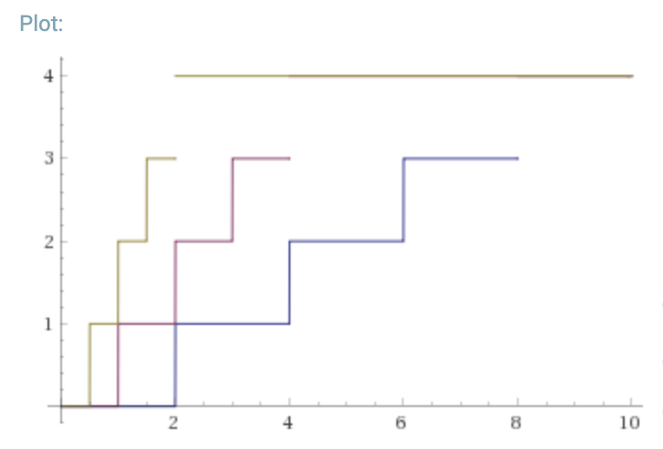
Coin-Age comparison with different coin amounts
200 coins
100 coins
50 coins
Coin Age
Days

Slide 6
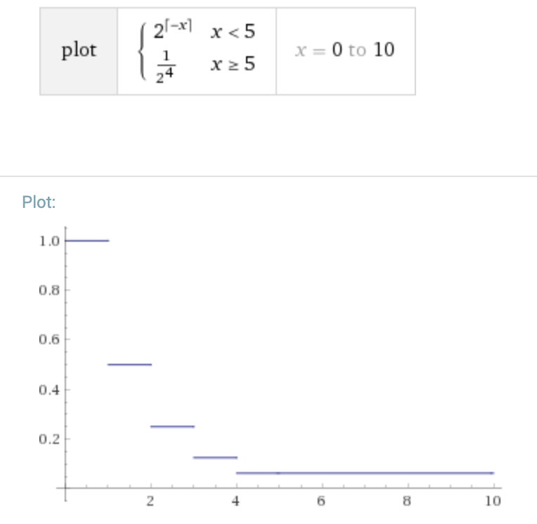
Proof of Work
Same concept as Bitcoin
PoW requirement depends on coin-age of miner.
Max difficulty handicap of 1/16th
Allows for users will less computational power to win sometimes
Default difficulty for coin age 0 is 20 zeros in hash
Difficulty is halved for each coin-age value up to 4.

Slide 7
Verifying a proof
All miners receive:
block with proof
context of miner
To Verify:
Check that the miner is mint eligible by calculating the time difference between the block timestamp and current time.
Calculate the target PoW difficulty based on the coin-age transaction submitted by miner
Verify the proof is valid

Slide 8
Difficulties experienced
Project based on BCL
Wallet is separate from blockchain – No way to only spend coin-age for successful blocks mined
Have to rewrite the wallet/transaction code
Implementing minting eligibility
Miners should only start mining when eligible
Miners have to verify other miners block and eligibility based on timestamps

Slide 9
Things I will ignore

Slide 10
Thank you

