Slide 1
Deterministic Networking (DetNet) Data Plane
guaranteed Latency Based Forwarding (gLBF)
for bounded latency with low jitter and asynchronous forwarding in Deterministic Networks draft-eckert-detnet-glbf-01
Toerless Eckert, Futurewei Technologies USA (tte@cs.fau.de),
Alexander Clemm, Futurewei Technologies USA (alex@futurewei.com),
Stewart Bryant, Independent (sb@stewartbryant.com),
Stefan Hommes, ZF Friedrichshafen AG (stefan.hommes@zf.de)
IETF117 DetNet WG meeting 07/26/2023, rev 1.0
https://github.com/toerless/detnet/tree/main/slides

Slide 2
Overview
Detailed step-by-step explanation of gLBF in draft
And 07/19/2023 interim
See https://wiki.ietf.org/en/group/detnet/wmosq (TBD)
https://datatracker.ietf.org/meeting/interim-2023-detnet-08/materials/slides-interim-2023-detnet-08-sessa-deterministic-networking-detnet-data-plane-guaranteed-latency-based-forwarding-glbf-00
This slide deck focusses on comparison and justification (benefits)
Details aspects that where questioned during interim and on WG list.

Slide 3
What is gLBF
gLBF is UBS (TSB-ATS) with Dampers – instead of shapers (regulators)

Slide 4
UBS (TSN-ATS)
SOURCE
RECEIVER
competing traffic
competing traffic
competing traffic
...
...
...
...
...
...
...
...
UBS
queuing/
scheduling
Per-flow
shaper
UBS
queuing/
scheduling
UBS
queuing/
scheduling
Per-flow
shaper
UBS
queuing/
scheduling
Per-flow
shaper
Per-flow
shaper
R1
R2
R3
R4
<= L(1)
<= L(2)
<= L(3)
Example: R1..R4 in metro network ring, each being a spoke to many source/receiver nodes (not shown)
Relevant end-to-end bounded (guaranteed) queuing latency for Flow F SOURCE->RECEIVER:
L = L(1) + L(2) + (L3)
Each L(i) calculated from all admitted flows (calculus).
Without competing traffic, queuing latency for F will be 0.
With maximum amount of competing traffic, queuing latency for F will be L
We call this “in-time” – packets can arrive as early as possible, but never later than bounded latency.
Shapers do not increase the per-hop bounded latency. They ensure that the per-hop latency can be calculated independently of the latency across any other hop!

Slide 5
gLBF
SOURCE
RECEIVER
competing traffic
competing traffic
competing traffic
...
...
...
...
...
...
...
...
UBS
queuing/
scheduling
Stateless
Damper
UBS
queuing/
scheduling
UBS
queuing/
scheduling
Stateless
Damper
UBS
queuing/
scheduling
Stateless
Damper
Stateless
Damper
R1
R2
R3
R4
= L(1)
= L(2)
= L(3)
gLBF replaces shapers with stateless damper
End-to-end bounded, (guaranteed) queuing latency for Flow F SOURCE->RECEIVER:
L = L(1) + L(2) + (L3)
Each L(i) calculated from all admitted “competing” flows (UBS calculus) – EXACTLY AS FOR UBS.
Latency through UBS queue/scheduling with be exactly as in UBS – depending on amount of competing traffic
But latency through UBS queu/scheduler plus following Damper will always exactly be L(i)
We call this “on-time” – packets can arrive as early as possible, but never later than bounded latency.
Dampers are there to replace shaper and their problems, and they also provide on-time service.

Slide 6
Why ?
Benefits of Dampers over Shaper/Regulators

Slide 7
System model with RFC2212/TSN-ATS
Network resource Database
Per-link/hop, per-queue free space
link free bandwidth
Per-flow, per-hop Database
Flow k: $$\hat{r}$$_{k}/ $$\hat{b}$$_{k} , {Q_{i} }
Controller
Flow k requirements
$$\hat{r}$$_{k}/ $$\hat{b}$$_{k}
End-to-end
Min..max latency
(Calculate path
or use shortest path
(slide does not show path steering)
<=>
Calculate best queue for each hop to meet min..max latency
Flow fits ?
Admit
else reject
Install flow k params on every hops per-flow state table
Flow
REQUEST
ACK/
NAK
Sender
e.g.
Flow k
IntServ/
TSN-ATS
Edge
IntServ/
TSN-ATS
Forwarder
IntServ/
TSN-ATS
Forwarder
IntServ/
TSN-ATS
Forwarder
IntServ/
TSN-ATS
Forwarder
Receiver
e.g.
Flow k
Ingress
PE
P
P
P
Egress
PE
Aggregating traffic from 10x PE routers,
Very fast, cost/operational-sensitive (no-per-flow control wanted)

Slide 8
System model with RFC2212/TSN-ATS
Network resource Database
Per-link/hop, per-queue free space
link free bandwidth
Per-flow, per-hop Database
Flow k: $$\hat{r}$$_{k}/ $$\hat{b}$$_{k} , {Q_{i} }
Controller
Flow k requirements
$$\hat{r}$$_{k}/ $$\hat{b}$$_{k}
End-to-end
Min..max latency
(Calculate path
or use shortest path
(slide does not show path steering)
<=>
Calculate best queue for each hop to meet min..max latency
Flow fits ?
Admit
else reject
Install flow k params on every hops per-flow state table
(1) Look up Flow k |  | Steer Flow | (2) Shaper param / state vars |  |  |  | (3)
L2 (TSN) or L3 (DetNet) Flow Key | Flow# k | Next Hop | $$\hat{r}$$_{k} | $$\hat{b}$$_{k} | time stamp | level | Queue
(S1,D1,Sport1, Dport1, Prot1) | 1 | … | … | … | … | … | 5
(S2,D2,Sport2, Dport2, Prot2) | 2 | … | … | … | … | … | 3
 | … | …
(S50k,D50k,Sport50k, Dport50k, Prot50k) | 50,000 | ... | … | … | … | … | 1
Per-flow state table
(4)
Strict tPrio Q
Max
delay
Per Hop Behavior
In Forwarding Plane
all on egress
(1)
Look
Up
Flow k
(2)
Shape
to
$$\hat{r}$$_{k}/ $$\hat{b}$$_{k}
(3)
Select
Prio Q
for k
PRIO1
1 msec
PRIO2
…
2 msec
PRIO8
8 msec
Flow
REQUEST
ACK/
NAK
Sender
e.g.
Flow k
IntServ/
TSN-ATS
Edge
IntServ/
TSN-ATS
Forwarder
IntServ/
TSN-ATS
Forwarder
IntServ/
TSN-ATS
Forwarder
IntServ/
TSN-ATS
Forwarder
Receiver
e.g.
Flow k
Ingress
PE
P
P
P
Egress
PE
Aggregating traffic from 10x PE routers,
Very fast, cost/operational-sensitive (no-per-flow control wanted)

Slide 9
System model with gLBF (or TCQF/CQSF/...)
DetNet controller-plane
Network resource Database
Per-link/hop, per-queue free space
link free bandwidth
Per-flow, per-hop Database
Flow k: $$\hat{r}$$_{k}/ $$\hat{b}$$_{k} , {Q_{i} }
Flow k requirements
$$\hat{r}$$_{k}/ $$\hat{b}$$_{k}
End-to-end
Min..max latency
(Calculate path
or use shortest path
(slide does not show path steering)
<=>
Calculate best queue for each hop to meet min..max latency
Flow fits ?
Admit
else reject
Install flow k params ONLY into first hop router
To ensure traffic from sender complies with its parameters
Flow
REQUEST
ACK/
NAK
Sender
e.g.
Flow k
Policing
Ingres
Edge
Per-flow
stateless
Forwarder
Per-flow
stateless
Forwarder
Per-flow
stateless
Forwarder
Per-flow
stateless
Forwarder
Receiver
e.g.
Flow k
Ingress
PE
P
P
P
Egress
PE

Slide 10
Why gLBF instead of UBS/RFC2212 1. The stateful shaper (regulator) problems
Operate (download/troubleshoot) per-flow shaper state on every hop.
Increases control-plane load N-times (N=#hops), increases troubleshooting complexity
SPs replaced RSVP-TE with SR to exactly eliminate these problems. And Shaper state is more complex than RSVP-TE “steering state”.
Similarily in multicast, steering/replication state is being eliminated by BIER because of state complexity.
Cost / feasibility of high-speed and large number of hardware shaper
Shaper require read/compute/write cycles to shaper state memory – which may need to have hundred of thousand of entries.

Slide 11
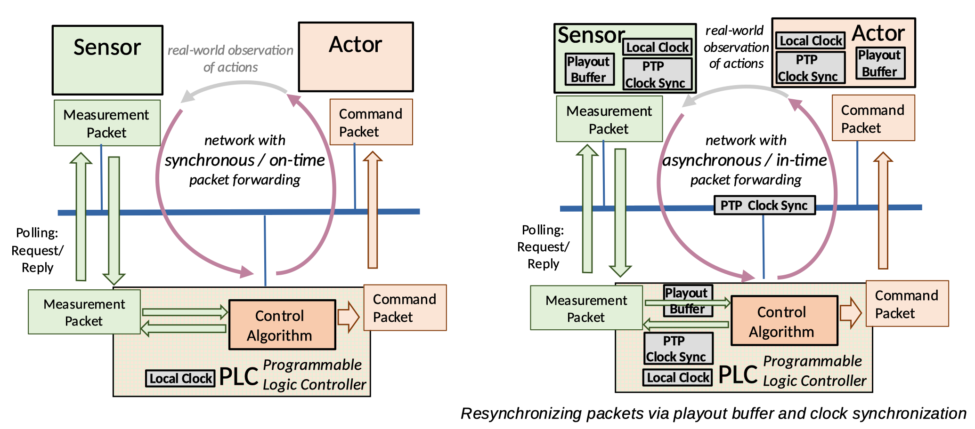
Benefits of on-time (synchronous)
(C) 2023, Springer, Journal of Network and Systems Management, 31, Article number: 34 (2023)

Slide 12
Why gLBF instead of UBS/RFC2212 2. On-time is most often better than in-time
Reduced need for clock synchronization
On-time allows lightweight devices to operate without clock synchronization – because they do not need playout buffering. This simplifies applications / control-loops
Can eliminate need for network to provide “clock synchronization as a service” to applications
No need for network size dependent playout buffering
Network takes care of buffering. Applications do not need to be designed with specific network size (playout buffer) in mind.
AFAIK: in-time services (guaranteed bouneded latency!) always requires shapers/interleavers (not a UBS specific issue!).
In large networks, this will be most cost/operations expensive.

Slide 13
Why not Damper with ANY queuing/scheduling ?
Benefits of using UBS

Slide 14
Standard system requirement
DetNet Controller-Plane
Calculate MAX through Queuing/Scheduling for each P router - for each flow
with only STANDARD information/
calculus (not vendor specific)
...
???
Queuing/Scheduling
proprietary Vendor 1
Queuing/Scheduling
proprietary Vendor 2
Queuing/Scheduling
proprietary Vendor 3
???
...
...
...
...
Policing
Ingres
Ede
Damper
Vendor1
Damper
Vendor 2
Per-flow
stateless
Forwarder
Per-flow
stateless
Forwarder
Receiver
e.g.
Flow k
Ingres
PE
P
P
P
Egress
PE

Slide 15
Why not Damper with ANY queuing/scheduling ?
We can not build a standardized control plane without picking a queuing/scheduling with standardized, public validated calculus.
We can not know whether Damper + “Some Queuing/Scheduling” can be implemented at high-speed/low-cost.
UBS is the most simple calculus (easier than RFC2212) with well vetted calculus
But yet extremely flexible to manage latency for each flow.
Using UBS allows to reuse / share much of controller plane that may be built for TSN-ATS
Includes complex network-wide bandwidth+latency path + queue(priority) selection algorithms
Which may use backtracking or Deep Learning.
Should even be of interest to small-scale networks (replacing UBS)
With minimal overall design changes.

Slide 16
Positioning

Slide 17
Positioning
Proposed as 2nd gen solution after TCQF/CSQF
These methods already provide on-time, stateless forwarding And have high-speed, low-cost large-scale network validation.
gLBF Adds more flexibility (UBS calculus instead of fixed cycles) and elimination of per-hop clock-synchronization
TCQF / CSQF solutions / deployment should be able to easily evolve / migrate into gLBF
E.g.: configure gLBF buffers to be same size on each hop: ~= TCQF !
Why longer term ?
gLBF requires new network packet header metadata (delay value)
TCQF (TC, DSCP) and CSQF (SRH) work with existing headers! Faster to adopt!
gLBF has no high-speed implementation, wide-area deployment validation yet
But 2 high-speed algorithm implementation proposals we think can be done at “Low cost”.

Slide 18
Validation

Slide 19
Validation
Simulation with 2 hops (minimum setup) to prove that without Damper (or Shaper), we can not calculate the bounded latency
Flows will exceed their calculated latency
With Damper inserted, flows again will be forwarded within calculated maximum queuing latency (in Router4 FIFO).
Router 1
X3, Y2, Y3: Measure per-flow/per-packet
leaky bucket, buffer and latencies
Flow1
Flow2
X1
FIFO
X3
Flow3
Link L1
30 Mbps
(gLBF) Router 4
Flow4
Router 2
only for gLBF test
Flow5
X1
FIFO
X3
Flow3, Flow6, Flow7
Flow6
Link L2
30 Mbps
Y1
gLBF delay (PIFO)
Y2
FIFO
Y3
Link L4
30 Mbps
Flow7
Router 3
Flow8
X1
FIFO
X3
Do not care: Flow1, Flow2, Flow4,Flow5,
Flow8, Flow9 sent to other interfaces
Flow9
Link L3
30 Mbps
Image (C) from 2020 IEEE/IFIP Network Operations and Management Symposium (NOMS 2020)

Slide 20
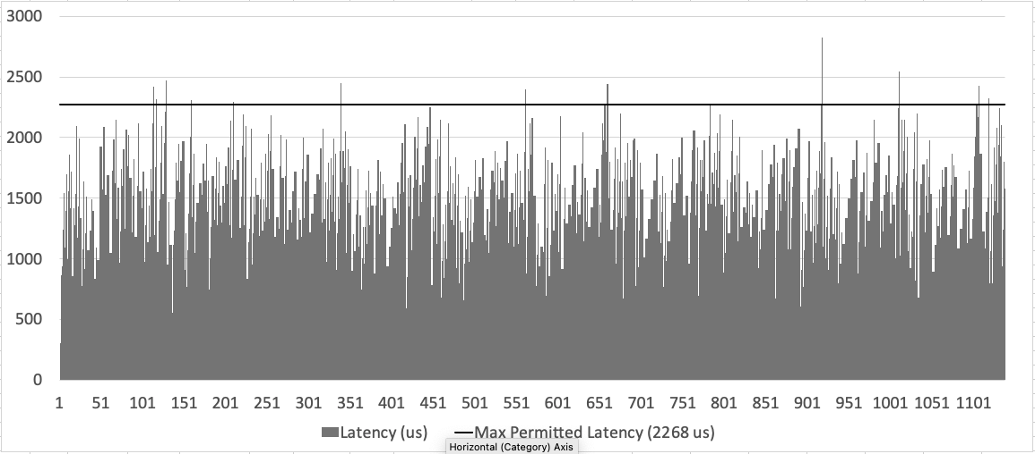
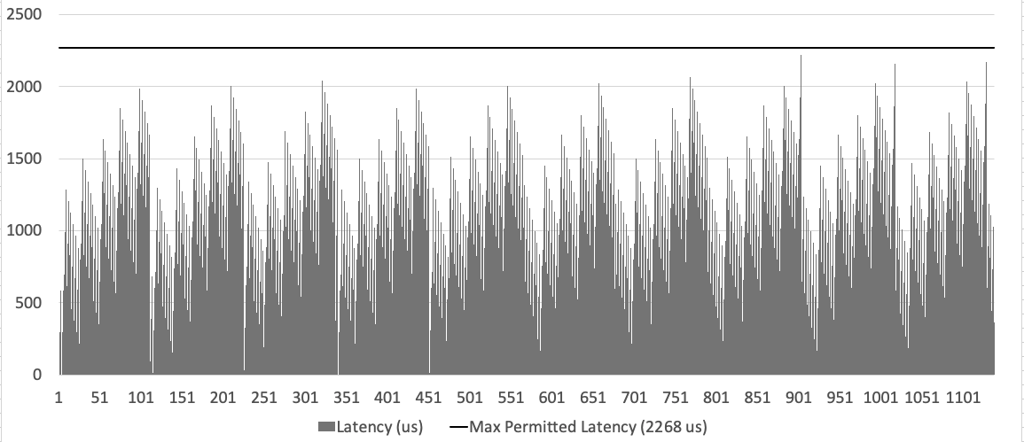
Validation
Latency of packets of
one of the 9 flows
across Router 4
FIFO queue.
Upper picture: no
Damper, some packets
exceed bounded latency
Lower picture: Damper
added, all packets
stay within calculated
limit.
Images (C) 2023, Springer, Journal of Network and Systems Management, 31, Article number: 34 (2023)

Slide 21
Questions ?

Slide 22
Backup Slides

Slide 23
gLBF model: metadata, forwarding, state
Measured time
Calculated time
Packet Metadata
P(rio): end-to-end or per-hop (eg:SIDs)
D(elay) [nsec]
Per-OIF state:
Prio 1: MAX1[1]
Prio 2: MAX1[2]
...
Prio 8: MAX1[8]
Forward
Measureand
Dampen
Prio 1 FIFO
Measure
and
Mark
IIF
OIF
Deserializing
Prio 2 FIFO
Strict Priority
Queueing
Sserializing
...
Prio 8 FIFO
T2
Tref1
T
Tref2
Td
<= MAX1[packet.P]
Tref1 = T - packet.psize[bits] / IIF.speed [bps]
Td = Tref1 + packet.D
Tref2 = T2 + packet.psize[bits] / OIF.speed [bps]
packet.D = MAX1[packet.P] - (Tref2 - Td)
Assumes forward step to have no relevant time variation to allow T measurement to be taken after it (egres linecard). If relevant, move T before forward and include in calculations.
Calculating Td instead of measuring it means Dampen and Queuing/Scheduling can be single-staged in implementation.

