Slide 1
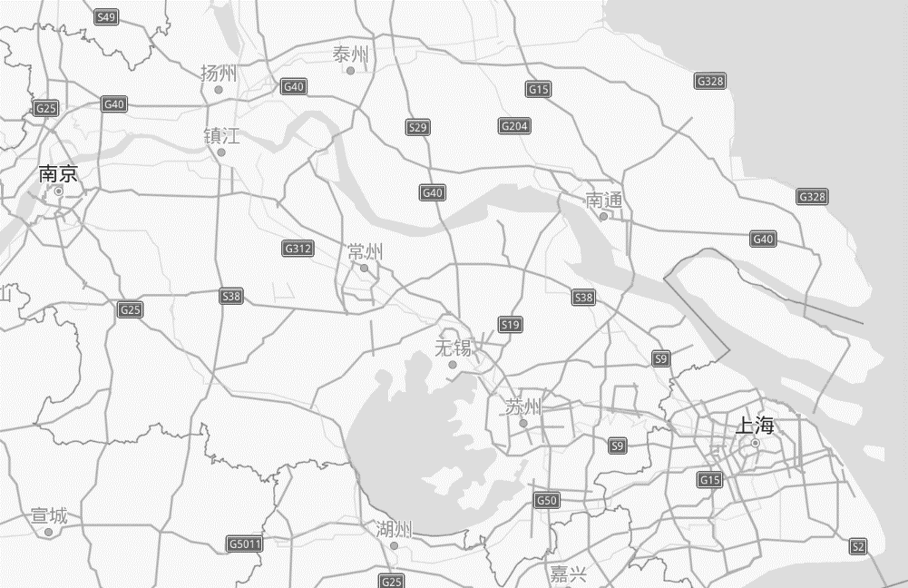
CENI TCQF (“DIP”) Testbed 2020
Taizhou
1200km Geo Distance
10Gbps Fiber
Equipment Room in NanJing
Shanghai
Yangzhou
DIP
Router
back
Transit
NanJing
Taizhou
DIP
Router
Beginning
Yangzhou
Test Engine
Shanghai
Target Flow：1Packet/10μs & pktsize is 1500B
Interference flow：128Packets/1ms & pktsize is 1500B

Slide 2
DIP test result of the Beijing-Nanjing 1k+ km loopback network
The number of interference flows | End-to-End delay of Non-DIP (μs) |  |  |  | End-to-End delay of DIP (μs)
 | Min | Ava | Max | Max Jitter | Min | Ava | Max | Max Jitter
1 | 27142 | 27146 | 27196 | 54 | 27176 | 27195 | 27205 | 29
2 | 27142 | 27152 | 27513 | 371 | 27176 | 27195 | 27205 | 29
3 | 27142 | 27162 | 27831 | 689 | 27176 | 27195 | 27205 | 29
4 | 27142 | 27211 | 28148 | 1006 | 27176 | 27195 | 27205 | 29
5 | 27142 | 27269 | 28466 | 1324 | 27176 | 27195 | 27205 | 29
6 | 27142 | 27338 | 28784 | 1641 | 27176 | 27195 | 27205 | 29
7 | 27143 | 27338 | 29102 | 1959 | 27176 | 27195 | 27205 | 29
8 | 27143 | 27444 | 29322 | 2179 | 27176 | 27195 | 27205 | 29
9 | 27143 | 27601 | 29545 | 2402 | 27176 | 27195 | 27205 | 29
10 | 27143 | 27713 | 29766 | 2623 | 27176 | 27195 | 27205 | 29
11 | 27143 | 27827 | 29989 | 2846 | 27176 | 27195 | 27205 | 29

