Slide 1
Cyclic Queuing and Forwarding for DetNet IP and MPLS Data Plane (TCQF)
...and BIER-TE... draft-eckert-detnet-tcqf-02
Toerless Eckert, Futurewei USA (tte@cs.fau.de)
Stewart Bryant, University of Surrey ICS (s.bryant@surrey.ac.uk)
Andy Malis (agmalis@gmail.com)
Guangpeng Li <liguangpeng@huawei.com>
IETF DETNET WG, IETF116, 03/30/2023, rev 1.0

Slide 2
Changes from -01 (IETF115)
Review David Black (after DetNetWG meeting)
Concern about pseudocode/explanation to be implying stricter than necessary forwarding rules
Pseudocode showed strict arrival time based serialization on output FIFO – First in on input, First out on output cycle buffer
What do we want ?
TCQF itself would work perfectly work well with packets within single cycle buffer be arbitrarily reordered.
BUT: Any end-to-end flow with more than one packet within a cycle could experience packet reordering if we did this
Revision -02:
Conservative approach: specify that we maintain order fom

Slide 3
Changes from -01 (IETF115)
Conservative approach: specify that we maintain order between packets arriving from the same input interace and going to the same output interface / cycle
while(1) {
ingress_flow_2_tcqf(oif,cycle) // [5]
wait_until(tnow >= nextcyclestart); // wait until next cycle
nextcyclestart += tcqf.cycle_time
forall(iif) {
forall(pak = tcqf_dequeue(oif.cycleq[cycle,iif]) {
schedule to send pak on oif before nextcyclestart; // [4]
}
}
cycle = (cycle + 1) mod tcqf.cycles + 1
}
Additional explanatory text to reconfirm that “schedule to send” can be arbitrary time within the cycle, but that order of dequeuing needs to be maintained.
Any better way to describe this ?

Slide 4
Changes from -01 (IETF115)
Feedback from Lou Berger
Added section “controller plane considerations”
TCQF applicable with centralized control plane (AC / PCE)
Simple AC policy (as outlined in ingres shaper): max number bits/flow in each cycle.
More complex option (no spec for ingres shaper): allocate bits in fewer than ever cycle for flow (e.g.: could use gates as from TSN).
TCQF applicable to distributed controller plane
Aka: RSVP(-TE) on-path/per flow admission conrtrol
Simple to make work with 1., not clear if/how to do 2.
Will eliminate per-flow-stateless benefit in control-plane But maintains per-flow-statelessness in high-speed HW-forwarding-plane!

Slide 5
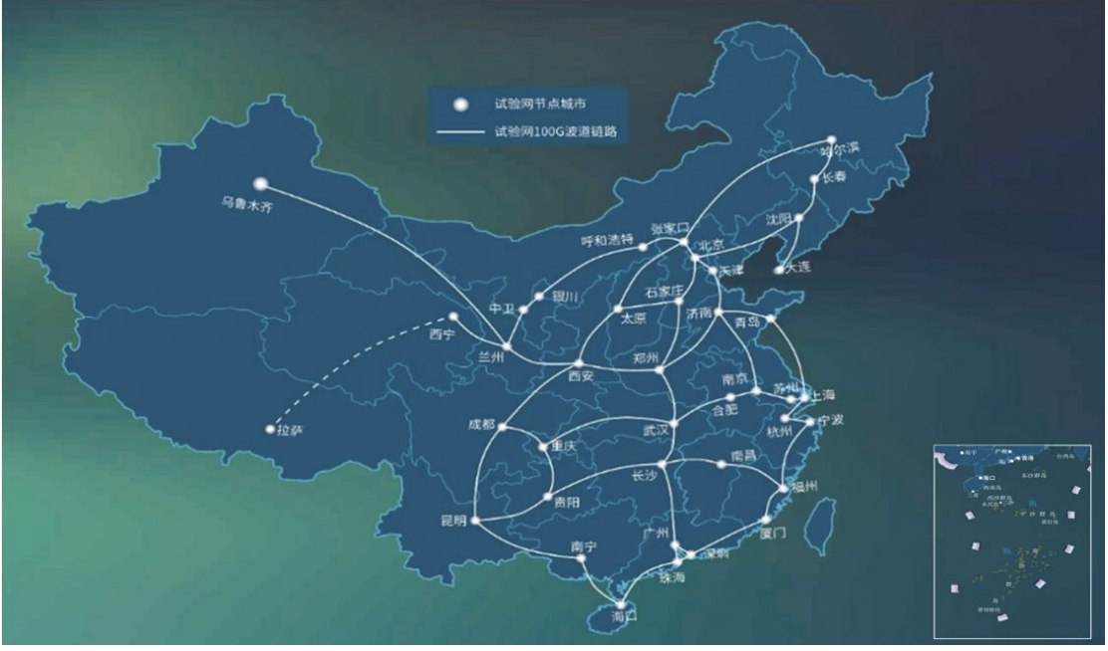
Changes from -01 (IETF115)
Added reference/summary to CENI validation in 2020
Validation report alas chinese language
CENI: Chinese research network
Across mayor chinese cities
Used 100Gbps interfaces prototype WAN routers with TCQF (“DIP2”) in FPGA

Slide 6
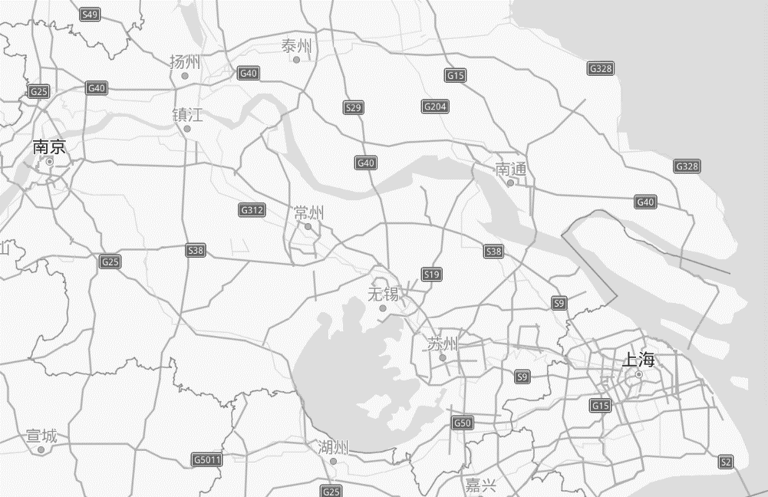


CENI TCQF (“DIP”) Testbed 2020
Taizhou
1200km Geo Distance
10Gbps Fiber
Equipment Room in NanJing
Shanghai
Yangzhou
DIP
Router
Transit
back
NanJing
Taizhou
DIP
Router
Beginning
Yangzhou
Test Engine
Target Flow：1Packet/10μs & pktsize is 1500B
Interference flow：128Packets/1ms & pktsize is 1500B
Shanghai
Target Flow：1Packet/10μs & pktsize is 1500B
Interference flow：128Packets/1ms & pktsize is 1500B

Slide 7
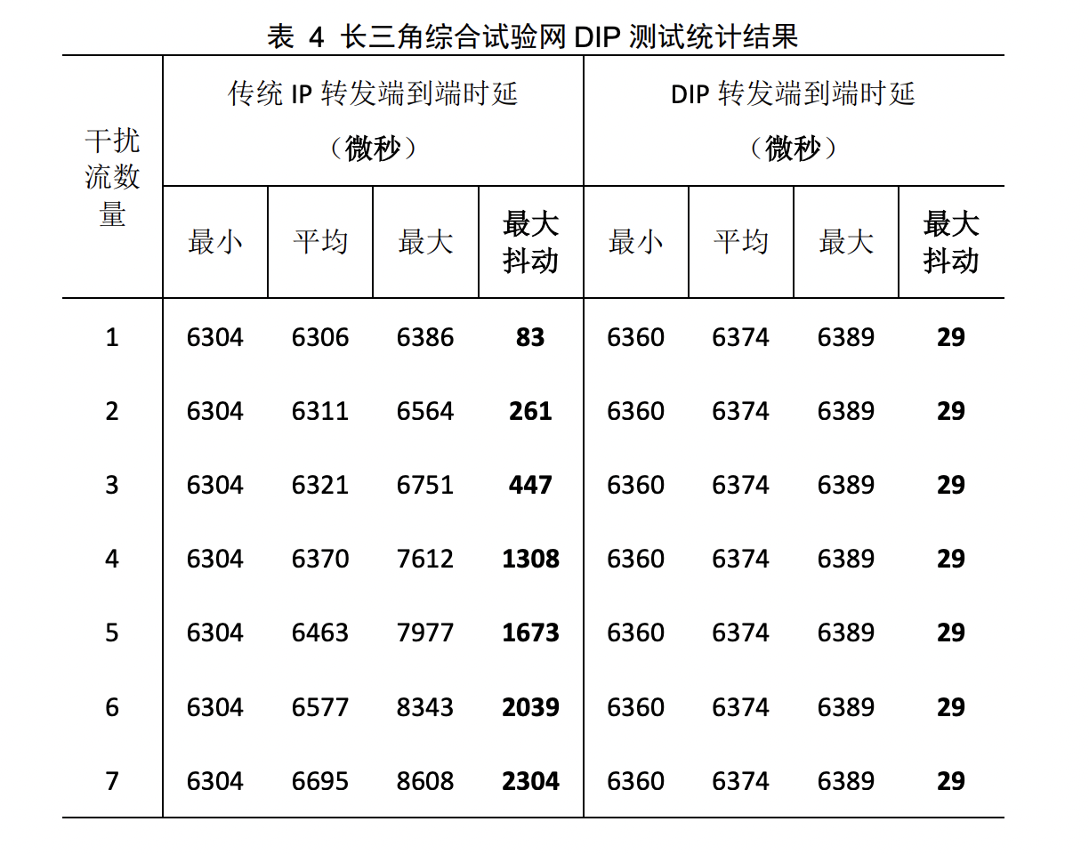
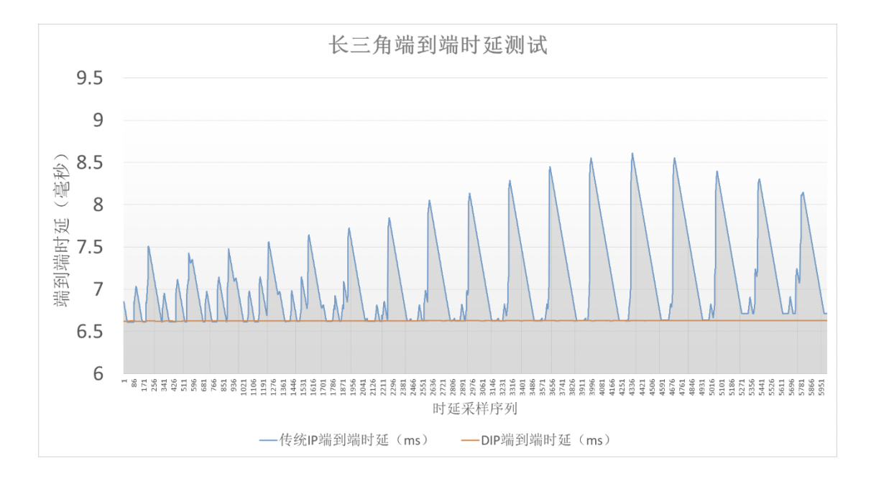
CENI TCQF (“DIP”) Testbed 2020

