Slide 1
IPv6 Options for Cyclic Queuing and Forwarding Variants draft-yizhou-detnet-ipv6-options-for-cqf-variant-00
Yizhou Li (Presenter)
Shoushou Ren
Guangpeng Li
Fan Yang
Jeong-dong Ryoo
Peng Liu
July, 2022

Slide 2
Fundamental CQF has attractive “simplicity” features for wider deployments
Holding time at src: DT - Tc
2-buffer per port. Input and output swap once every cycle interval Tc.
E2e time taken:
Min: (h-1) Tc +DT*
Max: (h+1) Tc
(*): DT = dead time (revisit later). very small in fundamental CQF
Attractive “simplicity” features:
Simple calculable latency bound: only relevant to Tc and h, ≈ h*Tc
Simple maintenance: no per-stream per-hop state maintenance
sink
Cycle 0
sink
Cycle 1
……….
sink
Cycle h-1
sink
Cycle h
hop 1
hop h
Rx time after cycle h-1:
0 - Tc

Slide 3
CQF has potentials for wider deployments - 1
Wider deployment requires supporting one or combination of the followings:
Smaller e2e latency bound (1)
Larger number of hops (2)
Longer links (3)
Larger processing time variance as node type diversity increases (4)
Recall that CQF latency bound ≈ h*Tc
Higher speed link provides the potential to reduce Tc, even with greater value of h
allow at least one 1500B/max size packet to be sent within Tc
With increasing of link speed, the same amount of data can be transmitted within a smaller cycle time
Counteract larger h
Potentials for item (1) and (2), next page for item (3) & (4)
Cycle Time (μs) | Buffer Size per Cycle (Byte)
 | Link bandwidth
 | 100Mbps | 1Gbps | 10Gbps
1 | 12.5 | 125 | 1250
1.2 | 15 | 150 | 1500
2 | 25 | 250 | 2500
4 | 50 | 500 | 5000
10 | 125 | 1250 | 12500
12 | 150 | 1500 | 15000
120 | 1500 | 15000 | 150000
Cycle time decreasing:
100x μs -> 10x μs -> few μs

Slide 4
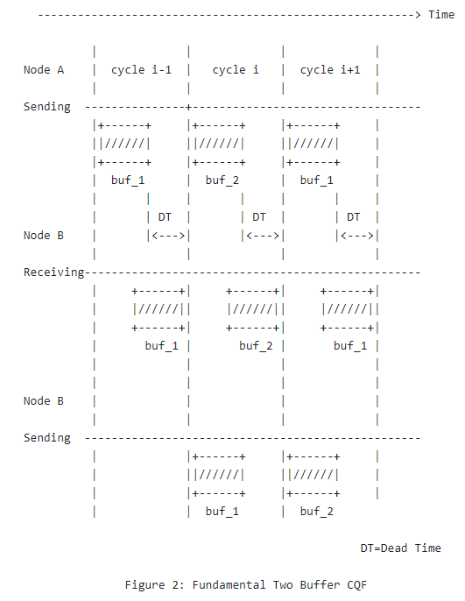
Fundamental CQF support req (3) &(4) but with low utilization
Revisit DT (dead time): the last byte sent by node A in cycle (i-1) has to be ready for sending at node B before the start of cycle i.
DT is at least: max propagation delay + max processing delay at the next node + max other time variations.
The longer the propagation or processing delay, the larger the DT.
DT eats up cycle interval Tc when Tc is small (both values < 1ms): result in low utilization or impractical in extreme case (consider prop delay > Tc)
Hard for fundamental CQF:
Shorter Tc for lower e2e latency bound
Larger DT for longer link and/or processing time
Smaller ratio of DT/Tc for better utilization

Slide 5
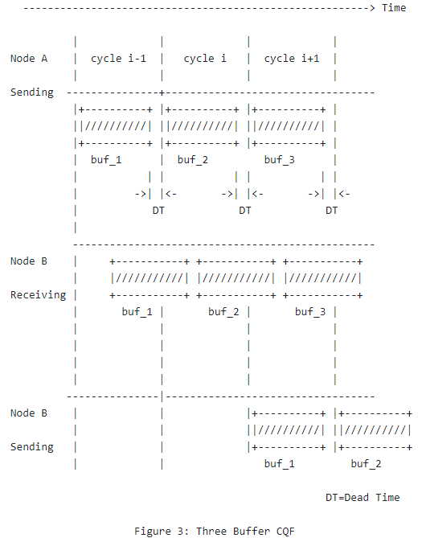
CQF Variant (>2 buffer) has the potential to support (3) & (4)
3 buffer works in rotation manner
A straightforward variant to fundamental 2-buffer CQF:
Configuration is similar
Can easily deduce from fundamental CQF without the rigid requirement to produce new standard
More than 3 buffer is required when the receiving time spans over two cycle interval boundaries.
In general, it is feasible.

Slide 6
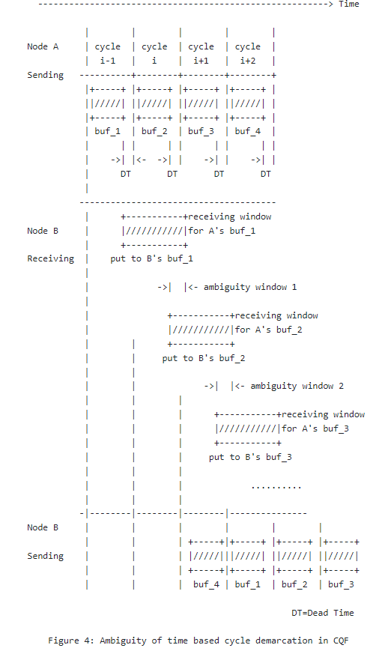
A closer look at the CQF variant: a time ambiguity window exists
Receiving time window swells when the (processing) time variance increases
Keep DT small
Time ambiguity window exists for two consecutive cycles
The larger the time variance and/or the smaller the DT, the larger the ambiguity window
So setting the time demarcation to differentiate pkts from two consecutive cycles is impractical (see left)
Way out: pkt carry cycle id metadata at output to help the downstream node determine the correct buffer to put it in
×
Possibility 2
Possibility 1

Slide 7
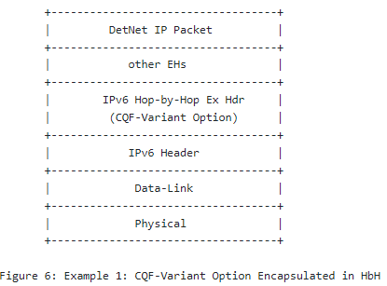
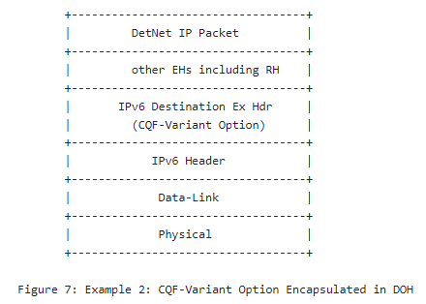
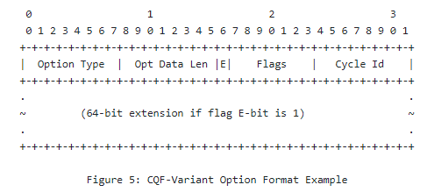
Summary
CQF has attractive features and potentials for wider deployments
CQF variant is a straightforward extension from fundamental CQF:
use more than two buffers
some extra configurations would be required
Other variants may exist
A missing part in current CQF variant: remove the ambiguity when identifying the packets from the upstream’s two consecutive cycles
IPv6 options to carry cycle id metadata is proposed.

Slide 8
Solicit feedback
Is it a good way to address the “ambiguity” issue in order to facilitate the increasing demand to use CQF and its variants in the wider scenarios?
IPv6 options, whether and/or how to collaborate with other WG (6man)

