Slide 1
Cyclic Queuing and Forwarding with tagging for Deterministic Forwarding draft-eckert-detnet-tcqf-02 draft-yizhou-detnet-ipv6-options-for-cqf-variant-01
Toerless Eckert, Futurewei USA (tte@cs.fau.de), Yizhou Li <liyizhou@huawei.com> Stewart Bryant, U. of Surrey ICS (s.bryant@surrey.ac.uk), Andy Malis (agmalis@gmail.com), Guangpeng Li <liguangpeng@huawei.com>, Shoushou Ren <renshoushou@huawei.com>, Guangpeng Li <liguangpeng@huawei.com>, Fan Yang <shirley.yangfan@huawei.com>, Jeong-dong Ryoo <ryoo@etri.re.kr>, Peng Liu <liupengyjy@chinamobile.com>
Interim meeting 04/2023, rev 0.6
https://github.com/toerless/detnet/blob/main/tcqf-slides.pptx

Slide 2
Agenda
Motivation (this is not vaporware): History / Context
From CQF to TCQF
Low Jitter
Scale
Packet encapsulations
Specification Outline

Slide 3
History / Context
What did we do for our proposal.

Slide 4
IETF side: Tagged Cyclic Queuing drafts
Historic drafts
2018 - 2019: draft-qiang-detnet-large-scale-detnet (00-05)
(Christina) Li Qiang, Xuesong Geng, Bingyang Liu, Toerless Eckert, Liang Geng, Guangpeng Li
2019: draft-chen-mpls-cqf-lsp-dp-00
Zhe Chen, (Christina) Li Qiang
2021: draft-dang-queuing-with-multiple-cyclic-buffers-00
Bingyang Liu, Joanna Dang
2021: draft-eckert-detnet-mpls-tc-tcqf
Toerless Eckert , Stewart Bryant , Andrew G. Malis , Guangpeng Li
Prior drafts all focussed on mechanism (only)
This attempt to write up all aspects considered to be required for standardization – and possible fastest adoption: Describe on-wire-behavior for MPLS (only) – matches best developed DetNet data plane. Then David Black cleared up confusion about DSCP...
Current drafts – intent to merge:
2022: draft-eckert-detnet-tcqf-02
From –mpls-tc-tcqf, added IP/DSCP encap (intradomain!).
2022: draft-yizhou-detnet-ipv6-options-for-cqf-variant
Yizhou Li, Shoushou Ren, Guangpeng Li, Fan Yang, Jeong-dong Ryoo, Peng Liu
Proposed / discusses IPv6 new header options – and more deteails of CQF->TCQF evolution to meet the scaling requirement

Slide 5
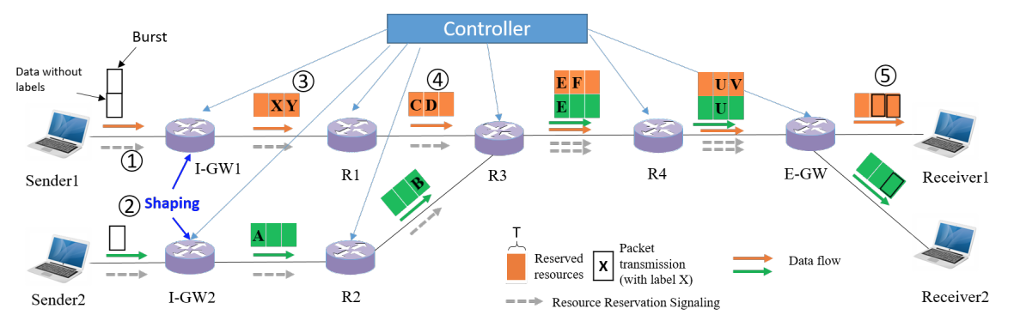
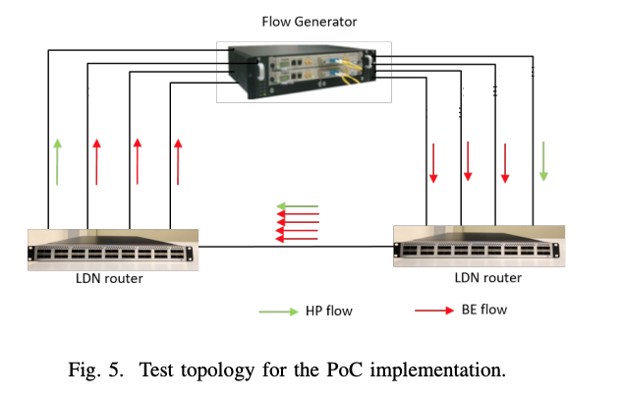
Development / Validation
Deterministic IP (DIP) “research” project
research ~= advanced PoC engineering
IFIP 2021 Networking Conference:
“Towards Large-Scale Deterministic IP Networks” †Bingyang Liu, †Shoushou Ren, †Chuang Wang, ∗Vincent Angilella,, Paolo Medagliani, ∗Sebastien Martin, ∗, Jeremie Leguay
https://dl.ifip.org/db/conf/networking/networking2021/1570696888.pdf
Two validation vehicles
High-speed PoC router implementation
Modified off-the-shelf metro-router 100Gbps Ethernets
Added FPGA for programmable queuing
Packet header processing (cycle-ID) by standard NPU
Omnet++ Simulation
Using published AS 1239 (Sprint) topology of 315 routers and 1944 links
Architecture (from paper)

Slide 6
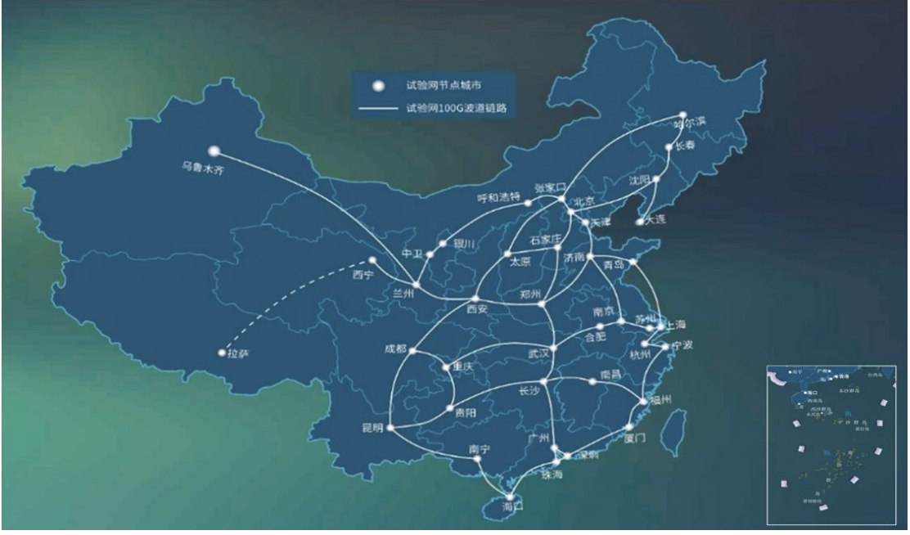
Large scale validation
2020: CENI: Research network across china
Connecting all mayor cities
Connected PoC routers to 100 Gbps fibers of network
And performed validation testing
Report:
https://ceni.org.cn/406.html

Slide 7
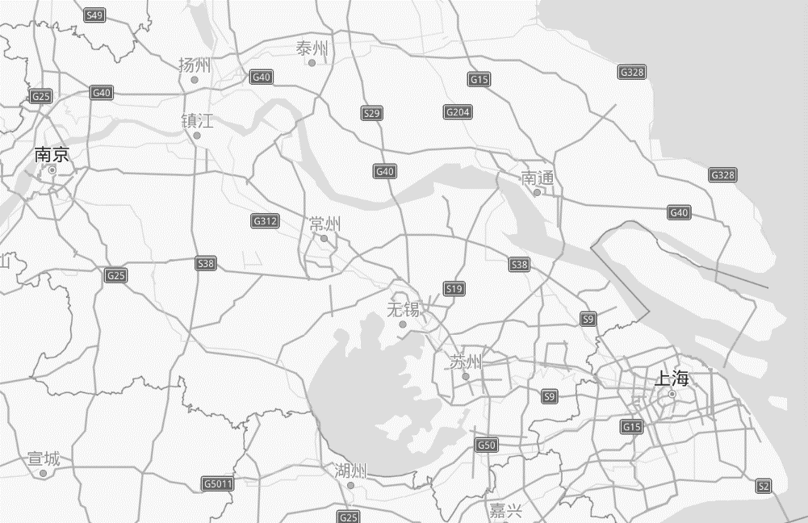


CENI DIP (tcqf) Testbed 2020 Example test case (NanJing region)
Taizhou
1200km Geo Distance
10Gbps Fiber
Equipment Room in NanJing
Shanghai
Yangzhou
DIP
Router
Transit
back
NanJing
Taizhou
DIP
Router
Beginning
Yangzhou
Test Engine
Target Flow：1Packet/10μs & pktsize is 1500B
Interference flow：128Packets/1ms & pktsize is 1500B
Shanghai
Target Flow：1Packet/10μs & pktsize is 1500B
Interference flow：128Packets/1ms & pktsize is 1500B

Slide 8
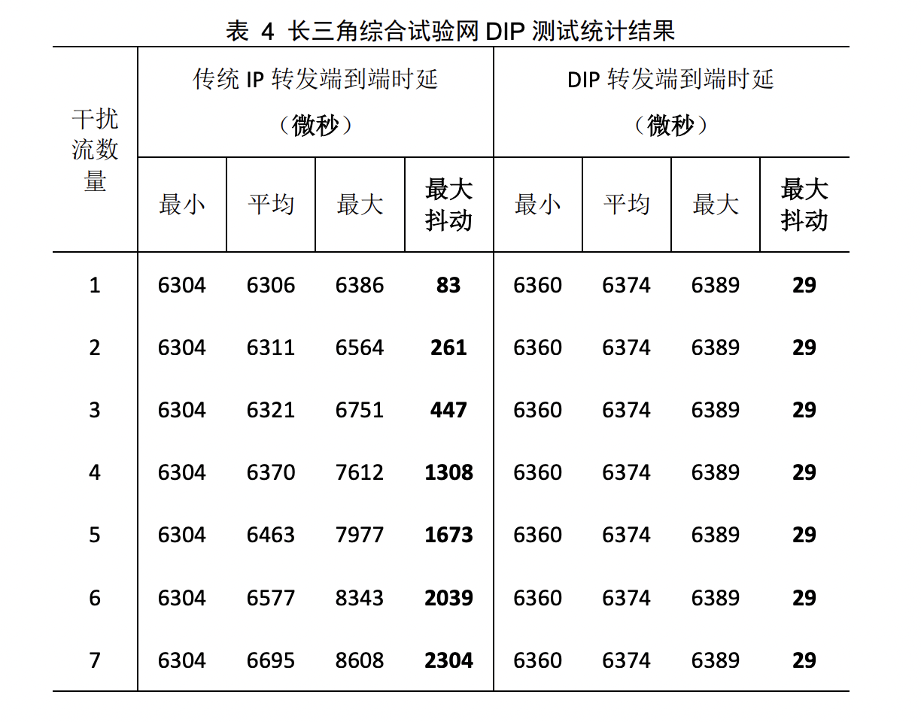
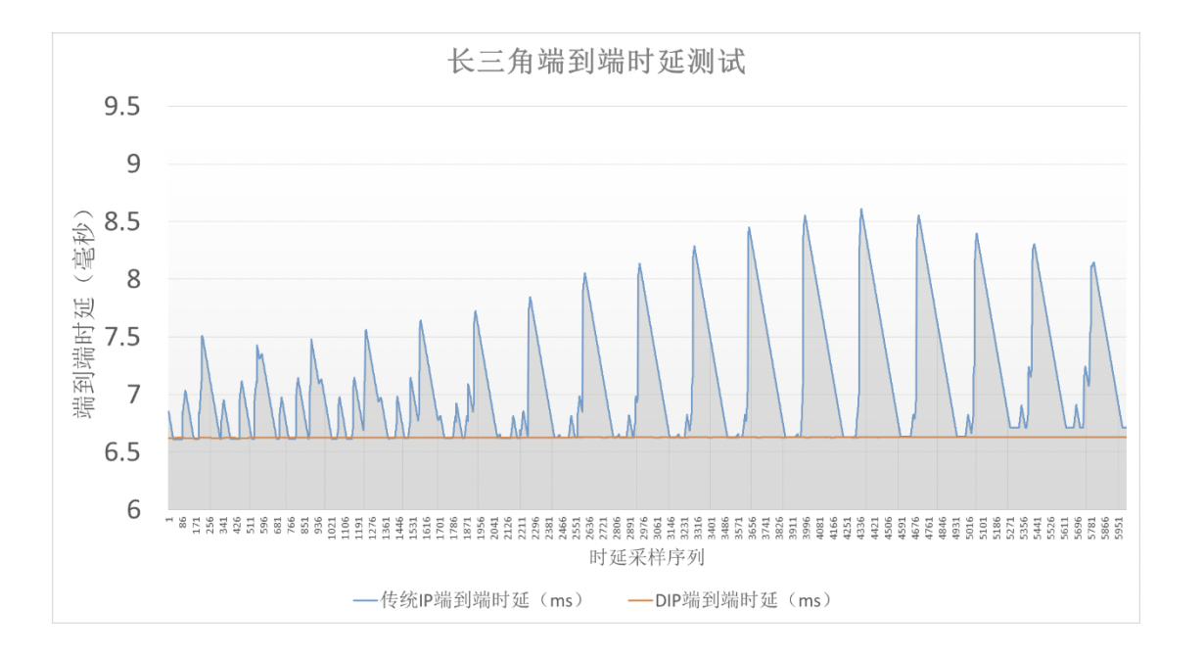
CENI TCQF (“DIP”) Testbed 2020

Slide 9
Summary
TCQF can be (easily) implemented at scale in existing type of wide-area network routers
TCQF has been validated through simulations and PoC implementations in wide-area (2000 Km paths) network deployment.
TCQF provides very low jitter (“on-time” forwarding)
We think this is core requirement for many core use-cases
TCQF can support any IETF network layer data-plane
Validation with IPv6
Drafts currently IP/IPv6/MPLS
SR – SRv6, SR-MPLS equally supportable
TBD: BIER (would require RFC8296 header enhancements)
IP/IPv6/MPLS could be supported short term without new packet headers
More on pro/cons of new headers later in slide deck

Slide 10
From CQF to TCQF
From draft-yizhou-detnet-ipv6-options-for-cqf-variant

Slide 11
CQF
Cyclic Queuing and Forwarding (CQF), IEEE802.1Qch
Part of IEEE Time Sensitive Networking (TSN) standards
Evolved from TSN Time Aware Shaper (TAS), IEEE802.1Qbv could be called a simple profile of TAS (which itself is quite complex)
At core of TAS/CQF are per-hop forwarding of packets based on their arrival time on each switch
This allows to operate TAS/CQF without TAS/CQF specific headers
TAS/CQF designed for <= LAN deployments
Intra-Car ... Manufacturing floor
Speed 100 Mbps, 1 Gbps (max 10 Gbps, but rarely used)

Slide 12
Fundamental CQF operations (2 buffer) Most simple bounded latency calculus, Low jitter
Holding time at src: DT - Tc
2-buffer per port. Input and output swap once every cycle interval Tc.
E2e latency across h hops:
Max: (h+1) Tc
Min: (h-1) Tc +DT*
(*): DT = dead time (revisit later). very small in fundamental CQF
Attractive “simplicity” features:
Simple calculable latency bound: only relevant to Tc and h, ≈ h*Tc
Simple maintenance: no per-stream per-hop state maintenance
sink
Cycle 0
sink
Cycle 1
……….
sink
Cycle h-1
sink
Cycle h
hop 1
hop h
Rx time after cycle h-1:
0 - Tc

Slide 13
Higher speed networks make basic CQF mechanism more attractive!
Wide-area network deployment requires supporting one or combination of the followings:
Smaller e2e queuing introduced latency bound
Potentially larger number of hops (seen e.g.: L3 mobile access rings - 15++ hops!)
Even manufacturing floor networks may have multiple hops for policy reasons...
Links with longer propagation latency (distance -> speed of light)
Larger in-node processing time variance (more complex/larger nodes)
CQF latency bound ≈ h * Tc
Higher speed link provides the potential to reduce Tc, even with larger h
allow at least one 1500B/max size packet to be sent within Tc
With increasing of link speed, the same amount of data can be transmitted within a smaller cycle time
Counteract larger h
Cycle Time (μs) | Buffer Size per Cycle (Byte)
 | Link bandwidth
 | 100Mbps | 1Gbps | 10Gbps | 100Gbps
1 | 12.5 | 125 | 1250 | 12500
1.2 | 15 | 150 | 1500 | 15000
2 | 25 | 250 | 2500 | 25000
4 | 50 | 500 | 5000 | 50000
10 | 125 | 1250 | 12500 | 125000
12 | 150 | 1500 | 15000 | 150000
120 | 1500 | 15000 | 150000 | 1500000
Cycle time decreasing:
100x μs -> 10x μs -> few μs

Slide 14
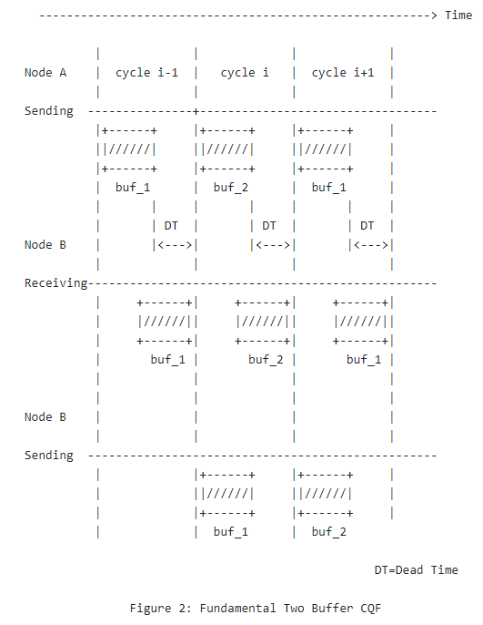
CQF Dead Time issue
Revisit DT (dead time): the last byte sent by node A in cycle (i-1) has to be ready for sending at node B before the start of cycle i.
DT is at least: max link propagation delay + max processing delay at the next node + max other time variations (e.g.: clock MTIE).
The longer the propagation or processing delay, the larger the DT.
The larger DT is in proportion to Tc, the lower the possible utilization
At DT >= Tc, throughput goes to zero!
Example for common 1Gbps CQF: LAN > 2 Km length => DT > Tc.
Dead Time issue makes CQF insufficient for large-scale:
, (2) Shorter Tc for lower e2e latency bound
(3), (4) Larger DT because of longer link and/or processing time
Need smaller ratio of DT/Tc for better utilization
Solution without Dead Time would be ideal! (100% utilization)

Slide 15
3 cycle operation
Sender
Node A
Cycle 1
Cycle 2
Cycle 3
Cycle 1
Sending times
of cycles on Node A
Cycle 1
Propagation latency
Cycle 1
Receiver
Node B
Cycle 1
Cycle 2
Cycle 3
Cycle 1
Sending times
of cycles on Node B
In example, A/Cycle-1 needs to get mapped into B/Cycle-3
Because while packets from A/Cycle-1 arrive, B sends from Cycle-1 and Cycle-2
This would work without packet header tag – as long as there is no jitter/variation whatsoever
Because we could exactly deduce from arrival time of packet when it was sent – and hence its cycle
This is one (non-adopted )proposal in IEEE-TSN (“multiple buffer CQF”)

Slide 16
Variations
Most important (our core reason!) ? Differences in synchronized clocks
Maximum Time Interval Error (MTIE)
If B thinks it is time T, then it is [T-MTIE...T+MTIE] at A
CQF at 1Gbps already requires sub usec MTIE so that variation due to MTIE does not impact performance
At 100Gbps, it would need to be 100 times better (impossible ?)
Differences in link/media propagation latency
Speed of light changes (great Sci-Fi movie!)
Length of link changes, e.g.: pole hanging copper (powerlines, cable) – up to 30..40% length between hottest/coldest times
Differences in processing latencies
Irrelevant ?
FEC / ARQ introduced variation (8 msec in DSL FEC – bad example, low-speed)
WiFi / Radio links – FEC / ARQ / interference / reflections / ... ? (TBD)
High-speed , complex forwarder , software forwarders
Buffering out variations in all these cases at lower processing layer could be more complex than solving variations through TCQF

Slide 17
Operation with Variations / Jitter
Sender
Node A
Cycle 1
Cycle 2
Cycle 3
Cycle 1
Sending times
of cycles on Node A
Cycle 1
Cycle 2
Propagation latency
and impact of variation
Cycle 1 1
Cycle 2
Receiver
Node B
Cycle 1
Cycle 2
Cycle 3
Cycle 1
Sending times
of cycles on Node B
When packets arrive at B, B can not determine from arrival time which Cycle the packet was sent from.
Jitter adds to the possible “length” (in time) of the received cycle data
Cycle
+ Variations/Jitter =
Cycle i
Cycle i+1

Slide 18
Impact of Variations for CQF (no tagging)
We can not simply “guess” the sending cycle / put packet into one of the cycle-buffers
Messes up admission-control / latency calculation / creates possible congestion.
We could use Dead Time concept
This quickly reduces possible throughput: With variations at 50% cycle-time, throughput is 0.
With tagging, we never need to reduce throughput
But: The higher the variations, the more cycles we need
Exact calculations currently not written into draft, but easy to add.
E.g.: variations < 50% cycle time -> 4 cycles suffice.

Slide 19
Summary
CQF has attractive features and potentials for Large-scale Deterministic Network deployments
Multi-buffer CQF is a straightforward extension from TSN CQF:
Easy to build (see PoC) with hardware that would also be required for CQF – but at higher speeds!
Cycle to Cycle mapping configuration based on link propagation latency
Number of cycles based on variations
Eliminate “reception time based” assignment of packets to cycle buffer!
Rely on metadata “cycle-id” in packet instead (“tag”)
Tag-switching: predecessor of MPLS (hop-by-hop rewritten packet header field).
Many different options how to do this across various forwarding planes.
Result:
Can support arbitrary links (propagation latency, latency-variation)
Can support lower clock-sync accuracy =~ higher-MTIE
Can support higher node propagation latency variations

Slide 20
Low Jitter

Slide 21
Jitter bounds – “In-time” vs. “On-time”
“In-time”
Packets with no
Queuing latency
(zero congestion)
Packets with max
Queuing latency
(max congestion)
“On-time”
In-network, every hop
Packet buffering hiding jitter From receiver
Queuing jitter
For an packets
Any congestion
0
0
Latency
Latency
path propagation latency
O(speed of light ,link serialization)
maximum path queuing jitter
min .. max queuing latency
path propagation latency
O(speed of light ,link serialization)
Close to zero path queuing jitter
min .. max queuing latency
“In-time” delivers packets as soon as possible.
Without traffic contention, no in-network per-hop queuing latency
IETF IntServ/Guaranteed Service, TSN-ATS, C-SCORE use this model
With maximum contending traffic, per-hop latency is maximum
Result: “In-time” creates worst-case jitter between no..max traffic load
On-time eliminates this jitter
Packet latency end-to-end always close to bounded latency
CQF, TCQF, “Damper” mechanisms provide this benefit
Othre mechanisms would require “playout buffer” on receiver / receiver edge.

Slide 22
Why we need low jitter
Application traffic profiles, e.g.: Industrial Internet Consortium (IIC) Time Sensitive Networks for Flexible Manufacturing Testbed https://www.iiconsortium.org/white-papers.htm
Isochronous, Cyclic, Audio-Video, (on-time), Alarm and Events (in-time), …
Media playout and most control loops want on-time
Media: Synchronous playout
If network is in-time, packets must be buffered in application and consumed at maximum guaranteed latency time
Playout buffer size requirement depend on network network size
Edge-router/receiver MUST be built against an assumed largest possible network ! Expensive war stories in industry how this can fail miserably
In-time also raises clock synchronization needs on devices
On-time delivered packets carry implicit timing information !
Dumb devices (actors) may not be able to support dejittering and/or accurate clock
Classical example: accurate PLC with periodic “polling” of dumb actors/sensor without accurate clock: on-time allows for isochronous operation.
In-time would require much more complex sensor/actor/control-loops
Command
effect
Actor
Sensor
Dejitter
Synchronize
Measurement
Packet
Command
Packet
Network
latency
and jitter
compensation
Measurement
Packet
Dejitter
Playout
Synchronize
Buffer
PLL
Phase Locked Loop
compute
Command
Packet
Programmable
Logic Controller
PLC

Slide 23
Summary
We need low-jitter “on-time” network services to support possible large number of “no-clock-sync” devices on network (sensors, small actors) for “Distributed IoT” use-cases.
Per-hop “on-time” mechanism (TCQF, Dampers) are solution to avoid problem of playout buffer scaling on edge-router hardware.
In Metro-area-Ring networks, every node is can be an edge-node – so all nodes require clock-sync anyhow (with e.g.: TSN-ATS)!
Aka: TCQF in our opinion is the most easy to build and scale mechanism near-term to support bounded latency and on-time jitter.

Slide 24
Scalability

Slide 25
Current DetNet model: per-flow,per-hop stateful also TSN-ATS, RFC2211
Network resource Database
Per-link/hop, per-queue free space
link free bandwidth
Per-flow, per-hop Database
Flow k: $$\hat{r}$$_{k}/ $$\hat{b}$$_{k} , {Q_{i} }
Controller
Plane
Flow k requirements
$$\hat{r}$$_{k}/ $$\hat{b}$$_{k}
End-to-end
Min..max latency
(Calculate path
or use shortest path
(slide does not show path steering)
<=>
Calculate best queue for each hop to meet min..max latency
Flow fits ?
Admit
else reject
Install flow k params on every hops per-flow state table
(1) Look up Flow k |  | Steer Flow | (2) Shaper param / state vars |  |  |  | (3)
L2 (TSN) or L3 (DetNet) Flow Key | Flow# k | Next Hop | $$\hat{r}$$_{k} | $$\hat{b}$$_{k} | time stamp | level | Queue
(S1,D1,Sport1, Dport1, Prot1) | 1 | … | … | … | … | … | 5
(S2,D2,Sport2, Dport2, Prot2) | 2 | … | … | … | … | … | 3
 | … | …
(S50k,D50k,Sport50k, Dport50k, Prot50k) | 50,000 | ... | … | … | … | … | 1
Per-flow state table
(4)
Strict tPrio Q
Max
delay
Per Hop Behavior
In Forwarding Plane
all on egress
(1)
Look
Up
Flow k
(2)
Shape
to
$$\hat{r}$$_{k}/ $$\hat{b}$$_{k}
(3)
Select
Prio Q
for k
PRIO1
1 msec
PRIO2
…
2 msec
PRIO8
8 msec
Flow
REQUEST
ACK/
NAK
Sender
e.g.
Flow k
IntServ/
TSN-ATS
Edge
IntServ/
TSN-ATS
Forwarder
IntServ/
TSN-ATS
Forwarder
IntServ/
TSN-ATS
Forwarder
IntServ/
TSN-ATS
Forwarder
Receiver
e.g.
Flow k
Ingres
PE
P
P
P
Egress
PE

Slide 26
O(N^{^2}) issue
Realistic reference worst case scenario in large-scale DetNet
Assume we aggregate all DetNet traffic from one ingres iPEj to one egres ePEk into one aggregate DetNet flow.
Most edge-aggregation we can do
j=1...100, k=1...100
Total # flows: j * k = 100 * 100 = 10,000
These flows may all go through one (core PE) interface
oif1 (output interface 1) on P1 in example network
RFC2211 (IntServ): per-flow shaping for 10,000 flows
IEEE ATS (Async Traffic Shape): interleaved regulators for 10,000 flows
Every time rate and/or burst-size of any of these 10,000 flows changes (because one of its member flow changes):
Both IntServ and ATS require signaling of new flow parameters to all routers affected (P1, P2, ...) – (limited optimizations possible).
TCQF: 3 ... 5 cyclic queues on P1 oif1.
No changes in any P router configuration when member flows change!
...
iPE1
iPE100
...
P1 rtr
oif1
P2 rtr
...
...
ePE1
ePE100

Slide 27
Desirable DetNet QoS option
Network resource Database
Per-link/hop, per-queue free space
link free bandwidth
Per-flow, per-hop Database
Flow k: $$\hat{r}$$_{k}/ $$\hat{b}$$_{k} , {Q_{i} }
Controller
Flow k requirements
$$\hat{r}$$_{k}/ $$\hat{b}$$_{k}
End-to-end
Min..max latency
(Calculate path
or use shortest path
(slide does not show path steering)
<=>
Calculate best queue for each hop to meet min..max latency
Flow fits ?
Admit
else reject
Install flow k params on every hops per-flow state table
DiffServ only, per-class QoS
Flow
REQUEST
ACK/
NAK
Sender
e.g.
Flow k
Ede-Gate
DiffServ
Flow- stateless
DiffServ
Flow- stateless
DiffServ
Flow- stateless
DiffServ
Flow- stateless
Receiver
e.g.
Flow k
Ingres
PE
P
P
P
Egress
PE

Slide 28
Summary
Metro and larger network operators do not want per-flow, per-hop state on P routers
Operational nightmare It is why Segment Routing (MPLS IPv6) and BIER (multicast) where created
Control plane performance, reliability, scale challenge (updates to each P router)
DetNet solutions need to support all those stateless forwarding “traffic-steering” options
This is not new:
RFC2212 was never adopted in SP-networks, but quickly superseeded by DiffServ hop-by-hop
But the faster the network, the more hardware challenges per-hop, per-flow has:
High-speed routers may not be abble to cheaply implement large number of packet-flow-lookup,data-read/write cycles
Need to decouple P-router state from applications
Can not have P-router state changes (such as aggregated flow-state) when new applications start sending DetNet traffic.
Only operator provisioned services currently have this (e.g.: with RSVP-TE), IP Multicast allowed applications to automatically do this – big security/reliability issue
But we should want to support automatically self-deployment applications (without ccomplex provisioning steps across core!).

Slide 29
Packet encapsulations

Slide 30
Encapsulation considerations
Short-term attractive (to simplify initial adoption/deployments):
No packet header changes necessary:
Cycle-ID can go into DSCP (IP/IPv6) or MPLS TC (Traffic Class) fields
Single-domain use: RFC2474, section 6: 16 private DSCP
Would need at minimum 3 cycle-ID could have up to 16.
Only advanced bounded latency forwarding option for DetNet with this benefit ?!
Long-term better:
Define packet header that explicitly considers Cycle-ID
Customers do not like to “overload DSCP” - (“legacy mechanism”, difficult to manage), and TC is quite limited.
We should be able to support for packets at least the following:
Queuing (TCQF): cycle-ID (and possible extensions)
Timestamp (sender) may be desired too
PREOF (flow-id, sequence-number)
Steering: If not using source-routing (e.g.: SRH), then some type of “aggregate-ID” packet header filed on which steering policy can be configured
Can we / should we have multiple extension headers ?
Or combine all required DetNet functions into single header ?

Slide 31
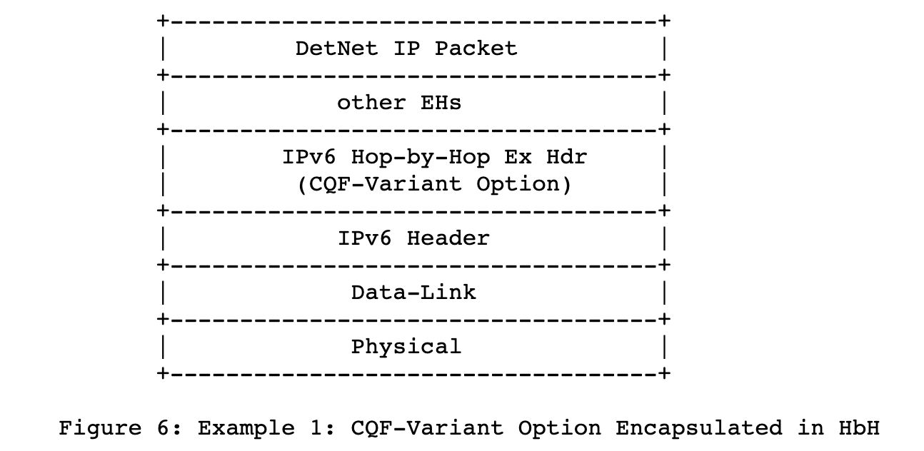
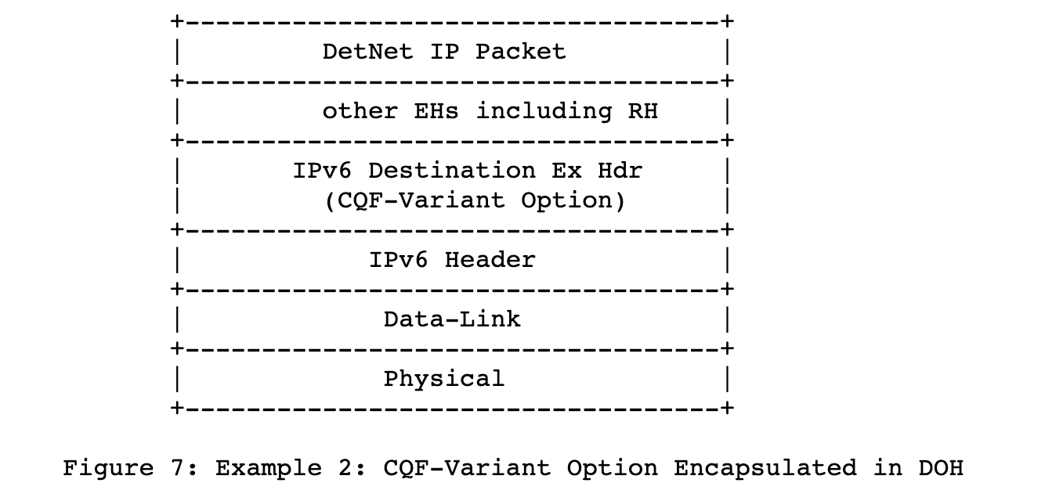
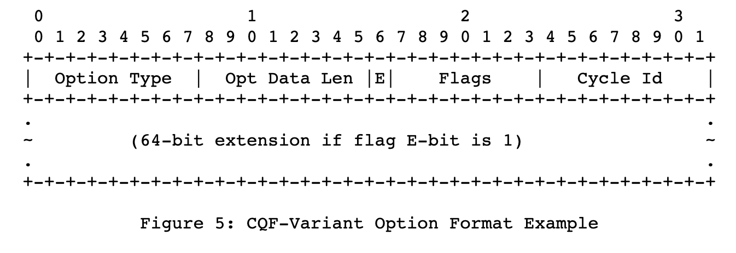
Encapsulation options from from draft-yizhou-detnet-ipv6-options-for-cqf-variant
Discussion with 6MAN WG:
What type of IPv6 extension header to use – HbH or DoH
Traditionally DoH would be incorrect
Because every router would need to inspect/modify header (Cycle-ID)
But DoH would likely allow to pass through un-supporting routers easier...
DetNet ?! Discussion
What fields to have in packet header
Example / simple proposal from draft: Cycle-ID + extensions
Other options discussed in draft.
Should also add fields for PREOF...

Slide 32
Specification outline
What do we (want / should must ?) specify

Slide 33
Specification outline (current target)
Section 1: Overview, motivation, background
Section 2: How TCQF fits into DetNet architecture
But maybe we need architecture extension (P/PE distinguishing) independent of the specification of the mechanism
Section 3: P Mechanism specification – forwarding plane independent
Per-hop configuration model (cycle mapping establishment)
Per-hop (P node) packet processing spec (output queue and cycle ID determination)
Textual and pseudocode
Section 4: Ingress (PE node) per-flow packet processing spec – forwarding plane independent
Configuration model, forwarding specification, initial queue and cycle ID determination: textual and pseudocode
Section 5:
Per-encapsulation specifications (header rewrite and other considertions – pseudocode, text):
IP/IPv6 DSCP
MPLS TC
Proposed IPv6 extension header - “Deterministic IP” (DIP) extension header ?!

Slide 34
Specification outline (current target)
Section 6: Further considerations
High-speed implementation optimizations on ingress
Computation of cycle-mapping at controller with link latency, different cycle-clock-offsets
Support of TCQF across links with different bandwidth controller plane issue!
Controller plane consideration applicability to centralized vs. Decentralized controller plane
References
Validation references,...
DO WE NEED THIS ALL ? IS THIS ALL WE NEED ????
Maybe we should discuss/know this for all proposals ???

Slide 35
Backup / Old slides

Slide 36
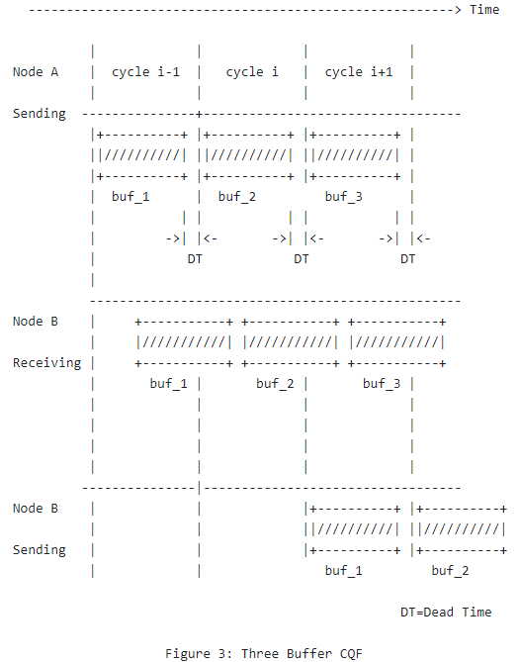
CQF with more than 2 buffers (“CQF Variant”) has the potential to support (3) & (4)
3 buffer works in rotation manner
A straightforward variant to fundamental 2-buffer CQF:
Configuration is similar
Can easily deduce from fundamental CQF without the rigid requirement to produce new standard
More than 3 buffer is required when the receiving time spans over two cycle interval boundaries.
In general, it is feasible.

Slide 37
Old slide 1
(from prior presentation)
3 Cycles always suffice as long as variations are negligible
4 Cycles sufficient with limited variations
Node 1 (sender)
Node 1 (sender)
cycle 1
cycle 2
cycle 3
cycle 1
cycle 1
cycle 2
cycle 3
cycle 4
Link propagation latency
Link propagation latency with variation,
e.g.: Clock drift (MTIE)
Node 2 (“receiver”)
Node 2 (“receiver”)
cycle 1 buffer
sending
sending
cycle 1 buffer
sending
sending
cycle 2 buffer
sending
sending
cycle 2 buffer
sending
sending
cycle 3 buffer
sending
sending
cycle 3 buffer
sending
cycle 2
cycle 3
cycle 1
cycle 2
cycle 4 buffer
sending
Outgoing interface
cycle 3
cycle 4
cycle 1
cycle 1

Slide 38
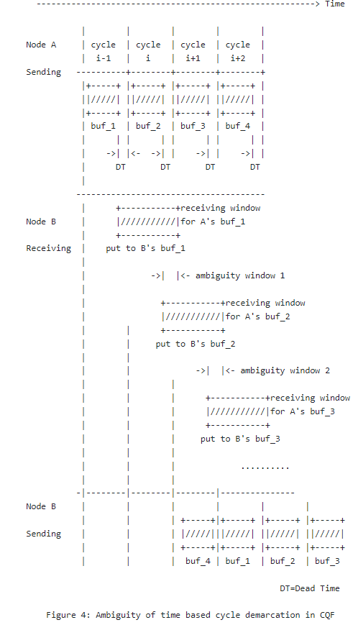
Old slide 2 (from prior presentation)
Time ambiguity window exists for two consecutive cycles – from different sources
Node processing delay variation
Link propagation latency variation (FEC, link retransmissions, temperature elongation,...)
Clock sync MTIE (Maximum Time Interval Error)
MTIE ~= clock sync accuracy Clock sync accuracy requirements increase the smaller TC and DT become:
1... 100 Gbps: 100x more accurate PTP clock
100x Cost factor ?! (not quite but important to watch)
Conclusion: Relying on reception time to decide on reception buffer is impractical for large-scale deployments
Way out: pkt carry cycle id metadata at output to help the downstream node determine the correct cycle buffer for the paket
×
Possibility 2
Possibility 1

