Slide 1
Deterministic Networking (DetNet) Data Plane
guaranteed Latency Based Forwarding (gLBF)
for bounded latency with low jitter and asynchronous forwarding in Deterministic Networks draft-eckert-detnet-glbf-01
Toerless Eckert, Futurewei Technologies USA (tte@cs.fau.de),
Alexander Clemm, Futurewei Technologies USA (alex@futurewei.com),
Stewart Bryant, Independent (sb@stewartbryant.com),
Stefan Hommes, ZF Friedrichshafen AG (stefan.hommes@zf.de)
DetNet Interim meeting 07/19/2023, rev 1.0
https://github.com/toerless/detnet/tree/main/slides/interim-2023-07-19-glbf.pptx

Slide 2
Agenda
Introduction
Positioning, History, Use-Cases
Background
bursts, per-flow shaper, damper
gLBF
Asynchronous Dampers, Dampers with UBS calculus
High-Speed implementation options
Validation
Packet Metadata
Benefits
Summary

Slide 3
Introduction
Positioning, History, Use-cases

Slide 4
Positioning
Gen 0: Imediate solution (small scale!) ???
DetNet via TSN: CQF, ATS (but operational complexity layering DetNet on TSN).
Proposed 1st gen large-scale solution: TCQF / SCQF
Best currently possible match for large scale requirements (opinion)
Derived from long-term TSN used mechanism (CQF) – Deployment experience
High-Speed, Wide-Area validation (implementation, deployment)
Various options to work without new headers (TC, DSCP, SID)
Proposed 2nd gen solution: gLBF
Incremental and integrative
Keeps TCQF/SCQF benefits
Adds benefits from TSN-ATS
Gaps/Work:
Depends on new packet header field(s)
No high-speed implementation validation
(When) will ASIC be able to do it ?!
No Formally/independently validated calculus
Specifically for high-speed implementation proposals

Slide 5
History / why
Research work: “Latency Based Forwarding” (LBF)
Track latency hop-by-hop
Signal Min/Max end-to-end latency objective in packet metadata
Distribute per-hop propagation latency via IGP
Calculate available queuing latency == urgency of packet re. Competing packets
Prioritize packet based on urgency
Did not manage (so far) to define calculus for admission control (too complex)
But likely very useful in conjunction with Congestion Control
Investigated if/how principles could be applied to well-known calculus (UBS / TSN-ATS)
Did no know that core mechanism was called Damper 30 years ago...

Slide 6




Use-cases
DetNet for large-scale networks
Potentially also intersting for smale-scale networks
Cloud PLC
Remote Driving, machine/robot control
“Outsourcing to cloud” of mobile devices compute (Cars, drones, ...)
“Control as a Service”
Generalization, network and cloud-compute as integrated service for the above and other use-cases
Tactile Operator
(Client)
Actuators & Sensors
(Server)

Slide 7
Background
bursts, per-flow shaper, damper

Slide 8
Guaranteed Latency, the Problem: Bursts
R1: Router 1
R2: Router 2
p1
p2
...
Queuing
Scheduling
Queuing
Scheduling
...
p4
p1:packet of some
admitted flow with
known properties
(rate/burst-size)
Known/calculated “bounded”
queuing/scheduling latency
Cannot (reasonably) calculate
bounded queuing/scheduling
latency
Pre: We have a model to calculate maximum bounded latency for packets of flows with known/defined properties across a router, e.g.: R1. We can therefore calculate how much buffer scheduling/queuing needs in R1 and when to stop admitting more flows because they would not fit anymore.
Problem: But we can not apply the same calculus for the following hops, e.g.: R2.
Reason: R1 receives packets from multiple interfaces all going to R2 (or from faster interface(s) than to R2)

Slide 9
Burst in R1
Flow F1 (green) of interest has periodic burst of e.g.: three packets
Before R1 queuing/shaping:
After R1 queuing/shaping: (*)
Time
Time
Delayed F1 packets
Competing traffic flows on R1
from other input interface
F1 Excess Burst (doubled)
Time
On further hops, F1 now has for this period in time
double the burst rate that it should have. This
will invalidate any bounded latency admission control
calculations
Time
Time

Slide 10
Example Bounded latency traffic model UBS: if queuing/scheduling is just a single FIFO queue (in R1, R2, ...)
Bandwidth admission control of flows (i)
r(i) [bits/sec] (guaranteed) bitrate of a flow
$$\sum_{i=0}^{n}{r\left(i\right)}$$ Controller: Reserves sum of flow bitrates for each link
Bursts
b(i) [bits] “burst size”
w(i, d) ≤ b(i) + d ∗ r(i) “Leaky Bucket Condition”
Maximum per-hop queuing latency
$$\sum_{i=0}^{n}{b\left(i\right) }$$ Buffer size needed on an outgoing interface
$$\frac{\sum_{i=0}^{n}{b(i) }}{R}$$ Maximum latency of packet

Slide 11
Classical Solution: per-flow shaper RFC2212, UBS / TSN-ATS(interleaved regulator)
R2: Router 1
R2: Router 2
p1
p2
...
Queuing
Scheduling
per flow
shaper
Queuing
Scheduling
...
p4
p1:packet of some
admitted flow with
known properties
(rate/burst-size)
Known/calculated “bounded”
queuing/scheduling latency
Known/calculated “bounded”
queuing/scheduling latency
Shaper: when burst gets too big: delay further packets so allowed burst is never exceeded
Time
non delayed burst
selay from
competing traffic
(4) Assume:
not sent burst
(5) First non-shaper
delayed burst
again
(2) Delayed from shaper
(3) Delayed from shaper

Slide 12
Why we do not like per-hop, per-flow bounded latency state In large-scale DetNets (small, slow networks are fine ?!)
Provisioning: every router hop needs to be provisioned with every flow keys and that flows shaper parameter
Violates P/PE design paradigm of large-scale networks (troubleshooping complexity, ...)
Creates lot of churn on control plane in dynamic deployment (flows come and go, network topologies change).
CANNOT use “source-routing” to eliminate them: shaper REMEMBER locally their state across packets
Router performance challenge (expensive)
Shaper-parameter read/calculate/write cycles: Need to have for large number of flows high-speed write memory so shaper state can get updated before next packet for same flow is processed (high speed read/write cycles).
These issues apply to interleaved regulators. Shapers do have on top also require the expensive per-flow scheduling cost at high-speed. Interleaved regulators (only) optimized that problem away.

Slide 13
System model with RFC2212 / TSN-ATS
Network resource Database
Per-link/hop, per-queue free space
link free bandwidth
Per-flow, per-hop Database
Flow k: $$\hat{r}$$_{k}/ $$\hat{b}$$_{k} , {Q_{i} }
Controller
Flow k requirements
$$\hat{r}$$_{k}/ $$\hat{b}$$_{k}
End-to-end
Min..max latency
(Calculate path
or use shortest path
(slide does not show path steering)
<=>
Calculate best queue for each hop to meet min..max latency
Flow fits ?
Admit
else reject
Install flow k params on every hops per-flow state table
Flow
REQUEST
ACK/
NAK
Sender
e.g.
Flow k
IntServ/
TSN-ATS
Edge
IntServ/
TSN-ATS
Forwarder
IntServ/
TSN-ATS
Forwarder
IntServ/
TSN-ATS
Forwarder
IntServ/
TSN-ATS
Forwarder
Receiver
e.g.
Flow k
Ingress
PE
P
P
P
Egress
PE
Aggregating traffic from 10x PE routers,
Very fast, cost/operational-sensitive (no-per-flow control wanted)

Slide 14
System model with RFC2212/TSN-ATS
Network resource Database
Per-link/hop, per-queue free space
link free bandwidth
Per-flow, per-hop Database
Flow k: $$\hat{r}$$_{k}/ $$\hat{b}$$_{k} , {Q_{i} }
Controller
Flow k requirements
$$\hat{r}$$_{k}/ $$\hat{b}$$_{k}
End-to-end
Min..max latency
(Calculate path
or use shortest path
(slide does not show path steering)
<=>
Calculate best queue for each hop to meet min..max latency
Flow fits ?
Admit
else reject
Install flow k params on every hops per-flow state table
Flow
REQUEST
ACK/
NAK
Sender
e.g.
Flow k
IntServ/
TSN-ATS
Edge
IntServ/
TSN-ATS
Forwarder
IntServ/
TSN-ATS
Forwarder
IntServ/
TSN-ATS
Forwarder
IntServ/
TSN-ATS
Forwarder
Receiver
e.g.
Flow k
Ingress
PE
P
P
P
Egress
PE
Aggregating traffic from 10x PE routers,
Very fast, cost/operational-sensitive (no-per-flow control wanted)

Slide 15
System model with RFC2212/TSN-ATS
Network resource Database
Per-link/hop, per-queue free space
link free bandwidth
Per-flow, per-hop Database
Flow k: $$\hat{r}$$_{k}/ $$\hat{b}$$_{k} , {Q_{i} }
Controller
Flow k requirements
$$\hat{r}$$_{k}/ $$\hat{b}$$_{k}
End-to-end
Min..max latency
(Calculate path
or use shortest path
(slide does not show path steering)
<=>
Calculate best queue for each hop to meet min..max latency
Flow fits ?
Admit
else reject
Install flow k params on every hops per-flow state table
(1) Look up Flow k |  | Steer Flow | (2) Shaper param / state vars |  |  |  | (3)
L2 (TSN) or L3 (DetNet) Flow Key | Flow# k | Next Hop | $$\hat{r}$$_{k} | $$\hat{b}$$_{k} | time stamp | level | Queue
(S1,D1,Sport1, Dport1, Prot1) | 1 | … | … | … | … | … | 5
(S2,D2,Sport2, Dport2, Prot2) | 2 | … | … | … | … | … | 3
 | … | …
(S50k,D50k,Sport50k, Dport50k, Prot50k) | 50,000 | ... | … | … | … | … | 1
Per-flow state table
(4)
Strict tPrio Q
Max
delay
Per Hop Behavior
In Forwarding Plane
all on egress
(1)
Look
Up
Flow k
(2)
Shape
to
$$\hat{r}$$_{k}/ $$\hat{b}$$_{k}
(3)
Select
Prio Q
for k
PRIO1
1 msec
PRIO2
…
2 msec
PRIO8
8 msec
Flow
REQUEST
ACK/
NAK
Sender
e.g.
Flow k
IntServ/
TSN-ATS
Edge
IntServ/
TSN-ATS
Forwarder
IntServ/
TSN-ATS
Forwarder
IntServ/
TSN-ATS
Forwarder
IntServ/
TSN-ATS
Forwarder
Receiver
e.g.
Flow k
Ingress
PE
P
P
P
Egress
PE
Aggregating traffic from 10x PE routers,
Very fast, cost/operational-sensitive (no-per-flow control wanted)

Slide 16
Desirable system model of latency guarantee
DetNet controller-plane
Network resource Database
Per-link/hop, per-queue free space
link free bandwidth
Per-flow, per-hop Database
Flow k: $$\hat{r}$$_{k}/ $$\hat{b}$$_{k} , {Q_{i} }
Flow k requirements
$$\hat{r}$$_{k}/ $$\hat{b}$$_{k}
End-to-end
Min..max latency
(Calculate path
or use shortest path
(slide does not show path steering)
<=>
Calculate best queue for each hop to meet min..max latency
Flow fits ?
Admit
else reject
Install flow k params ONLY into first hop router
To ensure traffic from sender complies with its parameters
Flow
REQUEST
ACK/
NAK
Sender
e.g.
Flow k
Policing
Ingres
Edge
Per-flow
stateless
Forwarder
Per-flow
stateless
Forwarder
Per-flow
stateless
Forwarder
Per-flow
stateless
Forwarder
Receiver
e.g.
Flow k
Ingress
PE
P
P
P
Egress
PE

Slide 17
Desirable system model of latency guarantee
DetNet controller-plane
Network resource Database
Per-link/hop, per-queue free space
link free bandwidth
Per-flow, per-hop Database
Flow k: $$\hat{r}$$_{k}/ $$\hat{b}$$_{k} , {Q_{i} }
Flow k requirements
$$\hat{r}$$_{k}/ $$\hat{b}$$_{k}
End-to-end
Min..max latency
(Calculate path
or use shortest path
(slide does not show path steering)
<=>
Calculate best queue for each hop to meet min..max latency
Flow fits ?
Admit
else reject
Install flow k params ONLY into first hop router
To ensure traffic from sender complies with its parameters
Per-flow ingress state:
Policing state, so each flows “behaves” as admitted across network
Can include gate for flow-interleaving to time packets
“ERO”: per-hop path-selection so flow is forwarded only exactly on the path for which its resources (bandwidth, buffers) are reserved
I.e.: Segment Routing (MPLS, IPv6), but “strict paths”
Any latency-method-specific additional per-path, per-hop parameters
i.e.: per-hop latency parameter
SHAPER stated WOULDNOT WORK: requires inter-packet processing
Flow
REQUEST
ACK/
NAK
Sender
e.g.
Flow k
Policing
Ingres
Edge
Per-flow
stateless
Forwarder
Per-flow
stateless
Forwarder
Per-flow
stateless
Forwarder
Per-flow
stateless
Forwarder
Receiver
e.g.
Flow k
Ingres
PE
P
P
P
Egress
PE

Slide 18
Dampers – basic concept
Router 1 (sender)
Router 2 (receiver)
Queuing
Scheduling
Dampen
Queuing
Scheduling
T1
<= MAX (from calculus)
T2
T1+MAX
Insert new packet metadata
T = T1+MAX
Delay by
T-T2
MAX calculus needs to include not only queuing/scheduling latency but also link-transmission (details later)
With Damper, all packets will have exactly the same inter-arrival time at R2 queuing/scheduling as they did on R1
We simply always delay all packets per-hop to their maximum guaranteed latency
This eliminates impact of any bursts on R1
If we could calculate MAX on R1, then so can we on R2. We eliminated burst impacts.
And no per-hop, per-flow state required

Slide 19
But wait...
With RFC2212/UBS/TSN-ATS we only delay packets when necessary (during bursts and as needed after wards). Most times, most packets will be delivered much earlier than maximum latency for this hop. With Damper, they will always be maximum “late”.
Yes, but this is actually beneficial for many if not most (stringent) applications
Synchronous delivery, control loops / media playout
Eliminates need of receivers to delay packets to make them synchronous.
Eliminates need for many application components (actors/sensors) to have local synchronized clocks
Good enough for one side of communications (e.g.: PLC) to have clock. Arrival/send time on other side known because latency is synchronous/fixed.
Shorter latency never guaranteed. Often dangerous to rely on it!
If you run control loops faster than with guaranteed latency, it may easily crash when latency goes higher (but stays within bounded latency of course!).

Slide 20
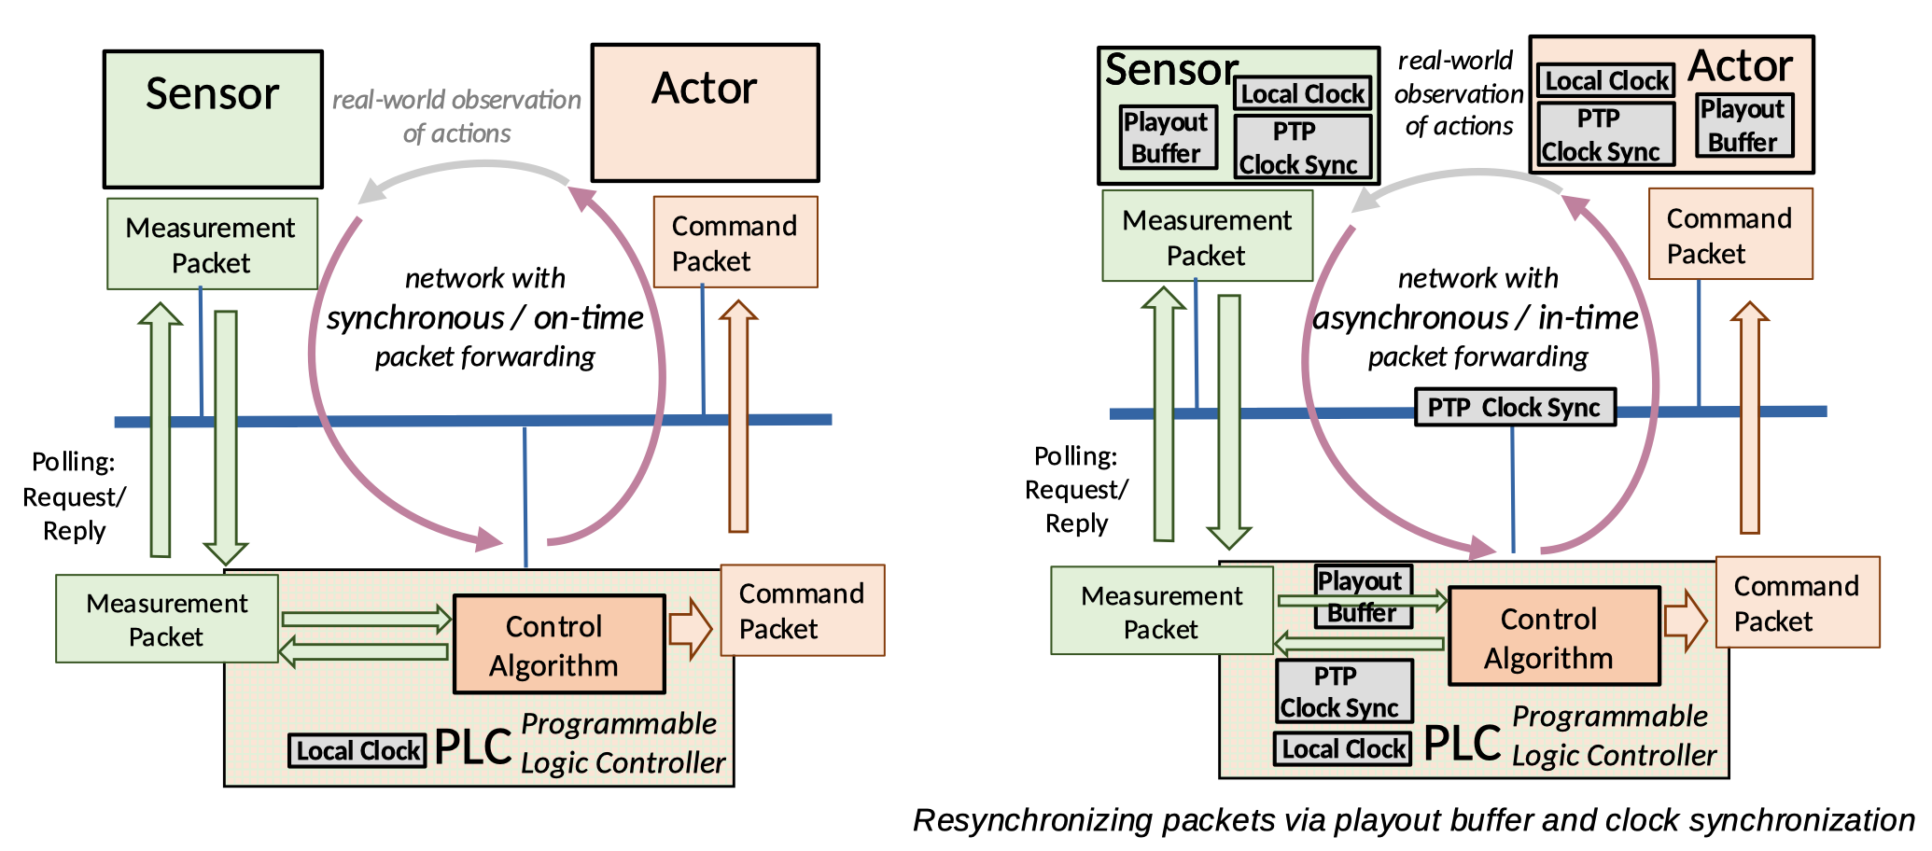
Benefits of synchronous packet transmission
(C) 2023, Springer, Journal of Network and Systems Management, 31, Article number: 34 (2023)

Slide 21
gLBF
Asynchronous Dampers, Dampers with UBS calculus

Slide 22
But wait (2)...
Dampers introduce clock synchronization needs between R1/R2, aka: across network.
Clock Synchronization is highly undesirable in most large-scale networks
One of the reasons, why CQF/TCQF/SQCF may not be ideal

Slide 23
Asynchronous Damper – basic concept
Router 1 (sender)
Router 2 (receiver)
Queuing
Scheduling
Dampen
Queuing
Scheduling
<= MAX
T1
T3
Calculation Error
T2
T1+MAX
Delay by
T + D
Insert new packet metadata
D = MAX - (T3-T1)
Now we transmit no (target delay) timestamp, but a time-delta as metadata: D.
Eliminates clock synchronization need between R1 / R2
But this is incomplete: The time between R1:T3 and T2 is not considered
Serialization latency: proportional to packet length – aka varies across packets. MUST BE CONSIDERED
Other VARIABLE delay: in-router, or network transmission (radio link, l2 retransmission, reflections,...)

Slide 24
Asynchronous Dampers: gLBF damping
Router 1 (sender)
Router 2 (receiver)
Deserial
izing
Forward
Dampen
Queuing
Scheduling
Serial
izing
Deserial
izing
Forward
Dampen
Queuing
Scheduling
Serial
izing
T1
MAX1
T3
Tref
T
T + D
Insert new packet metadata
Tref = T3 + psize[bits] / serialization-speed
D = MAX1 - (Tref-T1)
Tref = T - psize[bits] / serialization-speed
Delay by Tref + D
Tref is time of first bit of packet (TBD: L3 or L2/L2) observable on egress of R1
MAX1 is MAX + serialization speed of largest packet allowed
Assumes same serialization/deserialization speed (simple, common case)
“easily” adjusted if wired link properties are more complex (subrating etc..)
Does NOT consider speed of light propagation of link: NOT VARIABLE (enough) to care!

Slide 25
gLBF so far
We’re not (yet) at actual high-speed implementation proposal!
For wireline links: use asynchronous gLBF model
No clock synchronization needed
Metadata: D(amper) value.
E.g.: nsec resolution, >= 20 bit (100 usec max hop latency)
For edge-radio links (optional – RAW problem)
Use synchronous model (picture details not shown – left as exercise for readers)
Clock synchronization for radio links acceptable ?!
Metadata:Tref
Allows to compensate for variability of radio link
Retransmission at L1/L2, delay by reflections at building, speed changes by modulation...
See RAW architecture

Slide 26
Great ? Done ?
Yes, Great, But not Done!
This is not complete enough for standardization
This is not complete enough for high-speed implementation

Slide 27
Standard system requirement
DetNet Controller-Plane
Calculate MAX through Queuing/Scheduling for each P router - for each flow
with only STANDARD information/
calculus (not vendor specific)
...
???
Queuing/Scheduling
proprietary Vendor 1
Queuing/Scheduling
proprietary Vendor 2
Queuing/Scheduling
proprietary Vendor 3
???
...
...
...
...
Policing
Ingres
Ede
Damper
Vendor1
Damper
Vendor 2
Per-flow
stateless
Forwarder
Per-flow
stateless
Forwarder
Receiver
e.g.
Flow k
Ingres
PE
P
P
P
Egress
PE

Slide 28
Standardization Requirement
Need to pick (one or more) standard Queuing/Scheduling mechanism to use in conjunction with Dampers
gLBF proposes to use UBS / TSN-ATS Priority Queues
Or else it will me impossible to build good, vendor independent controller-plane. Proof: left as exercise to readers!
Consider that controller has potentially complex “best-latency/throughput path optimization” problem to solve
Solutions with vendor-specific proprietary controller-plane plugins would limit flexibility of algorithms in vendor independent controller-plane, eliminate many optimizations based on knowledge of common, standardized per-hop latency calculus.

Slide 29
gLBF model: metadata, forwarding, state
Measured time
Calculated time
Packet Metadata
P(rio): end-to-end or per-hop (eg:SIDs)
D(elay) [nsec]
Per-OIF state:
Prio 1: MAX1[1]
Prio 2: MAX1[2]
...
Prio 8: MAX1[8]
Forward
Measureand
Dampen
Prio 1 FIFO
Measure
and
Mark
IIF
OIF
Deserializing
Prio 2 FIFO
Strict Priority
Queueing
Sserializing
...
Prio 8 FIFO
T2
Tref1
T
Tref2
Td
<= MAX1[packet.P]
Tref1 = T - packet.psize[bits] / IIF.speed [bps]
Td = Tref1 + packet.D
Tref2 = T2 + packet.psize[bits] / OIF.speed [bps]
packet.D = MAX1[packet.P] - (Tref2 - Td)
Assumes forward step to have no relevant time variation to allow T measurement to be taken after it (egres linecard). If relevant, move T before forward and include in calculations.
Calculating Td instead of measuring it means Dampen and Queuing/Scheduling can be single-staged in implementation.

Slide 30
Proposed High Speed (ASIC/FPGA) implementation options
Internal behavior – not part of standard (appendix in draft).
Not implemented, not validated!

Slide 31
Performance requirement
Before R1 queuing/shaping:
Time
Competing traffic flows on R1
from other input interface
Deserial
izing
Forward
Dampen
Queuing
Scheduling
Serial
izing
Time
Time
Time
Prior burst example
Performance Bottleneck point
Dual stage damper / queuing/scheduling is highly undesirable, maybe even impossible at high speed
Remember burst example: packets arriving at same time, building queue.
With dampers, these packets would be simultaneous again next hop after the Damper (before queuing)
If applications send from different places in network packets simultaneous, then worst case the number of ideally simultaneous packets at the bottleneck point could be factor 100 or larger
Impossible to build processing much faster than without Damper – without big aded cost
Sequential processing only feasible at low speed or by introducing (high speed) big complexities: dequeuing from Damper, accounting for added dequeuing/enqueing latency to Queuing/Scheduling stage
Really need single-stage solution for high-speed
This requires well-defined/standardized Queuing/scheduling stage.
Luckily we already need this for system standards requirement

Slide 32
gLBF high speed option 1: timed PIFO
Forward
Prio 1 PIFO
Measure
and
Mark
IIF
OIF
Deserializing
Measure
Prio 2 PIFO
Strict Priority
Timed Dequeue
Sserializing
...
Prio 8 PIFO
T2
Tref1
T
Rank = - Td
Tref2
Unchanged calculations, semantic of behavior. Removed Damper stage
FIFO stage replaced by Push In First Out (PIFO) with timed dequeuing (timed PIFO):
Each packet in PIFO has a Rank. Packets are inserted into PIFO queue in order of decreasing Rank. Highest Rank is Top-of-PIFO.
In gLBF, Td is target damper time: Time when packet could first be sent. be sent (absent packets from a higher priority PIFO). The earlier Td, the higher the Rank of packet. E.g.: Rank = –Td.
Head of each PIFO can first be dequeued when time reaches (negative) Rank of Head of PIFO. Strict Priority dequeuing across the PIFOs.
Effectively PIFO serves as both as Damper and as Priority FIFO stage: as long as TD is not reached for a packet, it is logically in the Damper stage, afterwards it is in the FIFO stage of processing.

Slide 33
gLBF high speed option 1: PIFO
Promising research PoC implementation of High-Speed (100Gbps or more) PIFO in FPGA with scale better than O(#flows)
Early PIFO PoCs had scale/cost O(#flows) == O(#not-in-order-packets)
Currently relying on fixed Rank though
When timestamp is used as Rank (as gLBF needs), some additional logic is needed to wrap some fixed range of Ranks
32 bit timestamp with nsec resolution would wrap ever 4.2 seconds.
Size of rank will impact cost of implementation
Range needed for ranks at at time is O(MAX1[8]).
Unclear how difficult it is to add this missing piece in FPGA code

Slide 34
gLBF high speed option 2: timed FIFO
Forward
(IIF, pprio, prio) FIFO
Measure
and
Mark
IIF
OIF
Deserializing
Measure
(IIF, pprio, prio) FIFO
Strict Priority
Timed Dequeue
Sserializing
...
(IIF, pprio, prio) FIFO
T2
Tref1
T
Td
Tref2
PIFO can be replaced by FIFO – as long as packets are enqueued with increasing Td
Need a separate PIFO for each combination (IIF, pprio, prio)
Pprio is priority of packet on prior hop. Prio is P(rio) in packet header
Packets arriving from same IIF with the same prio on this hop and same prio on prior hop arrive in the same order as their Td
Addtl requirement: Needs pprio in packet header metadata
Same idea as high-speed implementation in UBS: per (IIF,prio) interleaved regulator
Except no shaper state/processing ; instead needs more FIFO

Slide 35
Discussion
No per-flow lookups required. No register write (as in updates for shapers/interleaved regulators)
Timed priority dequeue based on head of queue time (Td) same functionality as in UBS/TSN-ATS
In TSN-ATS this is calculated by shaper, in gLBF by delay calculation
Should hopefully be well feasible for high-speed, low-cost
Per (prio,pprio,IIF) FIFO queues same concept as in UBS: Uses per (IIF,prio) queues to also ensures queue will only receive packets in order in which they will have to depart (no need insert into middle as in PIFO solution).

Slide 36
Validation

Slide 37
Validation
Ad-hoc simulation implementation, 1 Gbps, 4 routers, 2 hops
1st hop to generate burst collisions
2nd hop with or without gLBF damper, compare results
Result
Without damper, some flows would show higher than guaranteed latency across second hop
With gLBF damper (of course) no excess latency.
Router 1
X3, Y2, Y3: Measure per-flow/per-packet
leaky bucket, buffer and latencies
Flow1
Flow2
X1
FIFO
X3
Flow3
Link L1
30 Mbps
(gLBF) Router 4
Flow4
Router 2
only for gLBF test
Flow5
X1
FIFO
X3
Flow3, Flow6, Flow7
Flow6
Link L2
30 Mbps
Y1
gLBF delay (PIFO)
Y2
FIFO
Y3
Link L4
30 Mbps
Flow7
Router 3
Flow8
X1
FIFO
X3
Do not care: Flow1, Flow2, Flow4,Flow5,
Flow8, Flow9 sent to other interfaces
Flow9
Link L3
30 Mbps
Image (C) from 2020 IEEE/IFIP Network Operations and Management Symposium (NOMS 2020)

Slide 38
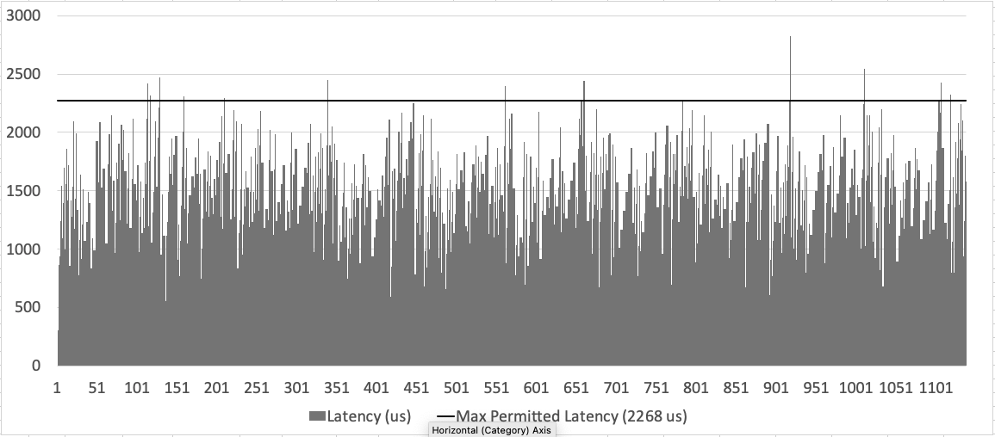
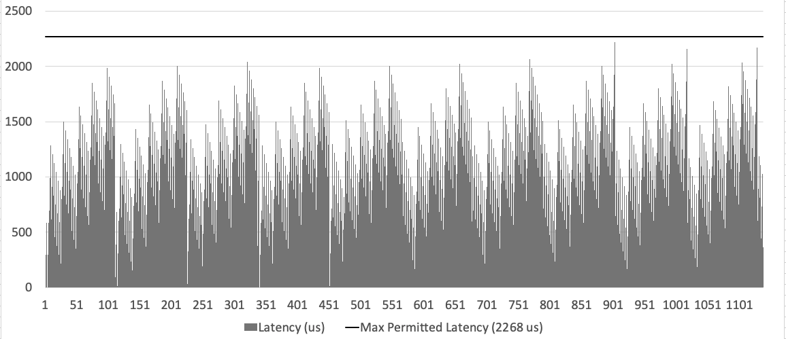
Validation
Images (C) 2023, Springer, Journal of Network and Systems Management, 31, Article number: 34 (2023)

Slide 39
Packet metadata / encaps

Slide 40
Packet metadata overview No actual proposals for encap, just various ideas...
Some indication that gLBF processing is desired for packet
Could be presence of Damper or Priority field’s in packet or TC/DSCP, or ...
D)delay (Damper) : for hops using asynchronous mode
per-hop rewritten. >= 20 bits, suggested unit: nsec (1 msec max buffer ?)
MPLS: 2 top of stack labels, special function + damper value ?? Or better post stack data (consistency with IP/IPv6 ?)
IP/IPv6: in common DetNet header
Td: Target damper timestamp: for hops using synchronous mode
Could be same size as Damper field, e.g.: 20 bit, resolution nsec, synchronized clock timestamp modulo 1 msec
P)riority: 3 bit for 8 priorities (to match TSN-ATS)
Always read-only, not changed in processing
Per-path priority: single metadata field
Per-hop priority, embed into SID based steering model Can use all the same ideas as CSQF
E.g.: 8 SID per OIF or 3 bit parameter (SRv6/SRH/RFC8986)

Slide 41
Benefits

Slide 42
Benefits re. CQF / TCQF / CSQF
Less jitter than *QF cycle time
Depending on accuracy of processing of timestamps in router / metadata
Can be asynchronous, no PTP clock sync required
Can support difficult/jittery links (radio) – synchronized only across link
TCQF backward compatible: Set up gLBF to behave like TCQF:
Single Priority, MAX1 buffer space same as TCQF cycle would be
CSQF backward compatible: Simpler model for fine-grained per-hop latency management:
Set up 8 priorities, each with same buffer size. Achieves per-hop synchronous latency of T, 2*T, 3*T, ... 8*T.
Higher flexibility
Buffer sizes for each hop == delay for each hop independently configurable. In TCQF, CSQF these need to have the same time

Slide 43
Benefits re. UBS / TSN-ATS
Same traffic model, bandwidth/latency calculus as UBS / TSN-ATS
Should be able to re-use most of existing TSN-ATS controller-plane
Specification of flow envelope
Algorithms for determining per-prio buffer-space, provisioning of buffer
Algorithms for path calculations for flows, calculating per-hop priority of flow, admitting flow
Can be asynchronous, no PTP clock sync required
Can support single (radio) link propagation variation requring only single link clock synchronization (but not path wide)
Plug & play co-existance and/or replacement ?
Core difference (benefit ?!):
On-time packet delivery (gLBF)
In-time delivery (UBS)

Slide 44
Summary

Slide 45
Summary
gLBF is adoption of old Damper idea
Enables per-hop, per-flow stateless operation, required for large-scale networks
Minimal/no jitter, minimal/no receiver playout buffer
The time seems to be right:
Feasible to implement at high speed with FIFO and/or PIFO options
When Damper was thought of, it was infeasible for forwarding planes
gLBF specifically contributes
Per-hop Asynchronous and/or synchronuous operation
Use of UBS calculus/queung/scheduling
Combined benefits of TSN-ATS and TSN-CQF – for DetNets ?!
Designed for large-scale / wide area network DetNet deployments
But potentially equally able to superceed prior mechanisms in smaller scale networks Based on its benefits

Slide 46
References

Slide 47
References
LBF: original research paper without guaranteed Latency
T. Eckert, A. Clemm, S. Bryant, "gLBF: Per-Flow Stateless Packet Forwarding with Guaranteed Latency and Near-Synchronous Jitter", 2021 17th International Conference on Network and Service Management (CNSM)
gLBF original paper
T. Eckert, A. Clemm, "High-Precision Latency Forwarding over Packet-Programmable Networks", in 2020 IEEE/IFIP Network Operations and Management Symposium (NOMS 2020)
Springer Journal 2023 extended paper with more validation data
T. Eckert, A. Clemm, S. Bryant, "High Precision Latency Forwarding for Wide Area Networks Through Intelligent In-Packet Header Processing (gLBF)", Journal of Network and Systems Management, 31, Article number: 34 (2023)

