Slide 1
Cyclic Queuing and Forwarding for Deterministic Forwarding draft-eckert-detnet-tcqf-02 draft-yizhou-detnet-ipv6-options-for-cqf-variant-01
Toerless Eckert, Futurewei USA (tte@cs.fau.de), Stewart Bryant, U. of Surrey ICS (s.bryant@surrey.ac.uk), Andy Malis (agmalis@gmail.com), Guangpeng Li <liguangpeng@huawei.com>, Yizhou Li <liyizhou@huawei.com>, Shoushou Ren <renshoushou@huawei.com>, Guangpeng Li <liguangpeng@huawei.com>, Fan Yang <shirley.yangfan@huawei.com>, Jeong-dong Ryoo <ryoo@etri.re.kr>, Peng Liu <liupengyjy@chinamobile.com>
Interim meeting 04/2023, rev 0.5

Slide 2
History / Context

Slide 3
Tagged Cyclic Queuing drafts
Historic drafts
2018 - 2019: draft-qiang-detnet-large-scale-detnet (00-05)
(Christina) Li Qiang, Xuesong Geng, Bingyang Liu, Toerless Eckert, Liang Geng, Guangpeng Li
2019: draft-chen-mpls-cqf-lsp-dp-00
Zhe Chen, (Christina) Li Qiang
2021: draft-dang-queuing-with-multiple-cyclic-buffers-00
Bingyang Liu, Joanna Dang
Current drafts – intent to merge:
2021: draft-eckert-detnet-mpls-tc-tcqf -> 2022: draft-eckert-detnet-tcqf-02
Attempt at standardizing “no-new-packet-header” for MPLS data plane (because best supported by DetNet)
Changed name after adding IP/IPv6 (DSCP) forwarding plane
Toerless Eckert , Stewart Bryant , Andrew G. Malis , Guangpeng Li
2022: draft-yizhou-detnet-ipv6-options-for-cqf-variant
Yizhou Li, Shoushou Ren, Guangpeng Li, Fan Yang, Jeong-dong Ryoo, Peng Liu
Related drafts
draft-geng-detnet-dataplane-enchancment-encap/

Slide 4
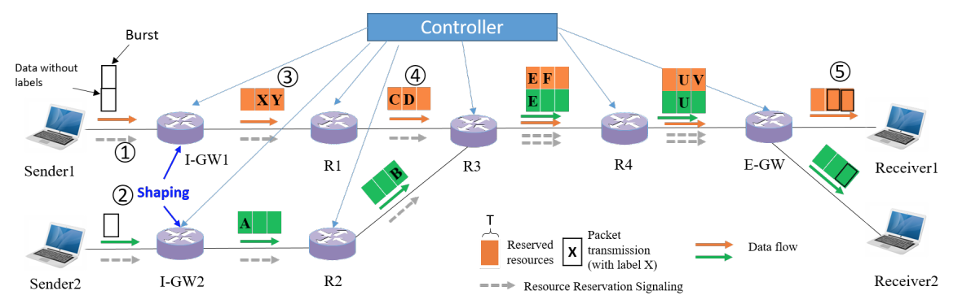
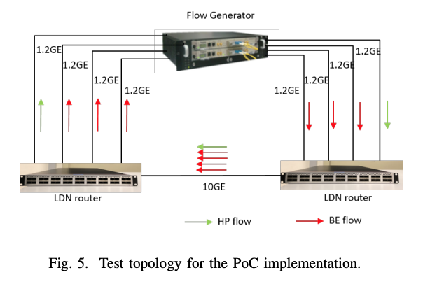
Development / Validation
2017 - 2021: Research and in-house validation
IFIP 2021 Networking Conference:
“Towards Large-Scale Deterministic IP Networks” †Bingyang Liu, †Shoushou Ren, †Chuang Wang, ∗Vincent Angilella,, Paolo Medagliani, ∗Sebastien Martin, ∗, Jeremie Leguay
https://dl.ifip.org/db/conf/networking/networking2021/1570696888.pdf
Two validation vehicles
High-speed PoC router implementation
“DIP” – Deterministic IP
Modified off-the-shelf metro-router 100Gbps Ethernets
Added FPGA for programmable queuing
Packet header processing standard NPU
Omnet++ Simulation
Using published AS 1239 (Sprint) topology of 315 routers and 1944 links
Architecture (from paper)

Slide 5
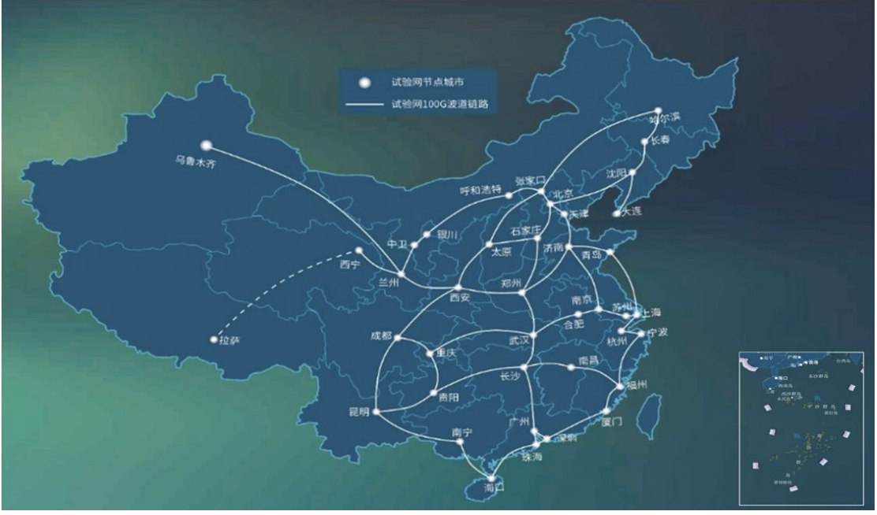
Large scale validation
2020: CENI: Research network across china
Connecting all mayor cities
Connected PoC routers to 100 Gbps fibers of network
And performed validation testing
Report:
https://ceni.org.cn/406.html

Slide 6
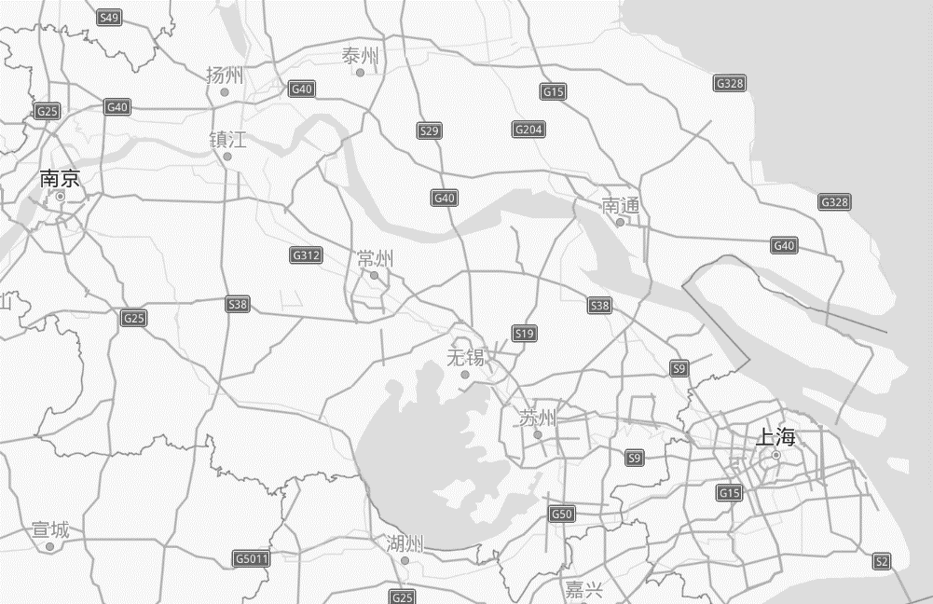


CENI DIP (tcqf) Testbed 2020 Example test case (NanJing region)
Taizhou
1200km Geo Distance
10Gbps Fiber
Equipment Room in NanJing
Shanghai
Yangzhou
DIP
Router
Transit
back
NanJing
Taizhou
DIP
Router
Beginning
Yangzhou
Test Engine
Target Flow：1Packet/10μs & pktsize is 1500B
Interference flow：128Packets/1ms & pktsize is 1500B
Shanghai
Target Flow：1Packet/10μs & pktsize is 1500B
Interference flow：128Packets/1ms & pktsize is 1500B

Slide 7
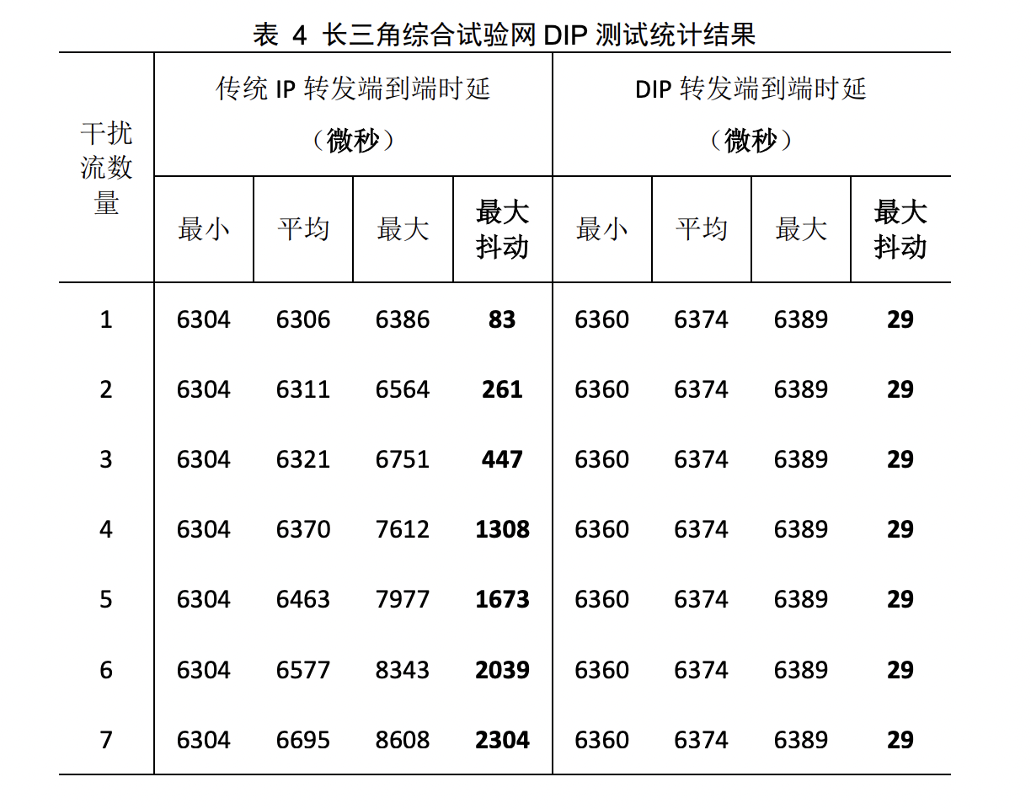
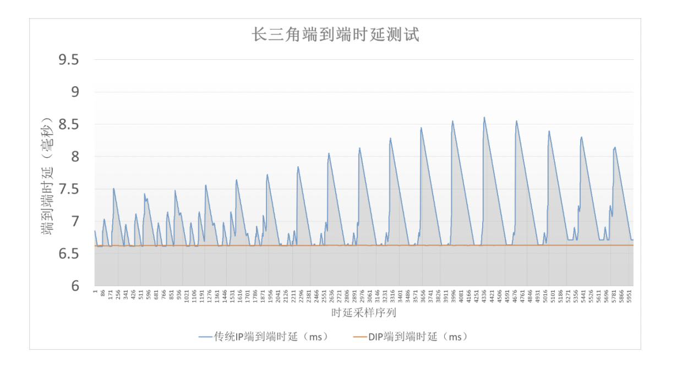
CENI TCQF (“DIP”) Testbed 2020

Slide 8
Scalability and TCQF

Slide 9
Scalability
With N edge nodes, we want less than O(N^{^2}) state in the core
O(N^{^2}) : Every combination ingres to egres edge-node
Hardware & control scale challenges
We do not want to update core-node forwarding plane state
When flows change
Too much control plane change
All big Service Provider Networks shy away from this
Reason for “stateless” forwarding, e.g.: MPLS, Segment Routing Instead of per-flow traffci steering (e.g.: RSVP-TE).

Slide 10
O(N^{^2}) issue
Realistic reference worst case scenario in large-scale DetNet
Assume we aggregate all DetNet traffic from one ingres iPEj to one egres ePEk into one aggregate DetNet flow.
Most edge-aggregation we can do
j=1...100, k=1...100
Total # flows: j * k = 100 * 100 = 10,000
These flows may all go through one (core PE) interface
oif1 (output interface 1) on P1 in example network
RFC2211 (IntServ): per-flow shaping for 10,000 flows
IEEE ATS (Async Traffic Shape): interleaved regulators for 10,000 flows
Every time rate and/or burst-size of any of these 10,000 flows changes (because one of its member flow changes):
Both IntServ and ATS require signaling of new flow parameters to all routers affected (P1, P2, ...) – (limited optimizations possible).
TCQF: 3 ... 5 cyclic queues on P1 oif1.
No changes in any P router configuration when member flows change!
...
iPE1
iPE100
...
P1 rtr
oif1
P2 rtr
...
...
ePE1
ePE100

Slide 11
Changes from -01 (IETF115)
Conservative approach: specify that we maintain order between packets arriving from the same input interace and going to the same output interface / cycle
while(1) {
ingress_flow_2_tcqf(oif,cycle) // [5]
wait_until(tnow >= nextcyclestart); // wait until next cycle
nextcyclestart += tcqf.cycle_time
forall(iif) {
forall(pak = tcqf_dequeue(oif.cycleq[cycle,iif]) {
schedule to send pak on oif before nextcyclestart; // [4]
}
}
cycle = (cycle + 1) mod tcqf.cycles + 1
}
Additional explanatory text to reconfirm that “schedule to send” can be arbitrary time within the cycle, but that order of dequeuing needs to be maintained.
Any better way to describe this ?

Slide 12
Packet encapsulations

Slide 13
Encapsulation considerations
Short-term attractive (to simplify initial adoption/deployments):
No packet header changes necessary:
Cycle-ID can go into DSCP (IP/IPv6) or MPS TC (Traffic Class) fields
Single-domain use: RFC2474, section 6: 16 private DSCP
Would need at minimum 3 cycle-ID could have up to 16.
Only advanced forwarding option for DetNet with this benefit ?!
Long-term better:
Define packet header that explicitly considers Cycle-ID
Customers do not like to “overload DSCP” - (“legacy mechanism”, difficult to manage), and TC is quite limited.
We should be able to support for packets at least the following:
Queuing (TCQF): cycle-ID (and possible extensions)
Timestamp (sender) may be desired too
PREOF (flow-id, sequence-number)
Steering: If not using source-routing (e.g.: SRH), then some type of “aggregate-ID” packet header filed on which steering policy can be configured
Can we / should we have multiple extension headers ?
Or combine all required DetNet functions into single header ?

Slide 14
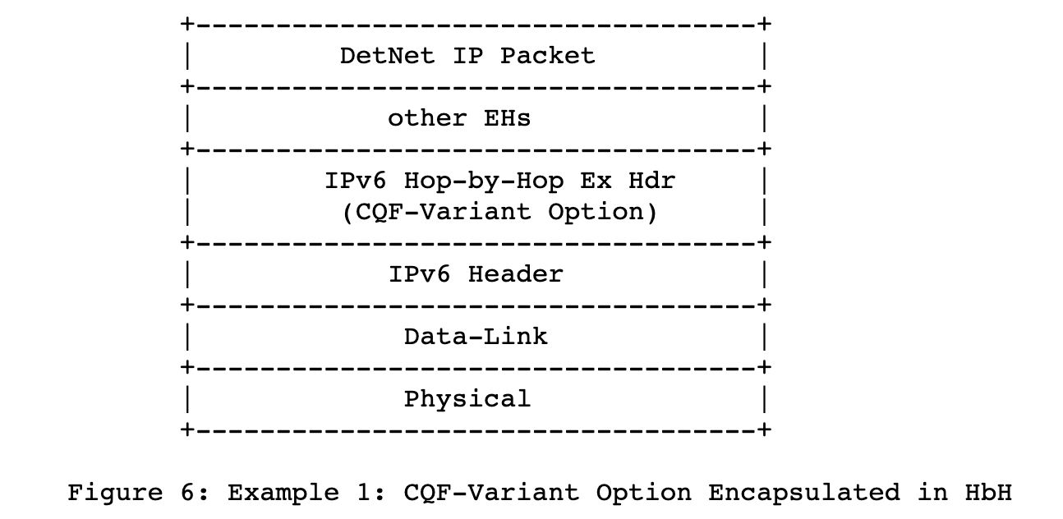
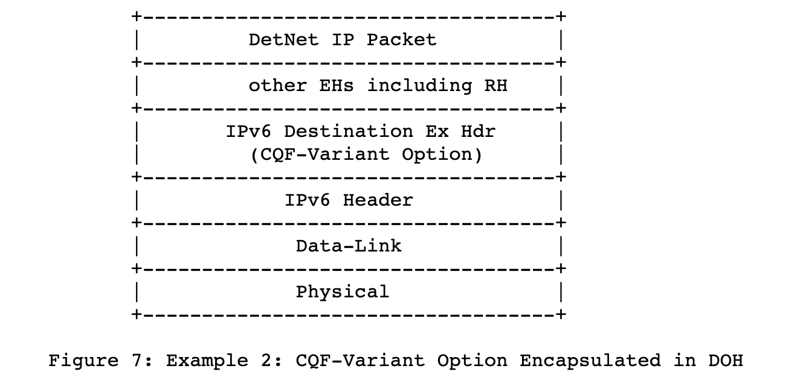
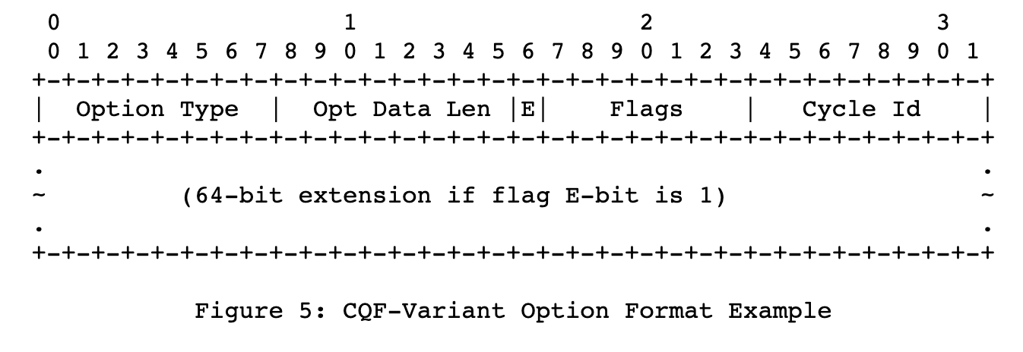
Encapsulation options from draft-yizhou-detnet-ipv6-options-for-cqf-variant
Discussion with 6MAN WG:
What type of IPv6 extension header to use – HbH or DoH
Traditionally DoH would be incorrect
Because every router would need to inspect/modify header (Cycle-ID)
But DoH would likely allow to pass through unsupporting routers easier...
DetNet ?! Discussion
What fields to have in packet header
Example / simple proposal from draft: Cycle-ID + extensions
Other options discussed in draft.
Could also add fields for PREOF...

