Slide 1

Network 2030
Focus Group at ITU-T for SG13
Toerless.Eckert@futurewei.com
Distinguished Engineer, Futurewei Technologies, Inc., USA
On behalf of Richard Li, Ph.D., Chairman, ITU-T FG Network 2030
Chief Scientist and VP of Network Technologies, Futurewei Technologies, Inc., USA
Presentation at 2nd Visions for Future Communications Summit
Lisbon, Portugal, November 27, 2019

Slide 2
Agenda
ITU-T FGNET 2030 – From vision to results
Networks, Services, Applications
Summary

Slide 3

2030 and beyond: What will be (needed)?
?
eMBB
Web
mMTC
uRLLC
Multimedia
APP
2000 - 2020
2020 - 2030
2030+

Slide 4
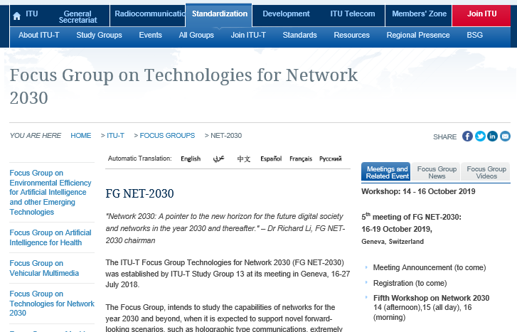
ITU-T Focus Group on Network 2030
https://www.itu.int/en/ITU-T/focusgroups/net2030/Pages/default.aspx
https://www.itu.int/en/ITU-T/focusgroups/net2030/Pages/default.aspx
Study capabilities of networks for the year 2030 and beyond
Expected to support novel forward-looking scenarios (app/networks)
Answer what kinds of network architecture are required
Enabling mechanisms are suitable to enable novel scenarios
Explore new communication mechanisms from a broad perspective
Not restricted by existing network paradigms or existing technologies
Network 2030 may be built upon a new or refined network architecture
Output to feed into ITU-T SG13, other ITU-T study groups or other SDO

Slide 5
FGNET2030 Focus and Deliverables
Use Cases and Requirements
(Sub-Group 1)
Network 2030
Capabilities and Technologies
(Sub-Group 2)
Architectures and Frameworks
(Sub-Group 3)

Slide 6
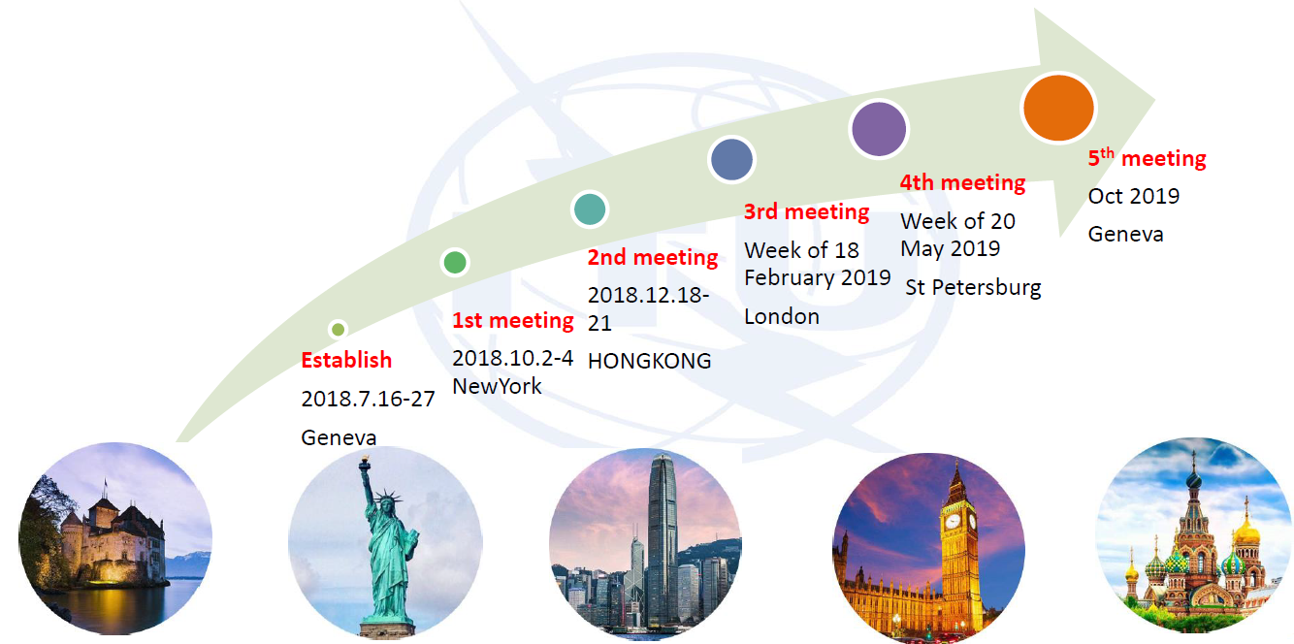
Meetings of ITU-T Network 2030
2018-2019 Plenary Meetings and Workshops
Link to All Workshops and Plenary Meetings on Network 2030

Slide 7
Agenda
ITU-T FGNET 2030 – From vision to results
Networks, Services, Applications
Summary

Slide 8
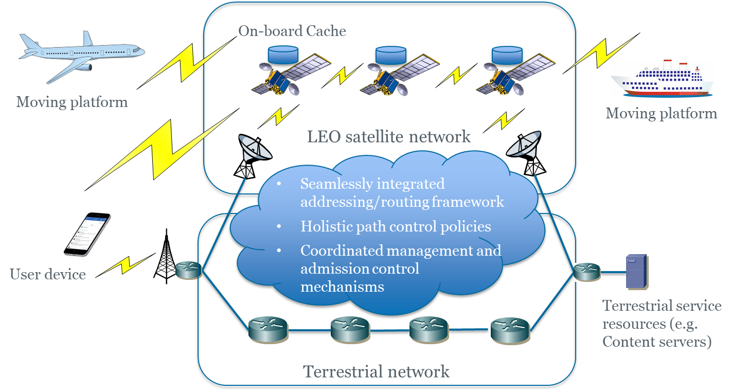
Convergence of Satellite Networks and Terrestrial Networks
Co. | Support | Scale
Starlink | SpaceX (Elon Musk) | 4K by 2019, then 12K
Oneweb | Softbank | 650 by 2019
Boeing | Apple (spec) | 2956, 1350 in 6 yrs
O3Nb | Virgin group, SES | 400
CASIC | China | 300 (54 trial)
(Data are from the Internet, not yet verified)
Distances | Bandwidth | delay
(LEO) 900-1200 KM | 1—200 Gbps | 35ms
(MEO) ~2000 KM | 1-200 Gbps | ~60ms
Space to space | ~100 KM – ~Tbps ~1000 KM ~10 Gbps
Use Cases
Satellite as access, and terrestrial networks as backhaul
Satellite as transport
Hybrid and Integrated
Requirements
Uniform Addressing and Converged Routing
Bandwidth capacity at the satellite side
Admission control by satellites
Edge storage and computing

Slide 9
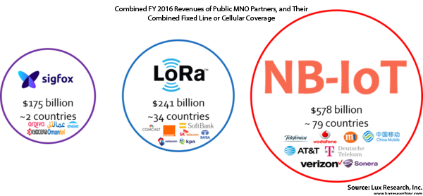
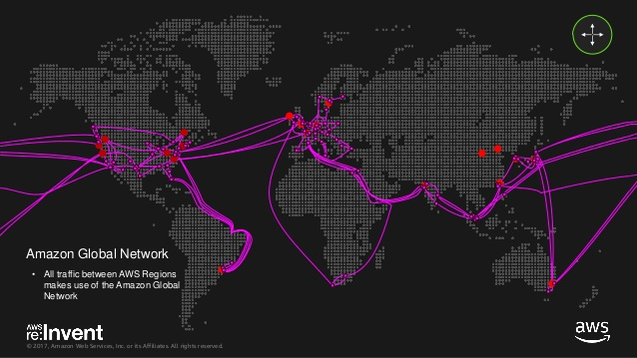
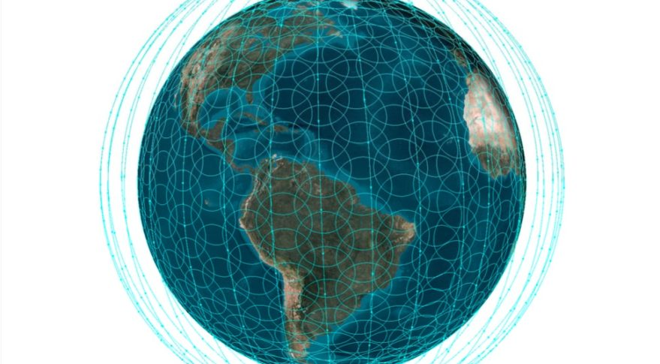
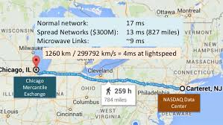
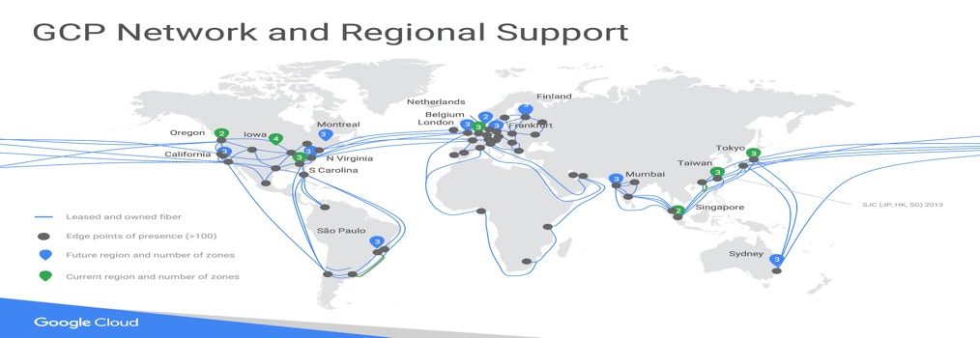
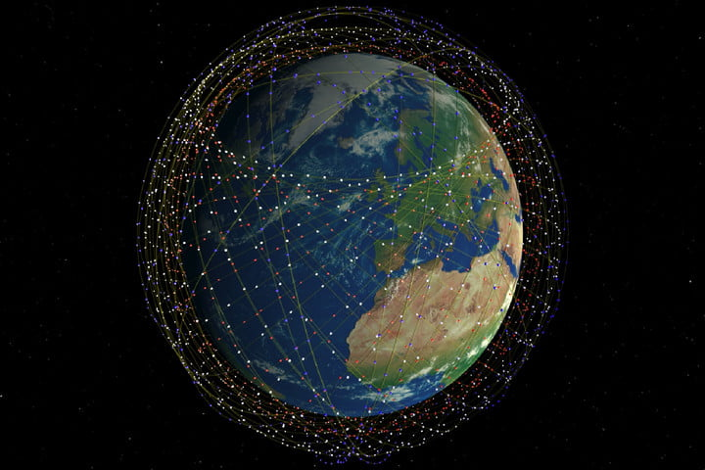
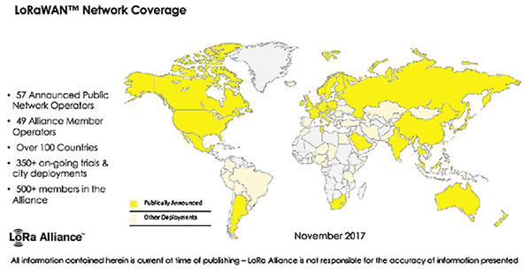
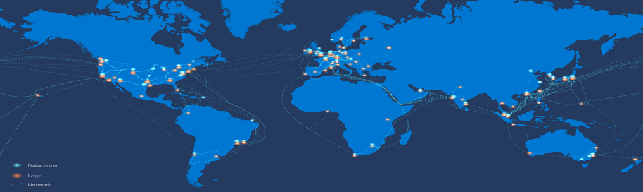


ManyNets: Embracing Diversity, Variety, and Economy
Non-IP Networks
(Growing market segment)
Private Global Backbones
(Death of Internet Transit)
Emerging Satellite Constellations
(Global Broadband connectivity for 4 billion people who are not connected to any network today)
Spread Networks
OneWeb
Starlink

Slide 10
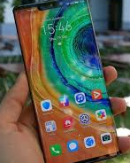
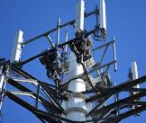


End-to-End Guarantees and Differentiation Throughput, Latency, Losslessness
Throughput and latency are not guaranteed by the current End-to-end Internet TCP/IP
Inefficient use of protocols
Tunnels over tunnels
Some header fields repeat each other
App(user)
App(user)
App(user)
App(user)
App(server)
TCP(user)
TCP(user)
TCP(user)
TCP(user)
TCP(user)
IP(user)
IP(user)
IP(user)
IP(user)
IP(user)
PDCP
PDCP
GTP-U(S1)
GTP-U(S1)
Delay variations: Radio retransmissions are not synchronized with TCP flow control, causing TCP to wastefully retransmit packets
RLC
RLC
UDP(Nwk)
UDP(Nwk)
Not suitable for mMTC and uRLLC
User payload efficiency is too low, making it unsuitable for mMTC and short messages
No end-to-end QoS, making it unsuitable for uRLLC
MAC
MAC
IP(Nwk)
IP(Nwk)
PHY
PHY
IP/MPLS
Backhaul
IP/MPLS
Backhaul
Eth/Nwk
Eth/Nwk
Cellular network
Fixed, IP based wireline network

Slide 11
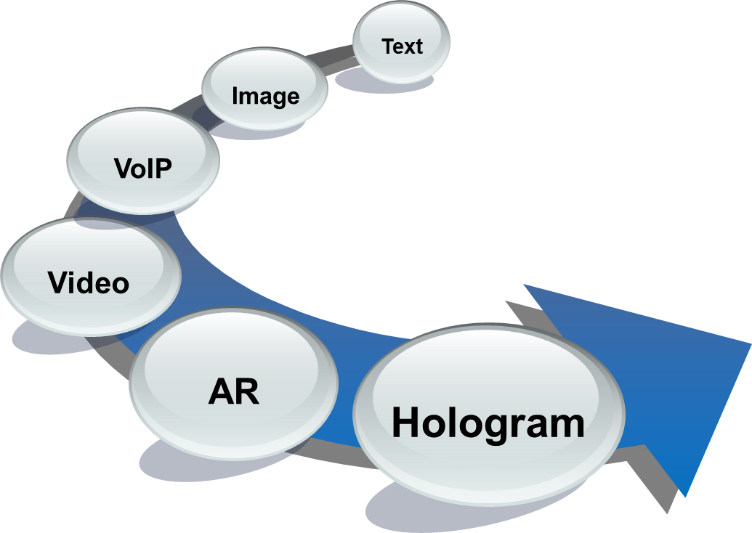
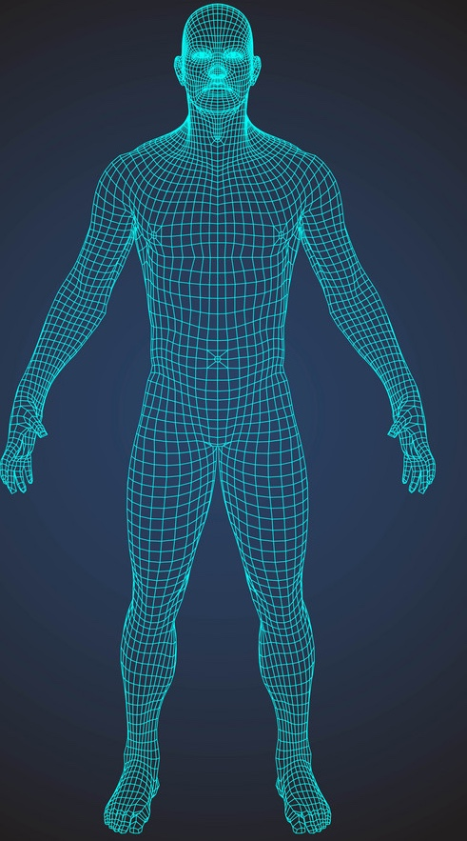
(Video) Holograms and Holographic Type Communications
20” wide
Throughput goes up
4”
4K/8K HD
VR/AR
Hologram
4”
35Mbps~140Mbps
band
width
25Mbps~5Gbps
band
width
2 Tbps~10 Tbps
Holographic Twin: Latency falls down
6’0” tall
4K/8K HD
VR/AR
Hologram
15 ms~35 ms
delay
5 ms~7 ms
delay
Sub ms~7ms
 | Dimensions | Bandwidth
Tile | 4 x 4 inches | 30 Gbps
Human | 72 x 20 inch | 4.32 Tbps
Synchronization of parallel streams
4K/8K HD
VR/AR
Hologram
Raw data; no optimization or compression.
color, FP (full parallax), 30 fps
(reference: 3D Holographic Display and Its Data Transmission Requirement, 10.1109/IPOC.2011.6122872), derived from for ‘Holographic three-dimensional telepresence’; N. Peyghambarian, University of Arizona)
Audio/Video(2)
streams
Multiple tiles (12)
streams
~thousands (view-angles)
Notes:
Numbers based on full-parallax of 200x200 streams.

Slide 12
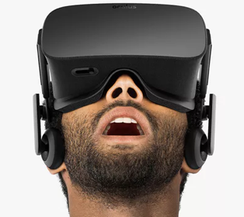

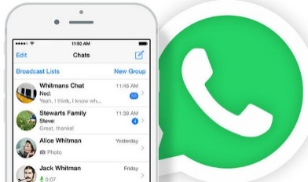

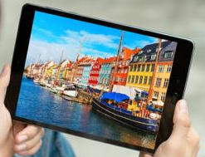

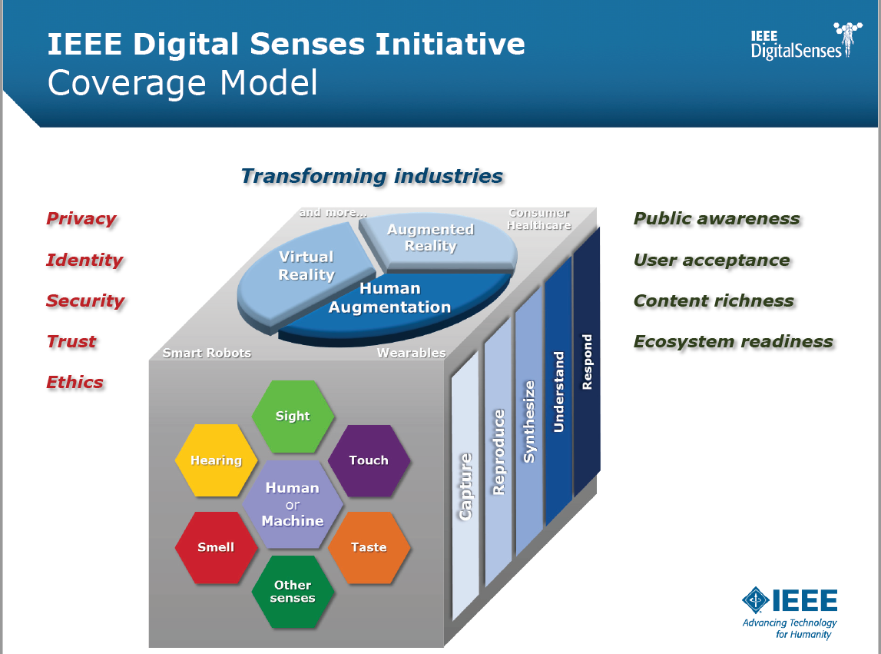





Digital Senses for Holographic Type Communications
Media Evolution
1T/s 1ms
D
Hologram
1G/s 17ms
AR/VR
D
Video
100M/s 33ms
Audio
Image
64k/s 50ms
Text

Slide 13

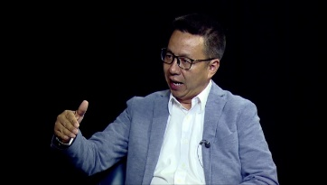




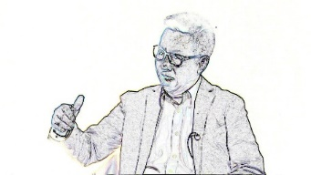

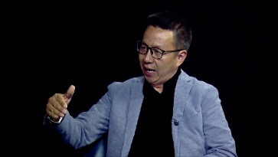

Quantitative vs. Qualitative
Current: Quantitative Communications
New: Qualitative Communications
Sender
Receiver
What is received is not required to be exactly the same as what is sent, accepting partial or degraded, yet useful, delivery of a packet
What is received may be repaired and recovered before being rendered
Intermediate routers may drop less significant chunks to avoid being discarded when congested
=
What is sent What is received
Packet
Packet
Noisy link
If they are not the same, the sender retransmits it until the receiver gets exactly the same copy
Congested Node
Congested Node
Qualitative Packet
Congested Node
Bits and bytes are not equally significant
Packet
Corrupted Packet

Slide 14
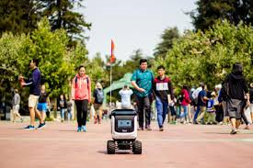
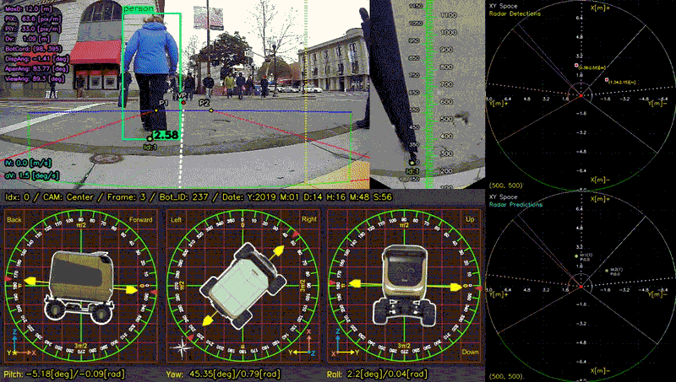


Case Study: Tele-Driving research at UCB
High Precision Latency Services
Sensory Image Capture: 40ms
Framing + Encoding: 120 ms
Decoding + Display: 100ms
RTT between Colombia to San Francisco: 300 – 400ms
Total: 560 – 660 ms
CAD caused by RTT alone:
5 km/hour = 1.4m/sec. Crash-Avoidance Distance = 1.4m/sec x 660ms = 0.92m
30 km/hour = 8.4m/sec. Crash-Avoidance Distance = 8.4m/sec x 660ms = 5.54m
60 km/hour = 16.8m/sec. Crash-Avoidance Distance = 16.8m/sec x 660ms = 11.08m

Slide 15
New Capabilities and Services Required from Networks
2020 Internet
Best Effort
Web, APP
IP(v4)
DiffServ
{Legacy} Voice/video
MPLS / IPv6
SR (Segment Routing)
Service/Path Engineering (2010-2025?!)
Capacity Optimization VPN / Leased Line
AR/VR, Industrial Internet
Autonomous Driving
Teledriving
Tactile Internet
Industrial Internet
Qualitative
Communications
High-Precision
Communications
New 2030
Capabilities
Holographic
Teleport
Digital Reality
Holographic Twin
Holographic Education
Holographic Healthcare

Slide 16
Agenda
ITU-T FGNET 2030 – From vision to results
Networks, Services, Applications
Summary

Slide 17
Eurêka
VLV&TIC
eMBB
BBE&HPC
ManyNets
Web
mMTC
uRLLC
Multimedia
APP
2000 - 2020
2020 - 2030
2030+

Slide 18
2030 Target Research Areas Summary
Very Large Volume & Tiny Instant Communications
VLV & TIC
Session / Coding / Application
Holographic Type Communications
Very High Throughput (> Tbps)
Holographic Teleport (< 5ms)
Digital Senses
Qualitative Communications
Coordinated Streams
Transport / Services
High Precision Communications
Lossless Networking
Throughput Guarantee
Latency Guarantee
In-Time Guarantee
On-Time Guarantee
Coordinated Guarantee
User-Network Interface
Network / Routing
Satellite Networks
Internet-Scale Private Networks
MEC
Special-Purpose Networks
Dense Networks
Network-Network Interface
Operator-Operator Interface
BBE & HPC
Beyond Best Effort and
High-Precision Communications
ManyNets

Slide 19
Output and Deliverables
Network 2030 Whitepaper (2019) A Blueprint of Technology, Applications, and Market Drivers towards the Year 2030 and Beyond, a White Paper on Network 2030, ITU-T, May 2019 (Download)
Sub-Group 2 output document (2019) New Services and Capabilities for Network 2030: Description, Technical Gap and Performance Target Analysis, ITU-T FG Network 2030, Oct 2019 (Download)
Use Cases and Requirements for Network 2030 (In Progress)
Architecture and Framework for Network 2030 (In Progress)

Slide 20
Touched on, but not fully studied yet
Manageability
Intent-Based Networking
Lifecycle: Virtual Network Operations & Development (including programming e.g.: beyond P4)
Accounting, Accountability and Validation
Security and Trust
ITU-T SG13 Y.3053 2020 – Framework of trustworthy networking/trust-centric network domains https://www.itu.int/itu-t/recommendations/rec.aspx?rec=13465
ITU-T SG13 Y.3054 - Framework for trust-based media services https://www.itu.int/itu-t/recommendations/rec.aspx?rec=13609
AI & ML
Y.3172 - Architectural framework for machine learning in future networks including IMT-2020 https://www.itu.int/itu-t/recommendations/rec.aspx?rec=13894 ).
Privacy
Resilience
Mobility
…

Slide 21


