Slide 1
NodeJS Lession 1

Slide 2

Website

Slide 3
NodeJs
- May 27 2009 . Ryan Dahl
- Based on Google Chrome V8 engine
- Open source, cross-platform JavaScript Runtime environment
- npm - largest open source libraries
(Server-side JavaScript)

Slide 4
NodeJs
Single threaded
Event loop
Non-blocking IO
Event Driven Language (JavaScript)
Notes:
Asynchronous and Event Driven − All APIs of Node.js library are asynchronous, that is, non-blocking. It essentially means a Node.js based server never waits for an API to return data. The server moves to the next API after calling it and a notification mechanism of Events of Node.js helps the server to get a response from the previous API call.
Very Fast − Being built on Google Chrome's V8 JavaScript Engine, Node.js library is very fast in code execution.
Single Threaded but Highly Scalable − Node.js uses a single threaded model with event looping. Event mechanism helps the server to respond in a non-blocking way and makes the server highly scalable as opposed to traditional servers which create limited threads to handle requests. Node.js uses a single threaded program and the same program can provide service to a much larger number of requests than traditional servers like Apache HTTP Server.

Slide 5
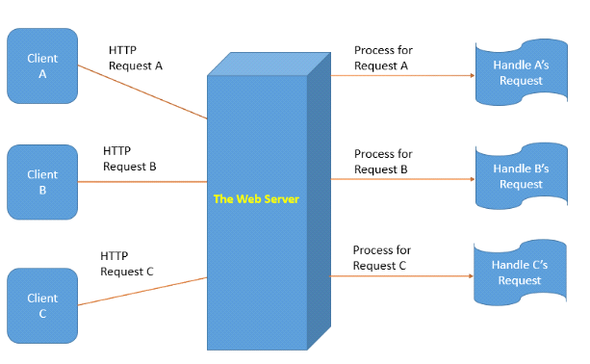
Process per request

Slide 6
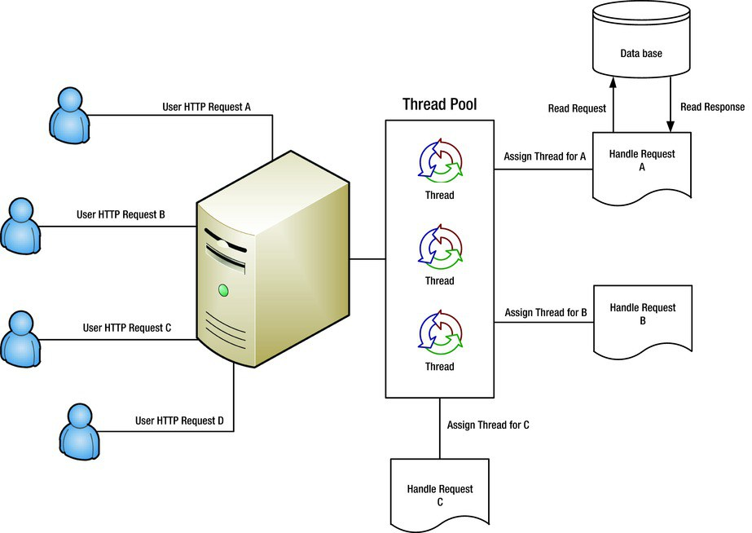
Thread pool

Slide 7
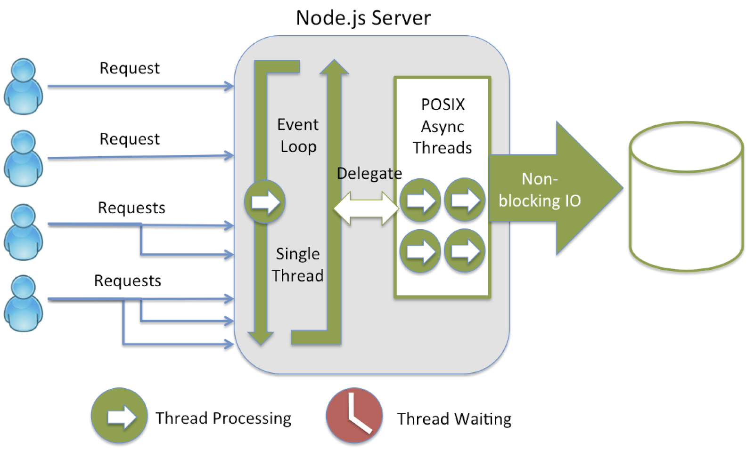
NodeJS server

Slide 8
Why NodeJS
- I/O bound Applications
- Data Streaming Applications
- Data Intensive Real-time Applications (DIRT)
- JSON APIs based Applications
- Single Page Applications

Slide 9
JavaScript
Variables
Function
Scope
Naming convention

