Slide 1
Comprehensive Analysis of Music Genre Classification Using Multiple Models
Presentation Topic

Slide 2
Course Title : Data Mining & Machine Learning Course Code : CSE 236
Presented By :
Tanzi Afrin (221-15-5793)
Saiful Islam Sumon (221-15-5793)
Inteshar Rahman Rafi (221-15-5302) Toufique Ahamed (221-15-4980)
Md.Shahinur Alam Rabbi (221-15-4673)
Presented To :
Md. Abdullah Al Kafi Lecturer
Dept. of CSE Daffodil International University

Slide 3
Table of contents
0 1
Introduction
02
About Dataset
03
Data Pre-processing
04
Model Overview
05
Model Evaluation
06
Limitations & Future Work
07
Conclusion

Slide 4
01
Introduction

Slide 5
Why Music Genre Classification is Important?
Music genre classification plays a significant role in organizing and retrieving music in the modern era of streaming services and digital libraries. Accurate classification enables users to explore music based on their preferences and helps service providers recommend music effectively.

Slide 6
Our Goal…
Given the exponential growth in music content, automated genre classification using machine learning offers scalable solutions for better user experience. Machine learning techniques allow us to analyze features like tempo, pitch, and rhythm to improve classification accuracy.
Compare performance across five models
Identify the best-suited model for genre classification

Slide 7



Project Workflow
02
04
Dataset
Pre
Processing
Model
Training
Result
Analysis
Evaluation

Slide 8
About Dataset
02
The dataset has Been Collected from Kaggle titled Music Genre Classification
Number of Instances: 50,000 \ Number of Attributes: 17 Input Features + 1 Target('Music Genre')
10 types Genre (Electronic', 'Anime', 'Jazz', 'Alternative', 'Country', 'Rap', 'Blues', 'Rock', 'Classical', 'Hip-Hop’.)

Slide 9
03
Data
Pre Processing

Slide 10
Data Pre Processing
Removes unnecessary columns like "instance_id" and "track_name". It then checks for missing data (NaN values) and drops entire rows containing them twice to ensure a clean dataset.
Categorical features (key, mode, music_genre, artist_name) are encoded using LabelEncoder, with key, mode, and music_genre encoded once to avoid redundancy.
An interesting step involves creating a new feature, "art_genre". This identifies the unique music genres associated with each artist and encodes them using the LabelEncoder. Finally, the code drops irrelevant numerical features and displays a summary of the cleaned and preprocessed data, ready for research analysis or model training.

Slide 11
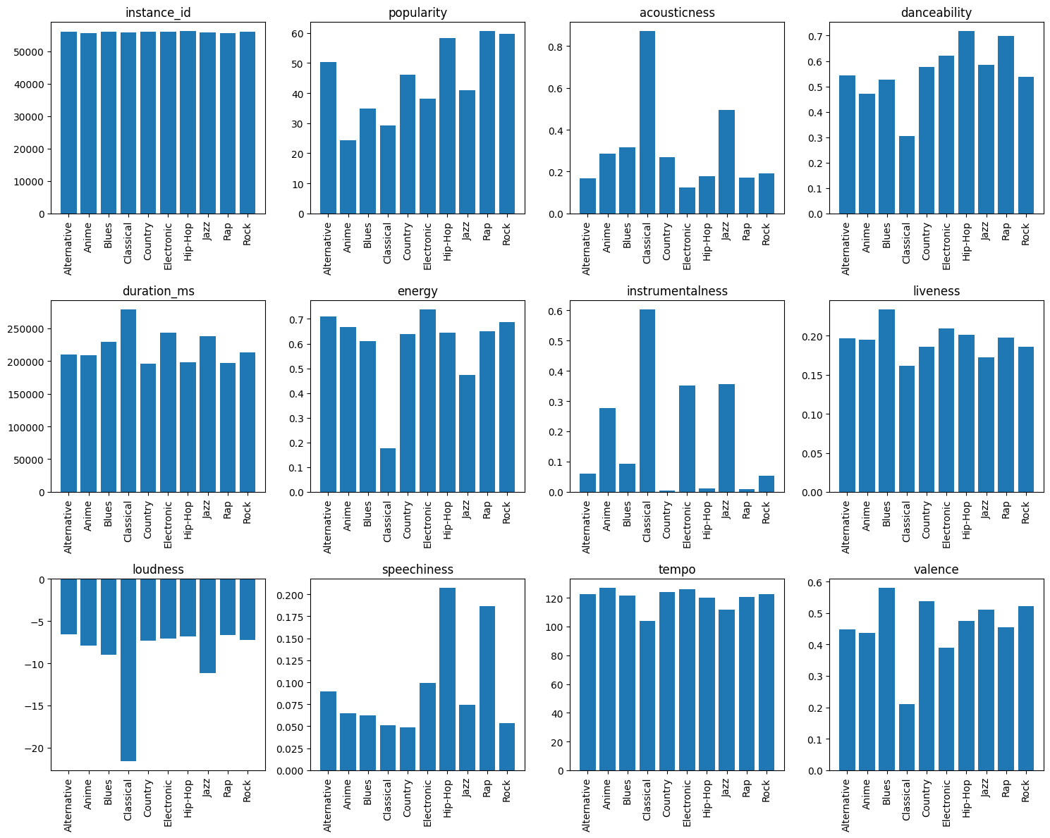
Plot for the
Features vs target

Slide 12
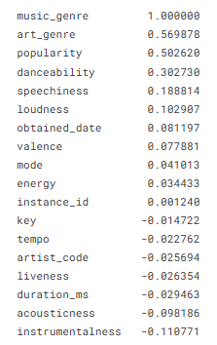
Features Extraction
Finding The Top correlation features with music_genre
Using Correlation matrix.
Art_genre is highly correlated with music_genre(our target). Loudness is highly correlated with energy
We will drop Instance_id', 'key','tempo','artit_code','artist_name’,
’liveness','duration_ms','obtained_date’, 'energy ‘

Slide 13
04
Models Overview

Slide 14
Model Building
1. Selects all features except music_genre as independent variables (X).
2. Assigns the music_genre column as the target variable (y). 3. Splits the data into training and testing sets. test_size = 0.2: 20% of the data is allocated to the testing set. Ensures that the distribution of music_genre in the training and testing sets is similar to the original dataset.
.

Slide 15
Selected Models
Support Vector Machine (SVM):
Effective for high-dimensional spaces
XGBoost:
Gradient boosting algorithm optimized for speed
and accuracy
K-Nearest Neighbors (KNN):
Simple and intuitive classification based on proximity
Random Forest:
Ensemble learning using multiple decision trees
Logistic Regression:
Probabilistic linear model for binary/multi-class
classification

Slide 16
05
Model Evaluation

Slide 17
Evaluation Matrix
Accuracy
Precession, Recall,F1-Score
Models | Accuracy | Precession | Recall | F1 Score
Logistic Regression | 47.58% | 43% | 48% | 46%
Random Forest | 78.2% | 78% | 78% | 78%
K Nearest Neighbor | 79.02% | 79% | 79% | 79%
SVM | 74.73% | 70% | 75% | 71%
XGboost | 81.77% | 82% | 82% | 82%

Slide 18
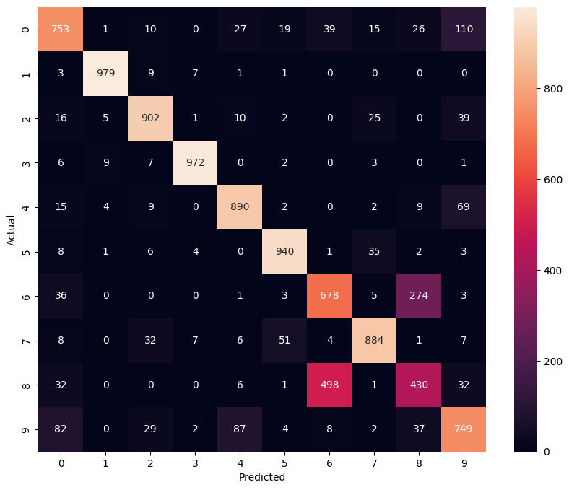
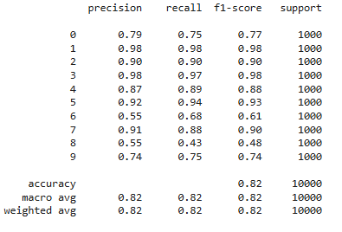
Performance metrics (XGBoost)

Slide 19
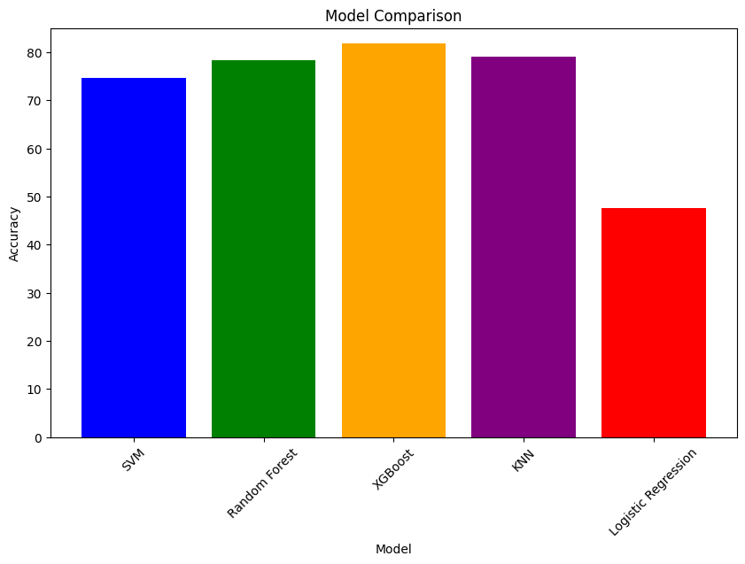
Model Comparison
This project evaluated five machine learning models for music genre classification: Decision Trees, SVM, Random Forest, KNN, and XGBoost. XGBoost achieved the highest accuracy. Evaluation metrics included accuracy, precision, recall, and F1-score, ensuring a thorough comparison of model performance.

Slide 20
06
Limitations and Future Works

Slide 21
Limitations
1. Limited size of the dataset.
2. Preprocessing complexity.
3. High computational requirements for some models.
Future Works
1. Integration of Deep Learning Models
2. Expanded Datasets
3. Optimization for Resource Efficiency
4. Exploration of Hybrid Models
5. Real-World Applications

Slide 22
07
Conclusion

Slide 23
The analysis of music genre classification shows that XGBoost and Random Forest excelled in handling complex patterns, while SVM and SVC performed well with proper tuning. Logistic Regression, though efficient, was less effective for non-linear data, making ensemble methods the most robust for this task.

Slide 24
Thank You
Do you have any questions?

