Slide 1
Not all of a large system will be well designed.

Slide 2
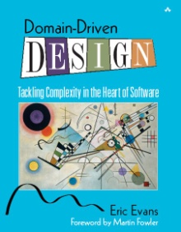


Strategic Design
Making Models Work in Large Projects
Eric Evans
Domain Language, Inc.
Eric Evans
Partnered in Scandinavia with

Slide 3
Not all of a large system will be well designed.

Slide 4
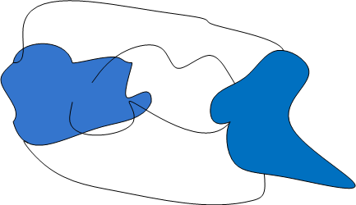
Ground Up Rebuild

Slide 5
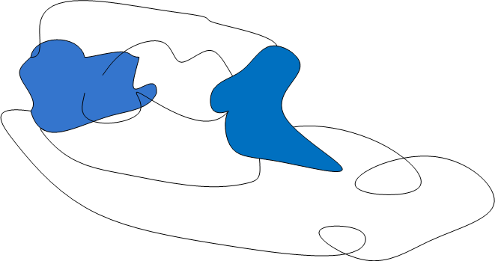
Ground Up Rebuild

Slide 6
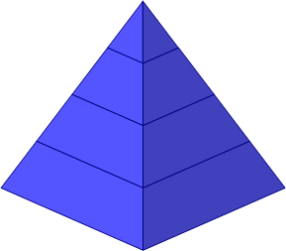
Ground Up Rebuild

Slide 7
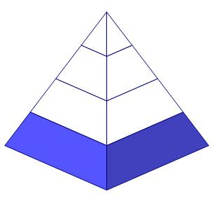
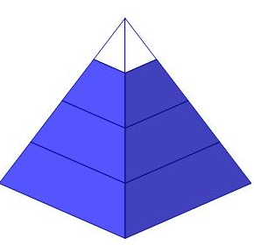
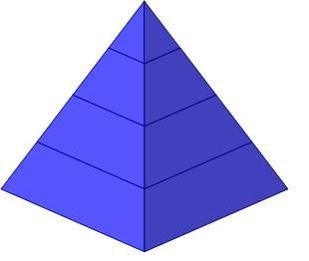
Ground Up Rebuild
Legacy Replaced
Year 1
Exciting New Features
Year 2
Year 3

Slide 8
Let’s Refactor

Slide 9
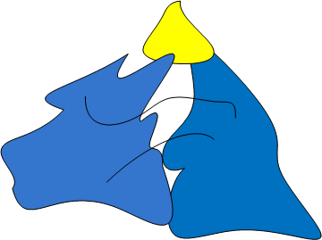
Let’s Refactor

Slide 10
Define Domain
domain A sphere of knowledge, influence, or activity.

Slide 11
Define Domain
domain A sphere of knowledge, influence, or activity.
The subject area to which the user applies a program is the domain of the software.

Slide 12
Why bother with models?

Slide 13
Critical Complexity Is
The critical complexity of most software projects is in understanding the domain itself.

Slide 14
What is a model?

Slide 15
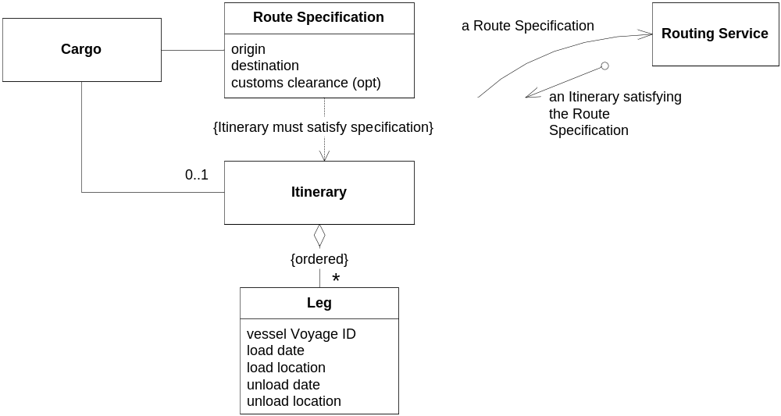

Slide 16
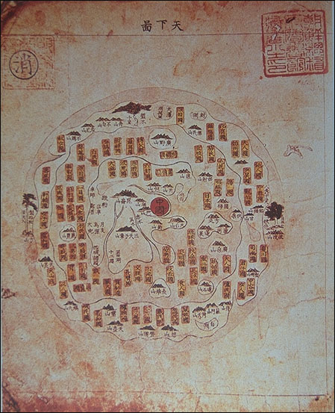
Chinese Map

Slide 17
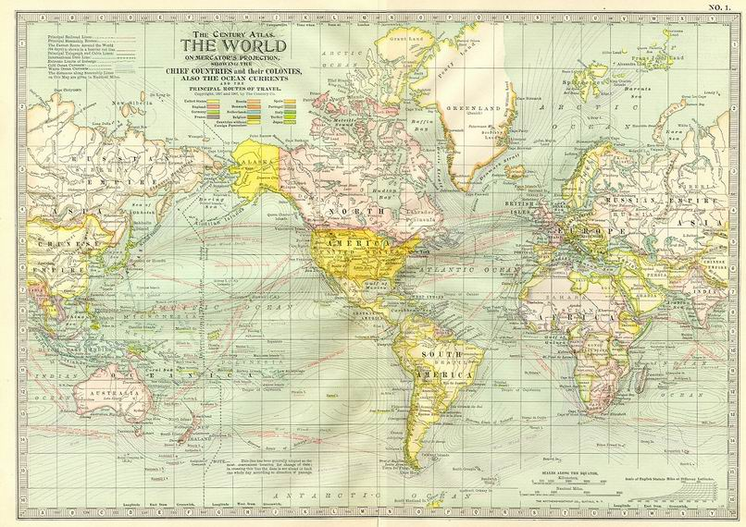
Mercator Map

Slide 18
Define Model
model A system of abstractions that describes selected aspects of a domain and can be used to solve problems related to that domain.

Slide 19
Define Model
model A system of abstractions that describes selected aspects of a domain and can be used to solve problems related to that domain.

Slide 20
Define Model
model A system of abstractions that describes selected aspects of a domain and can be used to solve problems related to that domain.

Slide 21
A Model Serves a Particular Use.

Slide 22
A Model Serves a Particular Use.
Not “as realistic as possible”

Slide 23
A Model Serves a Particular Use.
Not “as realistic as possible”
Useful relative to specific set of domain scenarios

Slide 24
Define Ubiquitous Language
ubiquitous language A language structured around the domain model and used by all team members to connect all the activities of the team with the software.

Slide 25
Define Context
context The setting in which a word or statement appears that determines its meaning.

Slide 26
There are always multiple models.

Slide 27
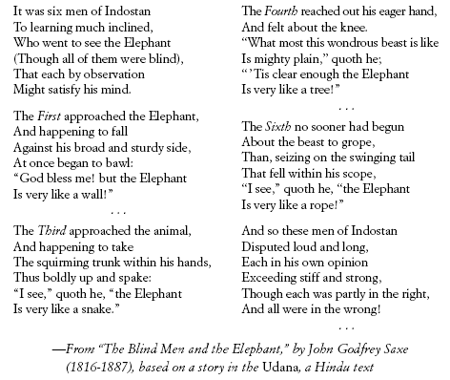

Slide 28
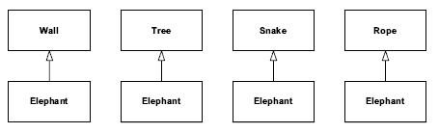

Slide 29
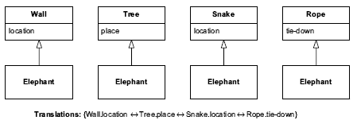

Slide 30
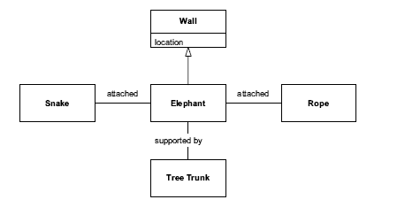

Slide 31
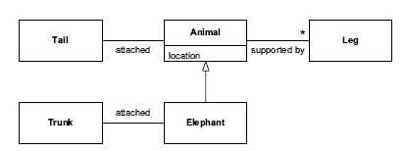

Slide 32

Rowing 8

Slide 33
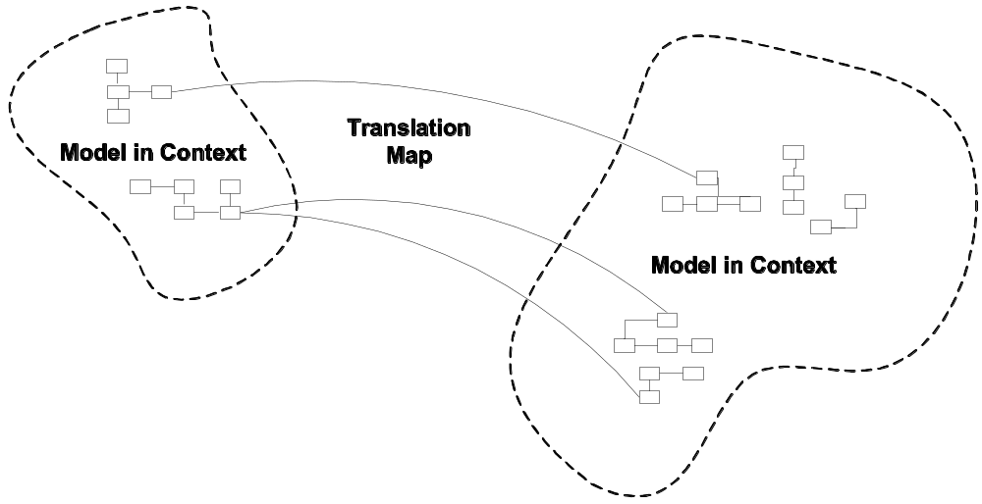
“Context Map”

Slide 34
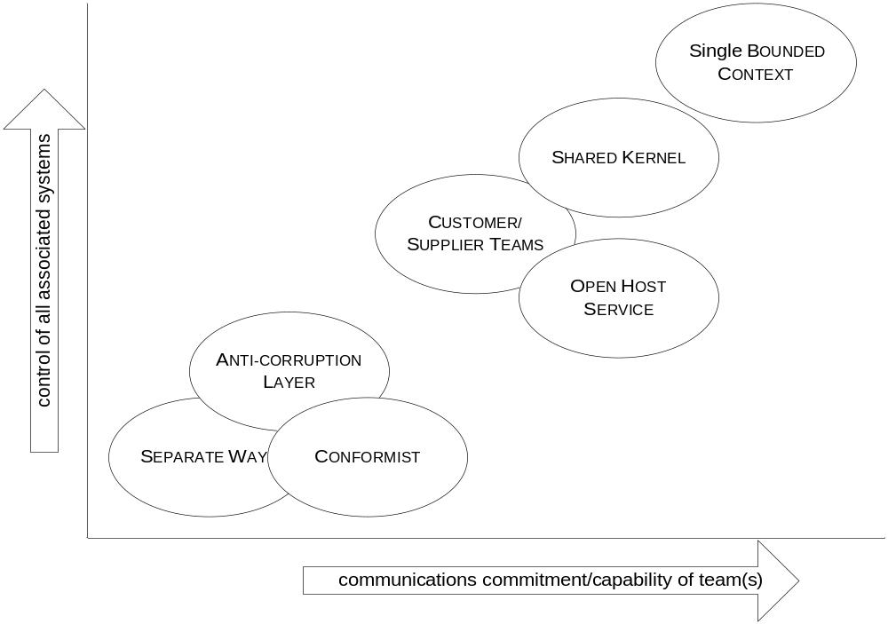

Slide 35
cooperative
upstream/downstream

Slide 36


Slide 37
uncooperative
upstream/
downstream

Slide 38


Slide 39
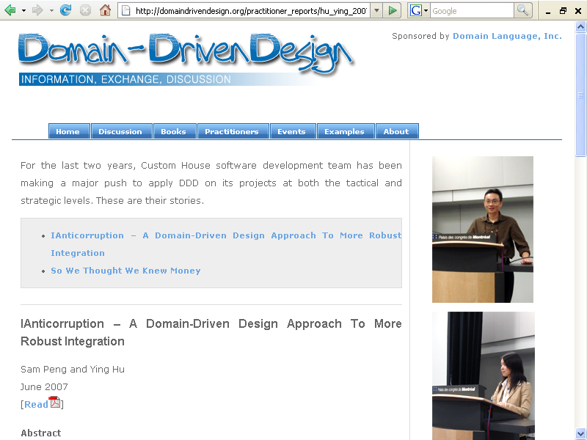


Slide 40
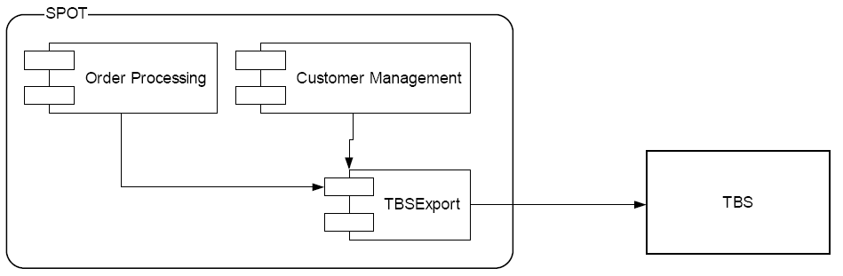
Custom House
Currency Exchange System early 2006

Slide 41
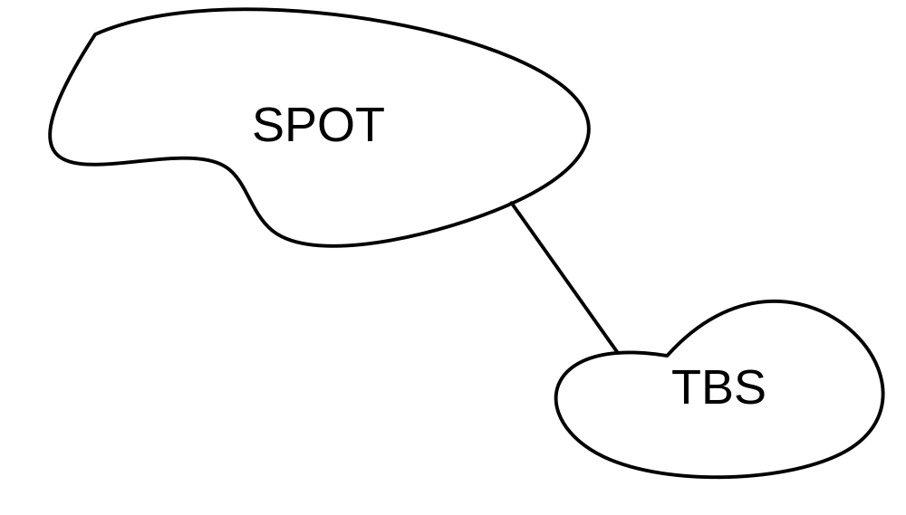
Custom House Context Map

Slide 42
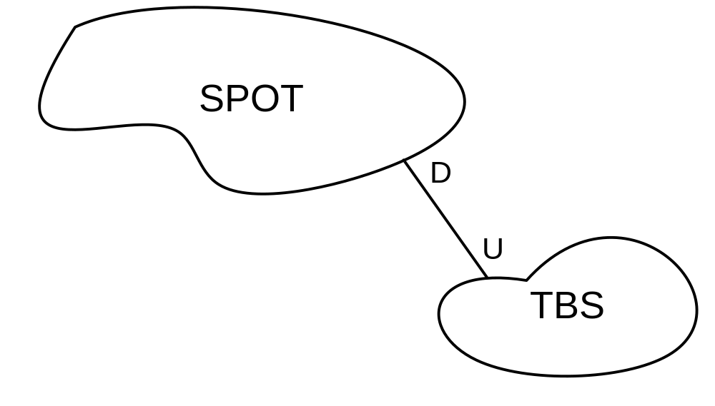
Custom House Context Map

Slide 43
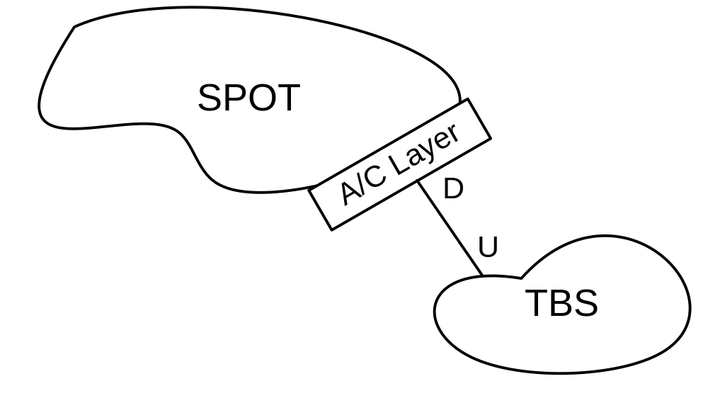
Custom House Context Map

Slide 44
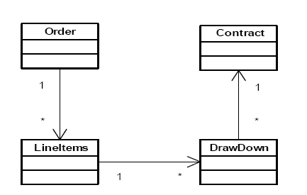
Custom House “SPOT” Model of Currency Exchange Deal

Slide 45
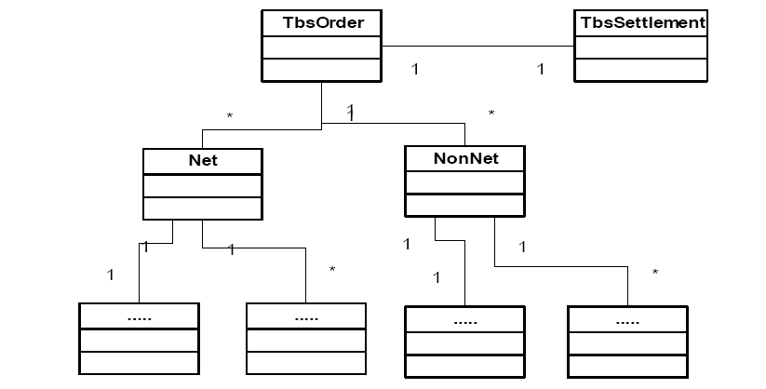
Object Interpretation of
Implicit “TBS” Model

Slide 46
Explicit Translation

Slide 47
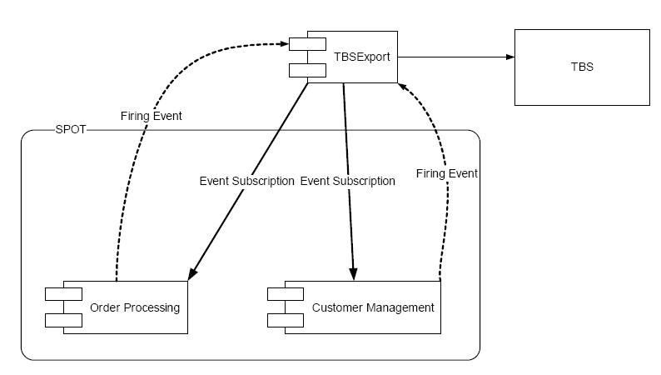
Custom House
Currency Exchange System late 2006

Slide 48
Map What Is

Slide 49
Push Translation to the Borders

Slide 50
Single, Unified Model within Any One Context

Slide 51
Single, Unified Model within Any One Context
(Where careful design is going on.)

Slide 52
Single, Unified Model within Any One Context
No duplication...

Slide 53
Single, Unified Model within Any One Context
No duplication...within a context!
Duplication between...

Slide 54
Single, Unified Model within Any One Context
No duplication...within a context!
Duplication between...AOK!

Slide 55
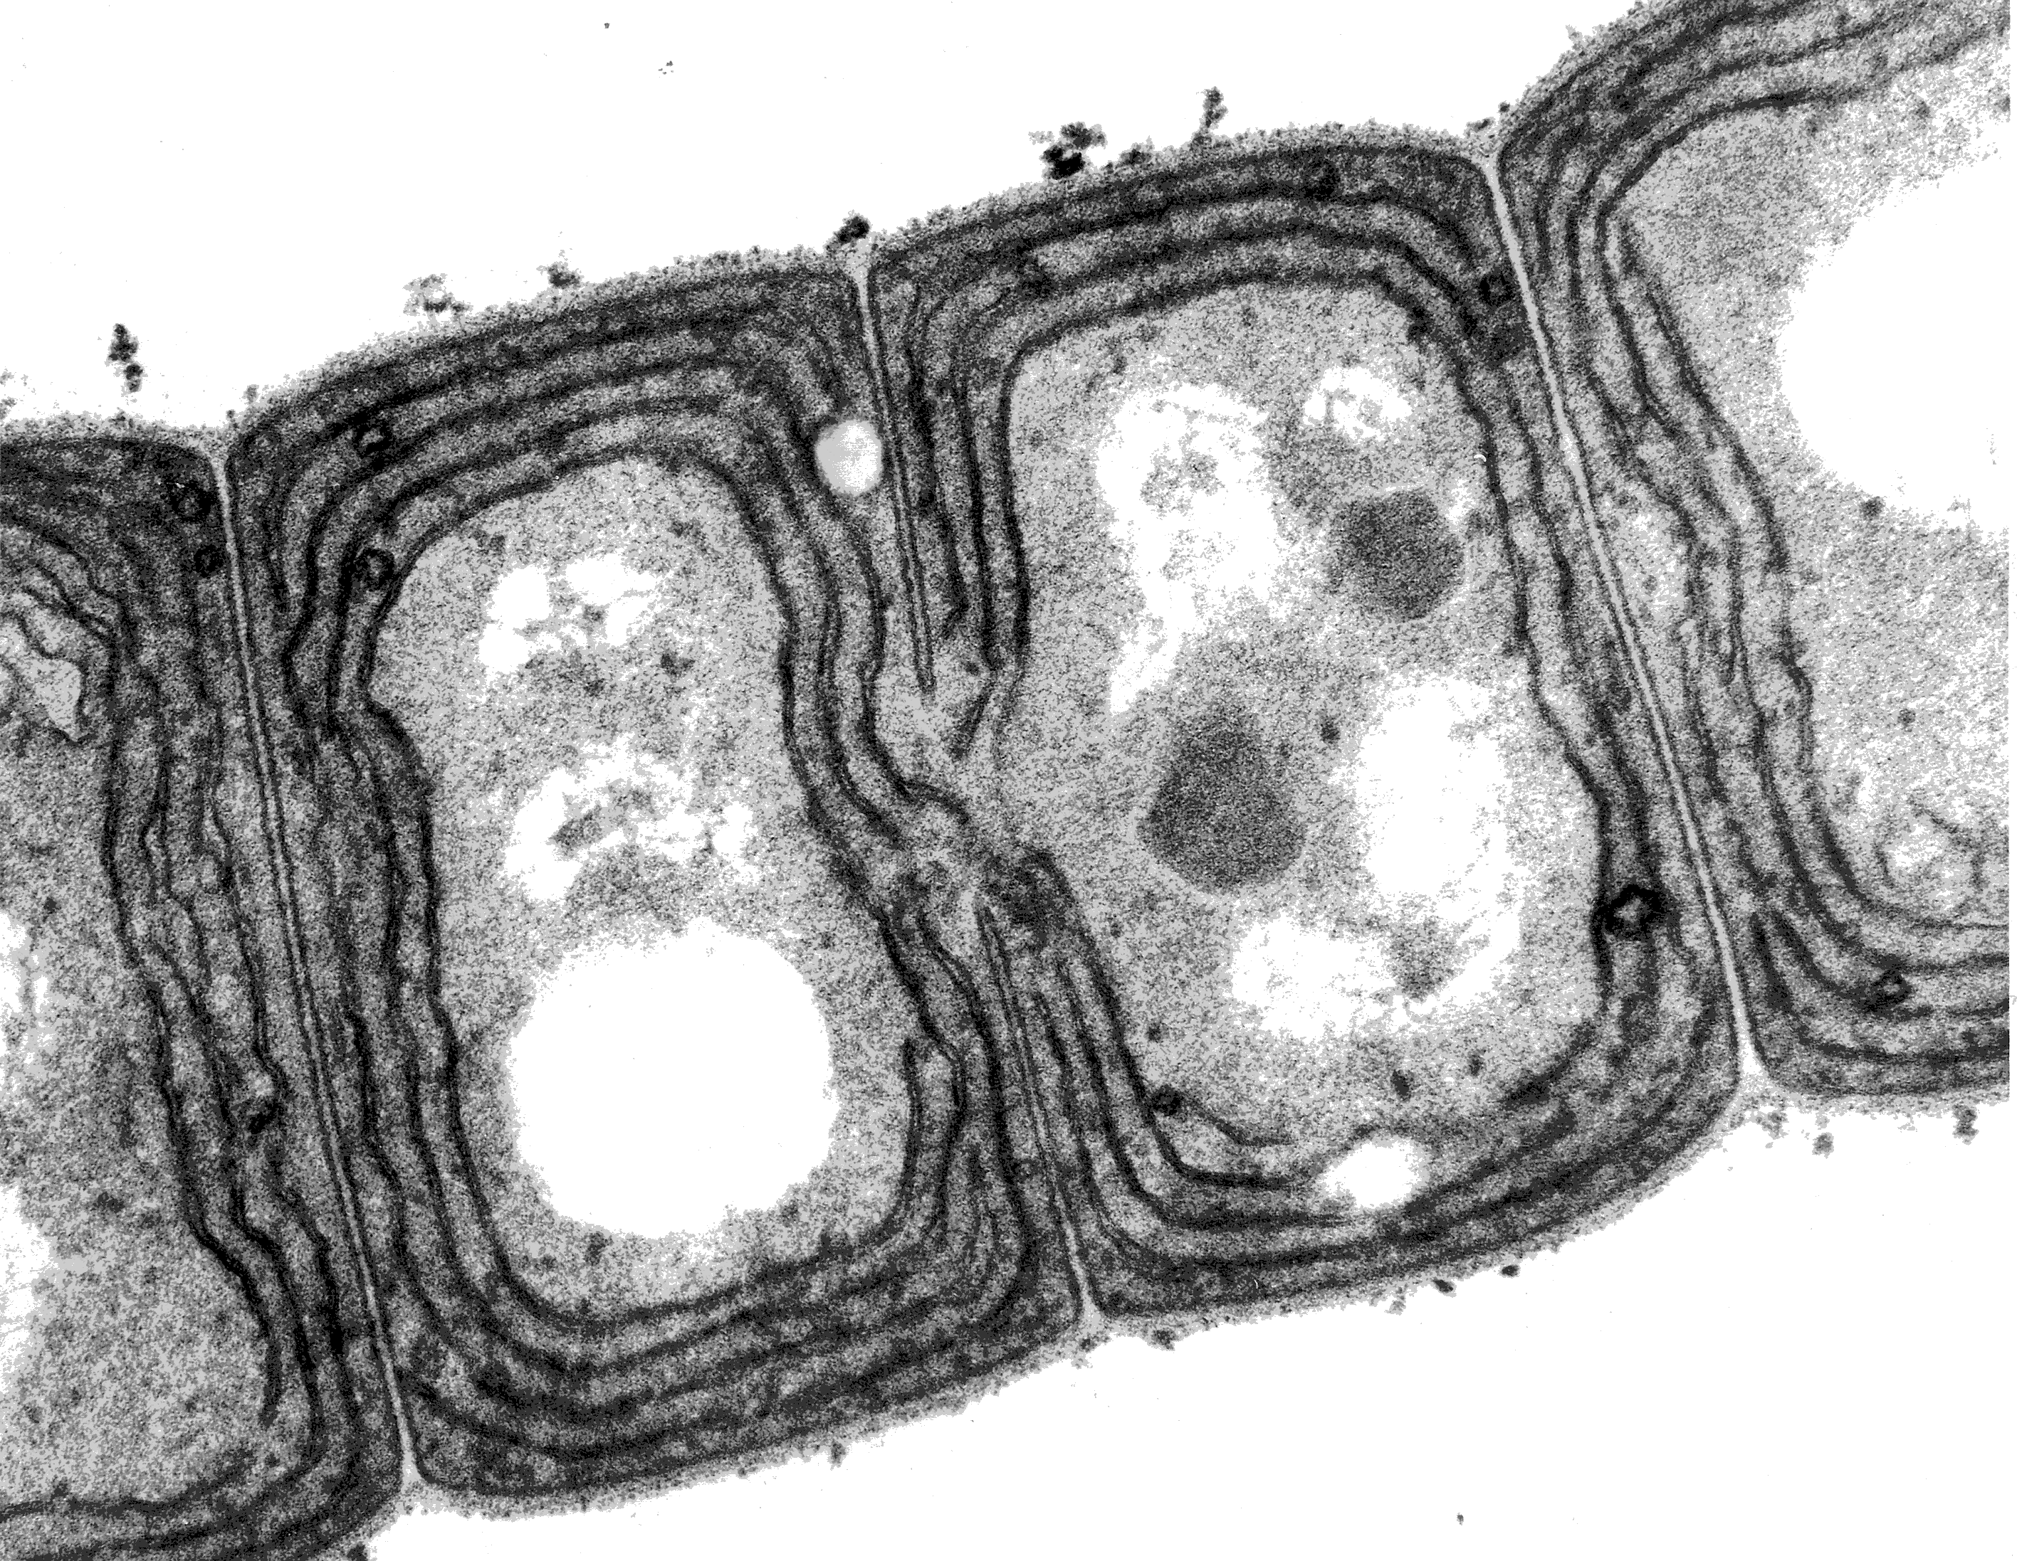

Slide 56
Ground Up Rebuild

Slide 57
Let’s Refactor

Slide 58
The Enterprise Model
One Ring to rule them all, One Ring to find them, One Ring to bring them all, and in the darkness bind them

Slide 59
Not all of a large system will be well designed.

Slide 60
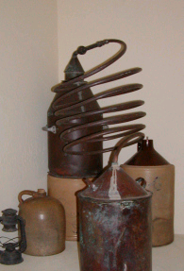
Distilling the Core Domain

Slide 61
Distilling the Core Domain
Generic Subdomains

Slide 62
Distilling the Core Domain
Generic Subdomains
Supporting Subdomains

Slide 63
Distilling the Core Domain
Generic Subdomains
Supporting Subdomains
Core Domain

Slide 64
Distilling the Core Domain
  What makes your system worth writing?

Slide 65
Distilling the Core Domain
  What makes your system worth writing?
  Why not buy it off the shelf?

Slide 66
Distilling the Core Domain
  What makes your system worth writing?
  Why not buy it off the shelf?
  Why not outsource it?

Slide 67
Distilling the Core Domain
  What makes your system worth writing?
  Why not buy it off the shelf?
  Why not outsource it?

Slide 68
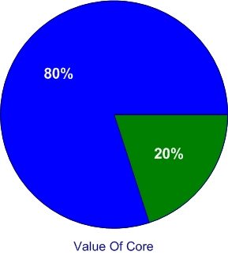
Effort Distribution

Slide 69
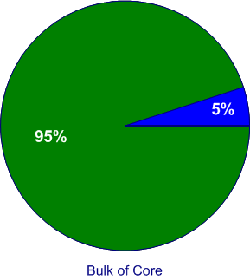
Effort Distribution

Slide 70
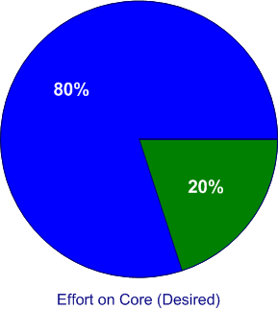
Effort Distribution

Slide 71
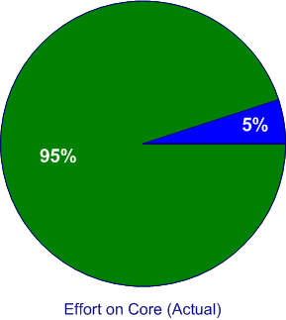
Effort Distribution

Slide 72
Ground Up Rebuild
Legacy Replaced
Year 1
Exciting New Features
Year 2
Year 3

Slide 73
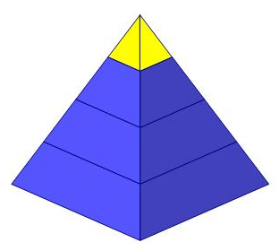
Which Part is Core?

Slide 74
Which Part is Core?

Slide 75
Responsibility Traps
…Or, Why do irresponsible programmers become heroes?

Slide 76
Let’s Hack

Slide 77
Let’s Hack

Slide 78
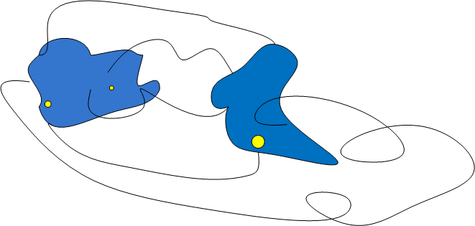
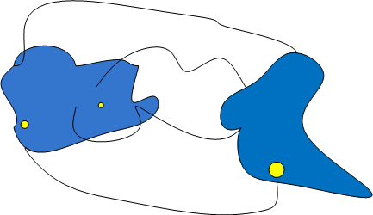
Which Parts are Core?

Slide 79
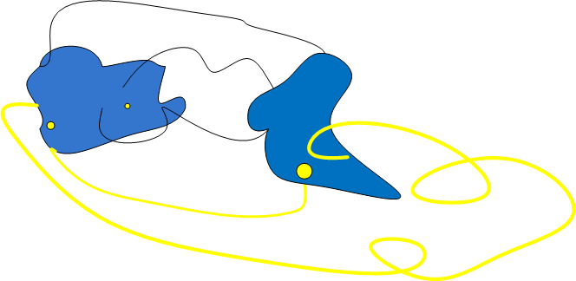
Which Parts are Core?

Slide 80
Responsibility Traps
Building a platform to make other (lesser) programmers more productive.
Cleaning up other people’s mess.

Slide 81
What’s a responsible designer to do?!!

Slide 82
How could we just build the core part?

Slide 83
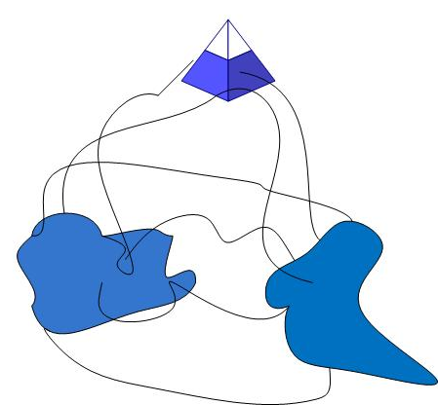
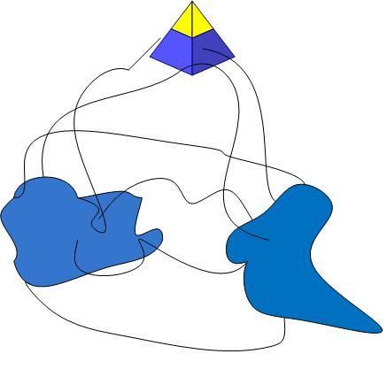
Build Platform Based on Model

Slide 84
Build Platform Based on Model

Slide 85
Strategy
Draw a Context Map.
Work with business leadership to define Core Domain.
Design a platform that supports work in the Core Domain.
Work with management to give freedom to the Core Domain Platform Context.
Develop and model in the Core Domain.

Slide 86
Strategy
Keep an eye on your Context Map.
Keep working with business leadership as Core Domain narrows and shifts.
Guard your platform that supports work in the Core Domain.
Keep working with management to maintain freedom of the Core Domain Platform Context.
Keep developing and evolving the model in the Core Domain.

Slide 87
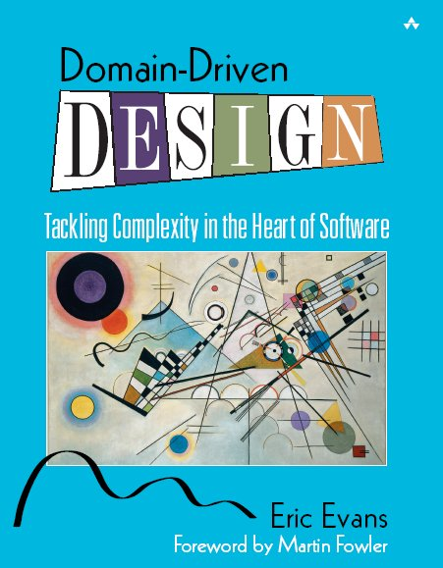
Strategic DDD Resources
www.domaindrivendesign.org
Domain-Driven Design
by Eric Evans
PART 4!
www.domainlanguage.com

