Slide 1
B
Distance Vector
Routing Simulator
2
3
A
C
4
1
An interactive, GUI-based tool for learning how routers find shortest paths.
5
D
2
E
Md. Tofazzol Alam Rahat | Roll 1740
Supervisor: Prof. Dr. Md. Shariful Islam
Institute of Information Technology, University of Dhaka
Notes:
Good morning everyone.
Today I’m going to present our project, “Distance Vector Routing Simulator.”
The main purpose of this project is to create an interactive simulator that shows how routers find the shortest path using the Distance Vector algorithm.
Instead of only seeing the final routing table, users can see the routing process step by step.

Slide 2


Problem Statement & Motivation
1
Routing protocols are taught from static tables — but they are dynamic processes.
THE PROBLEM
WHY THIS FAILS IN A TEXTBOOK
B
A
×
C
A static diagram can only show one snapshot. It cannot show a link failing, costs climbing round after round, or a loop-prevention rule stepping in to stop it — the exact moments where real understanding happens.
THE MOTIVATION
Goal: make every one of those moments visible and interactive.
Notes:
The main problem is that Distance Vector routing is usually taught using static routing tables.
Students can see the final result, but they cannot easily see how routers actually converge or what happens when a link fails.
Problems like routing loops and count-to-infinity are also difficult to understand from textbooks alone.
So, our goal is to make these processes visible and interactive.
The simulator will allow students to observe convergence, failures, loops, and loop-prevention techniques.

Slide 3

2
One engine, one interface
Java Swing GUI
C++ Core Engine
Build the topology: add or remove routers and links, set costs
Animated messages moving between routers
Live routing tables and convergence status
Start, pause, reset, step, speed control
Event and message log
Distance Vector with Bellman-Ford updates
Split Horizon, Poison Reverse, Hold-Down
Link State with Dijkstra’s algorithm
Discrete-event queue, periodic and triggered updates
Convergence and loop detection
commands
JSON / IPC
results & events
C++ does the routing. Java Swing shows it live.
Notes:
Our system has two main parts.
First, we have a C++ core engine, which performs the routing simulation.
Second, we have a Java Swing GUI, which allows users to interact with the simulator.
Users can create network topologies, add routers and links, change link costs, and observe routing tables and messages.
The simulator supports Distance Vector with Bellman-Ford, along with techniques like Split Horizon and Poison Reverse.
It also supports Link State using Dijkstra's algorithm for comparison.
C++ and Java communicate using JSON and IPC.

Slide 4

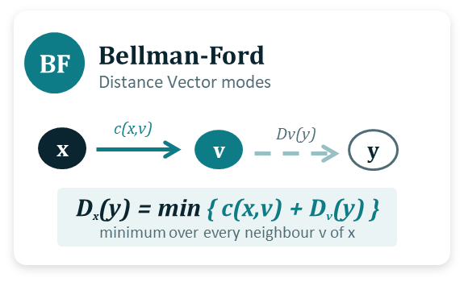
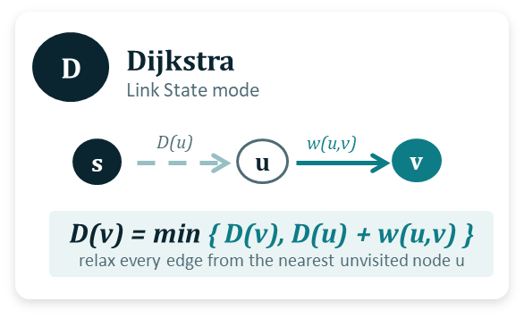
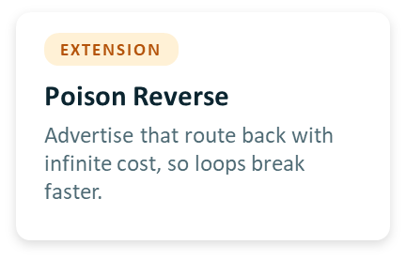
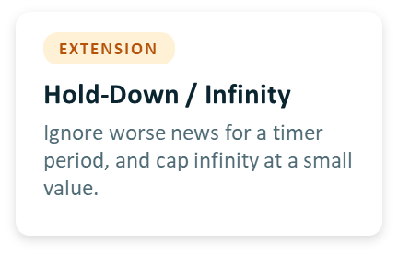
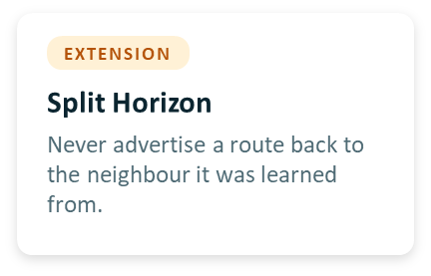
3
Notes:
Here we compare two routing approaches.
In Distance Vector, each router mainly knows information from its neighbouring routers. It uses the Bellman-Ford approach to find the minimum-cost path.
Because routers have limited information, problems like routing loops and count-to-infinity can occur.
On the other hand, Link State uses Dijkstra's algorithm. Here, routers have the complete topology information and calculate the shortest path from that information.
Our simulator will allow us to observe the difference between these two approaches using the same network and events.

Slide 5
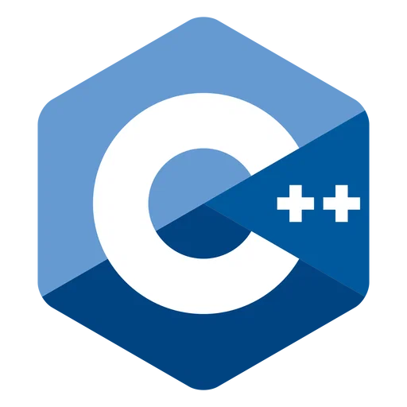


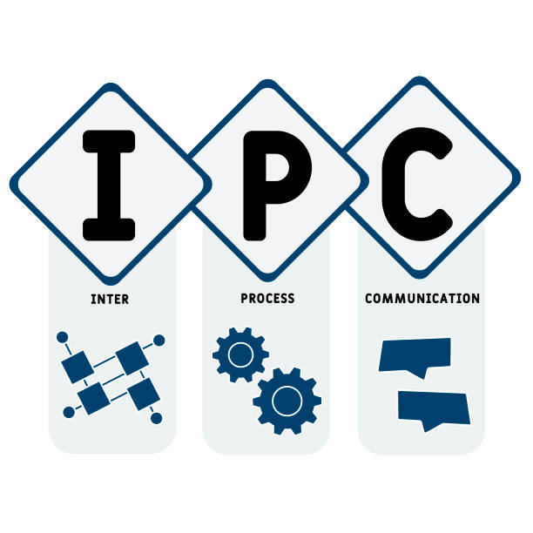
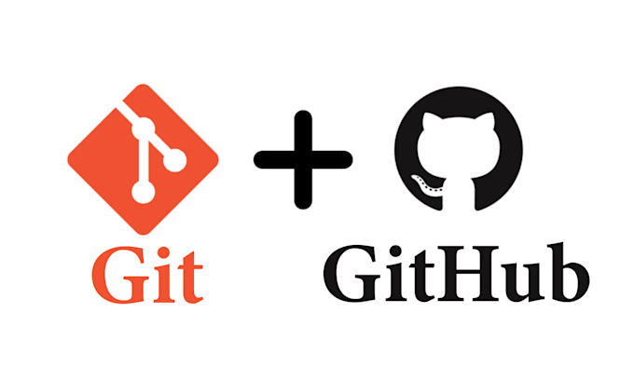
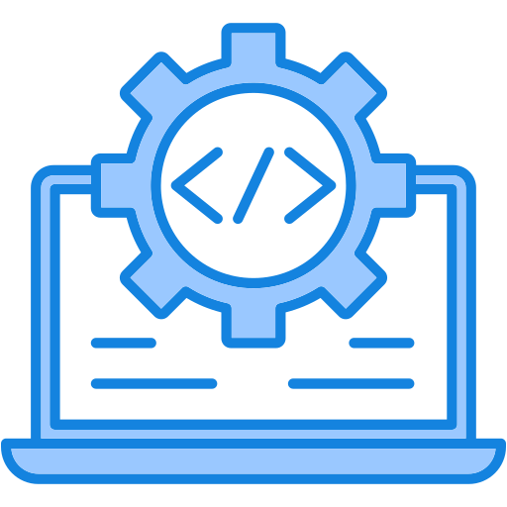


4
Target Users & Technology
Who it is for, and what it is built with.
TARGET USERS
TECHNOLOGY / TOOLS
•
Networking students
learning how routing protocols actually behave, not just their formulas
routing simulation core
Swing graphical interface
•
Course instructors
demonstrating Distance Vector vs Link State live in class
/
C++ ↔ Java communication
version control
•
Self-learners
studying RIP, Bellman-Ford, or Dijkstra hands-on
G++ & Java JDK
Linux command line
Notes:
Our main target users are networking students, course instructors, and self-learners.
Students can use it to understand routing protocols practically, while instructors can use it for classroom demonstrations.
For technology, we are using C++ for the simulation core, Java Swing for the GUI, and JSON/IPC for communication.
We are also using Git and GitHub for version control.

Slide 6


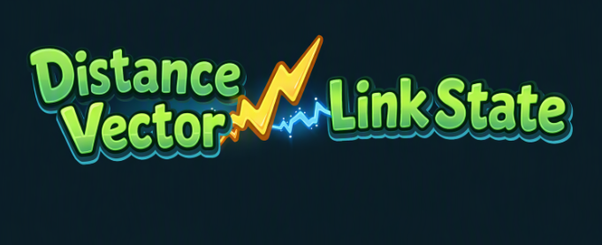
5
Expected Outcome
A working, demonstrable simulator — not just a set of algorithms.
B
2
3
A
C
4
5
×
1
2
E
D
A complete simulator
A ready demonstration
STRETCH GOAL
(optional)
Thank you
Side-by-side comparison
Questions & feedback are welcome.
Notes:
Finally, our expected outcome is a complete and working routing simulator.
It will demonstrate convergence, link failures, routing loops, and loop-prevention techniques.
We also want to provide a direct comparison between Distance Vector and Link State on the same topology.
If time allows, we also plan to package it as a standalone desktop application.
That’s all from my side.
Thank you everyone for listening. I’m happy to take any questions.

