Slide 1
CS 106B
Homework 7:
Trailblazer
This document is copyright (C) Marty Stepp and Stanford Computer Science.
Licensed under Creative Commons Attribution 2.5 License. All rights reserved.

Slide 2
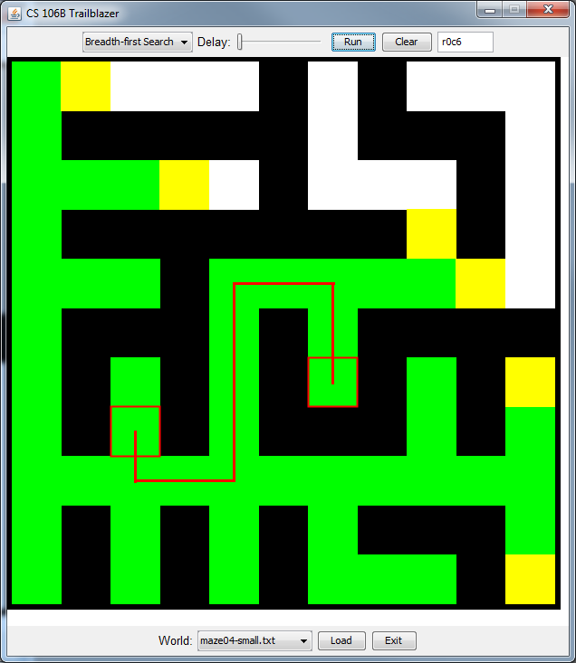
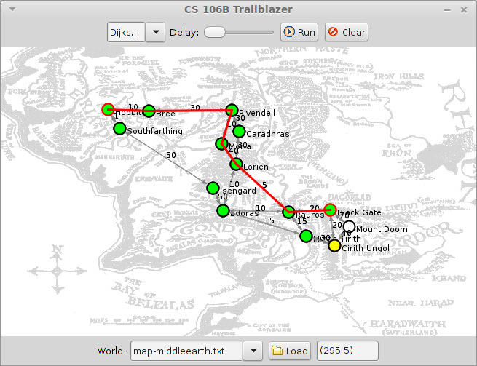
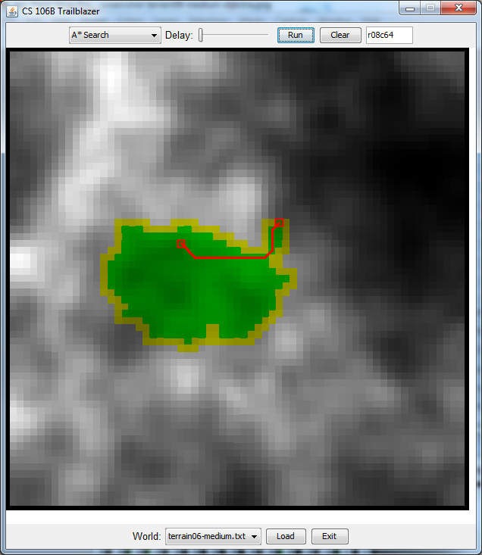
Screenshots

Slide 3
Functions to write
// four path-searching algorithms
Vector<Vertex*> depthFirstSearch(BasicGraph& graph,
Vertex* start,
Vertex* end)
breadthFirstSearch(...)
dijkstrasAlgorithm(...)
aStar(...)
// method for making random mazes by producing
// a minimum spanning tree of the graph
Set<Edge*> kruskal(BasicGraph& graph)

Slide 4
DFS
function dfs(v1, v2):
reset graph data.
dfsHelper(v1, v2, {}).
function dfsHelper(v1, v2, path):
add v1 to path.
mark v1 as visited.
if v1 is v2:
a path is found!
for each unvisited neighbor n of v1:
if dfsHelper(n, v2, path) finds a path:
hooray, a path is found!
// if we get here, no path was found here.
remove v1 from path.

Slide 5
BFS
function bfs(v1, v2):
queue := {v1}.
while queue is not empty:
dequeue a vertex v from the queue.
mark v as visited.
if v is v2:
a path is found! reconstructPath(v1, v2).
else for each unvisited neighbor n of v:
set n's previous to be v.
enqueue n in queue.
function reconstructPath(v1, v2):
v := v2.
while v does not equal v1:
insert v at front of path.
v = v's previous.

Slide 6
Dijkstra's Algorithm
function dijkstra(v1, v2):
initialize every vertex to have a cost of infinity.
set v1's cost to 0.
pqueue := {v1, at priority 0}.
while pqueue is not empty:
v := dequeue vertex from pqueue with minimum priority.
mark v as visited.
if v is v2:
reconstructPath(v1, v2).
else for each unvisited neighbor n of v:
cost := v's cost + weight of edge (v, n).
if cost < n's cost:
set n's cost to cost, and n's previous to v.
enqueue n in the pqueue
with priority of cost,
or update priority to cost
if it was already in the pqueue.

Slide 7
A* Search
function aStar(v1, v2):
initialize every vertex to have a cost of infinity.
set v1's cost to 0.
pqueue := {v1, at priority H(v1, v2)}.
while pqueue is not empty:
v := dequeue vertex from pqueue with minimum priority.
mark v as visited.
if v is v2:
reconstructPath(v1, v2).
else for each unvisited neighbor n of v:
cost := v's cost + weight of edge (v, n).
if cost < n's cost:
set n's cost to cost, and n's previous to v.
enqueue n in the pqueue
with priority of (cost + H(v1, v2)),
or update priority to (cost + H(v1, v2))
if it was already in the pqueue.

Slide 8
Kruskal's algorithm
function kruskal(graph):
// Place each vertex into its own "cluster" (group of reachable vertices).
// Implement as a map from vertex* to sets of other vertex*.)
clusters := {}.
for each Vertex v in graph:
clusters[v] = {v}.
// Put all edges into a priority queue, using weights as priorities.
pq := {}.
for each Edge e in graph.getEdgeSet():
pq.enqueue(e, e->cost).
MST := {}.
while pq.size() > 1:
Edge e := pq.dequeue().
if clusters[e->start] is different from clusters[e->finish]:
// Merge the clusters containing the start and finish vertices of e.
for each Vertex in clusters[e->start]:
add all of e->finish to that vertex's cluster.
for each Vertex in clusters[e->finish]:
add all of e->start to that vertex's cluster.
// Add this edge to the minimum spanning tree.
MST += e.
return MST.

Slide 9
Common bugs
int vs double issues (round-off)
  always use double when computing costs / priorities
algorithms only work once and fail the second time
  forgetting to call graph.resetData() at start of algorithm
A* produces wrong answer; total length or cost is too high
  wrong priority/cost being used; cost != priority!!
DFS crash on large graphs
  it's a stack overflow (this is okay)
Kruskal is very slow
  maybe used the wrong data structure (see our pseudo solution)

