Slide 1
CS 106X
Homework 6, Binary Trees:
21 Questions, Huffman Encoding

Slide 2
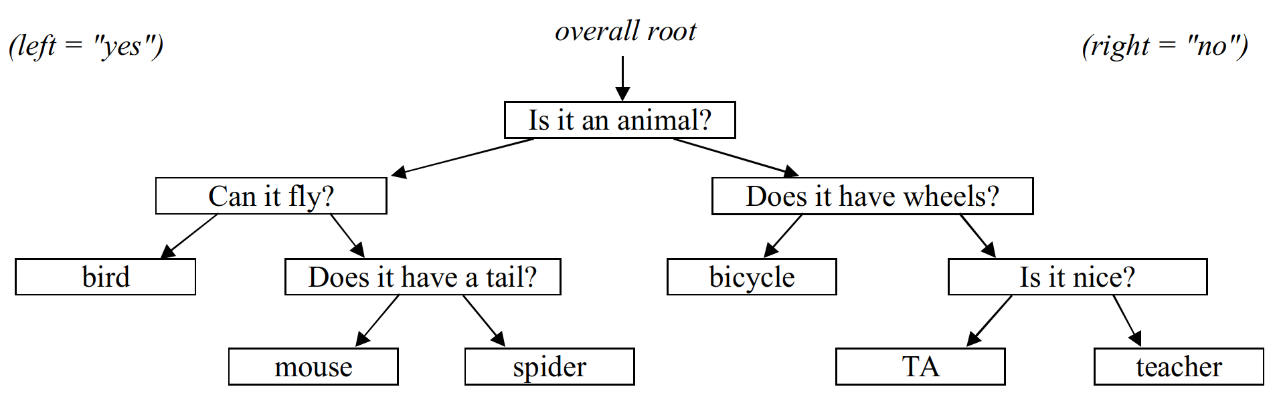
Part A: 21 Questions
"sequel" to past 20 Questions recursion problem:
  stores question/answer data in a binary tree
  "learns" after losing a game by asking player for new data
// questions.txt
Q:Is it an animal?
Q:Can it fly?
A:bird
Q:Does it have a tail?
A:mouse
A:spider
Q:Does it have wheels?
A:bicycle
Q:Is it nice?
A:TA
A:teacher

Slide 3
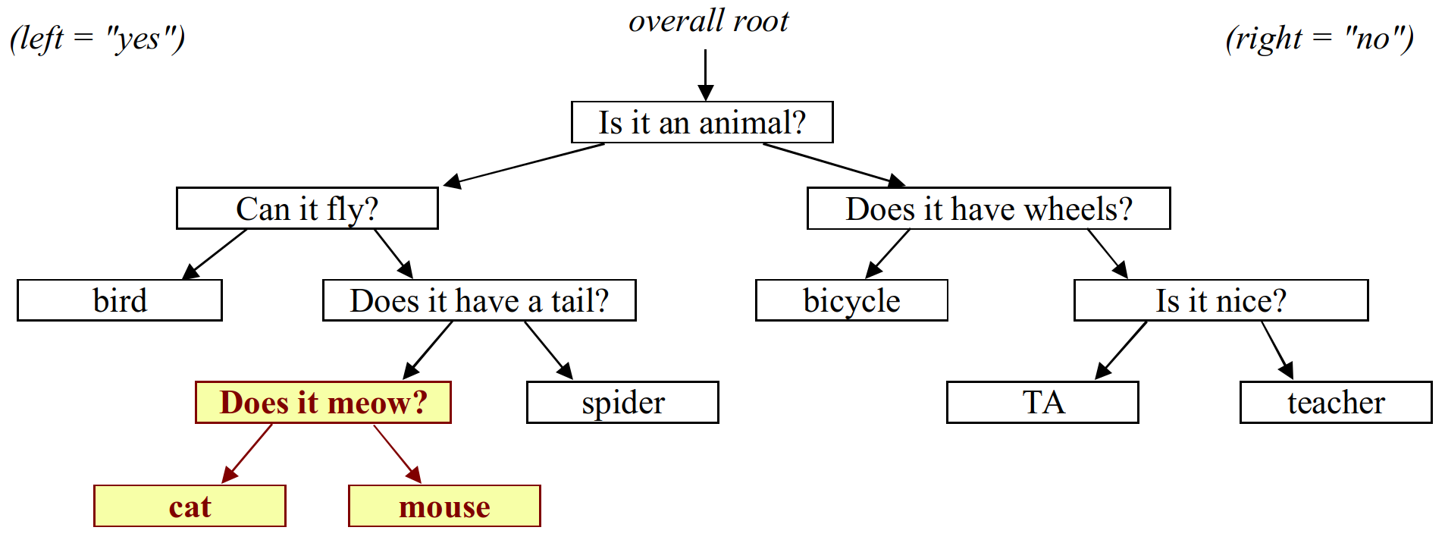
Growing question tree
when computer loses, asks human player for a new Q/A node
// log of execution
Is it an animal? y
Can it fly? n
Does it have a tail? y
Is your object: mouse? no
Drat, I lost. What is your object? cat
Type a yes/no question to distinguish cat from mouse: Does it meow?
And what is the answer for cat? y

Slide 4
Code they will write
game state is now stored in a QuestionTree class:
class QuestionTree {
public:
QuestionTree();
~QuestionTree();
int getGamesLost() const;
int getGamesWon() const;
void playGame();
void readData(istream& input); // save to file
void writeData(ostream& output); // load from file
private:
QuestionNode* root; // node = {string data, node* yes/no}
...
};

Slide 5
Part B: Huffman encoding
Uses variable lengths for different characters to take advantage of their relative frequencies.
Char | ASCII value | ASCII (binary) | Hypothetical Huffman
' ' | 32 | 00100000 | 10
'a' | 97 | 01100001 | 0001
'b' | 98 | 01100010 | 01110100
'c' | 99 | 01100011 | 001100
'e' | 101 | 01100101 | 1100
'z' | 122 | 01111010 | 00100011110

Slide 6
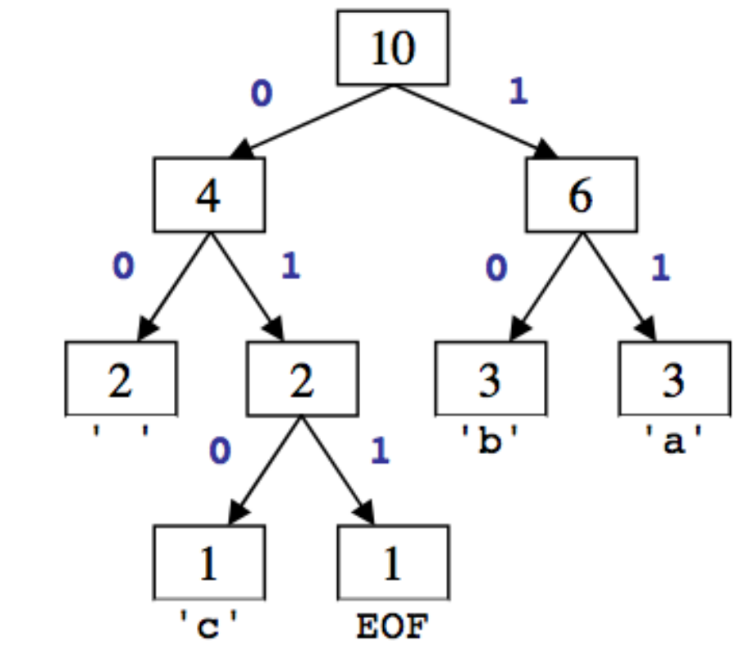
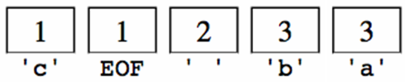
Huffman compression
  1. Count occurrences of each char in file
  {' ':2, 'a':3, 'b':3, 'c':1, EOF:1}
  2a. Place chars, counts into priority queue
  2b. Use PQ to create Huffman tree →
  3. Traverse tree to find (char → binary) map
  {' ':00, 'a':11, 'b':10, 'c':010, EOF=011}
  4. Convert to binary (For each char in file, look up binary rep in map)
  11 10 00 11 10 00 010 1 1 10 011 00

Slide 7
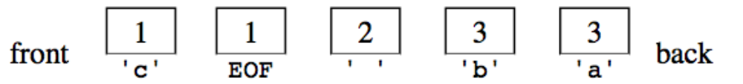
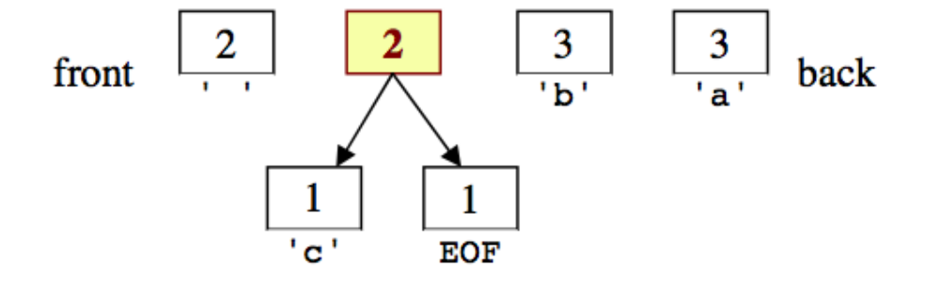
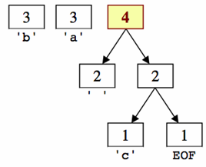
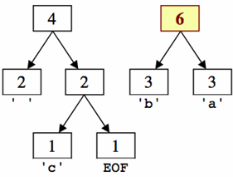
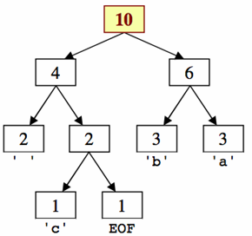
2b) Build tree

Slide 8
3) Tree to binary encodings
The Huffman tree tells you the binary encodings to use.
  left means 0, right means 1
  example: 'b' is 10
  example: 'c' is 010

Slide 9
4) Encode the file
Based on the preceding tree, we have the following encodings:
  {' ':00, 'a':11, 'b':10, 'c':010, EOF:011}
  The text "ab ab cab" would be encoded as:
  Overall: 1110001110000101110011, (22 bits, ~3 bytes)
char | 'a' | 'b' | ' ' | 'a' | 'b' | ' ' | 'c' | 'a' | 'b' | EOF
binary | 11 | 10 | 00 | 11 | 10 | 00 | 010 | 11 | 10 | 011
byte | 1 | 2 | 3
char | a b a | b c a | b EOF
binary | 11 10 00 11 | 10 00 010 1 | 1 10 011 00

Slide 10
Decompressing
  1011010001101011011
  Read each bit one at a time.
  If it is 0, go left; if 1, go right.
  If you reach a leaf, output the
  character there and go back
  to the tree root.
Output:
  bac aca
1011010001101011011
b a c _ a c a

Slide 11
Bit I/O streams
ibitstream: Reads one bit at a time from input.
obitstream: Writes one bit at a time to output.
  i/obitstream also contain the members from i/ostream.
    open, read, write, fail, close
int readBit() | Reads a single 1 or 0; returns -1 at end of file
void writeBit(int bit) | Writes a single bit (must be 0 or 1)

