Slide 1
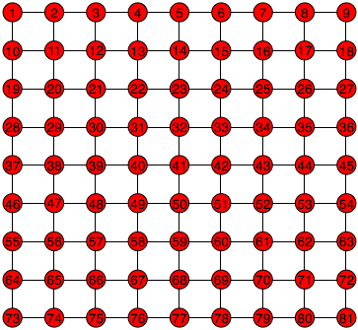
Start
Goal
A grid graph

Slide 2
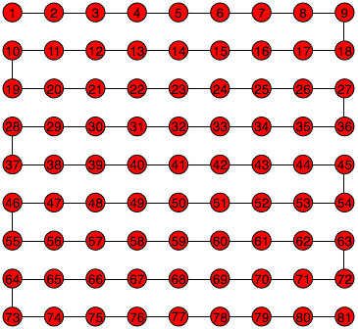
Start
Goal
A path from start to goal

Slide 3


Start
Goal
Key and treasure box

Slide 4
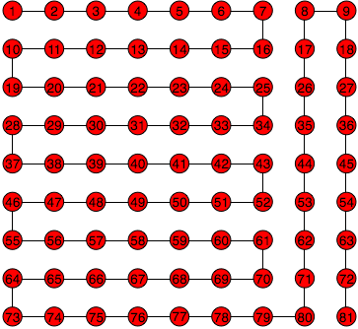
Start
Goal
A path on which the box is opened

Slide 5
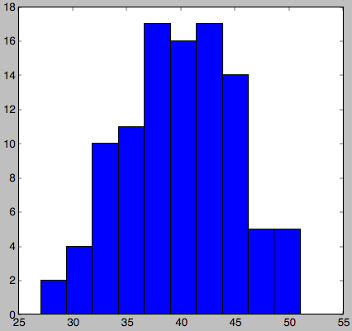
Histogram of turn counts

Slide 6

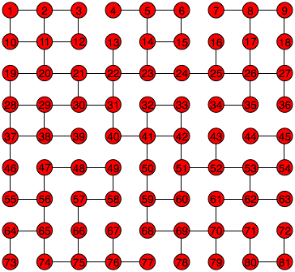
House
Line with switch
A power distribution network

Slide 7
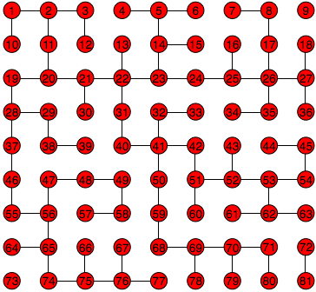
An unsafe power flow

Slide 8
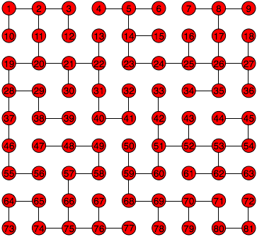
A safe power flow

Slide 9
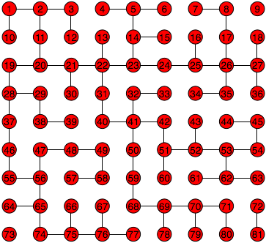
Current unsafe configuration

Slide 10
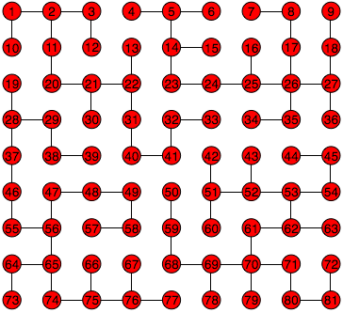

switch operated
Similar but safe configuration

