Slide 1
Scenario 1: High Car prob
Max Car Spaces: 100
Max small car spaces: 20
Max Motorcycle Spaces: 20
Max Queue Size: 10
RNG Seed: 100
Car Prob: 1.0
Small car prob: 0.2
Motorcycle prob:0.05
meanStay: 120.0
sdStay: 39.6

Slide 2
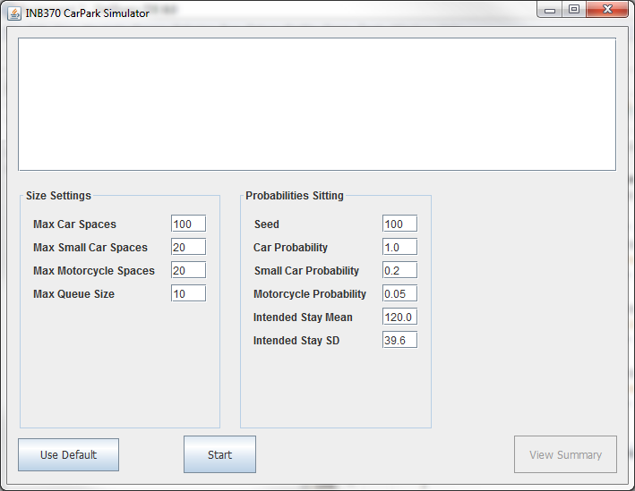
Screenshot

Slide 3
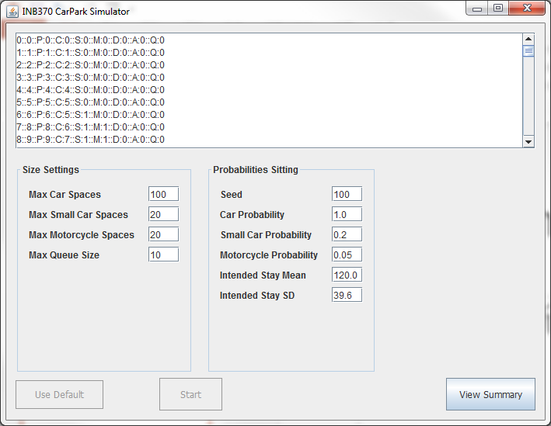
Start Simulation

Slide 4
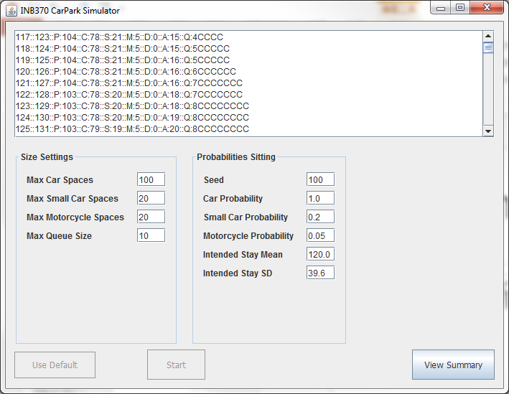
Start Simulation

Slide 5
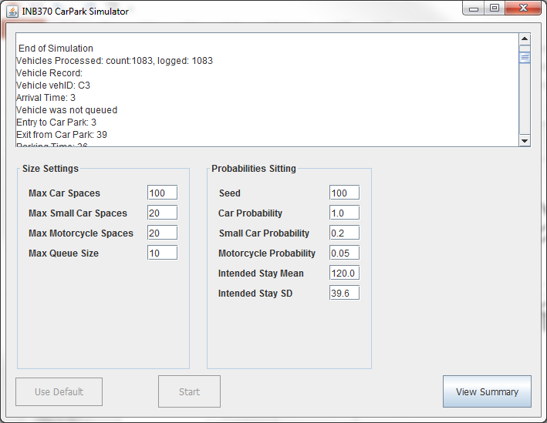
End of Simulation

Slide 6
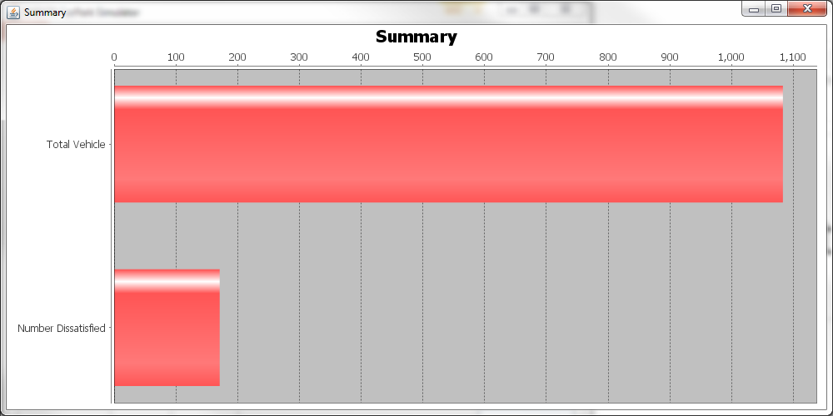
Summary Bar Chart

Slide 7
Scenario 2: Low Car prob
Max Car Spaces: 100
Max small car spaces: 20
Max Motorcycle Spaces: 20
Max Queue Size: 10
RNG Seed: 100
Car Prob: 0.4
Small car prob: 0.2
Motorcycle prob:0.05
meanStay: 120.0
sdStay: 39.6

Slide 8
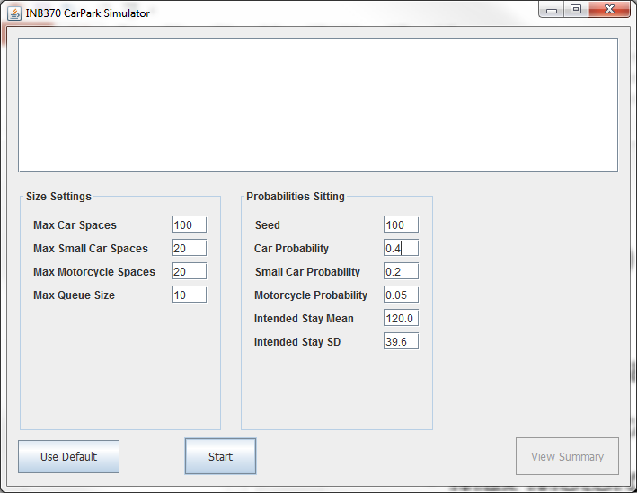
Screenshot

Slide 9
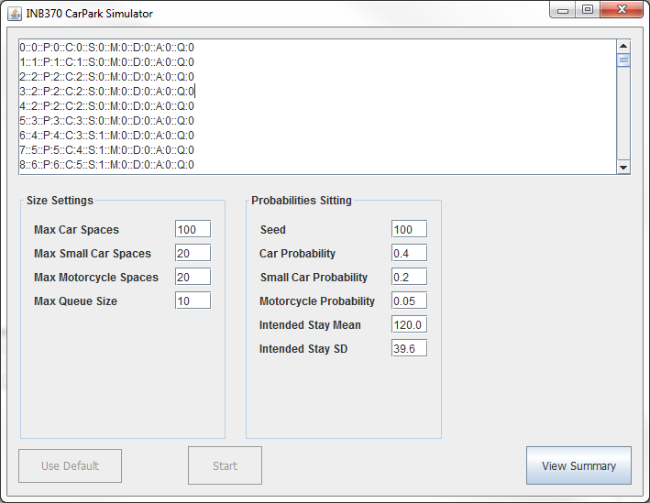
Start Simulation

Slide 10
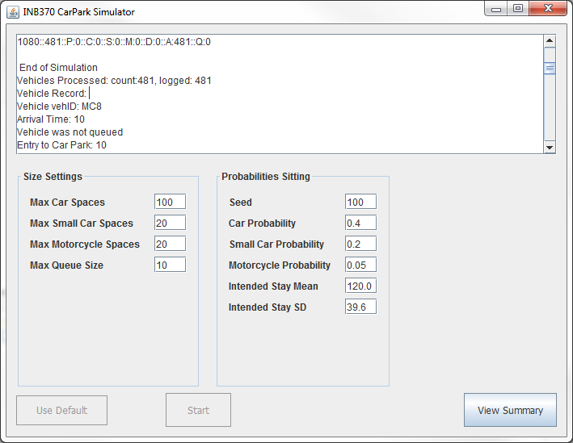
End of Simulation

Slide 11
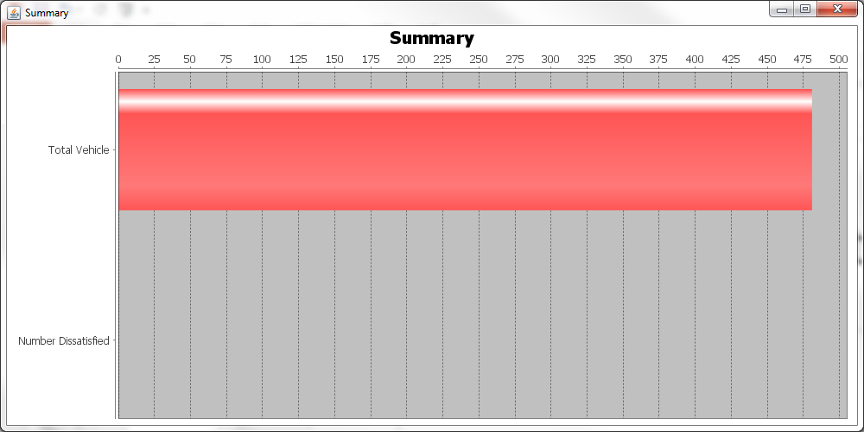
Summary Bar Chart

Slide 12
Scenario 3: High small Car prob
Max Car Spaces: 100
Max small car spaces: 20
Max Motorcycle Spaces: 20
Max Queue Size: 10
RNG Seed: 100
Car Prob: 1.0
Small car prob: 0.8
Motorcycle prob:0.05
meanStay: 120.0
sdStay: 39.6

Slide 13

Screenshot

Slide 14
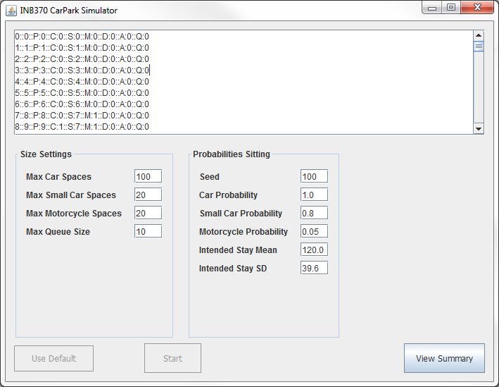
Start Simulation

Slide 15
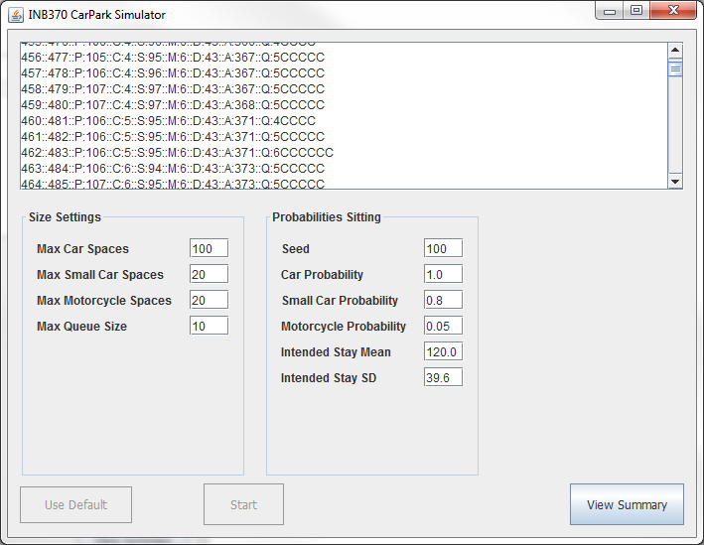
Start Simulation

Slide 16
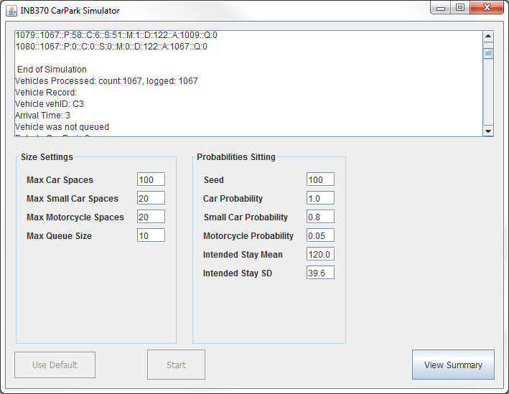
End of Simulation

Slide 17
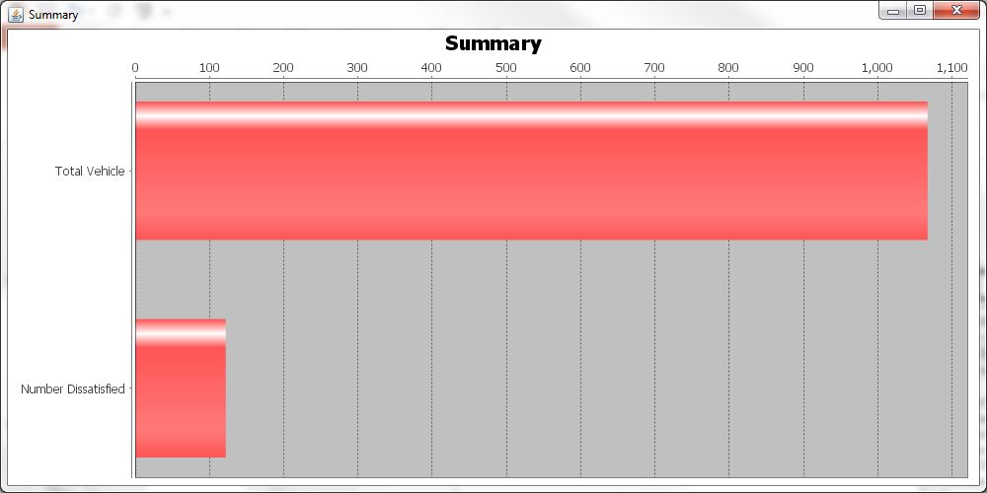
Summary Bar Chart

Slide 18
Scenario 4: High motorcycle prob
Max Car Spaces: 100
Max small car spaces: 20
Max Motorcycle Spaces: 20
Max Queue Size: 10
RNG Seed: 100
Car Prob: 1.0
Small car prob: 0.2
Motorcycle prob:0.8
meanStay: 120.0
sdStay: 39.6

Slide 19
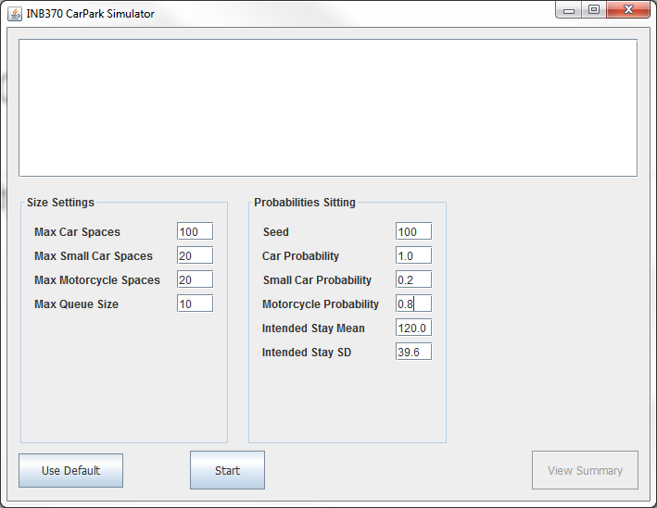
Screenshot

Slide 20
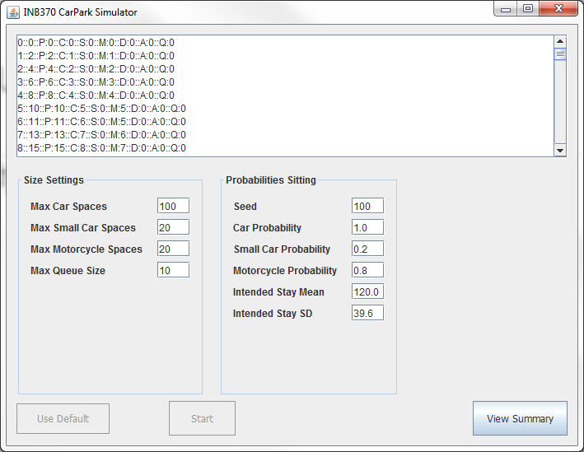
Start Simulation

Slide 21
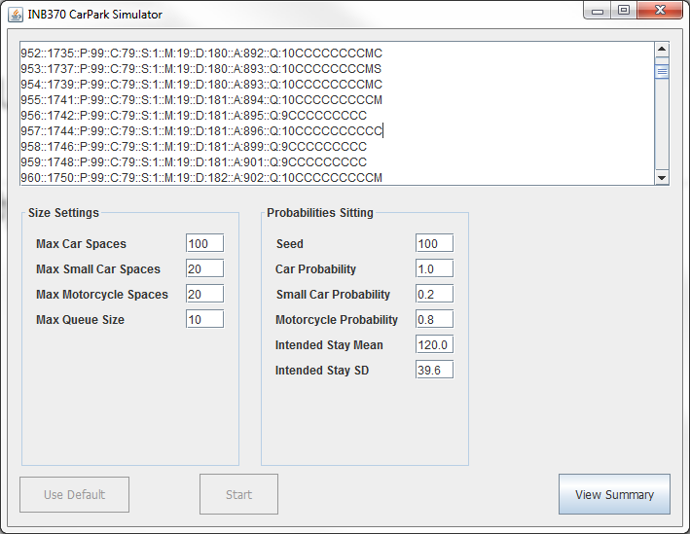
Start Simulation

Slide 22
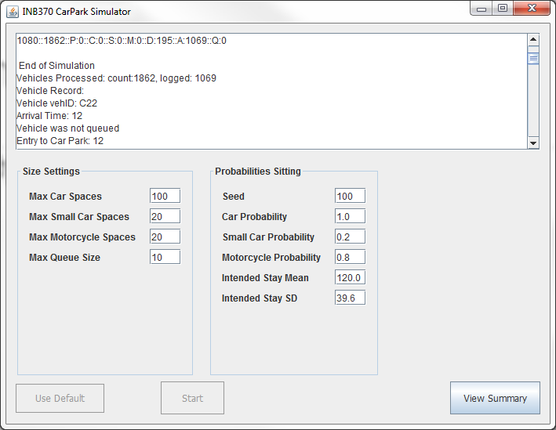
End of Simulation

Slide 23
Summary Bar Chart

Slide 24
Scenario 5: Small car parks
Max Car Spaces: 20
Max small car spaces: 5
Max Motorcycle Spaces: 5
Max Queue Size: 10
RNG Seed: 100
Car Prob: 1.0
Small car prob: 0.2
Motorcycle prob:0.05
meanStay: 120.0
sdStay: 39.6

Slide 25
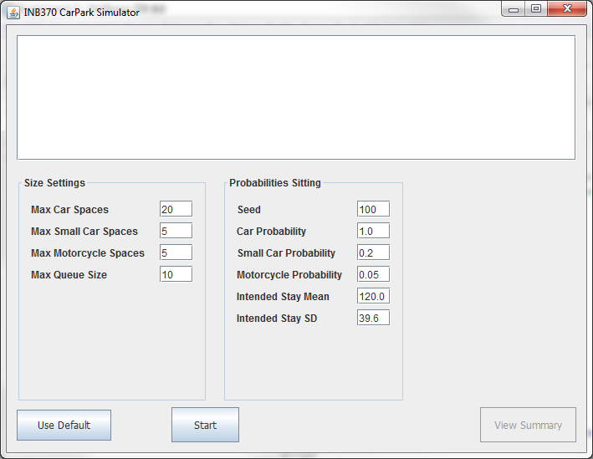
Screenshot

Slide 26

Start Simulation

Slide 27
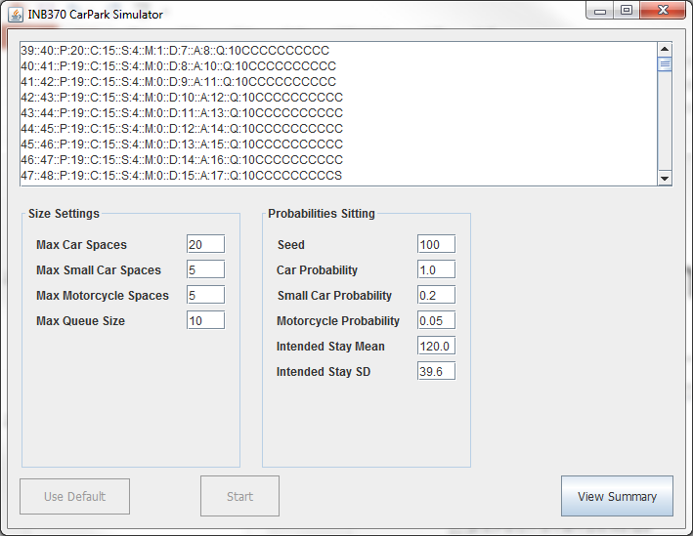
Start Simulation

Slide 28
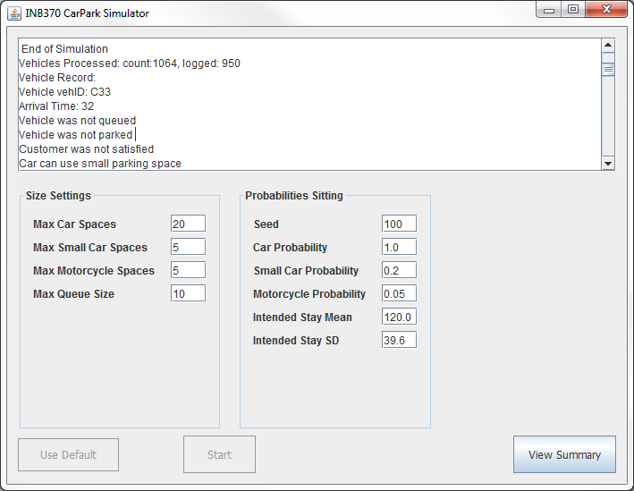
End of Simulation

Slide 29
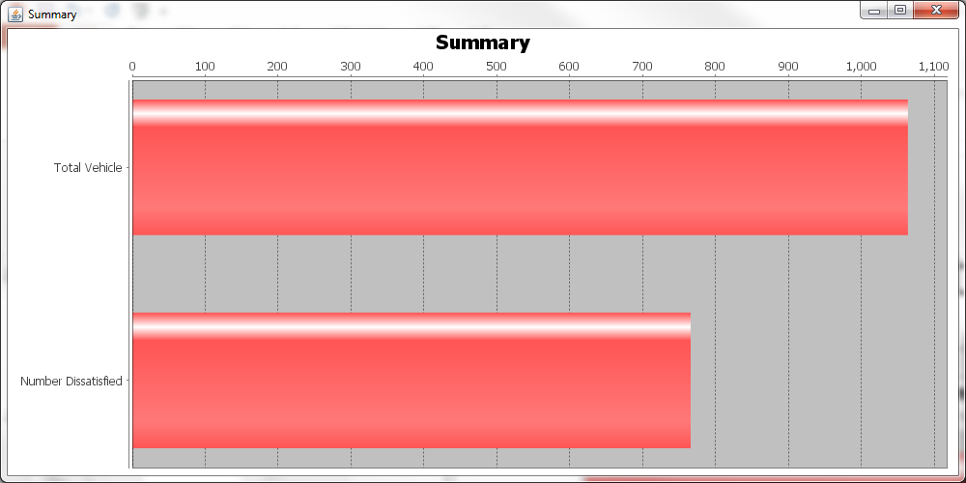
Summary Bar Chart

Slide 30
Scenario 6: No queue
Max Car Spaces: 100
Max small car spaces: 20
Max Motorcycle Spaces: 20
Max Queue Size: 0
RNG Seed: 100
Car Prob: 1.0
Small car prob: 0.8
Motorcycle prob:0.05
meanStay: 120.0
sdStay: 39.6

Slide 31
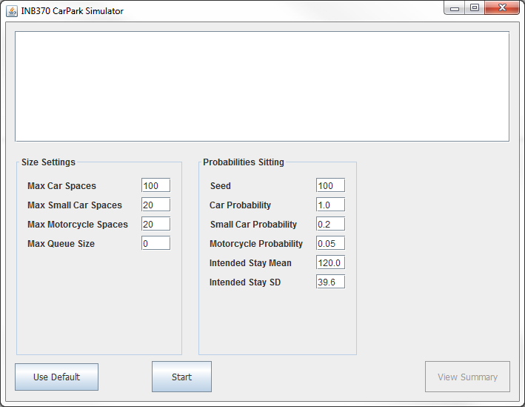
Screenshot

Slide 32
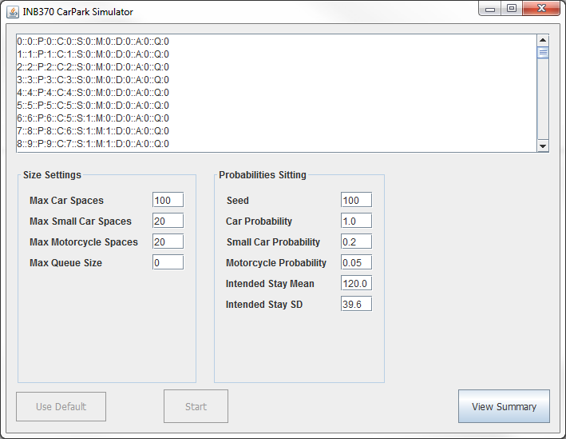
Start Simulation

Slide 33
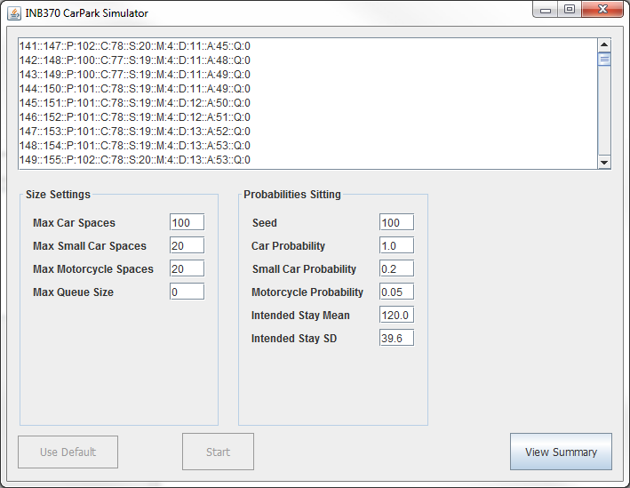
Start Simulation

Slide 34
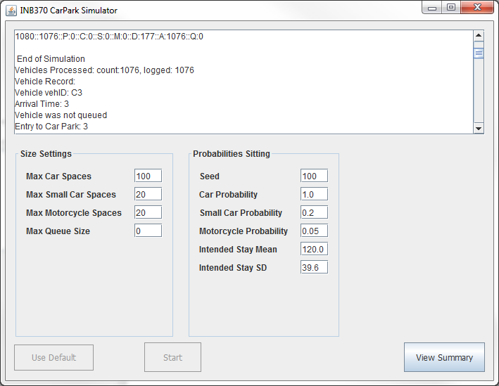
End of Simulation

Slide 35
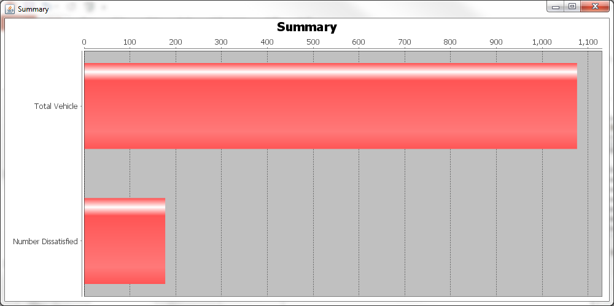
Summary Bar Chart

