Slide 1
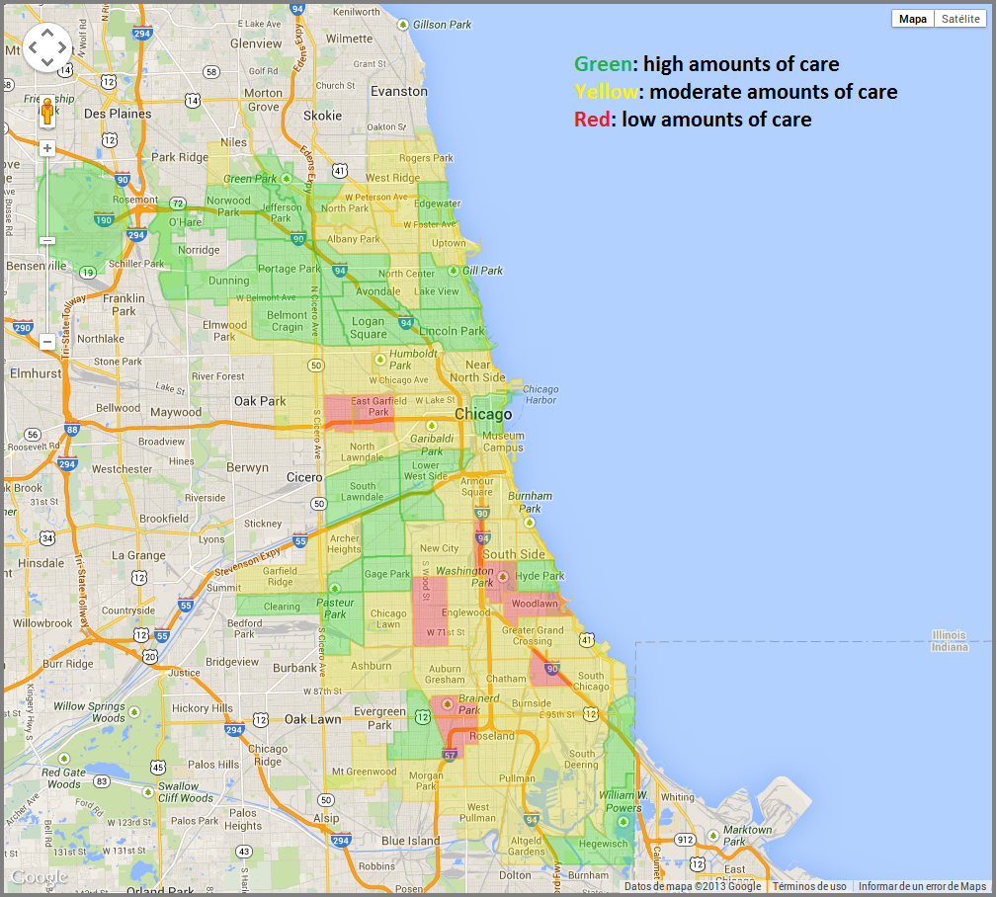
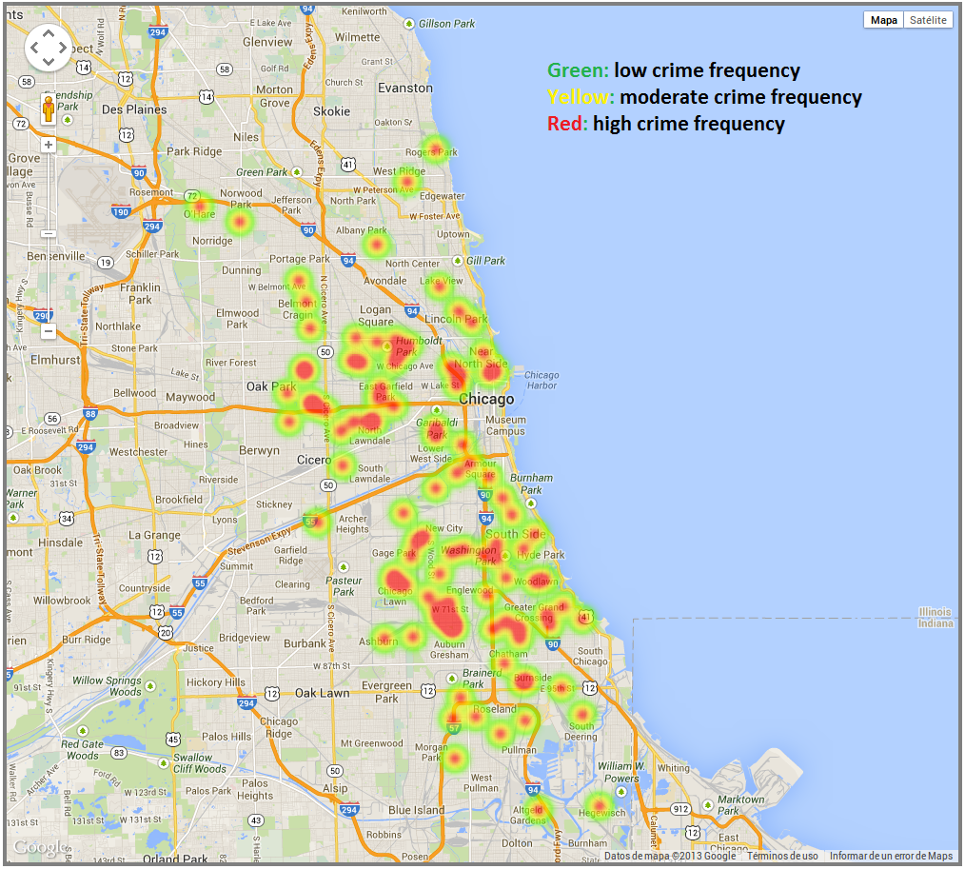
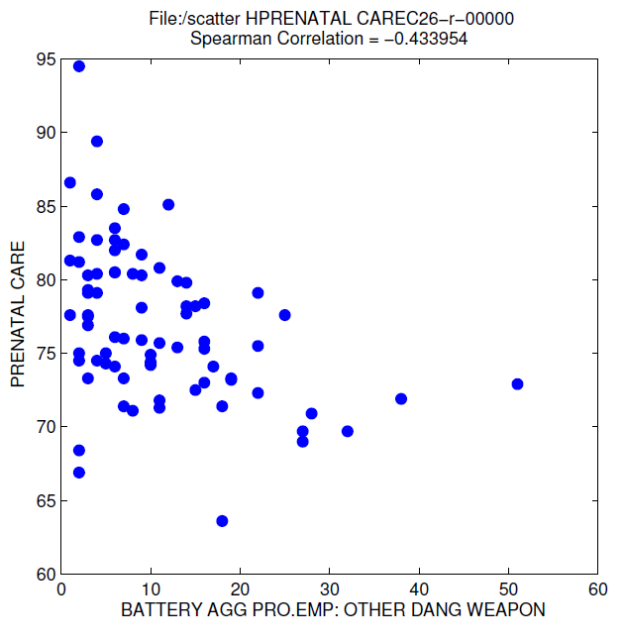
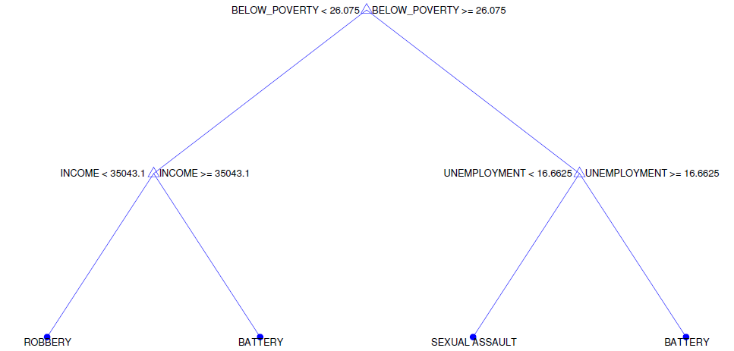
Geospatial crime predictions based on weather, public health and socioeconomic indicators
Gabriel Trisca and Reuben Tanner
ABSTRACT
RESULTS
Cities and communities maintain databases of crime to be able to predict and prevent criminal activities from happening. A major motivation behind what is called “crime data mining” (Blockeel2013) is identifying patterns of criminal behavior.
Crime is a big burden on society: in the United States alone, 23 million criminal offenses were committed in 2007. The economic loss of victims was $15 billion and $179 billion were spent by the government on police protection, judicial and legal activities, and corrections (Justice2008). Even if a small percentage of these crimes can be prevented, the impact would be extremely significant.
In addition, identifying what variables influence the likelihood of a certain type of crime happening can shed light on the complex dynamics behind all criminal behavior, helping understand the motivations behind these antisocial conducts, and how the environment affects people and the choices they make(BUSS2012).
Based on our analysis, we were able to derive substantial correlations between certain crimes and various socioeconomic and public health indicators.
Out of the top 50 crimes committed in the various community areas of Chicago, we chose to group them in three main groups: Battery, Sexual Assault and Robberies.
These crimes were the most frequent and we believed that they are different enough that a causal pattern was highly likely.
Based on these observations, we proceeded to generate artificial samples from the mean values of the indicators for each crime type. The algorithm is described below:
1. Identify which group a given indicator belongs to (BATTERY, SEXUAL ASSAULT, ROBBERY).
2. Extract the mean of the top 5 values for said indicator
3. Create a sample with these values.
These steps are performed on every one of the top 50 crimes, and then the data is used as training for a classification tree.
OBJECTIVE
We want to predict crime by using socio-economical information, health indicators for the different areas in which crimes are committed and historical weather information collected in the city of Chicago.
Prenatal Care beginning in first trimester
Battery
DATASETS
Chicago Crime This dataset reflects reported incidents of crime that occurred in the City of Chicago from 2001 to present.
Weather Daily weather summaries from the City of Chicago for the time period 2001 – 2013.
Socioeconomic Indicators Census Data - Selected socioeconomic indicators in Chicago
Public Health Statistics Selected public health indicators by Chicago community area.
Battery vs. Prenatal Care
METHODS
In order to calculate correlation between different datasets, we needed a common key between them. The community area’s which Chicago is divided up into was that exact key, linking our weather, socioeconomic and public health indicators and crimes committed in those community areas.
As an initial step, we are calculating the correlation between crime frequency and different indicators. To achieve this, we performed a join operation between the weather data and the crime frequency data with date as the key. For the socio-economic and public health indicators we joined the datasets on the community area where the statistics came from and where the crime was committed, and the crime frequency was accumulated.
Classification tree based on three factors, INCOME,%BELOW POVERTY and UNEMPLOYMENT

