Slide 1
Mod 3 Project Hypothesis Testing
Thomas O’Gara

Slide 2
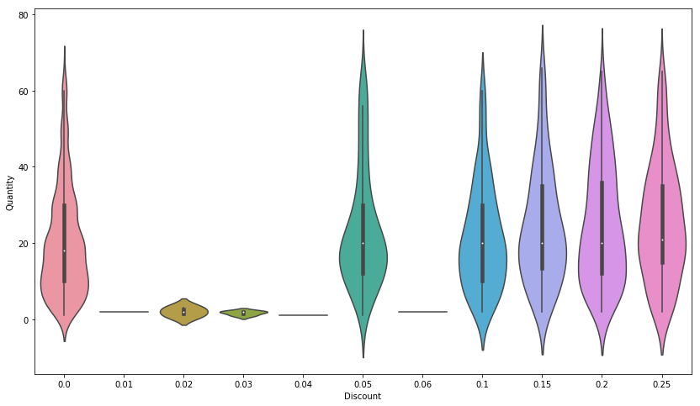
Hypothesis Test 1: Discount’s effect on Order Quantity

Slide 3
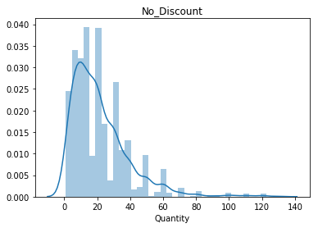
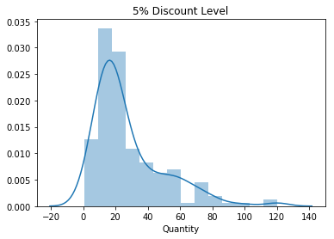
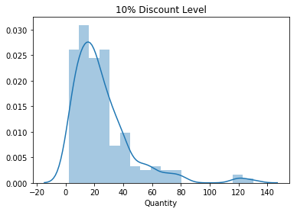
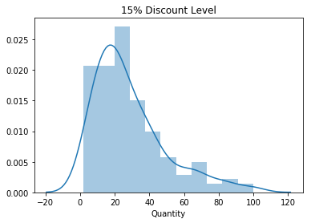
Discount level distributions

Slide 4
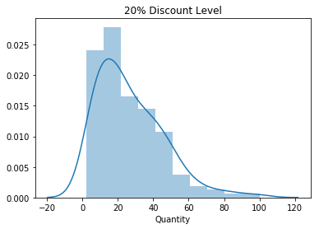
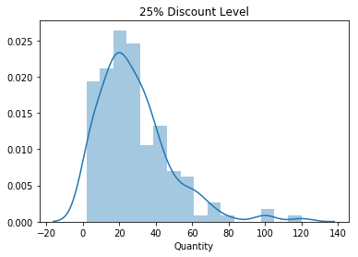
Discount level distributions cont.

Slide 5
Business Recommendation
Larger Discount % not worth loss in profit in most cases
Would recommend a 5% discount level

Slide 6
Hypothesis Test 2: Unit Price’s effect on Order Quantity
Percent different isn’t significant
Customers don’t seem to buy more or less of an item based on unit Price
More work needed

Slide 7
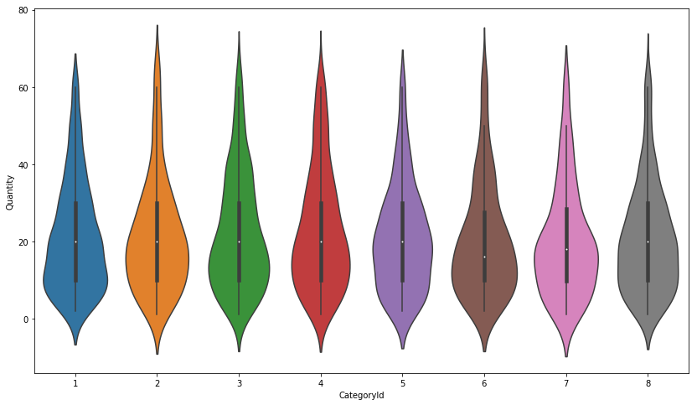
Hypothesis Test 3: Product Category’s effect on Quantity

Slide 8
Business Recommendation
Product category’s selling around the same quantity
Don’t favor any particular product category – more research needed to narrow focus

Slide 9
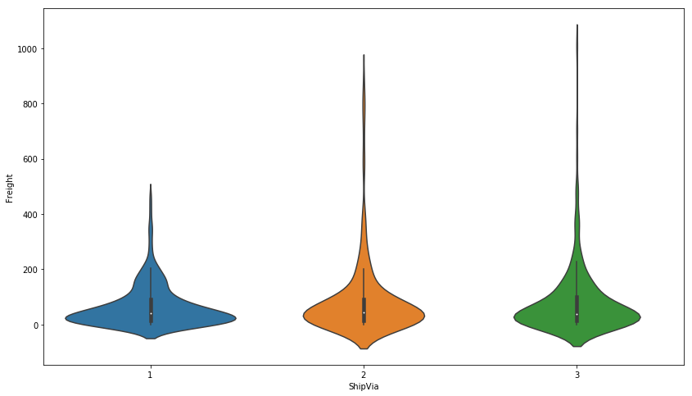
Hypothesis Test 4: Shipper’s effect on Freight cost

Slide 10
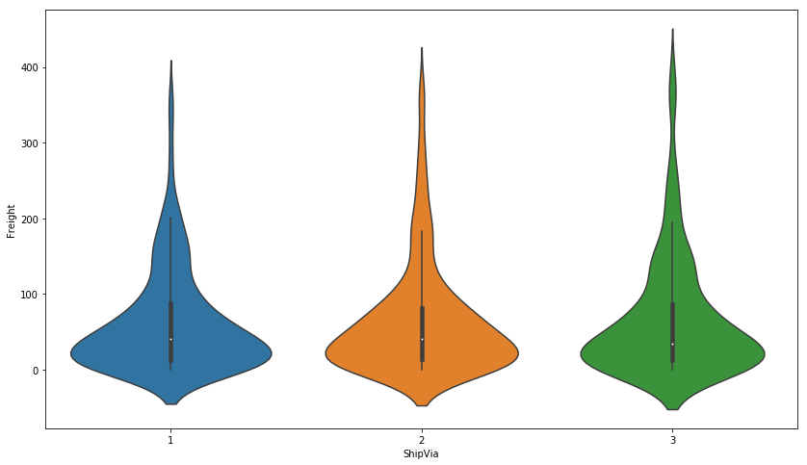
Freight Cost less than $400

Slide 11
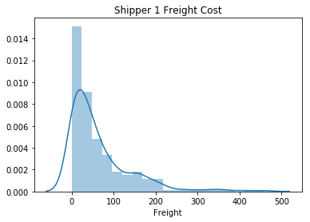
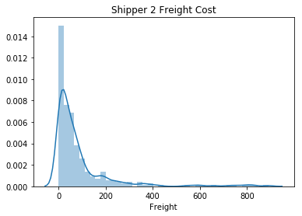
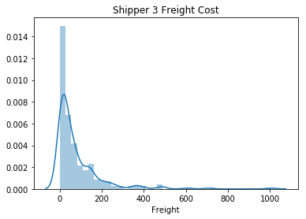
Shipper’s effect on Freight cost: Distributions

Slide 12
Business Recommendation
Favor using Shipper 1 to reduce Freight costs
More research to ensure comparing apples to apples

Slide 13
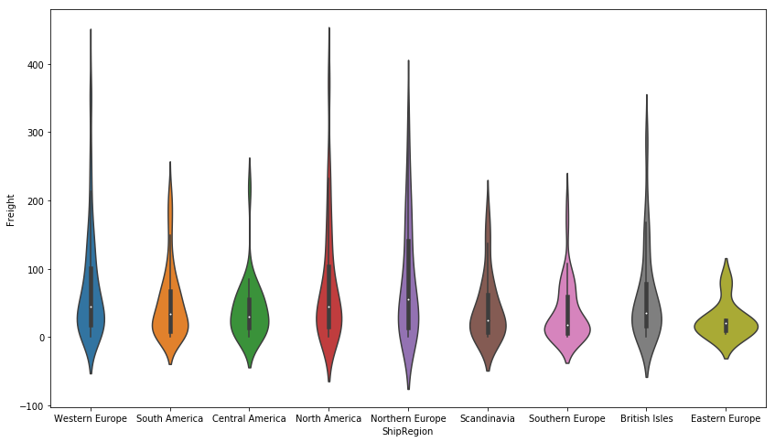
Hypothesis Test 5: Ship Region’s effect on Freight

Slide 14
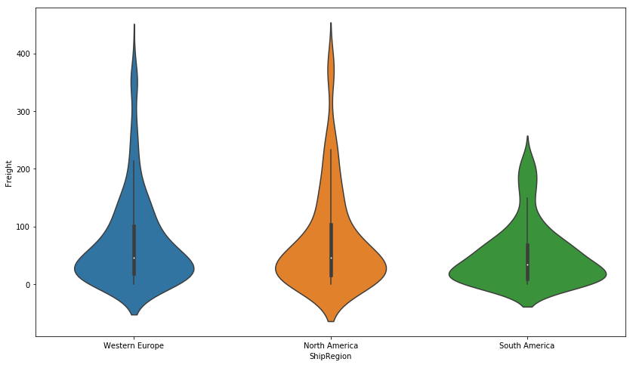
Top 3 Ship Regions

Slide 15
Top 3 Ship Regions distributions

Slide 16
Business Recommendation
North America and Western Europe have higher freight costs
Expand & invest in South America because the freight cost is lower
Margins in South America?

Slide 17
Thank you
Questions?

