Slide 1
Mod 3 Project Hypothesis Testing
Thomas O’Gara

Slide 2
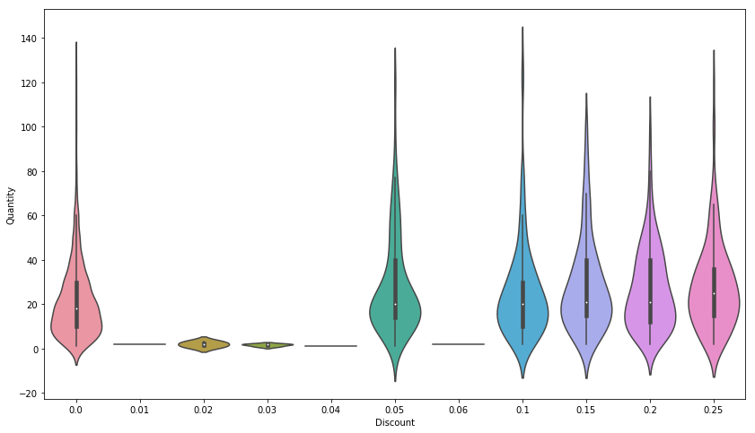
Hypothesis Test 1: Discount’s effect on Order Quantity

Slide 3
Business Recommendation
Larger Discount % not worth loss in profit in most cases
Would recommend a 5% discount level
More work needed to analyze discount % effect
Product types
Seasonality
Price of item

Slide 4
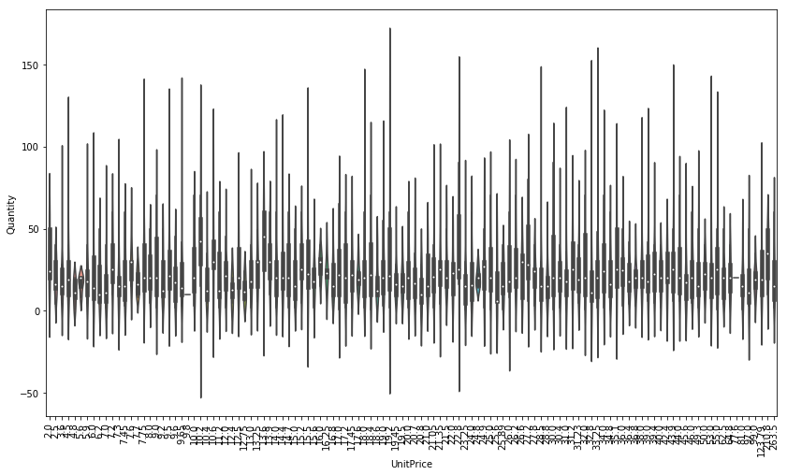
Hypothesis Test 2: Unit Price’s effect on Order Quantity

Slide 5
Business Recommendation
Percent different isn’t significant
Customers don’t seem to buy more or less of an item based on unit Price
More work needed

Slide 6
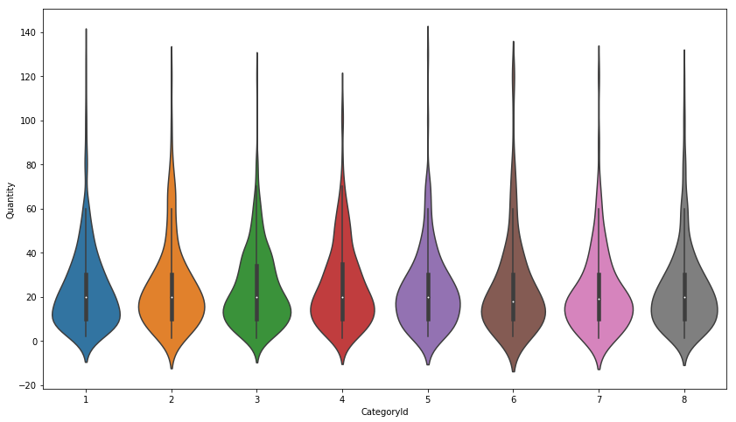
Hypothesis Test 3: Product Category’s effect on Quantity

Slide 7
Business Recommendation
Product category’s selling around the same quantity

Slide 8
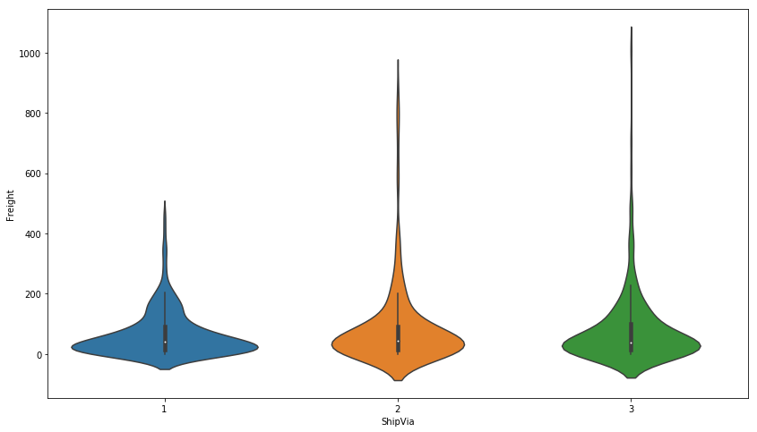
Hypothesis Test 4: Shipper’s effect on Freight cost

Slide 9
Business Recommendation
Favor using Shipper 1 to reduce Freight costs

Slide 10
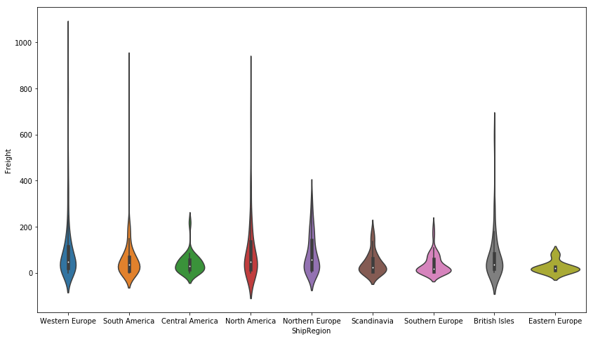
Hypothesis Test 5: Ship Region’s effect on Freight

Slide 11
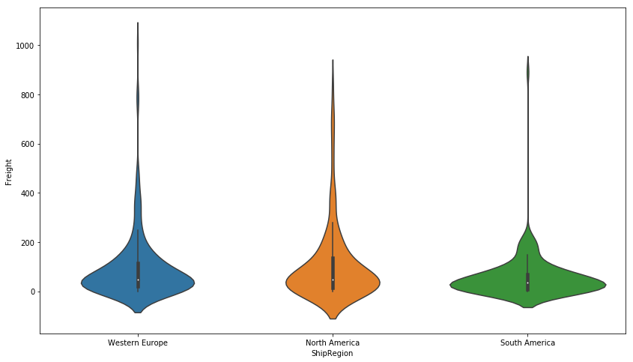
Top 3 Ship Regions

Slide 12
Business Recommendation
North America and Western Europe have higher freight costs
Expand & invest in South America because the freight cost is lower
Margins in South America?

Slide 13
Thank you
Questions?

