Slide 1
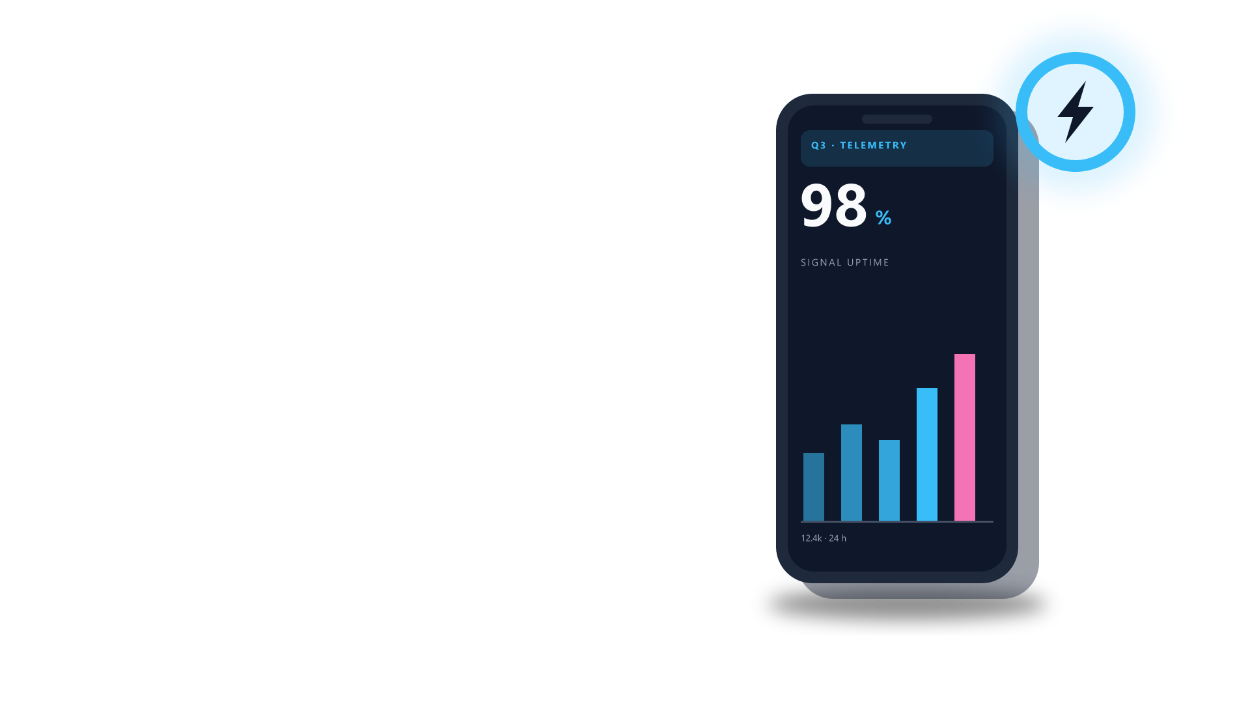
HANDHELD TERMINAL
Field telemetry,
in your hand.
Every reading from the floor,
on one screen.
asset · field-terminal · native shapes · 20 parts

