Slide 1
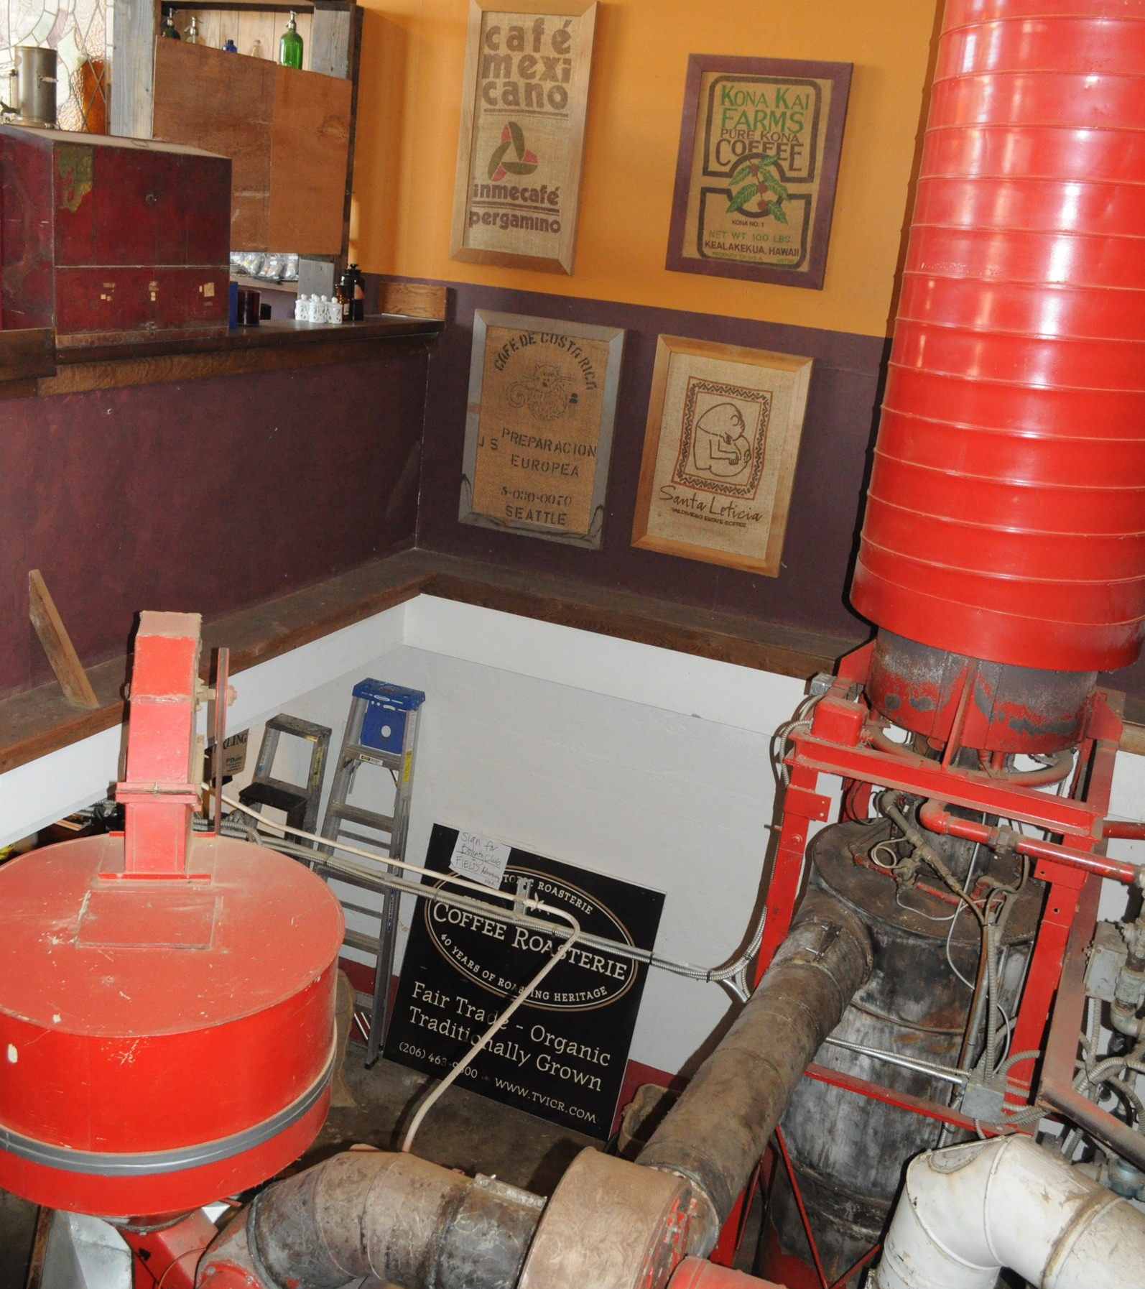
QUARTERLY REVIEW
Coffee that travels well
Northwind Roasters · Q3 2026 · synthetic data
Notes:
Image: “Vashon Island Coffee Roasterie - roasting equipment 02” by Joe Mabel, CC BY-SA 3.0 (https://commons.wikimedia.org/w/index.php?curid=25111993)

Slide 2
THE HEADLINE
We doubled direct orders while cutting delivery time by a third.

Slide 3

Q3 in numbers
0%
14%
25%
34%
40%
44%
46%
47%
48%
0 t
298 t
543 t
738 t
891 t
1,005 t
1,087 t
1,142 t
1,176 t
1,193 t
1,199 t
1,200 t
2.1 days
growth in direct orders
roasted this quarter
average delivery
Growth came from subscriptions, not discounts.

Slide 4
Direct orders by month
September alone beat last year's best quarter.

Slide 5
How an order travels
Order
Roast
Pack
Ship
Brew
Notes:
First the order lands, then we roast, then pack, then ship, and finally the customer brews.

Slide 6
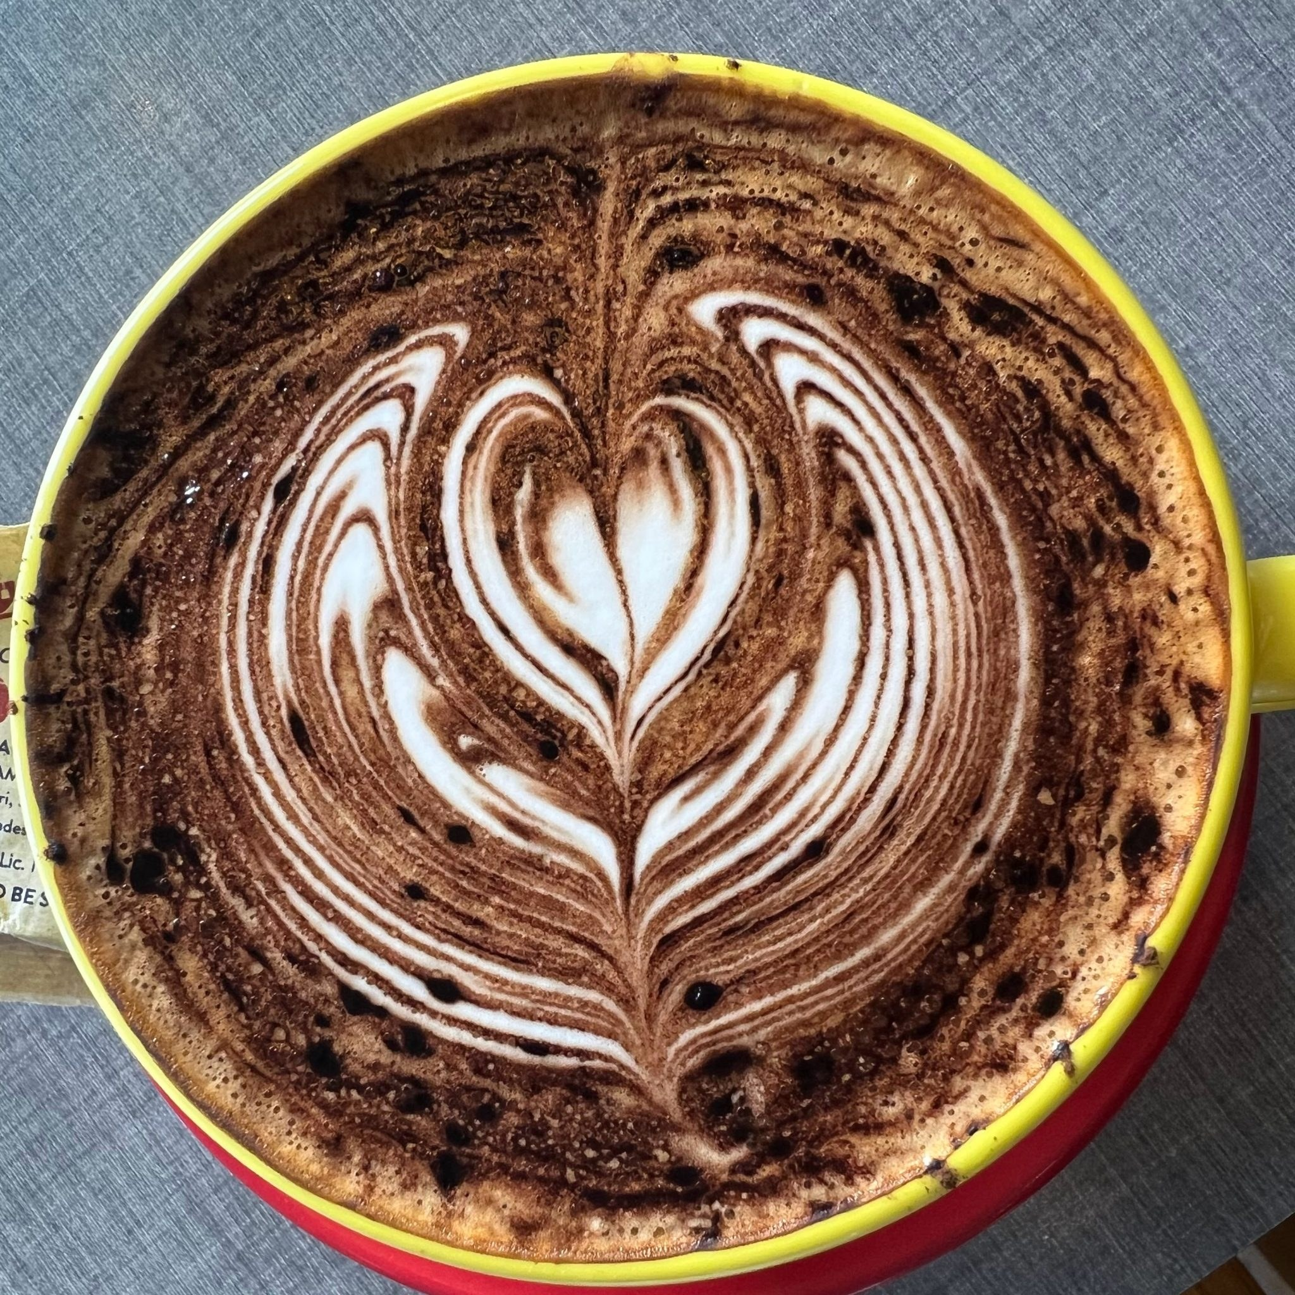
Why customers stay
• Roasted within 48 hours of every order
• Flexible subscriptions, pause any time
• Solar roof covers 40% of our energy
Notes:
Image: “A close-up, overhead view of a hot chocolate or mocha in a y” by Alina Kakshapati, CC0 (https://wordpress.org/photos/photo/589692bc66/)

Slide 7
Our improvement loop
Listen
Measure
Customer
Roast
Deliver
Notes:
Introduce the loop, then walk each stage.

Slide 8
Subscriptions vs one-off orders
Subscriptions
One-off orders
• Predictable roasting volume
• Higher lifetime value
• Lower acquisition cost
• Seasonal spikes
• Discount-driven
• Harder to forecast

Slide 9
“
The coffee arrives faster than my old café could brew it.
Subscriber since 2024 (synthetic)

Slide 10
Next: a second roastery in 2027
Questions and discussion

Slide 11
Image credits
Slide 1: “Vashon Island Coffee Roasterie - roasting equipment 02” by Joe Mabel, CC BY-SA 3.0
Slide 6: “A close-up, overhead view of a hot chocolate or mocha in a y” by Alina Kakshapati, CC0
Notes:
[static] Attribution for licensed images.

