Slide 1
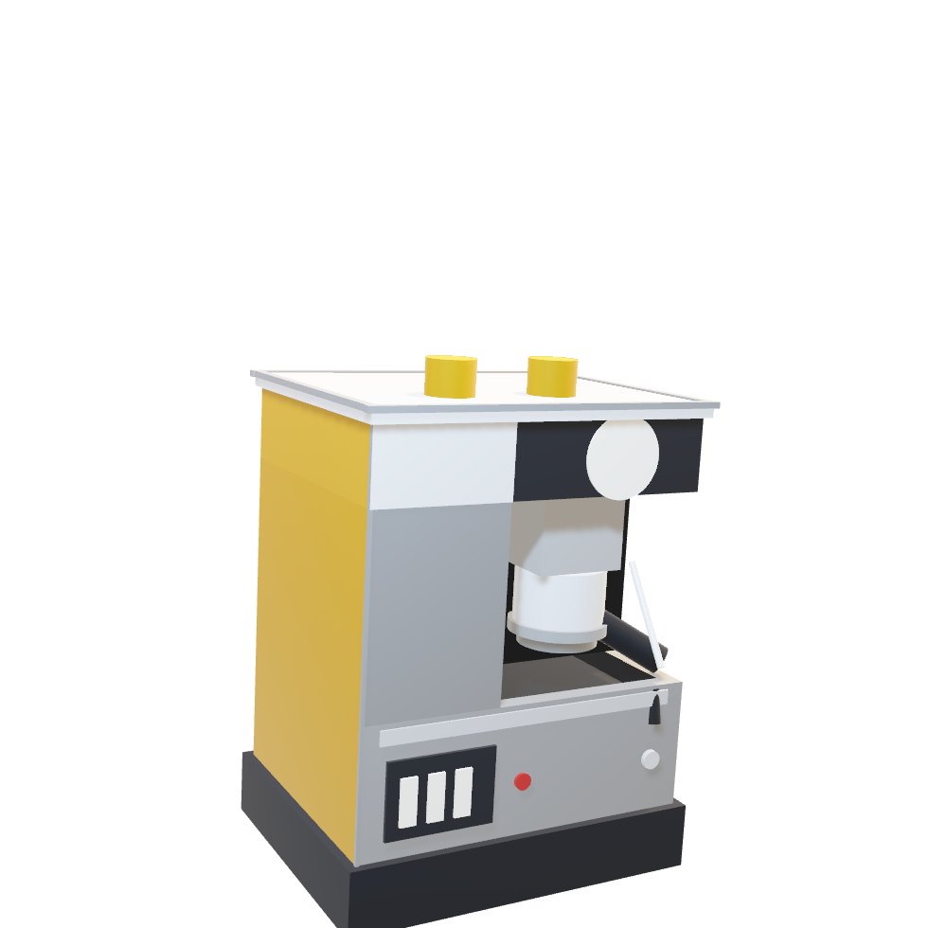
CAMERA MORPH PROBE
Two views, one model, one object name.
If Morph animates the camera, the frames show one model
from an in-between angle. If it fades, the frames show
two models ghosted over each other.
T064 · NATIVE 3D · MORPH · CREATEVIDEO

Slide 2
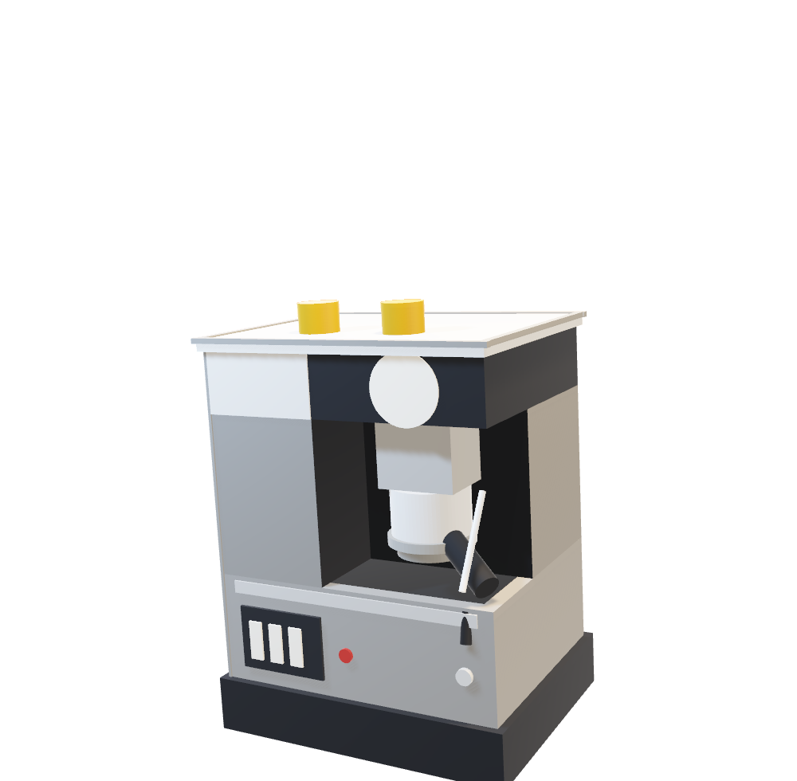
CAMERA MORPH PROBE
Two views, one model, one object name.
If Morph animates the camera, the frames show one model
from an in-between angle. If it fades, the frames show
two models ghosted over each other.
T064 · NATIVE 3D · MORPH · CREATEVIDEO

