Slide 1
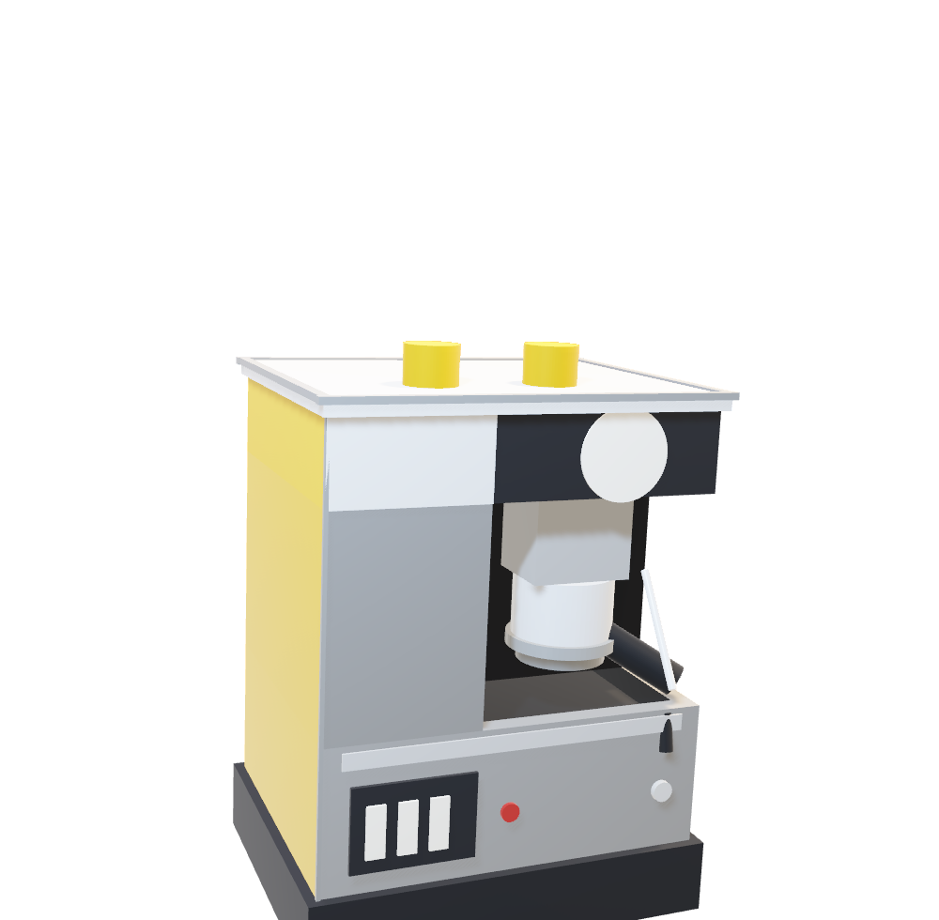
QUICK MILL
01
OMRE / MASSING STUDY
01 / STRUCTURE
A black bay,
a chrome lid.
The black housing wraps the brewing bay. The chrome lid overhangs it; the left tower is the only yellow volume.
01
HEIGHT
553 mm
WIDTH
400 mm
DEPTH
326 mm
01
TOP HOUSING
80 mm black massing. The bay soffit is part of the same volume.
NATIVE 3D · EMBEDDED GLB · EDITABLE CALLOUTS
ROTATE IN POWERPOINT

Slide 2
QUICK MILL
02
OMRE / MASSING STUDY
02 / BREWING BAY
The group sits
inside the mass.
A 229 × 121 × 211 mm recess holds the group head and portafilter. The steam wand enters from the right.
02
BAY
229 × 121 × 211 mm
GROUP HEAD
Ø100 mm
BASKET
Ø88 mm
02
GROUP HEAD
Ø100 mm, 60 mm deep. The portafilter projects into the bay.
NATIVE 3D · EMBEDDED GLB · EDITABLE CALLOUTS
ROTATE IN POWERPOINT

Slide 3
QUICK MILL
03
OMRE / MASSING STUDY
03 / CONTROLS
Three switches,
one cast base.
The switch plate sits on the lower front-left. The tray is a 31 mm recess under a black grate; the base is a single dark casting.
TRAY
340 × 240 mm
SWITCH PLATE
120 × 82 mm
BASE
400 × 320 mm
03
03
SWITCH PLATE
Three 18 × 50 mm rockers on a 120 × 82 mm plate.
NATIVE 3D · EMBEDDED GLB · EDITABLE CALLOUTS
ROTATE IN POWERPOINT

