Slide 1

GAMIFICATION FOR LEARNING SCIENCE : ELIZA (enzyme linked immuno sorbent assay) game study case)
Muhammad Noor ( 05111850010003 )

Slide 2
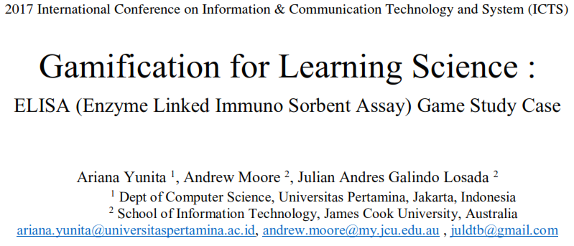

Slide 3
Gamification For Learning Science : ELIZA (Enzyme Linked Immuno Sorbent Assay) Game Study Case
Author | Arina Yunita (Dept of Computer Science, Universitas Pertamina, Jakarta, Indonesia) Andrew Moore, Julian Andreas Galindo Losada (School of Information Technology, James Cook University, Australia)
Conference | ICTS 2017 : 11th International Conference on Information & Communication Technology and System (IEEE Conference)
Organized by | Informatics Department, Institut Teknologi Sepuluh Nopember (ITS) Surabaya
DOI | 10.1109/ICTS.2017.8265687
Year | 2017

Slide 4
Introduction
Immunology is a science that studies the immune system of human and animal.
It is a discipline that in its development rooted in the prevention and treatment of infectious diseases.
While Serology is a science that studies the antibody antigen by invitro. Serologic examination is often performed as an attempt to make the diagnosis.
Although the current serologic examination is not limited to infectious diseases, but to support the diagnosis of infectious diseases is often conducted and it allows in vitro observation of antigen-antibody complex changes (Ag-Ab).

Slide 5
Introduction
ELISA (Enzyme-linked immunosorbent assay) is a serological test commonly used in immunological laboratories.
This test has several advantages such as relatively simple, economical, and has a high enough sensitivity.
ELISA was firstly introduced in 1971 by Peter Perlmann and Eva Engvall to analyze the presence of antigenic interactions with antibodies in a sample using an enzyme as a reporter

Slide 6
Introduction
To conduct an ELISA test, there are several equipments that should be prepared, such as ELISA reader, washer machine, pipe and microplate.
Those equipments are in a various range of price and it will be costly to conduct a real test for huge number of students.
Therefore, using a simulation game, students can learn the cost independently as well as it can decrease cost for laboratory practical.
Author claimed ELISA game is a simulation game because it is fantastical but not competitive.

Slide 7
Related Works
Games are usually associated with play and play is often associated with children, but a digital game has been found that can be effective and motivational for learning and it effects for both gender: males and females.
Since it was found that games support learning in complex or boring contexts, researchers have developed and research for effective games for helping education in various fields.

Slide 8
Related Works
For example a game for dental learning in higher education, a game of mathematical logic to help computer science students learn about logic and a game for civil engineering students.
Those games were developed for higher education and found to be effective in their learning environment.
Games attempt to be challenging and engaging. For more than ten years, the term “serious game” has been introduced and intended not for entertaining, but for educating, military, health and also training and development.

Slide 9
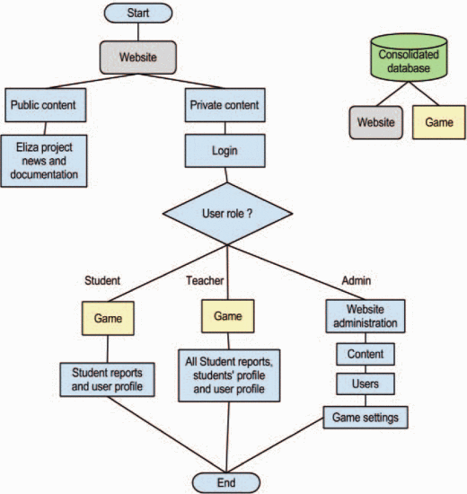
Design : Flowchart of The Website
A simulation game called ELISA is designed using Flash Action Script 3.0 and it is embedded on a website built using Drupal CMS.

Slide 10
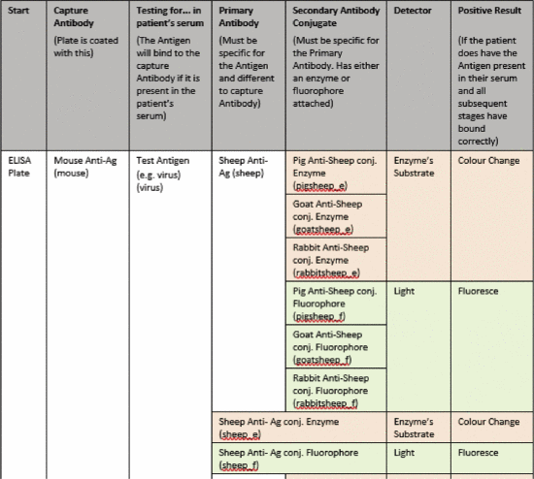
Design : Ex. ELISA Combination
Before designing database, basic data requirements are given from Veterinary Science Department which is combinations of ELISA technique.

Slide 11
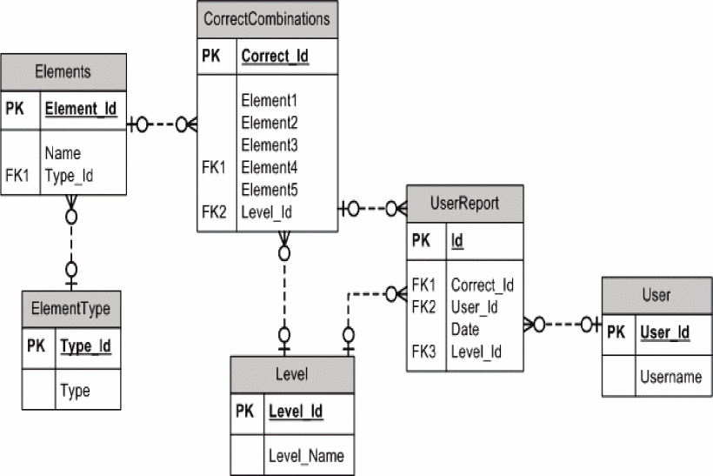
Db Design
Then, the database could be designed based on the documents of ELISA combinations. Combinations consist of antibody, antigen, detector, conjugate, capture antibody. They store in ElementType and will be checked in CorrectCombinations entity.

Slide 12
Design : Procedures
After designing database, according to procedures of ELISA method and also correct combinations given, game flowchart was designed.
Basically, every elements need to be incubated and washed. Then, every elements that put into the tube could not be the same as the previous ingredients.
For example, first we would like to input Capture Antibody which is namely Pig-antiAg, then it should be incubated and washed, after that another element is chosen and it should be incubated and washed and it will be iterated until the correct combinations are made.
Error prompt will be displayed once the users not following the ELISA rule.

Slide 13
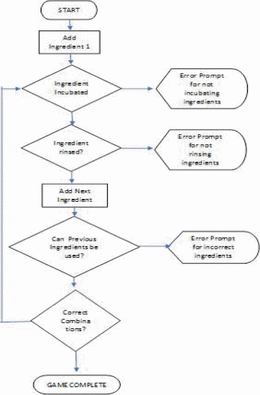
Design : FlowChart

Slide 14
Implementation : Game Chalengges
This game challenge users to design an ELISA to detect the two type of detections which are antigen detection and antibody detection.
In antigen detection menu, users are challenged to design ELISA for hepatitis B, dengue virus, ross river virus, influenza, HIV and Herpes virus simplex 1.
Furthermore, for antibody detection, users should design ELISA to detect an antibody against one of the following viruses. It includes chicken pox, measles, hepatitis A, rubella.

Slide 15
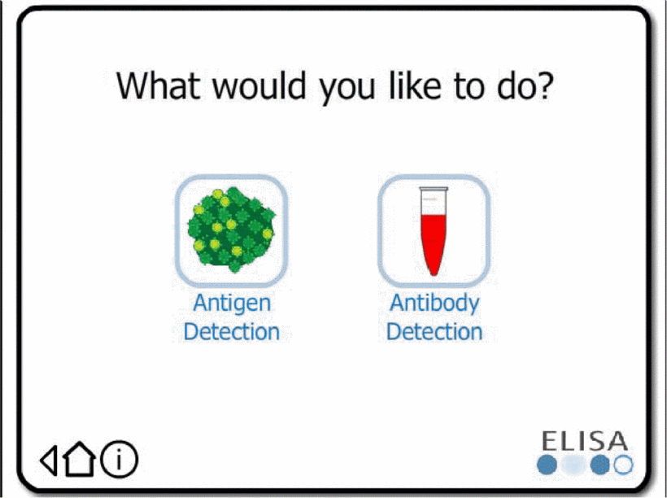
Implementation : Main menu of ELISA game
Main menu of ELISA game : kind of simulation will be chosen whether antibody detection or antigen detection

Slide 16
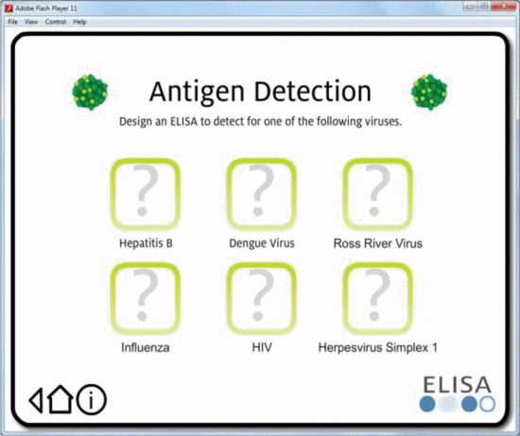
Implementation : Antigen Detection Menu
Antigen detection menu : kind of virus will be detected using the antigen detection menu respectively

Slide 17
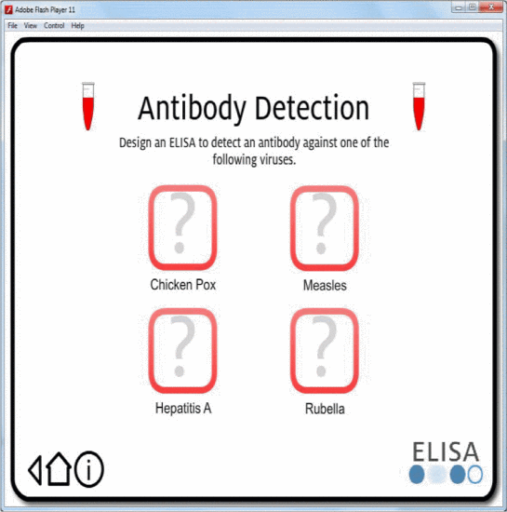
Implementation : Antibody Detection Menu
Antibody detection menu : kind of virus will be detected using the antibody detection menu respectively

Slide 18
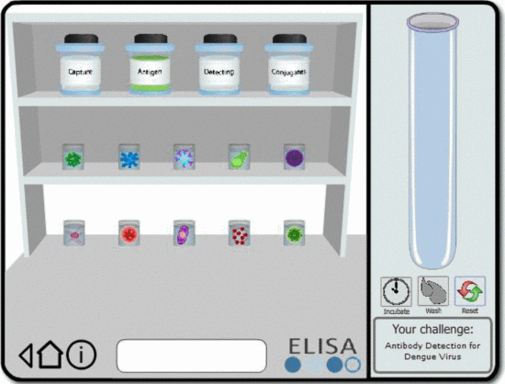
Implementation : Main Board of ELISA Game
Main board of ELISA game : is the main board of the game and the users can do drag and drop the substances into the tube. Elements are also categorized, so the users can easily choose them.

Slide 19
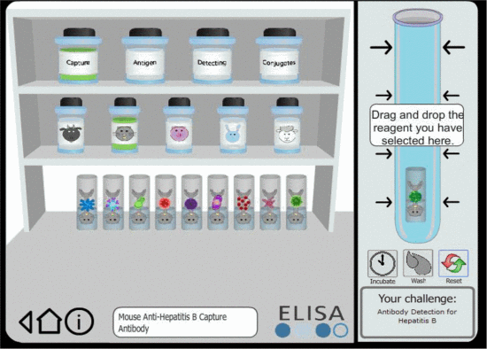
Implementation : Main Board of ELISA Game
Main board of ELISA game : Users drag and drop the reagent.

Slide 20
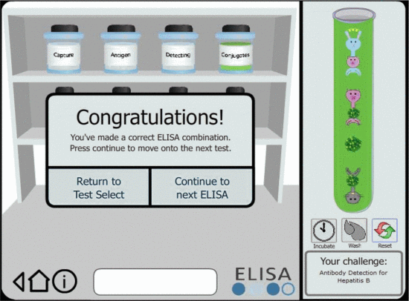
Implementation : Main Board of ELISA Game
Main board of ELISA game : Users made A corest combination of ELISA.

Slide 21
Testing : Target Users
The main target users are third year James Cook University science students.
The students are assumed to be familiar with biological concepts and have an understanding of how they are applied in ELISA.
The other remaining target group is teachers, who will use the application to view student results produced from the ELISA game.
Characteristics of users:
Age: approximately 20 years (science students), and above 30 years (teachers/lecturers)
Gender: Female and Male
Educational background: Veterinary Science
Language: English (as the main language in James Cook University, Australia)
Computing skills: know the basic of computing
Physical abilities and disabilities: perhaps there are disabled persons or colour-blind persons who are amongst the target users.
Domain-related knowledge and skills: biology

Slide 22
Testing : Result
After implemented the game, usability testing were conducted among 42 third year veterinary science students
In term of efficiency, the results are users were able to navigate the application and locate the game screen with ease. The minimum amount of steps taken to solve the problem was 8. The longest test took 5–10 minutes with a significant number of clicks to get a solution.
In term of accuracy, 3 out of 7 tests took submitted 2 incorrect combinations. The remaining 4 out of 7 submitted only 1 incorrect combination. Overall, all users eventually submitted a good combination. In addition, 3 out of 7 users submitted 4 elements in the incorrect order, 2 out of 7 users only submitted 1 incorrect element. The remaining two users submitted 2 incorrect elements

Slide 23
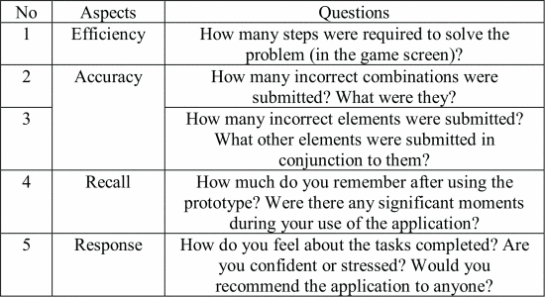
Testing : Questionnaire
Some questions that were asked into the testers

Slide 24
Testing : Result
For the last question about response, users stated they liked the application and felt it was an enjoyable experience. Furthermore, several were unsure how to solve the problem but eventually found a solution.
Regarding to recall, users found the prototypes are easy to use. Once the users viewed the game they could remember elements and figure out how the ELISA test works.

Slide 25
Conclusion & Future Works
ELISA game found to be usable for third year veterinary science students. However, it has not been researched whether it is effective for learning ELISA compared to in a real laboratory.
ELISA game has not been tested among lecturers in veterinary science department.
For future works, it is considered that Flash Action Script is no longer current technology for game. It might be better to develop using other current game technologies, for example Unity 3D.

Slide 26
Reference
https://ieeexplore.ieee.org/document/8265687

Slide 27
Terima Kasih Matur Nuwun Hatur Nuhun Thank You Shukraan Lak Danke XieXie Dhanyavaad Arigato Bedankt Grazie Gomawo Merci Blagodaryu Vas Gracias

