Slide 1
Adaptive Level Generator for Puzzle Game

Slide 2
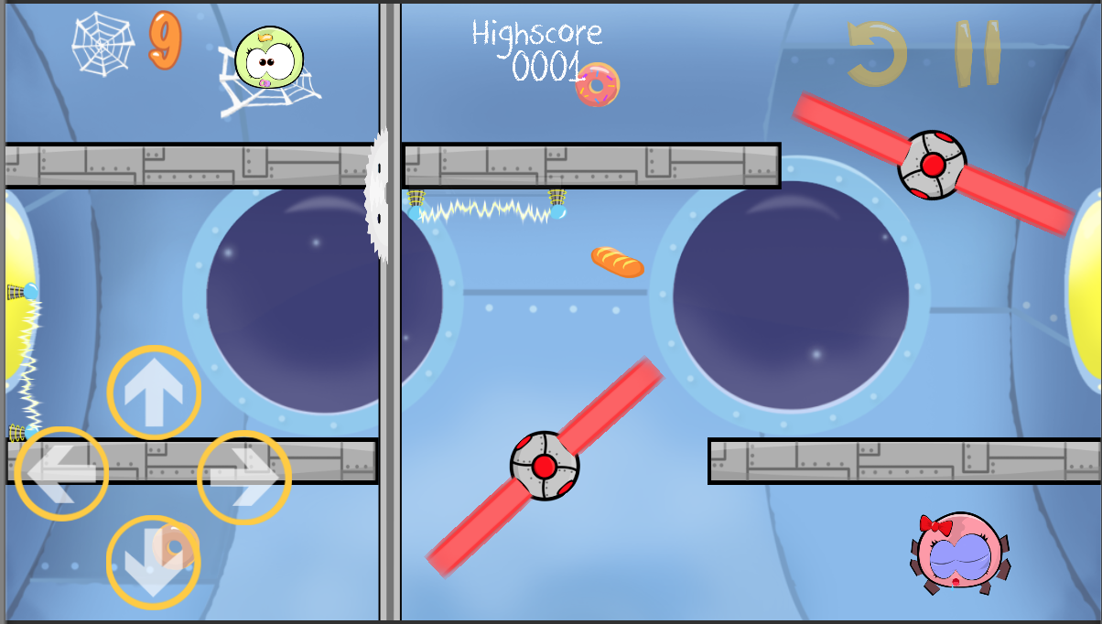
Design

Slide 3
Obstacle
Wall
Ice
Gear
Laser
Electricity

Slide 4
Character
Spider
Spider Baby

Slide 5
Stage
Space

Slide 6
How to play
Navigate the spider to walk on the web
Avoid the obstacles
Collect the foods
Bring them to child

Slide 7
Level Generator

Slide 8
Adaptive
Time
Food collected
Web count
Killed by

Slide 9
Adaptive (2)
 |  | Difficulty | Obstacle | Food
Finished | Food count > 80% | +1.5 | + | +
 | Food count 50% - 80% | +1.0 | / | /
 | Food count < 50% | +1.0 | / | -

Slide 10
Adaptive (3)
 |  | Difficulty | Obstacle | Food
Finished | Time new < Time old | +1.5 | + | /
 | Time new < Time old + 5 | +1.0 | / | /
 | Web Count = min | +1.5 | + | /
 | Web Count > min | +1.0 | / | /

Slide 11
Adaptive (4)
 |  | Difficulty | Obstacle | Food
Killed | By Obstacle | -1.5 | - | /
 | Remaining web is zero | -1.5 | / | /

