Slide 1
Automatic Level Design With Limited Path

Slide 2
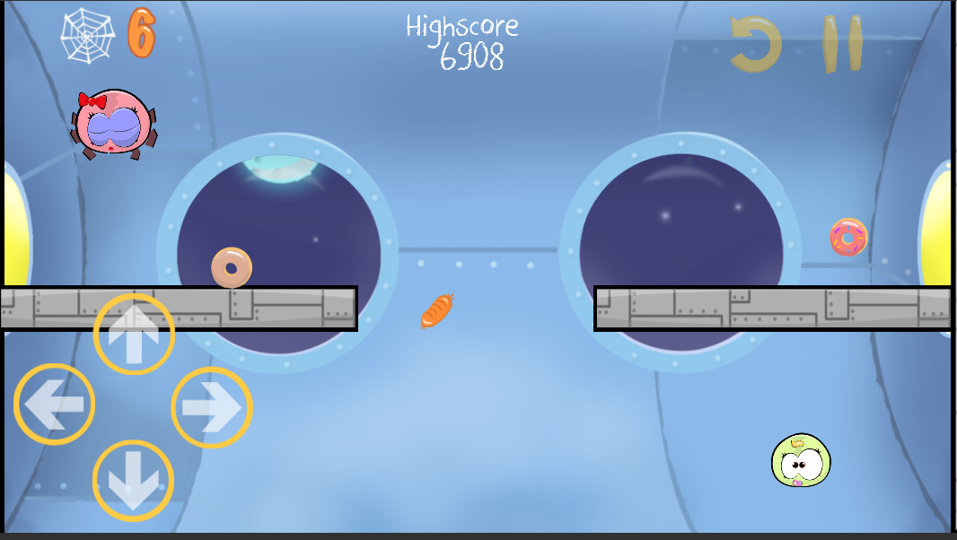
Design

Slide 3
Step
Building Block
Finding Track
Food Placement

Slide 4
How to play
Navigate the spider to walk on the web
Collect the foods
Bring them to child

Slide 5
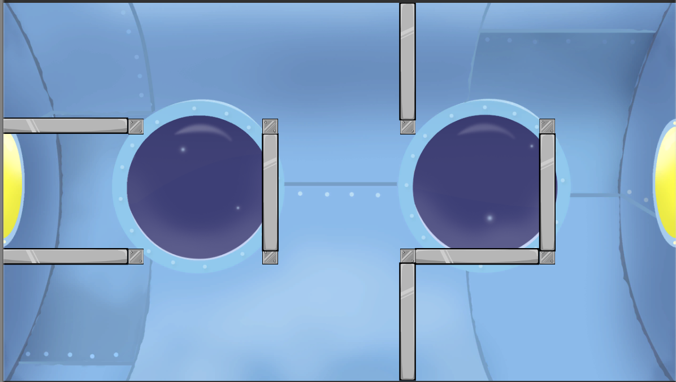
Building Block

Slide 6
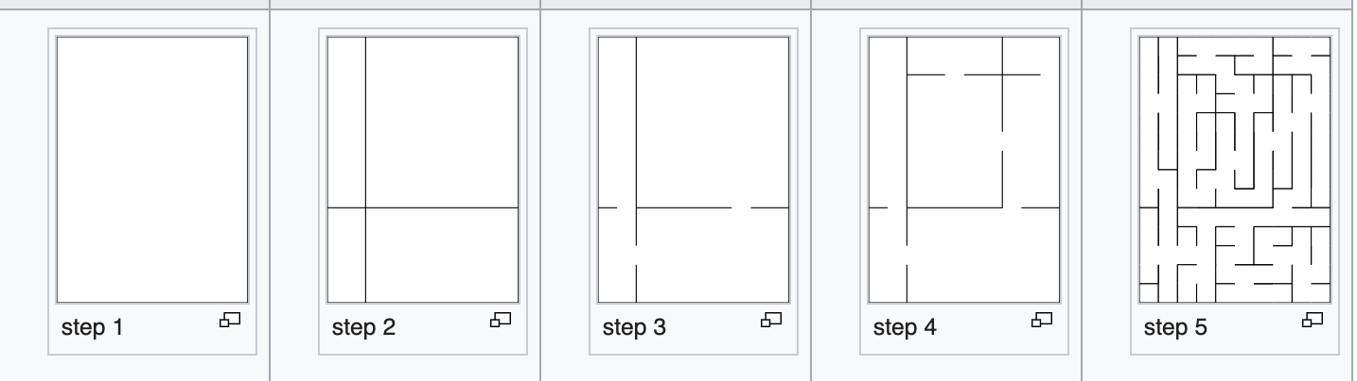
Recursive Division

Slide 7
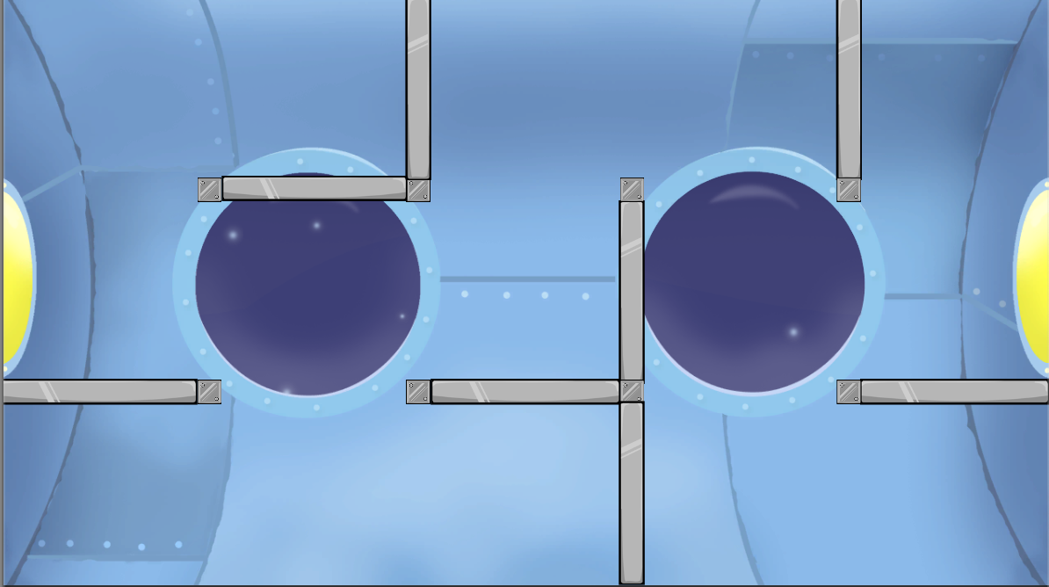
Recursive Division (One Destroyed)

Slide 8
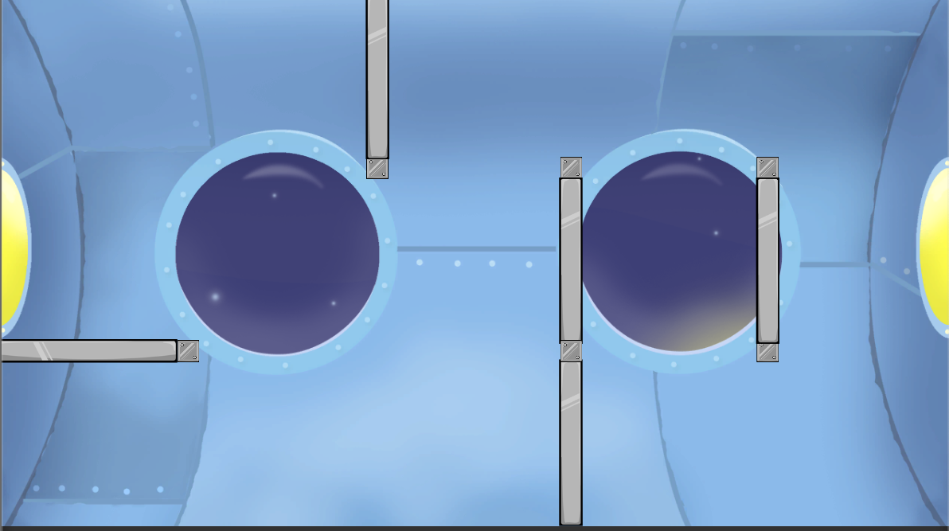
Recursive Division (Two Destroyed)

Slide 9
Find Track (Path Finding)

Slide 10
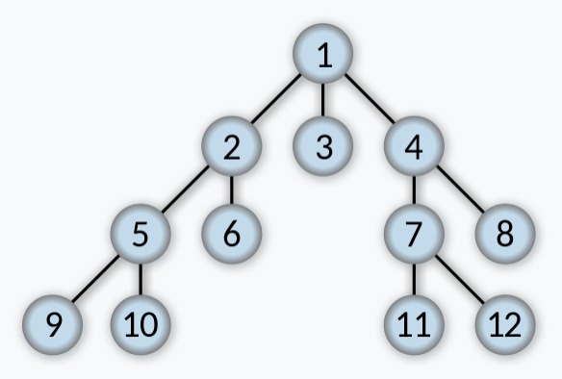
Breadth First Search

Slide 11
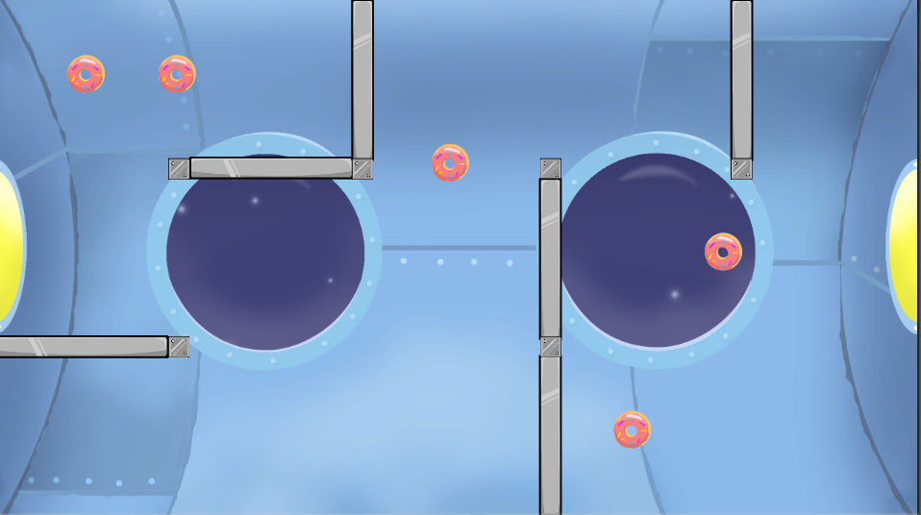
Food Placement

Slide 12
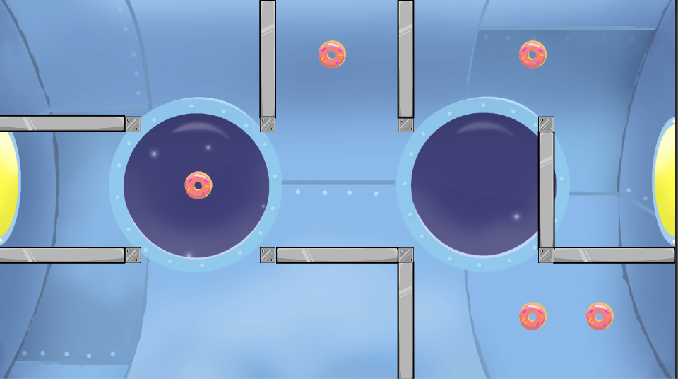
Food Placement (2)

