Slide 1


Meta plan
for Sedifly

Slide 2
WHAT YOUR ACCOUNT SHOWS
Twelve months of data, three lessons
We read every campaign, ad set and ad in your Meta account from November 2025 to November 2026: S$18,831 spent and 718 form leads.
MESSAGE
AUDIENCE
TRACKING
S$38
21%
S$124
The diagnostic message won
Spend went outside your buyers
Website forms lost leads
Your two September Readiness Check tests reached the same ages. The diagnostic ads cost S$38 a lead and the parent roadmap ads S$132. Parents aged 45 to 54 answered the diagnostic ads at S$37.
94% of spend ran in ad sets open to ages 18 to 65, and the parent ad sets used luxury interests such as Ferrari and Rolex. Both pull in business owners and executives.
Campaigns that sent people to the website cost S$124 a lead (7 leads), against S$21 for Instant Forms. Your Meta reports show form fills with no qualified or booked counts.
WHAT WE CHANGE
WHAT WE CHANGE
WHAT WE CHANGE
Every Readiness Check ad leads with the diagnostic angle, with Ke Yue as proof.
Fixed age bands, no interest layers, and Advantage+ audience off.
Instant Forms into HubSpot, with qualified, booked and attended sent back to Meta.
Every campaign ends in one conversion: a booked Readiness Check.
02

Slide 3
PERFORMANCE RECOVERY
Reversing the decline, week by week
Cost per lead rose from S$14 in May to S$45 in October on similar spend. Most of the rise came from Readiness Check campaigns that kept spending after they stopped converting.
COST PER LEAD BY MONTH
WHERE THE SPEND MOVES
Weekly forecast
STOP
On S$467 a week, once the fixes are live.
S$45
Readiness Check ads that sent people to the website or used the parent roadmap message
REQUESTS
LEADS
COST
S$33
S$30
S$124 to S$396 a lead
Weeks 1 and 2
4
11
S$43
S$23
From 9 Nov
S$20
REPLACE
S$14
The eBook ad set running since 14 May, still on luxury interests
Weeks 3 and 4
6
14
S$34
From 23 Nov
S$9 a lead in May, S$43 in October
May
Jun
Jul
Aug
Sep
Oct
Month two
8
17
S$28
203 leads
54 leads
27 leads
44 leads
50 leads
55 leads
SCALE
From 7 Dec
The diagnostic angle on Instant Forms, in the Reel and Ke Yue campaigns
October: three Readiness Check campaigns spent S$924, 37% of the month, for 3 leads. The medicine webinar spent S$814 for 35.
These are forecasts, and they depend on the fixes in this deck: HubSpot tracking, the creative edits and the blockers on slide 11. Leads adds Ke Yue downloads to requests. We reset the numbers after 30 days.
S$23 (medicine webinar) and S$38 (September test)
03

Slide 4
THE META PLAN
Four campaigns, on S$2,000 budget
Applicants get the Readiness Check offer straight away. Parents also see Ke Yue's results and Joash, then get the offer through retargeting.
Readiness Check
Ke Yue case study
Joash interview
Retargeting
Applicants, 18 to 24
Parents, 38 to 60
Parents, 38 to 60
People who know Sedifly
S$600 · S$20 a day
S$700 · S$23 a day
S$400 · S$13 a day
S$300 · S$10 a day
WHO
JC and poly graduates, NS, gap year
WHO
Parents planning a US or UK application
WHO
Parents planning a US or UK application
WHO
Video viewers and page engagers
CREATIVE
Admissions Readiness Reel
CREATIVE
Ke Yue statics and carousel
CREATIVE
Joash interview video
CREATIVE
15-second Reel, Joash, carousel
EXPECT
10 to 15 requests
EXPECT
3 to 5 requests
EXPECT
28 to 46 downloads
EXPECT
5 to 7 requests
OBJECTIVE
TARGETING
PLACEMENTS
Leads, with Meta Instant Forms synced to HubSpot in real time.
Singapore, fixed age bands, Advantage+ audience off, past leads excluded.
Instagram and Facebook Feeds, Stories and Reels. Reels and Stories took 59% of your spend.
04

Slide 5
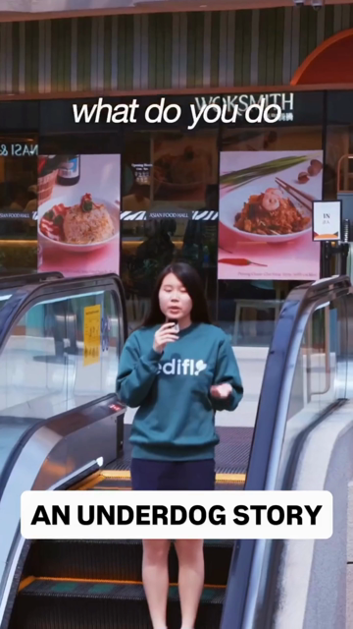
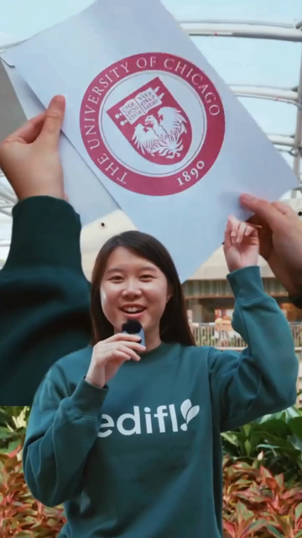
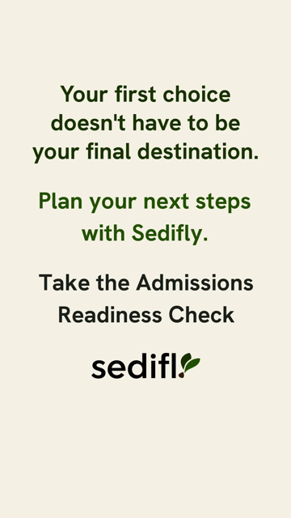
CREATIVE REVIEW · ADMISSIONS READINESS REEL
A strong story, with the offer too late
Ke Yue's opening holds attention. The Readiness Check appears at 0:41 of a 0:45 video, and on your account about 2 in 100 people shown your videos watch 15 seconds.
0:00
0:37
0:41
WHAT WE WOULD CHANGE
Put "Free Admissions Readiness Check" on screen from about 8 seconds, and again on the letter shot.
Cut a 30-second main version and a 15-second version for Stories and retargeting.
Label the letter "Offer: University of Chicago" so the result reads in one second.
Move the "Underdog Story" label into the top third, clear of the caption and button.
Strong hook. The label sits under the Reels caption.
The UChicago letter shows for one second, unnamed.
The offer appears at 0:41, 3.5 seconds before the end.
Test plan
BUDGET
S$280 over the first 14 days
TARGETING
Applicants 18 to 24. A parent version runs from mid-December, when Early Decision results land.
SCALE IF
Hook rate of 25% or more (your top-spending video: 28%) and S$55 or less per request
05

Slide 6
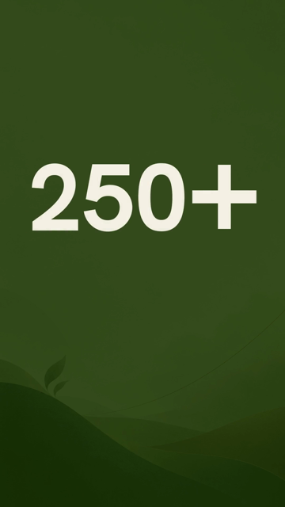
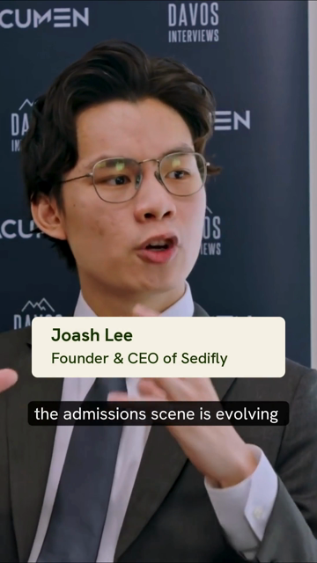

CREATIVE REVIEW · JOASH INTERVIEW AD
Founder trust, plus one student result
Joash's dinner invite cost S$16 a lead on your account. The interview ad needs a student result and the same offer as every other ad.
0:00
0:04
0:27
CAMPAIGN SETUP
OBJECTIVE
Leads, with an Instant Form synced to HubSpot
TARGETING
Parents in Singapore, ages 38 to 60
PLACEMENTS
Reels and Stories, plus a 4:5 cut for Feeds
BUDGET
S$400 a month (S$13 a day), plus retargeting
FORECAST
3 to 5 Readiness Check requests at S$70 to S$130 each
TRACKING
Qualified, booked and attended in HubSpot, sent back to Meta
STOP RULE
Above S$130 a request after S$260 spent, it moves to retargeting
A still card runs for 2.5 seconds before Joash appears.
Name and title from 0:03. Keep this.
Says free consultation. The other ads say Readiness Check.
EDITS BEFORE LAUNCH
Open on Joash speaking, with the offer count over the shot.
Add 3 seconds of Ke Yue before the end card: an unsuccessful first cycle, then UChicago.
End on "Take the free Admissions Readiness Check".
06

Slide 7
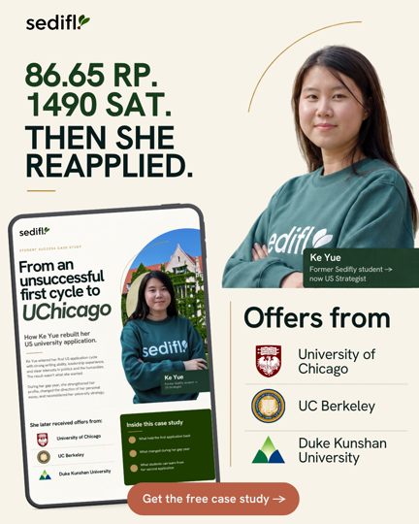
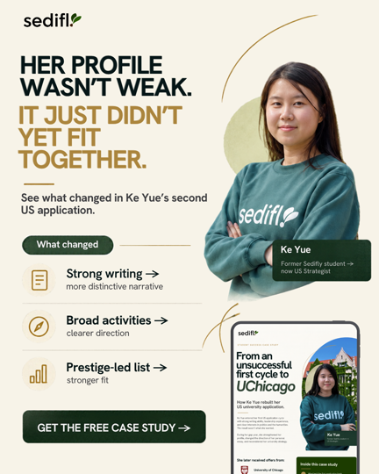
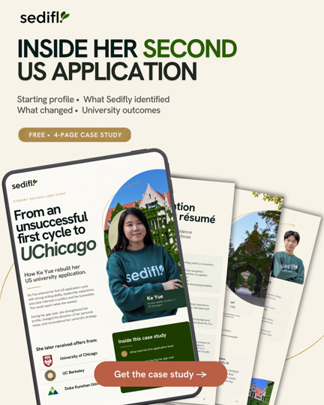
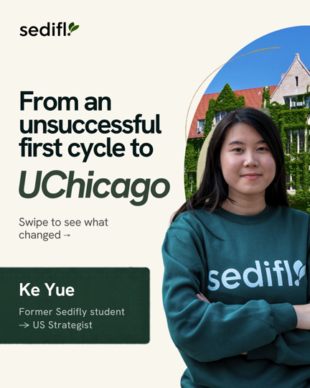
CREATIVE REVIEW · KE YUE CASE STUDY
Ke Yue's case study, proof for parents
Your eBook cost S$21 a lead. Ke Yue is stronger proof, and every download gets a strategist's follow-up.
CAMPAIGN SETUP
OBJECTIVE
Leads, with an Instant Form synced to HubSpot
TARGETING
Parents in Singapore, ages 38 to 60, one ad set
Lead with
Lead with
Test
Feeds
PLACEMENTS
Feeds for the 4:5 statics and carousel, Stories and Reels for the 9:16 statics
The grades and the "profile wasn't weak" lines give parents specifics to compare with their own child, so those two lead.
BUDGET
S$700 a month (S$23 a day)
FORM
The three Readiness Check questions: who is filling it in, the student's level, and target universities
FIX BEFORE LAUNCH
SAT: the ads say 1490 and a case study page says 1390. Which should the ads use?
FOLLOW-UP
The PDF arrives at once. A Readiness Check invite follows on day 3, and a strategist calls every A or B lead within 24 hours.
The last carousel card reads "Once Cycle Later".
KPIS
S$15 to S$25 per download (28 to 46 downloads), 40% to 55% scored A or B, 10% to 15% booking a Readiness Check
Three 9:16 statics place the logo or button where Stories and Reels cover the frame.
We need the 4-page PDF, hosted at a link the form can open.
07

Slide 8
FIRST-MONTH FORECAST
Month one, 20 to 33 Readiness Check requests
We kept the stages and conversion rates from the September proposal and applied them to S$2,000. Costs come from your account where it has data.
STAGE | RATE | LOW | HIGH | MEDIA EACH
Readiness Check requests | All four campaigns | 20 | 33 | S$100 to S$61
Qualified, scored A or B | 50% to 65% | 10 | 21 | S$200 to S$95
Readiness Check booked | 75% to 90% | 7 | 18 | S$286 to S$111
Consultation attended | 80% to 83% | 5 | 14 | S$400 to S$143
Enrolled | 20% to 30% | 1 | 4 | S$2,000 to S$500
From the September proposal
47 to 68
Enquiries at S$3,000, including masterclass sign-ups
37 to 49
The same cost bands at S$2,000, without the masterclass
20 to 33
Your costs: Ke Yue downloads turn into requests over weeks, and retargeting runs at S$48
Plus 28 to 46 Ke Yue downloads in the follow-up pool. Most enrollments land in months two and three.
ASSUMPTIONS AND SOURCES
Cost per request: Reel S$38 to S$55 (September test: S$38), Joash S$70 to S$130, retargeting S$38 to S$55 (your warm ad sets: S$48).
Your team calls each request within 5 minutes, between 10:00 and 22:00.
Weeks one and two cost more while Meta learns. Your HubSpot numbers replace every band after 30 days.
Ke Yue: S$15 to S$25 per download (your eBook: S$21), and 10% to 15% go on to request a Readiness Check.
08

Slide 9
TRACKING
Every lead, from form to consultation
Until now, Meta saw form fills and nothing after them. HubSpot will tell it who qualified, booked and attended, so it can find more people like them.
Instant Form
HubSpot
Score
Booked
Attended
Three qualifying questions on every campaign
Each lead lands in real time, tagged with its ad
A and B count as qualified
Your team marks it within 24 hours
Your team marks it within 24 hours
HubSpot sends qualified, booked and attended back to Meta, so Ads Manager shows cost per consultation by ad.
WHAT TOGGLE FIXES
WHAT WE FIX FIRST
HubSpot stages: Lead, MQL (A or B), SQL (booked), Opportunity (attended), Customer.
Three pixels sit on your account and one fires. We keep that one.
Your website audience holds about 20 people, so we check the pixel on the Wix site.
UTM tags on every ad, so visits show in GA4 by campaign and ad.
After about 100 qualified leads, Meta's Conversion Leads goal, which bids for quality.
Booked and attended reach Meta when your team updates HubSpot. We cannot do that step for you.
09

Slide 10
REPORTING AND OPTIMIZATION
A one-pager every Tuesday
You get a one-page report every Tuesday, starting the week after launch. Each one ends with what we changed and why.
Sedifly · Weekly one-pager
SAMPLE
HOW WE OPTIMIZE
SAMPLE LAYOUT, ILLUSTRATIVE FIGURES
WHEN | WE
First 7 days | Leave it to learn, unless tracking breaks
Video hook rate under 15% after 2,000 views | Re-cut the opening or retire the video
Cost per request above ceiling for 5 days | Swap creative first, then cut budget
Under 35% of leads scored A or B | Cut budget, even if leads look cheap
30% of a week's leads fit neither buyer | Tighten that ad set the same week
A campaign 20% under ceiling for 7 days | Move up to S$200 a month into it
SPEND
REQUESTS
QUALIFIED
BOOKED
S$467
7
4
3
CAMPAIGN | SPEND | REQUESTS | PER QUALIFIED
Applicants | S$140 | 3 | S$70
Ke Yue | S$163 | 1 | S$163
Joash | S$93 | 1 | None yet
Retargeting | S$70 | 2 | S$70
Total | S$466 | 7 | S$117
DECISION THIS WEEK
We moved S$5 a day from Joash to the applicant Reel after it reached a 27% hook rate.
Ceilings per request: S$55 applicants, S$130 Joash, S$55 retargeting, S$25 per Ke Yue download.
10

Slide 11
LAUNCH
Live in the week of 9 November
Your team clears the items below by Friday 6 November, and the campaigns go live the following week.
4 to 6 Nov
Week of 9 Nov
Tue 17 Nov
After 30 days
Build and approve
Launch
First one-pager
KPI review
You approve the plan and clear the blockers. We build the forms, HubSpot sync, audiences and ad copy.
All four campaigns go live once a test lead reaches HubSpot.
Then every Tuesday.
We reset the targets on your HubSpot numbers.
ASSETS WE NEED BY 9 NOV
BLOCKERS TO CLEAR BY 6 NOV
Reel: the 30-second and 15-second cuts.
Claims: your Speedy Prep page still says 150+ offers against 250+ on the homepage, and Ke Yue's SAT score.
Your client and past-lead lists, so cold ads skip people you know.
Joash: the re-cut with Ke Yue's result and a 4:5 version.
Ke Yue: the PDF, the fixed carousel card and the corrected SAT score.
A privacy policy page on sedifly.com for the forms to link to (PDPA).
Your Roscoe webinar campaign is set to S$350 a day and has spent S$35 since 16 October. Inside or outside the S$2,000?
HubSpot admin access and one person who updates booked and attended.
11

