Slide 1


Launch plan
for Sedifly

Slide 2
YOUR ASKS FROM 4 NOVEMBER
Five asks, and our answers
Each row points to the slides with the detail. All launches and changes wait for your approval.
YOUR ASK | OUR ANSWER | SLIDES
Meta inventory | One campaign is live: the new Roscoe webinar at S$150 a day. Every Readiness Check campaign is paused, and slide 03 lists their IDs. | 03
Creative review | Ke Yue's Reels and the Joash ad can run. The case study needs two small edits. Jeremy A and B can run after the copy and form changes, and C needs a re-cut. | 05 to 08
Consultation CTA | It adds a consultation form and two ad sets with their own budgets. The month-one total stays close to our last forecast: 21 to 35 requests. | 04, 09, 10
Launch and tracking | Ke Yue case study at S$600 a month for 24 to 40 downloads. View-only HubSpot access for us. Launch in the week of 16 November, or earlier if reviews finish sooner. | 06, 11, 13
Channel expansion | Google Search from mid-January, after 30 days of Meta data. We suggest S$1,000 a month for two months. | 12
Please send the copy for each ad and form, so we can review it before launch.
02

Slide 3
META INVENTORY
Your account on 4 November
We pulled your account on 4 November. It holds 30 campaigns and 168 ads, and one campaign is live.
LIVE NOW
ADMISSIONS READINESS CHECK CAMPAIGNS, ALL PAUSED
2026-11-15_Roscoe_G9-11_Webinar – New
CAMPAIGN AND ID | VARIANTS | LAST EDIT | 30 DAYS
MSA | Readiness Assessment | Messaging Test 01 120256027176360569 | Diagnostic, Planning, Prioritisation | 9 Oct | S$109 1 lead
MSA | Parents | Readiness Assessment | Test 01 120256036587060569 | Hidden gaps, Roadmap, Early planning | 5 Oct | S$45 0 leads
SG | Leads | Website+IF | Admissions Readiness 120256206011020569 | Personalised Guidance, Small-Group Strategy, Sedifly Environment | 16 Oct | S$396 1 lead
SG | Admissions | Leads | Evergreen Grades 120256342662220569 | Parent SG Admissions Reel | 26 Oct | S$95 2 leads
CAMPAIGN ID
120256629675680569
BUDGET
S$150 a day, set at campaign level
AD SETS
Parent angle (120256629751870569) and Student Angle (120256629675700569), one ad in each
FORM
Instant Form with the Sign Up button
TARGETING
Ages 18 to 65 with Advantage+ audience on
TWO QUESTIONS
At S$150 a day it can spend up to S$1,650 before the 15 November webinar. Does that sit inside or outside the S$2,000?
Grade 9 to 11 students are 14 to 17, and Meta cannot show ads to anyone under 18, so the Student Angle ad set reaches adults. Shall we move its budget to the parent ad set?
Together they spent S$644 in the last 30 days for 4 leads. None of their variants is running now.
WHAT WE DO WITH THEM
We leave the paused campaigns as they are, so your history stays in the account. The new plan runs in new campaigns, named so HubSpot shows which ad brought each lead.
Instant Forms do not show at our access level. Please share the copy of the forms you use today, including the Admissions Readiness Check form, so we can match them.
03

Slide 4
THE META PLAN
Five ad sets, one S$2,000 budget
Jeremy's ads take S$300. We moved S$100 each from the Ke Yue Reel, the Ke Yue case study and Joash to fund them, so the total stays at S$2,000.
Readiness Check
Consultation
Ke Yue case study
Consultation
Retargeting
Applicants, 18 to 24
Applicants, 18 to 24
Parents, 38 to 60
Parents, 38 to 60
People who know Sedifly
S$500 · S$17 a day
S$300 · S$10 a day
S$600 · S$20 a day
S$300 · S$10 a day
S$300 · S$10 a day
CREATIVE
Ke Yue Reels, 33s and 19s
CREATIVE
Jeremy A and B
CREATIVE
4 statics and the carousel
CREATIVE
Joash interview
CREATIVE
Ke Yue Reels, 33s and 19s
FORM
Consultation
FORM
Consultation
FORM
Readiness Check
3 to 5 requests
FORM
Case study download
2 to 4 requests
FORM
Readiness Check
9 to 13 requests
EXPECT
EXPECT
5 to 7 requests
EXPECT
24 to 40 downloads
EXPECT
EXPECT
WAS S$600
NEW
WAS S$700
WAS S$400
NO CHANGE
WHEN A NEW AD NEEDS ITS OWN AD SET
TARGETING
OBJECTIVE AND PLACEMENTS
A new ad gets its own ad set when it changes the audience, the form or the offer. Otherwise it joins an existing ad set.
Singapore, fixed age bands, Advantage+ audience off. We exclude your clients and past leads.
Leads, with Instant Forms synced to HubSpot. Instagram and Facebook Feeds, Stories and Reels.
04

Slide 5
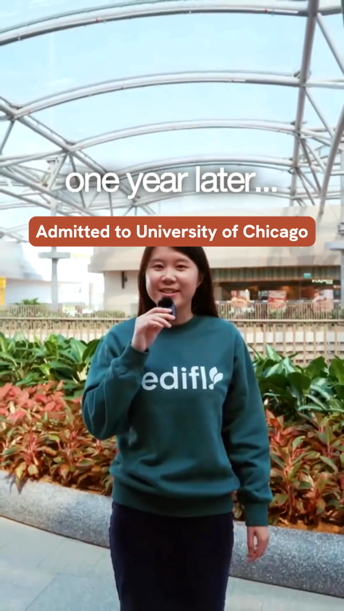
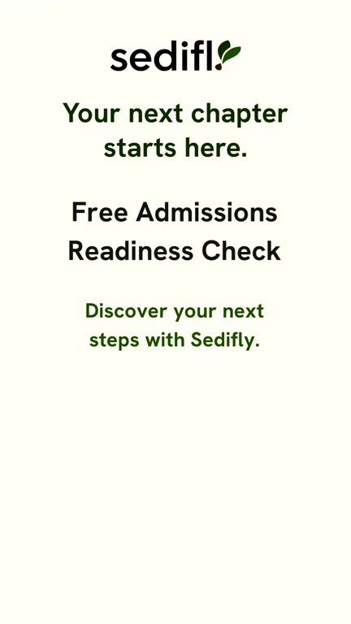
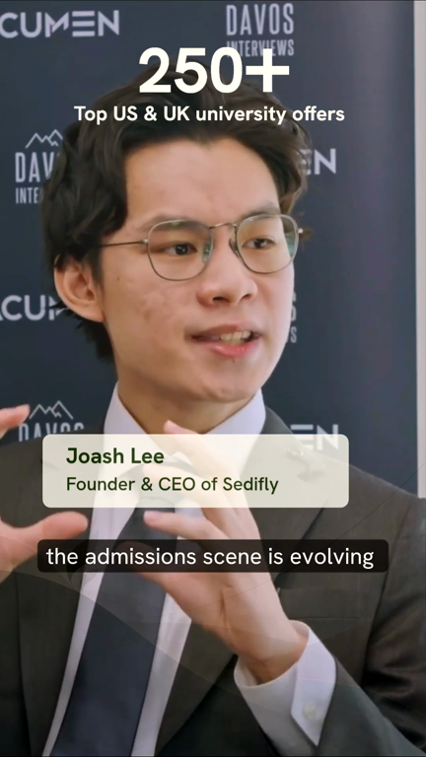

CREATIVE REVIEW · KE YUE REELS AND JOASH
Both are ready to run
You made the edits we asked for on the Reels, and Joash now opens on him speaking. One claim on your website needs to match the Joash ad.
0:14
0:15
0:00
0:24
WHAT YOUR TEAM CHANGED
The Reel now runs in two cuts, 33 and 19 seconds, down from 45.
The UChicago letter is labeled, and the end card names the free Readiness Check.
Joash opens on him speaking at 0:00, with the 250+ offers line on screen.
BEFORE LAUNCH
Your homepage says 250+ offers and 40%+ Ivy League and Oxbridge. Your Speedy Prep page still says 150+ and 30%+ (checked on 4 November). Please update the Speedy Prep page, so a parent who checks after seeing Joash finds the same number.
19s Reel: the letter now reads "Admitted to University of Chicago".
The Readiness Check offer shows in the last 4 seconds of both cuts.
Joash opens speaking, with 250+ offers over the shot.
Ends on "Book a free consultation".
COPY AND SETUP
Please send the post copy, headline and description for both Reels and the Joash ad. The offer appears late in each Reel, so name the free Readiness Check in the first line and the headline.
Joash keeps "Book a free consultation" and runs in the parent consultation ad set. Ke Yue stays out of the Joash ad, as you asked.
05

Slide 6
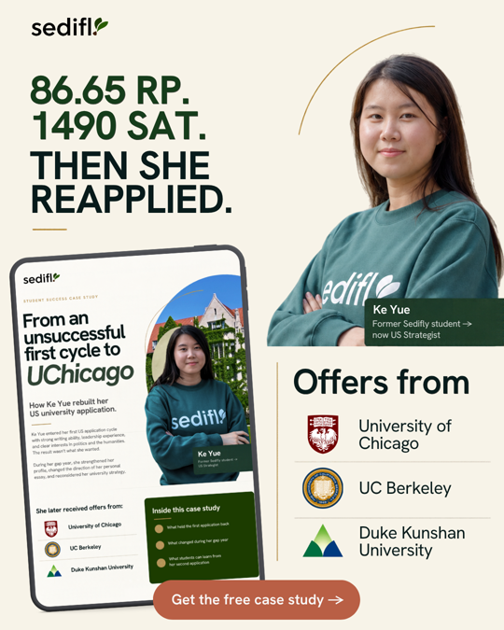
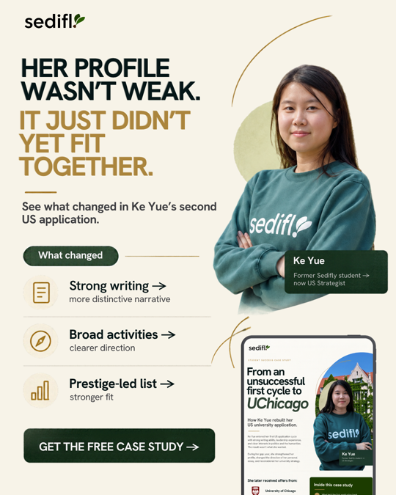
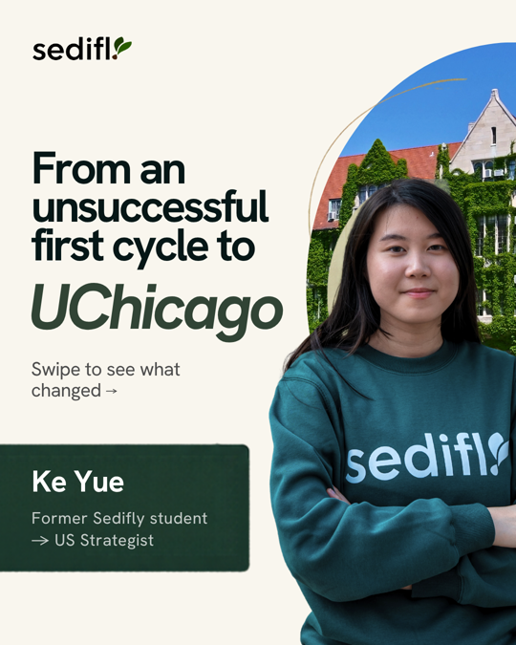
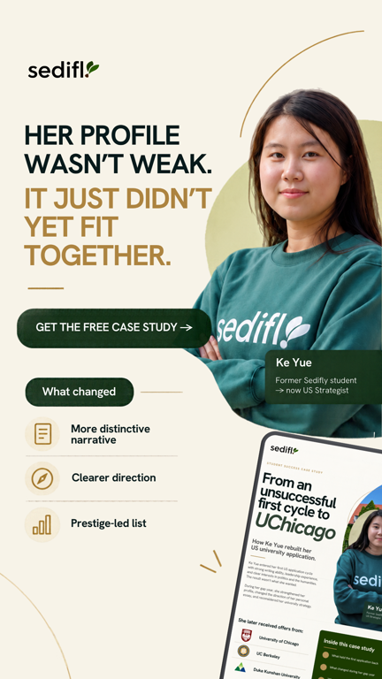
KE YUE CASE STUDY
Budget, KPIs and follow-up
Your corrected files fix the SAT score and the last carousel card. Two small edits remain. Please send the copy for the statics, the carousel and the form.
9:16
CAMPAIGN SETUP FOR YOUR APPROVAL
BUDGET
S$600 a month (S$20 a day), down from S$700 to fund Jeremy's ads
TARGETING
Parents in Singapore, ages 38 to 60, one ad set
PLACEMENTS
Feeds for the 4:5 statics and carousel, Stories for the 9:16 statics
The 4:5 statics and the carousel run in Feeds. The 9:16 statics run in Stories and stay out of Reels, where the caption and button cover the bottom third of the image.
FORM
Higher Intent Instant Form with the three Readiness Check questions: who is filling it in, the student's level, target universities
DELIVERY
The form's thank-you screen links to the PDF
TWO EDITS
FOLLOW-UP
Your team sends a Readiness Check invite on day 3, and a strategist calls each A or B lead within 24 hours. The PDF's button links to your Check My Readiness page with tracking tags, so it doesn’t need to change.
9:16 diagnostic static: "Prestige-led list" sits under What changed without the "stronger fit" line the 4:5 version has. It reads as if Sedifly built a prestige list. Please add the line.
PDF page 2: "The writing was strong; and the underlying story was a common one" reads better as "The writing was strong, but the underlying story was a common one."
KPIS
S$15 to S$25 per download (24 to 40 downloads), 40% to 55% scored A or B, 10% to 15% go on to request a Readiness Check
COPY
Post copy, headline and description for each static and the carousel, plus the form copy, from your team
PREVIEW
We send a Meta preview link for each ad before launch
06

Slide 7
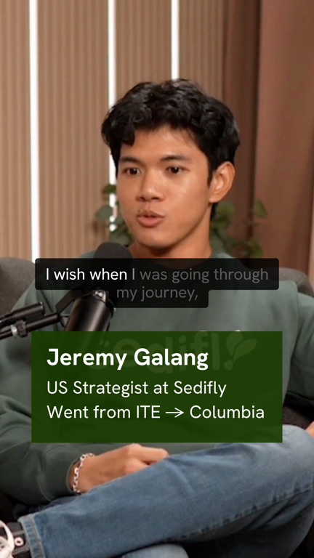
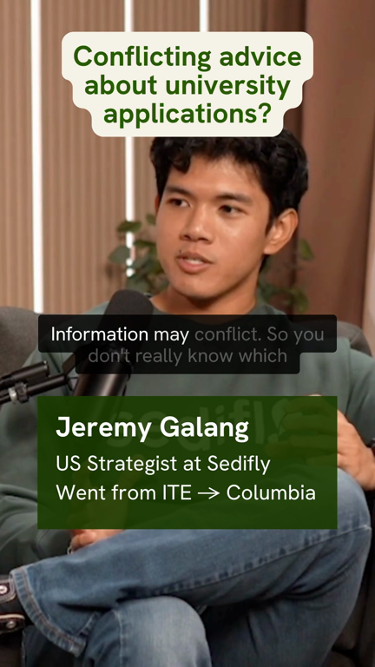
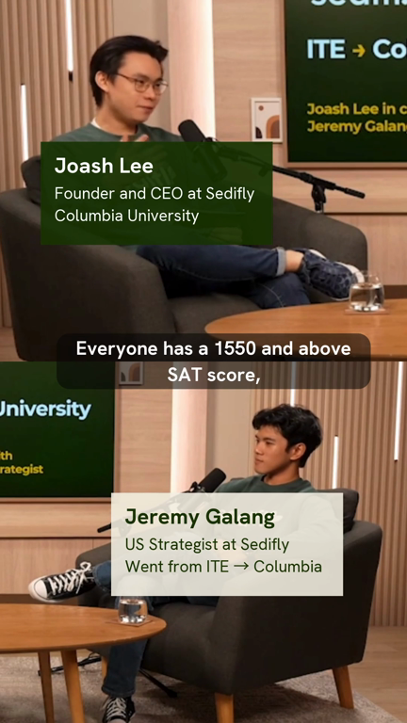
CREATIVE REVIEW · JEREMY GALANG PODCAST ADS
Two to run, one to re-cut
Jeremy speaks to students, and "ITE to Columbia" gives ITE and poly students someone who took their route. A and B can run once your team updates the copy and form with the changes below and sends them to us.
A
B
C
COPY CHANGES
Write to the student. Ad A asks about "your own or your child's" journey, but Jeremy talks to students and this ad set reaches 18 to 24.
Open with "ITE to Columbia". Meta cuts the post copy after about two lines, so it has to sit in the first one.
Cut "could", "may" and "explore how". Tell people what they get: a free consultation with a Sedifly strategist.
Change the button from Sign Up to Book Now, which matches booking a call.
In the brief, Ad B carries Ad A's title. We recommend renaming it to "Conflicting Advice".
RUN
RUN
RE-CUT
"I wish I had a mentor" (0:30). His first line tells students what the ad is about.
"Conflicting advice" (0:21). The question on screen is about conflicting advice, but Jeremy talks about telling his own story. The post copy should connect the two.
"Beyond grades" (0:33). The first 5 seconds are a wide shot with small faces, and the clip stops mid-sentence at "the FITZ app".
RE-CUT FOR C
Open on Jeremy's close-up at "The first one was definitely the national service experience". Cut Joash's opening line, "Everyone has a 1550 and above SAT score". A 1550 is a top score, so ITE and poly students without one may decide the ad is not for them and scroll past. End on what National Service and his app added to his application.
07

Slide 8
JEREMY GALANG PODCAST ADS
Forms, setup and KPIs
Jeremy A and B share one ad set with the consultation form. It reaches the same applicants as the Ke Yue Reels, which offer the Readiness Check.
FORM CHANGES
CAMPAIGN SETUP
One consultation form for Jeremy A, Jeremy B and Joash, so their results compare.
Higher Intent form type, so people review their answers before they submit.
The three Readiness Check questions: who is filling it in, the student's level and target universities. We added ITE to the level options.
Your draft does not ask where the student wants to apply, so we could not score its leads A to D.
A thank-you screen that says who gets in touch and when: "A Sedifly strategist will WhatsApp you within one working day to book a time."
TARGETING
Singapore, ages 18 to 24, Advantage+ audience off, clients and past leads excluded
PLACEMENTS
Instagram and Facebook Reels and Stories. A Feed crop would cut the top text on Jeremy B.
TESTING
A and B run in the same ad set. Once each ad has 2,000 plays, we keep the one with the higher hook rate and lower cost per request.
BUDGET
S$300 a month (S$10 a day)
TIMELINE
You approve the copy and form by Tue 10 Nov, we send previews by Fri 13 Nov, and the ads go live in the week of 16 Nov. C joins after the re-cut.
KPIS
3 to 5 consultation requests a month at S$55 to S$85 each, a hook rate of 25% or more, and 50% to 65% of leads scored A or B
How we set the cost
Your account has no consultation ads to learn from. A call asks more of a student than a Readiness Check, so we set the cost at 1.5 to 2 times your September test's S$38 a lead.
08

Slide 9
THE CONSULTATION CTA
A second offer with its own form
Yes, it changes the setup and the forecast. Requests now come through two offers at different costs, and HubSpot tracks each one.
SETUP
FORECAST
READING THE TEST
A consultation Instant Form sits beside the Readiness Check form. HubSpot shows which form each lead came through, so you can see the offer they chose.
Two consultation ad sets, Jeremy for applicants and Joash for parents, each with a fixed budget. Fixed budgets stop Meta from moving all the money to the cheaper offer.
The weekly one-pager shows the two offers side by side.
OFFER | SPEND | REQUESTS
Readiness Check | S$1,400 | 16 to 26
Consultation | S$600 | 5 to 9
Total | S$2,000 | 21 to 35
The two applicant ad sets differ in creative as well as offer. Month one tells you which pairing of creative and offer works.
For a read on the CTA alone, export Jeremy A once more with a Readiness Check end card and run the same video with both forms.
We compare the offers on cost per attended meeting after six to eight weeks, once enough people have come to a call.
Our last forecast was 20 to 33. The higher consultation cost applies to S$600 of the S$2,000, so the total stays close.
Readiness Check covers the Ke Yue Reels, retargeting and case study follow-ups. Consultation covers Jeremy and Joash. Cost per request: S$38 to S$55 for the Readiness Check, S$55 to S$130 for a consultation.
One question: does a Readiness Check lead into a consultation, or are they separate first meetings?
09

Slide 10
FIRST-MONTH FORECAST
Month one, 21 to 35 requests
We kept the stages and rates from the September proposal and the cost bands from our last plan, and added the consultation ad sets.
BY AD SET
FUNNEL
AD SET | BUDGET | COST EACH | REQUESTS
Readiness Check, applicants | S$500 | S$38 to S$55 | 9 to 13
Consultation, applicants | S$300 | S$55 to S$85 | 3 to 5
Ke Yue case study | S$600 | S$15 to S$25 | 2 to 6
Consultation, parents | S$300 | S$70 to S$130 | 2 to 4
Retargeting | S$300 | S$38 to S$55 | 5 to 7
Total | S$2,000 |  | 21 to 35
STAGE | RATE | LOW | HIGH | MEDIA EACH
Requests | All five ad sets | 21 | 35 | S$95 to S$57
Qualified, A or B | 50% to 65% | 10 | 22 | S$200 to S$91
Booked | 75% to 90% | 7 | 19 | S$286 to S$105
Attended | 80% to 83% | 5 | 15 | S$400 to S$133
Enrolled | 20% to 30% | 1 | 4 | S$2,000 to S$500
ASSUMPTIONS AND SOURCES
Readiness Check: S$38 in your September diagnostic test. Retargeting: your warm ad sets averaged S$48. Ke Yue: 24 to 40 downloads at S$15 to S$25 (your eBook: S$21), and 10% to 15% go on to request.
Consultation: no history in your account, so 1.5 to 2 times the Readiness Check cost for applicants. Parents use our last Joash band, S$70 to S$130.
Both offers use the same funnel rates until HubSpot shows a difference. Your team calls each request within 5 minutes, between 10:00 and 22:00.
Weeks one and two cost more while Meta learns, and most enrollments land in months two and three. Your HubSpot numbers replace every band after 30 days.
10

Slide 11
HUBSPOT ACCESS
View-only access to your ad leads
Please add jordan@toggle.solutions as a view-only user. We need to see the leads from your ads and how far each one gets.
WHAT WE LOOK AT
ACCESS WE NEED
FROM YOUR SIDE
View-only seat
AREA | ACCESS AND WHY
Contacts | View, to see each lead and its form answers
Deals | View, to see booked, attended and enrolled
Ads | View, to see which ad brought each lead
Lists | View, to check who the ads exclude
Reports | View, to read your lead dashboards
Connect the Meta Instant Forms to HubSpot, so each lead arrives with its form and ad name. We send a test lead before launch to check it.
Who updates booked, attended and enrolled in HubSpot? We need one name, and each update within 24 hours of the call.
The leads from each ad and their answers to the form questions.
How far each lead gets: qualified, booked, attended and enrolled.
We use these numbers in the weekly one-pager and the 30-day review.
Not needed: edit rights, admin, billing or user management.
11

Slide 12
CHANNEL EXPANSION
Google Search, from month two
We suggest adding Google Search in mid-January, after 30 days of Meta, when HubSpot can show which Meta leads qualify.
WHY SEARCH
TWO BUDGET OPTIONS
What Search needs
Parents and students who type "US university admissions consultant Singapore" want help now. Of the channels we looked at, Search has the strongest case on audience fit and lead quality.
OPTION | CLICKS | REQUESTS | COST EACH
S$500 a month Brand and top intent | 100 to 165 | 4 to 11 | S$45 to S$125
S$1,000 a month Plus wider terms | 170 to 290 | 5 to 17 | S$59 to S$200
A landing page with the Readiness Check form. Your Check My Readiness page could serve.
Google Ads conversion tracking on that form, and the form feeding HubSpot.
WHY NOT THE OTHERS
We suggest S$1,000 a month for two months. Google's automated bidding needs about 30 conversions a month, which neither option reaches, so we set bids by hand. Two months at S$1,000 gives you 10 to 34 requests to judge quality on.
TikTok: each ad group needs more than US$20 a day, about S$800 a month, so S$500 cannot fund one. It also cannot reach under-18s.
LinkedIn: targets job titles, not families planning university.
YouTube: builds awareness, with few direct leads at this budget.
Access to your Google Ads account, or a new one in your name.
We report brand and non-brand searches apart, since people who search "Sedifly" know you before they click.
ASSUMPTIONS
S$3 to S$5 a click on brand and top-intent terms, S$4 to S$7 on wider terms. 4% to 7% of clicks request a Readiness Check, 2% to 5% on wider terms. We replace these estimates with Google's keyword volumes and bids before you approve a budget. January follows the US Regular Decision deadlines, so the first weeks may run quieter.
12

Slide 13
LAUNCH
Live in the week of 16 November
We moved the launch a week so your team has time to review the copy, forms and previews. If the reviews and revisions finish sooner, we can launch earlier.
5 to 10 Nov
11 to 13 Nov
Week of 16 Nov
Tue 24 Nov
Mid-December
You review
We build
Launch
First one-pager
30-day review
Approve this plan. Send the copy for each ad and form, including the revised Jeremy copy. Share HubSpot access.
Forms, audiences and ads. We send a Meta preview link for each ad by Fri 13 Nov.
All five ad sets go live once you approve the previews and a test lead reaches HubSpot.
Then every Tuesday.
We reset the targets on your HubSpot numbers and decide on Google Search.
WHAT WE NEED FROM YOUR TEAM
OPEN QUESTIONS
Post copy, headline and description for the Ke Yue Reels, statics, carousel and the Joash ad (slides 05 and 06).
The revised Jeremy A and B copy and the consultation form copy (slides 07 and 08).
View-only HubSpot access for jordan@toggle.solutions, with the Meta forms connected to HubSpot (slide 11).
Your client and past-lead lists, so the ads skip people you know.
Roscoe webinar: inside or outside the S$2,000 (slide 03)?
Who updates booked, attended and enrolled in HubSpot (slide 11)?
Speedy Prep page: can it show 250+ offers, as the homepage does (slide 05)?
Readiness Check and consultation: one path or two (slide 09)?
13

