Slide 1


SEDIFLY · META PLAN · 4 NOVEMBER 2026
Meta plan for November,
built on your account data
One slide for each of your asks. The numbers come from 12 months of your Meta account: S$18,831 spent and 718 form leads between November 2025 and November 2026.
Jordan Pinto Cofounder · jordan@toggle.solutions
[ Your Digital Growth Partner ]
[ toggle.solutions ]

Slide 2
[ toggle.solutions ]
YOUR ASK: LESSONS FROM THE PREVIOUS CAMPAIGNS
What S$18,831 on Meta taught us about your buyers
We read every campaign, ad set and ad in your account from November 2025 to November 2026. Three findings shape the plan.
01
Parents want proof before a consultation
COST PER LEAD BY OFFER
Parent Readiness Check ads cost S$132 a lead in September. In the same months, parents signed up for the medicine webinar at S$23 and the eBook at S$21. The plan shows parents Ke Yue's results first.
Awareness video
S$19
98 leads
eBook
S$21
81 leads
Webinars and events
S$23
02
21% of spend reached people outside your buyers
386 leads
Readiness Check, 18 to 24
S$38
Most ad sets ran at ages 18 to 65 with Advantage+ free to widen them. The parent ad sets used luxury interests such as Ferrari, Hermès and Rolex to find affluent families, and those interests reach executives more than parents. That is the B2B and C-suite drift you saw.
19 leads
Readiness Check, parents
S$132
3 leads
WHERE THE SPEND WENT, BY AGE
03
Meta never learned which leads were good
26%
18%
14%
33%
6%
No qualified, booked or attended status went back to Meta, so it chased the cheapest form fill. Website forms lost leads too: campaigns that sent people to the website cost S$124 a lead, against S$21 for Instant Forms.
18-24
25-34
35-44
45-54
55-64
Orange: ages 25 to 34 (18%) and 65+ (3%), outside both buyer groups. S$3,877 of spend.
Source: Sedifly Meta ad account, 5 Nov 2025 to 3 Nov 2026. The two Readiness Check rows are small September tests (S$714 and S$397 of spend).
2

Slide 3



[ toggle.solutions ]
YOUR ASK: THE META PLAN
Four campaigns that all end in a booked Readiness Check
Applicants get the Readiness Check offer from the first ad. Parents see Ke Yue's results and Joash first, then get the offer through retargeting and a strategist's follow-up.
Priority | Campaign | Who sees it | Creative | Budget | Month one
1 | Readiness Check for applicants | Singapore, ages 18 to 24: JC and poly graduates, NS, gap year | Admissions Readiness Reel | S$600 (S$20 a day) | 10 to 15 enquiries
2 | Ke Yue case study for parents | Singapore, ages 38 to 60 | Four statics and the carousel | S$700 (S$23.33 a day) | 28 to 46 downloads
3 | Joash interview for parents | Singapore, ages 38 to 60 | Joash interview video | S$400 (S$13.33 a day) | 3 to 5 enquiries
4 | Retargeting | 25,000+ video viewers, 5,000 Instagram and Facebook engagers, case study downloads | 15-second Reel cut, Joash video, carousel | S$300 (S$10 a day) | 7 to 10 enquiries
Total |  |  |  | S$2,000 (S$66.67) | 22 to 36 enquiries
Objective
Targeting
Placements
Leads, with Meta Instant Forms (Higher Intent) synced to HubSpot. On your account, Instant Forms cost S$21 a lead and website campaigns cost S$124.
Age bands locked, with Advantage+ audience off. We add no interest layers. Current clients and past leads stay out of the cold campaigns.
Instagram and Facebook Feeds, Stories and Reels. Reels and Stories took 59% of your spend at the same cost per lead as Feeds, so every campaign needs 9:16 assets.
3

Slide 4
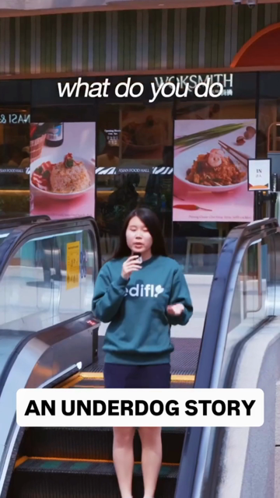
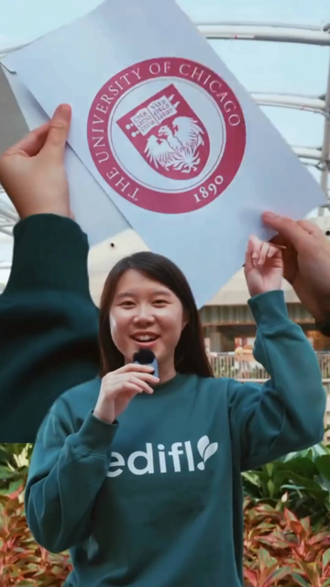
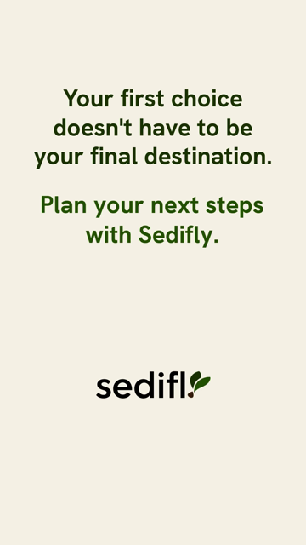
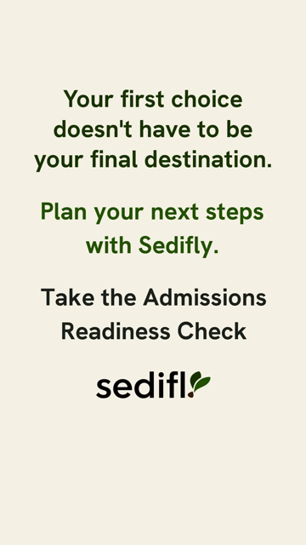
[ toggle.solutions ]
YOUR ASK: REVIEW THE ADMISSIONS READINESS REEL AND SET A TEST BUDGET
A strong story with the offer in the last 4 seconds
On your account, about 2 in 100 people who see a video watch 15 seconds of it. Ke Yue's opening earns attention, so the offer has to appear while people are still watching.
0:00
0:37
0:40
0:41
WHAT WE WOULD CHANGE
Show "Free Admissions Readiness Check" on screen from about 8 seconds, and again on the letter shot.
Cut a 30-second main version and a 15-second version: hook, gap year, letter, offer. The 15-second cut runs in Stories and retargeting.
Label the letter shot "Offer: University of Chicago". The outcome is the reason to book.
Test two more openers from Ke Yue's own lines: the "aiming too high" advice she got, and the letter shot first.
Move the label into the top third, and confirm the Readiness Check is free before the ads say so.
Strong hook. The "Underdog Story" label sits where Reels puts its caption and button.
The UChicago letter shows for one second, with no text naming it.
The end card opens without an offer.
The Readiness Check appears in the last 4 seconds.
TEST BUDGET
S$280 over 14 days in the applicant campaign. We scale the Reel if its hook rate reaches 25% (your best video so far: 28%) and cost per enquiry stays at S$55 or less. Its best window opens mid-December, when US Early Decision results land.
4

Slide 5
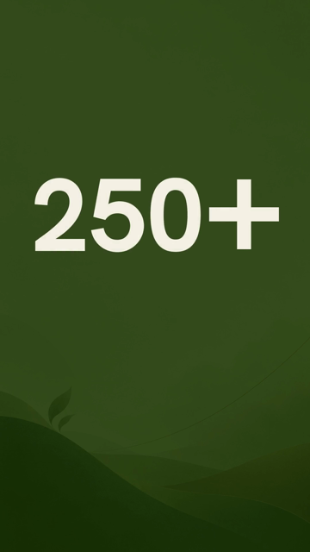
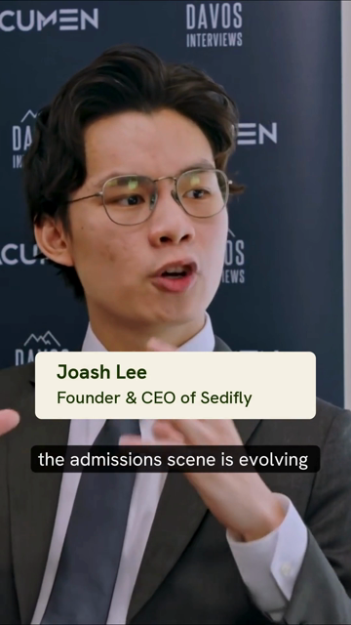

[ toggle.solutions ]
YOUR ASK: LAUNCH AND OPTIMIZE THE JOASH INTERVIEW AD
Joash builds trust, and the ad still needs a result
Joash's dinner invite cost S$15 a parent lead on your account. Direct consultation asks cost S$132, so this ad runs with a stop rule.
0:00
0:04
0:27
Setup | What we propose
Objective | Leads, Instant Form (Higher Intent), synced to HubSpot
Audience | Parents in Singapore, ages 38 to 60, age band locked
Placements | Reels and Stories in 9:16, plus a 4:5 cut for Feeds
Budget | S$400 a month (S$13.33 a day), plus a share of retargeting
Forecast | 3 to 5 Readiness Check requests at S$70 to S$130 each
Stop rule | Above S$130 per enquiry after S$260 spent, the video moves to retargeting, where people already know Sedifly
A still card fills the first 2.5 seconds. It says 250+; your site says 150+.
Name and title arrive at 4 seconds. Keep this.
The offer says "free consultation". Every other ad says Readiness Check.
EDITS BEFORE LAUNCH
Open on Joash speaking, with the offer count as text over the shot.
Add one result before the end card, such as 3 seconds of Ke Yue: an unsuccessful first cycle, then UChicago.
End on "Take the free Admissions Readiness Check".
Confirm 250+ or 150+, and that the interview's producer allows paid use of the footage.
5

Slide 6
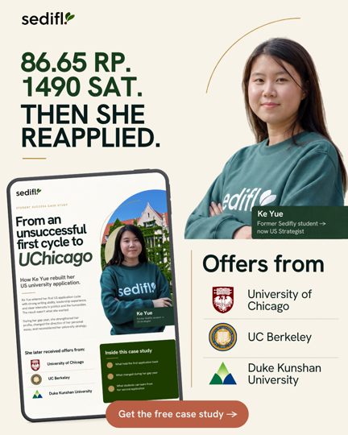
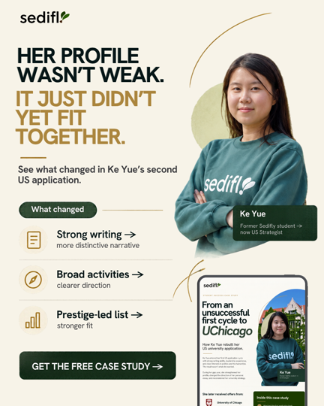
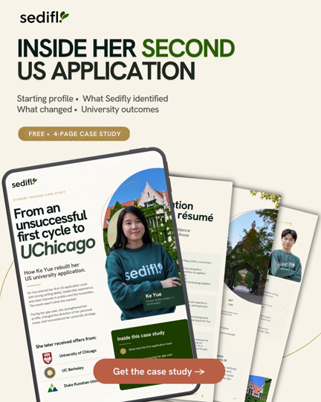
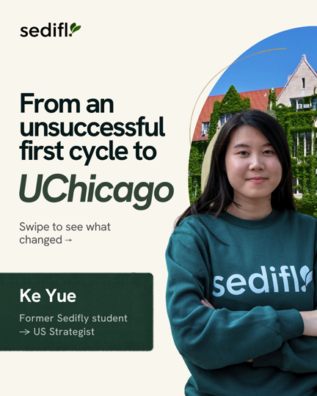
[ toggle.solutions ]
YOUR ASK: THE KE YUE CASE STUDY CAMPAIGN
Ke Yue gives parents proof before the Readiness Check
Your eBook brought in parent leads at S$21 each. The Ke Yue case study is stronger proof, so it runs the same way and hands A and B leads to a strategist.
Setup | What we propose
Objective | Leads, Instant Form (Higher Intent), synced to HubSpot
Audience | Parents in Singapore, ages 38 to 60, one ad set
Budget | S$700 a month (S$23.33 a day)
Form | The three Readiness Check questions: who is filling it in, the student's current level, and target universities
Follow-up | The PDF arrives at once. A Readiness Check invite follows on day 3, and a strategist calls every A or B lead within 24 hours.
KPIs | S$15 to S$25 per download (28 to 46), 40% to 55% scored A or B, and 10% to 15% booking a Readiness Check within 30 days
Lead candidate
Lead candidate
Test
Feeds
Exact grades parents can compare with their child's.
Names the worry: a good profile that did not fit together.
Shows what the download contains.
The swipe order tells the story.
FIX BEFORE LAUNCH
SAT score: the ads say 1490 and the case study page says 1390.
The last carousel card reads "Once Cycle Later" in the 4:5 and 1:1 sets.
On three of the four 9:16 statics, the logo or button sits where Stories and Reels cover the frame.
We need the 4-page PDF itself, hosted at a link the form and HubSpot can open.
6

Slide 7
[ toggle.solutions ]
YOUR ASK: THE FIRST-MONTH FORECAST
Month one: 22 to 36 requests and 1 to 4 enrollments
Same stages and conversion rates as the September proposal. The request count moves for two reasons, both shown on the right.
LOW TO HIGH
MEDIA EACH
HOW THIS TIES TO THE SEPTEMBER PROPOSAL
Readiness Check requests
22 to 36
S$56 to S$91
September proposal at S$3,000, including masterclass sign-ups
All four campaigns
47 to 68
Qualified, scored A or B
11 to 23
S$87 to S$182
50% to 65% of requests
Readiness Check booked
8 to 20
S$100 to S$250
37 to 49
Same cost bands on S$2,000, with the masterclass cell removed
75% to 90% of qualified
Consultation attended
6 to 16
S$125 to S$333
80% to 83% of booked
Enrolled
1 to 4
S$500 to S$2,000
22 to 36
Your account data: a direct ask to parents cost S$132, so S$1,100 of parent budget goes through Ke Yue and Joash first
20% to 30% of attended
Plus 28 to 46 Ke Yue downloads in the follow-up pool. Low takes the weaker end of every rate, high the stronger end, and each step rounds down. Most enrollments land in months two and three.
ASSUMPTIONS AND SOURCES
Conversion rates are the September proposal's bands. Cost per request: applicants S$38 to S$55 (September test: S$38), parents S$70 to S$130 (September: S$132), retargeting S$28 to S$38 (your warm ad sets: S$33), case study S$15 to S$25 per download (your eBook: S$21). Your team calls within 5 minutes. Weeks one and two cost more while Meta learns, and your HubSpot data replaces every band after 30 days.
7

Slide 8
[ toggle.solutions ]
YOUR ASK: TRACKING FOR QUALIFIED LEADS AND CONSULTATION BOOKINGS
We trace every lead from the form to the consultation
Until now, Meta saw form fills and nothing after them. HubSpot stages will tell it who qualified, booked and attended, and Meta then bids for more people like them.
Instant Form
HubSpot
Score A to D
Booked
Attended
One form per campaign, three qualifying questions
Lead lands in real time through the Meta Lead Ads sync
Form answers set the score. A and B count as qualified
Your team marks the Readiness Check booked within 24 hours
Your team marks the consultation attended within 24 hours
HubSpot's Conversions API sync sends qualified, booked and attended back to Meta, so Ads Manager shows cost per consultation by ad.
WHAT WE SET UP
WHAT WE FOUND AND WILL FIX
HubSpot stages: Lead, then MQL (A or B), SQL (booked), Opportunity (attended), Customer.
Each Meta lead carries its campaign, ad set and ad, so you can see which ad produced each consultation.
Once the account logs about 100 qualified events, we test Meta's Conversion Leads goal, which bids for qualified leads.
UTM tags on every ad link, so ad visits show in GA4 by campaign and ad.
Three pixels sit on your account. "Sedifly - CURRENT" fires, one stopped on 19 October, and one has never fired. We keep one.
Your website retargeting audience holds about 20 people, so the pixel on the Wix site needs a check.
Booked and attended reach Meta when your team updates HubSpot. We cannot do this step for you.
Website campaigns cost S$124 a lead on your account, so every campaign uses an Instant Form.
8

Slide 9



[ toggle.solutions ]
YOUR ASK: FIRST REPORTING DATE, CADENCE AND OPTIMIZATION CRITERIA
You get a report every Monday from 16 November
Each report covers spend, requests, qualified, booked and attended by campaign, the ads we kept and cut, and the one decision we made that week.
Signal | Trigger | Action
First 7 days | Meta is still learning | No changes unless tracking breaks or an ad is rejected
Video hook rate | Under 15% after 2,000 impressions (your account average: 9%) | Re-cut the opener or retire the video
Static click rate | Under 0.7% after 1,500 impressions (your average: 0.8%) | Retire the static
Cost per request | Above the ceiling five days running: S$55 applicants, S$130 Joash, S$38 retargeting, S$25 per download | Rotate creative first, then cut budget
Lead quality | Under 35% of leads scored A or B after 10 leads | Cut budget, even when cost per lead looks good
Winning campaign | Cost per qualified request 20% under ceiling for 7 days | Move up to S$200 a month into it
Audience drift | Over 30% of a week's leads are neither parent nor applicant | Tighten the ad set that week
Every Monday from 16 Nov
One-page report by campaign, with cost per qualified request and lead quality by age.
Day 14: Tuesday 24 Nov
Creative call: Reel, Joash and the Ke Yue statics, with keep, cut and scale decisions.
Day 30: Thursday 10 Dec
KPI review against this forecast. We reset the KPIs on your real numbers.
9

Slide 10
[ toggle.solutions ]
YOUR ASK: LAUNCH TIMELINE, REQUIRED ASSETS AND BLOCKERS
Live on 10 November if these items close by Friday
We build from Thursday 5 November. Blockers on the right need an answer by Friday 6 November, and the assets by Monday 9 November.
Wed 4 Nov
Thu 5 to Mon 9
Tue 10 Nov
Mon 16 Nov
Tue 24 Nov
Mid-December
Thu 10 Dec
You review this plan
We build forms, HubSpot sync and audiences
All four campaigns go live
First weekly report
Day-14 creative call
Early Decision results: Reel push
30-day KPI review
ASSETS WE NEED BY MON 9 NOV
BLOCKERS TO CLEAR BY FRI 6 NOV
Reel: a 30-second and a 15-second cut, with the offer on screen.
Joash: the re-cut with a result, the new end card and a 4:5 version.
Ke Yue: the 4-page PDF, the fixed carousel card and the corrected SAT score.
Ad copy: we draft the primary text and headlines for every ad, and you approve them.
Claims: confirm 250+ or 150+ offers, Ke Yue's SAT score, and that the Readiness Check is free.
Permissions: Ke Yue's written consent for paid ads, and the producer's approval for the interview footage.
HubSpot: admin access for us, the Meta Lead Ads connection, and one person who updates booked and attended.
A privacy policy page on sedifly.com for the forms to link to (PDPA).
Your client and past-lead lists, so the cold campaigns skip people you already know.
Your Roscoe webinar campaign for 15 November is live. Tell us if it sits inside or outside the S$2,000.
10

