Slide 1

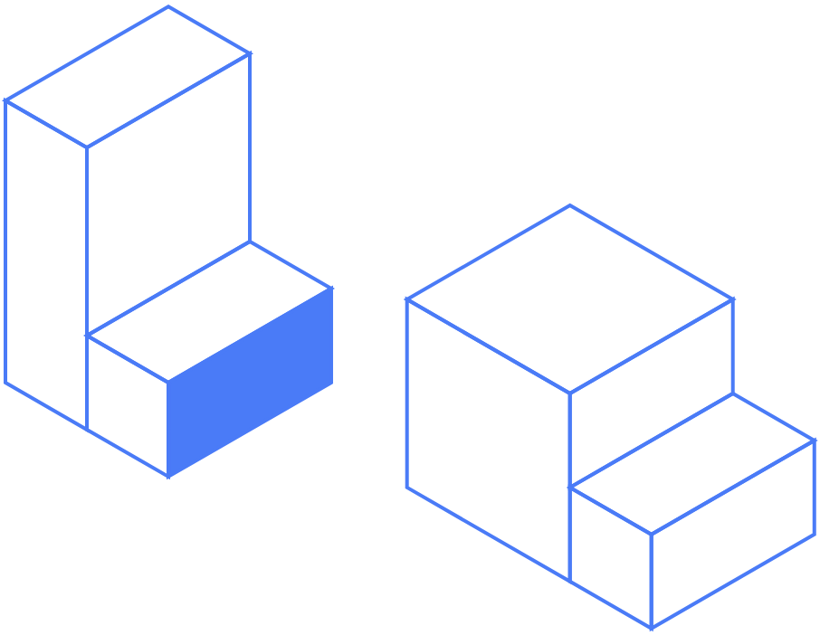
CodeFortyNine
Google Ads Optimization Plan
Prepared for the 15 August start, covering the first two weeks of work.
[ Google Search ]
[ 15 to 30 August 2026 ]
Notes:
Opening slide. Confirm the start date of 15 August is still correct before sending. Update checklist: Client name and the date range in the bottom right seal are the only fields that change per version.

Slide 2
[ toggle.solutions ]
What we are working on
Four optimizations, run in sequence from 15 August. The slides that follow take each one in turn.
1
Pause what does not convert
2
Tighten keywords and match types
Seven ad groups spent across 30 days and returned nothing. We switch them off and let the budget flow to the ad groups that do convert.
We pause the keywords that spend without converting, move the two biggest broad match terms to phrase match, and add a validated set of new ones.
3
Rebuild the campaign structure
4
Refresh ad copy and extensions
Five campaigns organized by product feature become three organized by buyer intent, so budget follows the way people search.
Nine new responsive search ads go live, along with the sitelinks, callouts and structured snippets the account is missing today.
Notes:
This is the map for the deck. Walk through the four in order, then say each one gets its own slide. Update checklist: Card titles and bodies are plain text boxes. If an optimization is added or dropped, keep the count at four so the two by two grid holds.

Slide 3
[ toggle.solutions ]
Optimization 1: pause what does not convert
Seven of the thirteen ad groups spent money across a 30 day window and produced no conversions at all.
Campaign | Ad groups paused | Spend released | What keeps running
instanceclone | 3 of 5 | €403.86 | Instance Clone Generic and Instance Clone Project
generic | 1 of 2 | €243.85 | The main Generic ad group
projectclone | 3 of 4 | €74.45 | Template Project Clone
Total | 7 of 13 | €722.16 | Six ad groups continue
The ad groups coming out are the issue, space and work item variants across all three campaigns, plus the bulk clone group. Every one of them draws clicks on searches that describe a Jira action rather than a buying decision.
7 ad groups paused | €722.16 released | 0 conversions between them
Notes:
The point to land is that this money is not being cut, it is being moved to the ad groups that already convert. Update checklist: The four spend cells and the two count cells come from the Immediate Action tab of the optimization log. Check the arithmetic: 403.86 plus 243.85 plus 74.45 equals 722.16, and the paused ad group count must equal 7.

Slide 4
[ toggle.solutions ]
Optimization 2: tighten keywords and match types
Three moves inside the six ad groups we keep. Broad match is where most of the waste sits.
Move | Scope | Size of the move | Why
Pause | 12 keywords across 6 ad groups | €1,037.90 | These keywords spent through the full window and returned no conversions.
Switch to phrase match | 2 keywords, deep clone jira and jira cloud migration | €1,077.57 | Together they are 28 percent of all spend and returned one conversion each. Phrase match keeps the intent and drops the drift.
Add | 14 keywords across 4 themes | 1,040 searches | Validated monthly volume across instance clone, project clone, brand and template themes.
Shared negative list: terms like jobs, position, training, hiring, KPI, free and vs get blocked across all campaigns, so research and recruitment traffic stops drawing clicks.
12 paused | 2 switched to phrase | 14 added
Notes:
Keep this at the level of the move. Do not list individual keywords unless asked. Two keywords are named because each one carries several hundred euros on its own. Update checklist: The three figure cells come from the Immediate Action tab and the keyword research list. Check that 12 plus 2 matches the keyword lines in the log, and that the 14 added keywords sum to 1,040 monthly searches.

Slide 5
[ toggle.solutions ]
Optimization 3: rebuild the campaign structure
The account is built around product features today. We rebuild it around how buyers search.
Today
After the rebuild
5 campaigns, 13 ad groups
3 campaigns, split by intent
instanceclone
Generic, people describing the problem
brand
→
generic
Brand, people already asking for Deep Clone
competition
Competition, people comparing against another tool
projectclone
Ad groups are split by product feature: issues, spaces, work items, epics and templates.
Budget can then follow intent, so the campaigns closest to a decision are funded first.
Naming convention: c49deepj-new-lead-search_generic, _brand, _competition
Notes:
The argument is that a person searching for a migration tool and a person searching for Deep Clone by name are not the same buyer and should not share a budget. Update checklist: The two headline counts, 5 campaigns with 13 ad groups and 3 campaigns, are the only figures on this slide.

Slide 6
[ toggle.solutions ]
Optimization 4: refresh ad copy and extensions
Nine new responsive search ads are written and ready, three for each of the new campaigns.
Campaign | New ads | Messaging direction
Generic | 3 | Points migration research toward a Jira specific tool rather than native Atlassian tooling or a generic plugin built for another platform.
Brand | 3 | Captures validated brand demand, including cloud specific searches, with a direct push to the free trial.
Competition | 3 | Speaks to buyers already comparing tools, with switching led messaging rather than more competitor name coverage.
Also being built
Sitelinks
Callouts
Structured snippets
UTM tagging
Campaign level, none live today
Campaign level, none live today
Campaign level, none live today
Set before anything goes live
9 responsive search ads | 3 extension types | All copy within Google character limits
Notes:
The ads are already drafted and checked against Google character limits. Offer to share the full copy sheet if they want to read every headline. Update checklist: The ad counts come from the campaign structure workbook, three responsive search ads per campaign. If a fourth extension type gets added, the four cards need to be resized to fit the row.

Slide 7
[ toggle.solutions ]
The next two weeks
How the work is sequenced between 15 and 30 August.
15 to 16 August
We confirm access, take a snapshot of the account as it stands, and prepare every change so nothing is built live.
Account setup
17 to 23 August
The seven ad groups and twelve keywords go off, the two broad match terms move to phrase, and the three new campaigns get built.
Pauses and rebuild
24 to 30 August
The nine responsive search ads and the extensions launch, and the fourteen new keywords are added with the negative list applied.
New ads go live
Everything above runs inside the account | No budget changes | No changes to the Marketplace listing
Notes:
This slide answers the question of what happens while they are away. Keep it factual and short. Update checklist: The three date ranges are the only fields that change. The counts in each description must match slides 3, 4 and 6.

Slide 8
[ toggle.solutions ]
Setting a biweekly call
We suggest starting the week after 30 August, then holding the same slot every second week.
Option | Day | Date | Time, CEST
1 | Tuesday | 1 September 2026 | 9:00 am | Our recommendation
2 | Tuesday | 1 September 2026 | 3:00 pm
3 | Wednesday | 2 September 2026 | 9:00 am
4 | Wednesday | 2 September 2026 | 2:00 pm
Whichever slot you pick becomes the standing one. If we start on Tuesday 1 September, the following calls fall on 15 September, 29 September and so on. If you would rather start on Wednesday 2 September, the next one lands on 16 September.
Every second week | Tuesday or Wednesday | Same time each session
Notes:
Ask them to pick one of the four before they leave on 17 August, so the calendar invite is already in place when they are back. Update checklist: The four rows hold day, date and time. If the start date moves, update the follow on dates in the callout below the table as well. Check the weekdays: 1 September 2026 is a Tuesday and 2 September 2026 is a Wednesday.

Slide 9
[ toggle.solutions ]
Thank you
We start on 15 August and the first two weeks are already mapped out. Let us know which call slot works for you and we will hold it from September onward.
[ Toggle Solutions ]
Notes:
Close on the call slot question so the meeting ends with a decision to make. Update checklist: The start date appears once in the closing paragraph.

