Slide 1






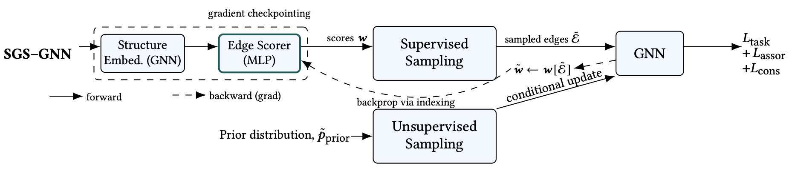
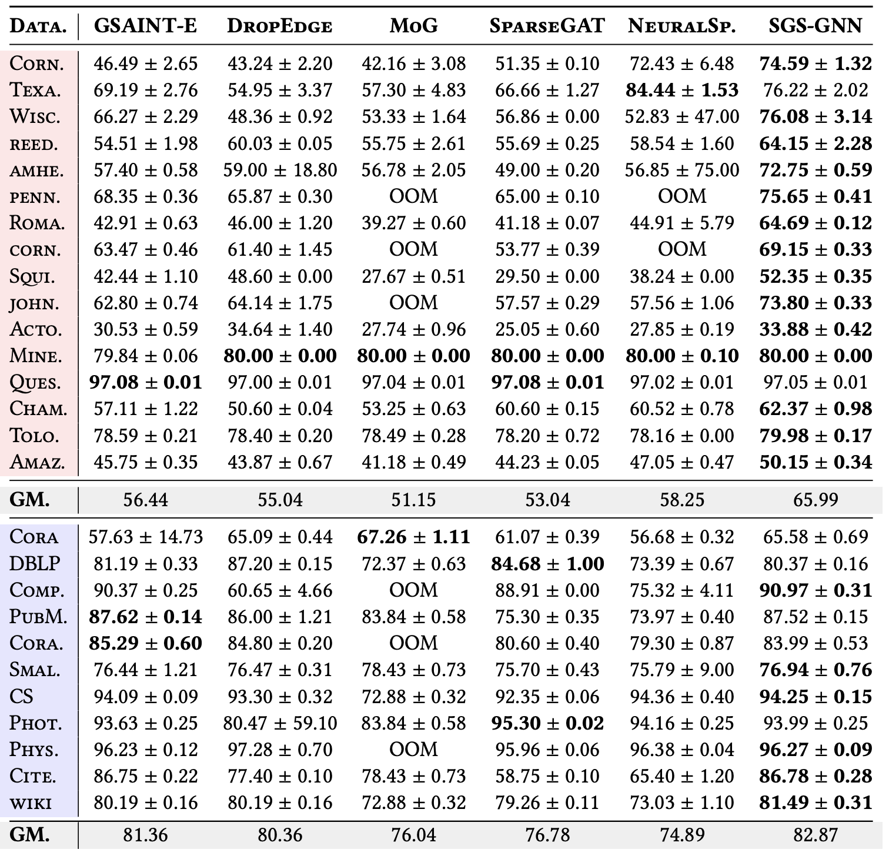
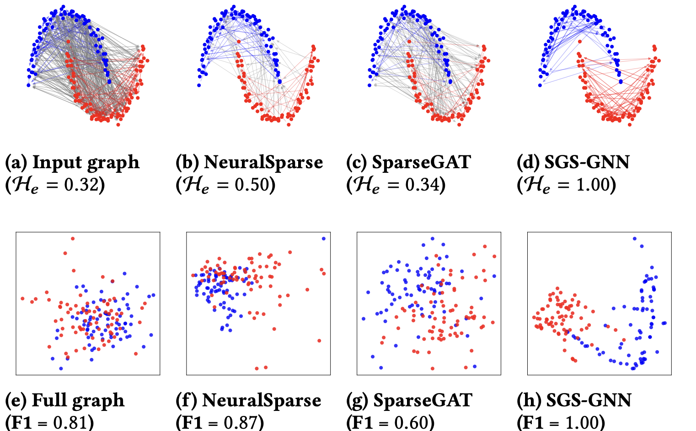
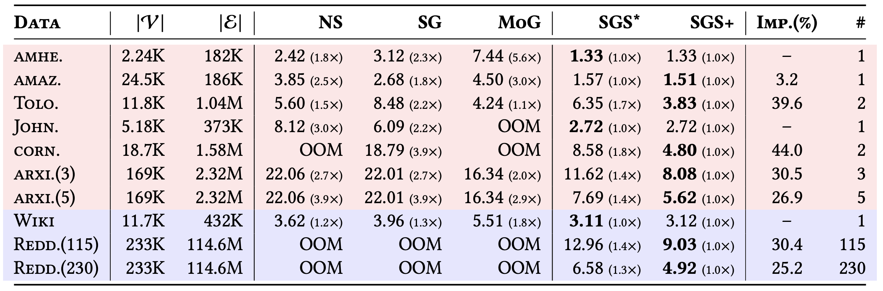
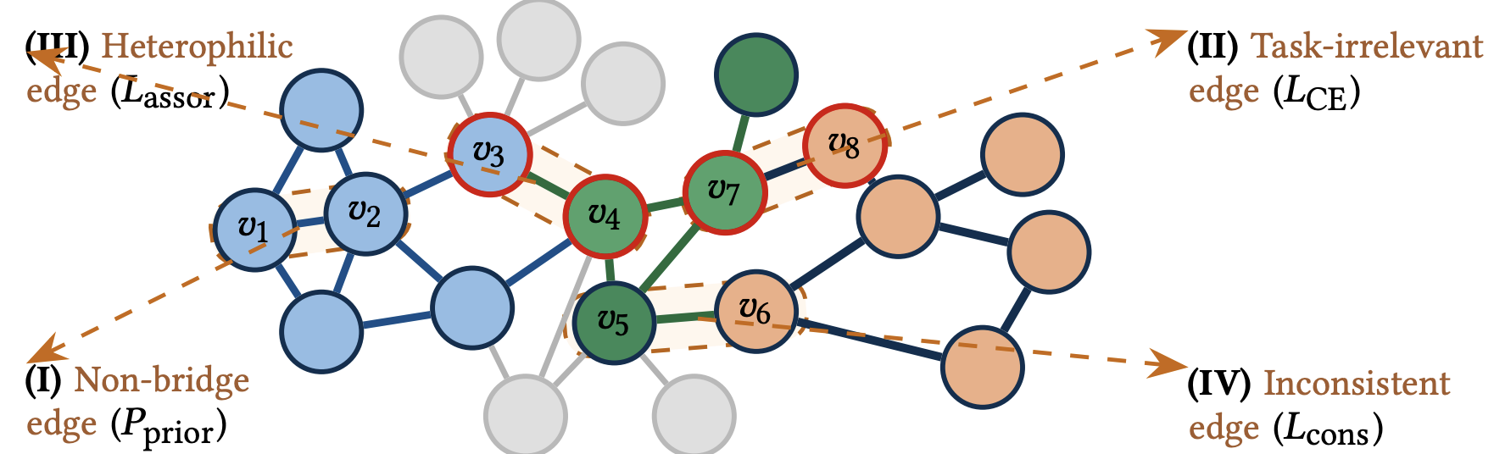
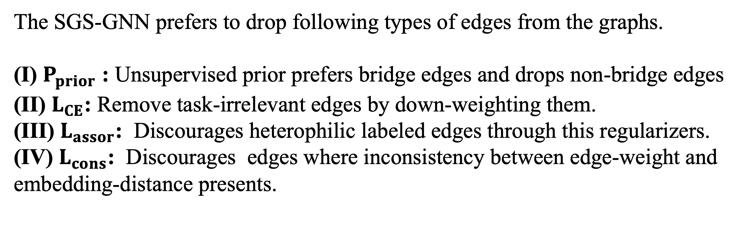
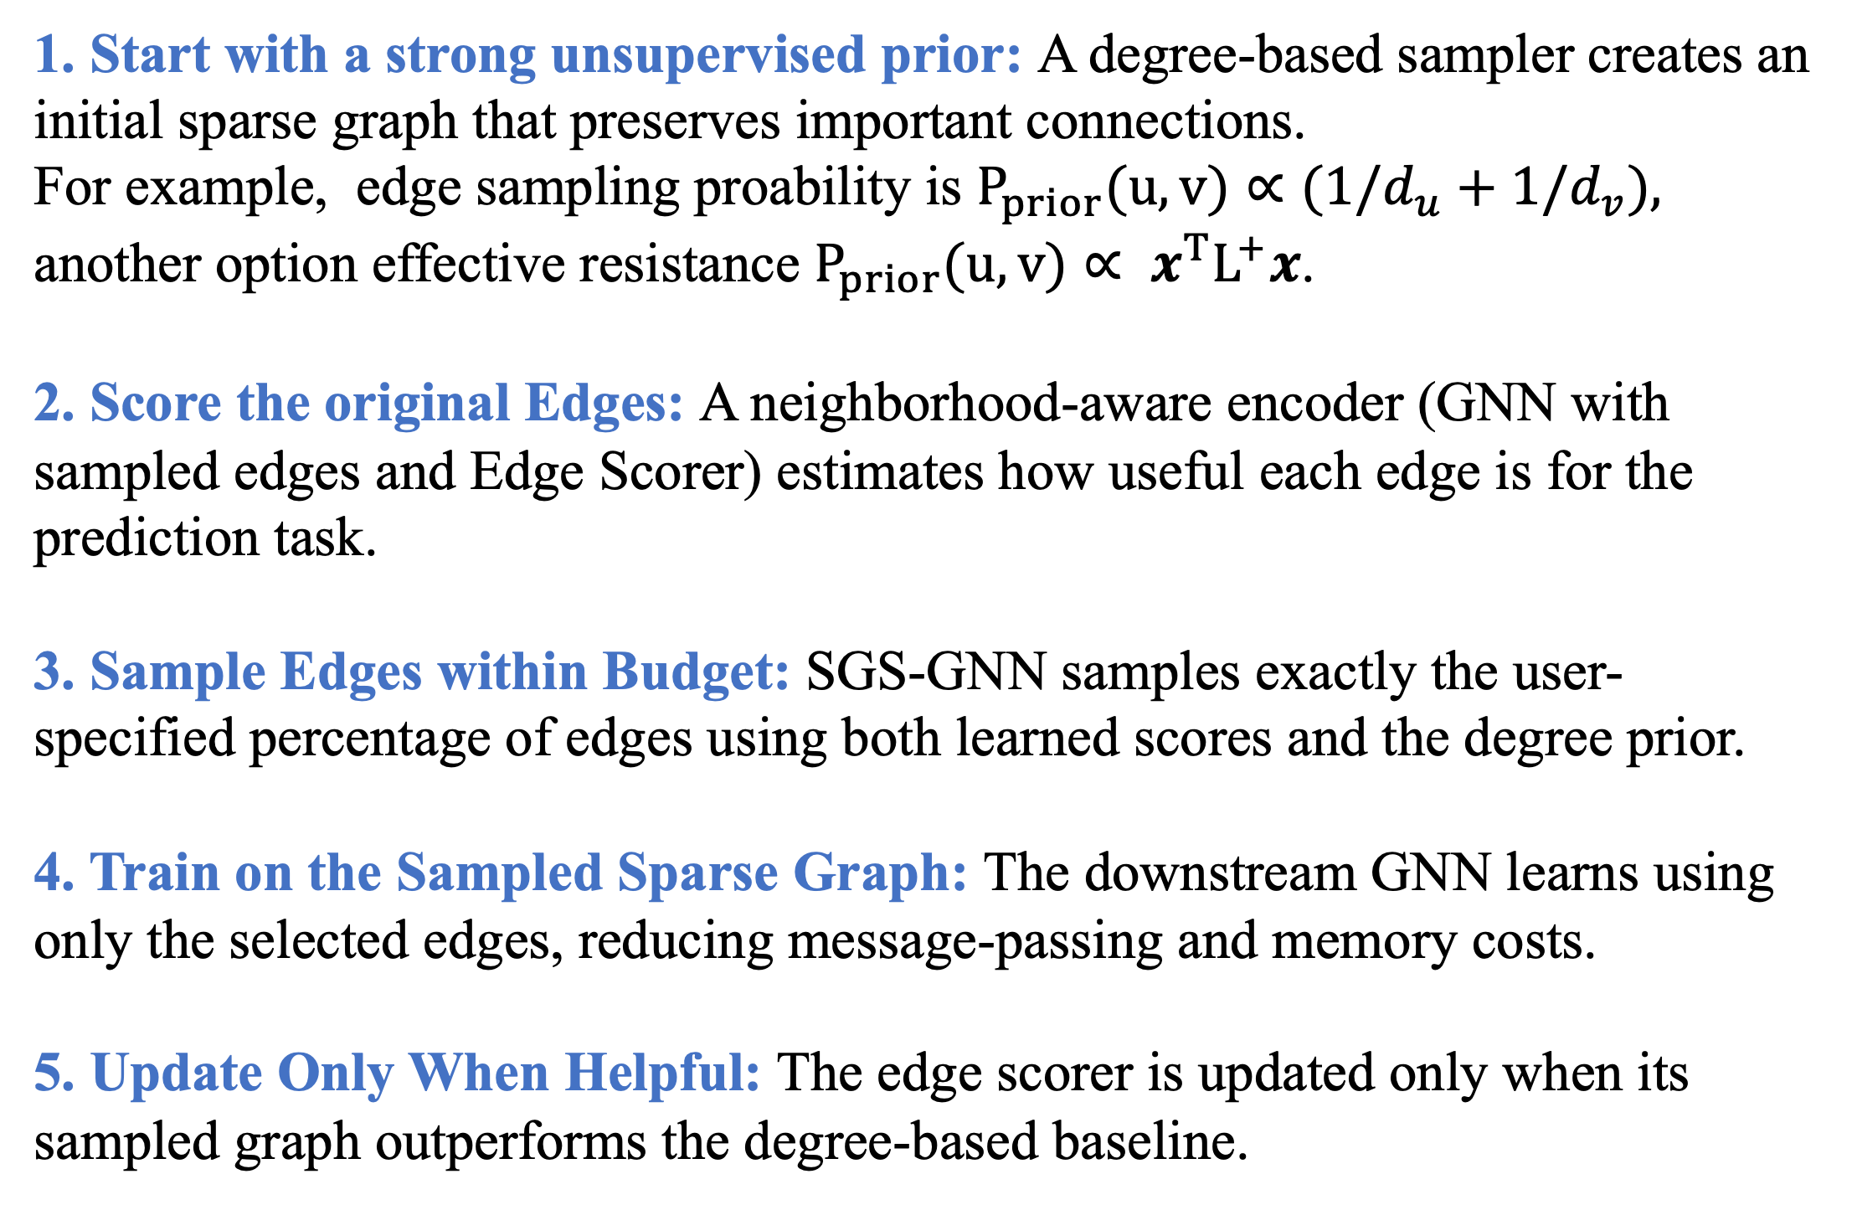
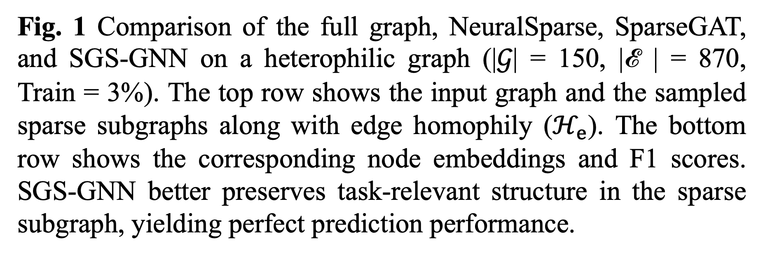
SGS-GNN: A Supervised Graph Sparsifier for Graph Neural Networks
Siddhartha Shankar Das‡, Naheed Anjum Arafat†, Muftiqur Rahman*, SM Ferdous‡, Alex Pothen ✣, Mahantesh Halappanavar‡, Danda B. Rawat†
Pacific Northwest National Laboratory (PNNL)‡, Howard University†, Islamic University of Technology*, Purdue University✣,
Contact: siddhartha.das@pnnl.gov
Why SGS-GNN?
Proposed Method: SGS-GNN
GNNs typically process all graph edges, increasing computation and GPU memory while propagating information through noisy or task-irrelevant connections. Existing supervised sparsifiers often lack precise global sparsity control, retain costly edge-level computation graphs, and overlook graph homophily and heterophily.
SGS-GNN addresses these limitations in the following manner:
Precise Sparsity Control: Explicitly samples a subgraph that strictly satisfies the target global sparsity ratio.
Scalable Learning: Backpropagates only through sampled edges and uses gradient checkpointing for efficient training.
Reduced GPU Memory: Avoids retaining edge-level computation graphs and gradients for pruned edges.
Reliable Performance: Updates the edge scorer only when it outperforms a strong degree-based sampler, preventing degradation below the baseline.
Fig. 2 SGS-GNN starts by computing edge sampling probabilities, then the sampler selects sparse subgraphs, and the downstream GNN operates on the sampled edges. To reduce high memory cost of edge-scorer, SGS-GNN applies gradient checkpointing and updates only if supervised sampling is beneficial.
Training Steps
Key Results
1. Start with a strong unsupervised prior: A degree-based sampler creates an initial sparse graph that preserves important connections.
For example, edge sampling proability is $P_{prior}(u,v)∝(1/d_{u}+1/d_{v}),$
another option effective resistance $P_{prior}(u,v)∝ x^{T}L^{+}x$.
2. Score the original Edges: A neighborhood-aware encoder (GNN with sampled edges and Edge Scorer) estimates how useful each edge is for the prediction task.
3. Sample Edges within Budget: SGS-GNN samples exactly the user-specified percentage of edges using both learned scores and the degree prior.
4. Train on the Sampled Sparse Graph: The downstream GNN learns using only the selected edges, reducing message-passing and memory costs.
5. Update Only When Helpful: The edge scorer is updated only when its sampled graph outperforms the degree-based baseline.
33 graphs evaluated
4–7% better F1 than prior sparsifiers at similar sparsity
Up to 30% improvement on heterophilic graphs
Up to 3.9× lower peak memory
Case Study: Heterophilic Graph
The following is a two half-moon heterophilic graph, with edge homophily of 0.32 meaning only 32% of edges connect vertices of the same class.
A GNN using the full graph is only about 81% accurate. Compared to others only SGS-GNN can find sparse-subgraphs with 100% edge homophily to yield 100% accuracy.
Which Edges Are Removed?
The SGS-GNN prefers to drop following types of edges from the graphs.
(I) $P_{prior}$ : Unsupervised prior prefers bridge edges and drops non-bridge edges
(II) $L_{CE}$: Remove task-irrelevant edges by down-weighting them.
(III) $L_{assor}$: Discourages heterophilic labeled edges through this regularizers.
(IV) $L_{cons}$: Discourages edges where inconsistency between edge-weight and embedding-distance presents.
Table 1: Mean F1-score (%) ± std. dev. for baseline sparsifiers with 20% edges. Bold: best method. OOM: out of memory. GM: geometric mean, computed over datasets where all methods report results
Fig. 1 Comparison of the full graph, NeuralSparse, SparseGAT, and SGS-GNN on a heterophilic graph (|𝒢| = 150, |ℰ | = 870, Train = 3%). The top row shows the input graph and the sampled sparse subgraphs along with edge homophily ($ℋ_{e}$). The bottom row shows the corresponding node embeddings and F1 scores. SGS-GNN better preserves task-relevant structure in the sparse subgraph, yielding perfect prediction performance.
Table 2: Peak GPU memory (GB). SGS*/SGS+ denote runs without/with gradient checkpointing. For each dataset, the minimum memory is normalized to 1.0 (bold); parentheses show relative factors. Imp.(%) reports the memory reduction from checkpointing. #-METIS partitions of SGS-GNN; NS: NeuralSparse; SG: SparseGAT.
Fig. 3. Four inductive-bias cases guiding edge removal (training nodes have red borders)
Acknowledgements: This work used computing resources at PNNL and Purdue University and was supported by DOE Advanced Computing Technologies, PNNL LDRD, DOE grant SC-0022260, and the DoW CoE-AIML at Howard University under Contract W911NF-20-2-0277. PNNL is operated by Battelle under Contract DE-AC05-76RL01830. The views expressed are those of the authors.

