Slide 1


ZEAL EDUCATION SOCIETY’S
ZEAL COLLEGE OF ENGINEERING AND RESEARCH
NARHE │PUNE -41 │ INDIA
COMPUTER ENGINEERING DEPARTMENT
AY: 2023-2024 Semester: IV
DETECTION of CYBERBULLYING on
SOCIAL MEDIA USING BiLSTM
A PROJECT PRESENTATION ON
BY-
ADITYA BHAMRE (77200082E)
Guide-
PROF. APARNA MOTE

Slide 2
CONTENTS
Introduction
Objective
Problem Statement
Motivation
Literature Survey
System Architecture
Algorithm/Methodology
Hardware and Software Requirements
Comparison
Outcomes
Applications
Conclusion
References

Slide 3
INTRODUCTION
Rising concern of cyberbullying in the digital age.
Suicides, depression and mental health issues.
Issue relevant in 2024, more than ever when queer content creator lost life to the bullying comments.
Introduction to the use of advanced deep learning technique, Bidirectional Long Short-Term Memory (BiLSTM).
Significance of leveraging cutting-edge technology for ensuring online safety.

Slide 4
OBJECTIVES
Develop and implement a robust Cyberbullying Detection System using BiLSTM.
Go beyond traditional methods by harnessing bidirectional processing.
Contribute to a safer and more secure digital space for users worldwide.
Investigate and understand the limitations of existing cyberbullying detection methods.
Explore the bidirectional processing capabilities of BiLSTM for capturing nuanced linguistic patterns associated with cyberbullying.

Slide 5
PROBLEM STATEMENT
Develop and implement an advanced Cyberbullying Detection System utilizing Bidirectional Long Short-Term Memory (BiLSTM) to enhance accuracy and effectiveness in identifying online harassment

Slide 6
MOTIVATION
Bidirectionality as a Solution:
Motivated by the inadequacies of unidirectional models in capturing comprehensive context.
Bidirectional Long Short-Term Memory (BiLSTM) stands out as a solution to this limitation.
Enhanced Contextual Understanding:
Motivation behind choosing BiLSTM lies in its ability to process information in both forward and backward directions simultaneously.
Bidirectional processing ensures a more profound understanding of linguistic nuances associated with cyberbullying.
Optimizing Detection Accuracy:
Our motivation is to optimize detection accuracy by leveraging bidirectional processing, enabling the system to capture a more comprehensive range of linguistic patterns indicative of cyberbullying.

Slide 7
LITERATURE SURVEY
Serial No. | Title of paper | Author | Publications | Technology | Pros
1 | Cyberbullying Detection on Social Networks using LSTM Model | Arsha Dass M A, Deepa K Daniel | International Conference on Innovations in Science and Technology for Sustainable Development (ICISTSD) 2022 IEEE | Long Short Term Memory (LSTM) | Proposes LSTM model for cyberbullying detection, achieving an accuracy of 75.12%, better than previous machine learning models.
2 | Cyberbullying Detection using LSTM-CNN architecture and its applications | Mihir Gada, Kaustubh Damania, Smita Sankhe | International Conference on Computer Communication and Informatics (ICCCI -2021) IEEE | LSTM, CNN, Logistic Regression, Random Forest, XGBoost | Combines various machine learning techniques and LSTM-CNN model to detect cyberbullying. Implemented in a web application, Telegram Bot, and Chrome Extensions for practical use.
3 | Cyberbullying Detection: Ensemble-Based ML Approach | Alam, K.S., Bhowmik, S., Prosun, P.R.K. | ICICV 2021 | Ensemble-based ML | Introduces an ensemble-based voting model for categorizing items into offensive and non-offensive, utilizing ML classifiers, ensemble models, feature extraction algorithms, and n-gram evaluations. SLE and DLE voting classifiers outperform Logistic Regression and Bagging Ensemble Model Classifiers.

Slide 8
LITERATURE SURVEY
Serial No. | Title of paper | Author | Publications | Technology | Pros
4 | Multi-featured Cyberbullying Detection | Luo, Y., Zhang, X., Hua, J., Shen, W. | ICCSE 2021 IEEE | Deep Learning (BiGRU-CNN | Presents a BiGRU-CNN sentiment classification model for cyberbully detection. Utilizes Kaggle text dataset and emoji dataset from social media. Model's classification accuracy surpasses traditional models.
5 | Machine & Deep Learning in Cyberbullying Detection | Ahmed, M.T., Rahman, M., Nur, S., Islam, A., Das, D. | ICAECT 2021 IEEE | ML (Naive Bayes, SVM, Logistic Regression, XGBoost), Deep Learning (CNN, LSTM, BLSTM, GRU) | Deploys ML and DL algorithms for cyberbullying detection in Bangla and Romanized Bangla text. CNN outperforms for Bangla texts (84% accuracy), while Multinomial Naive Bayes performs best for Romanized Bangla (84%) and combined datasets (80%).

Slide 9
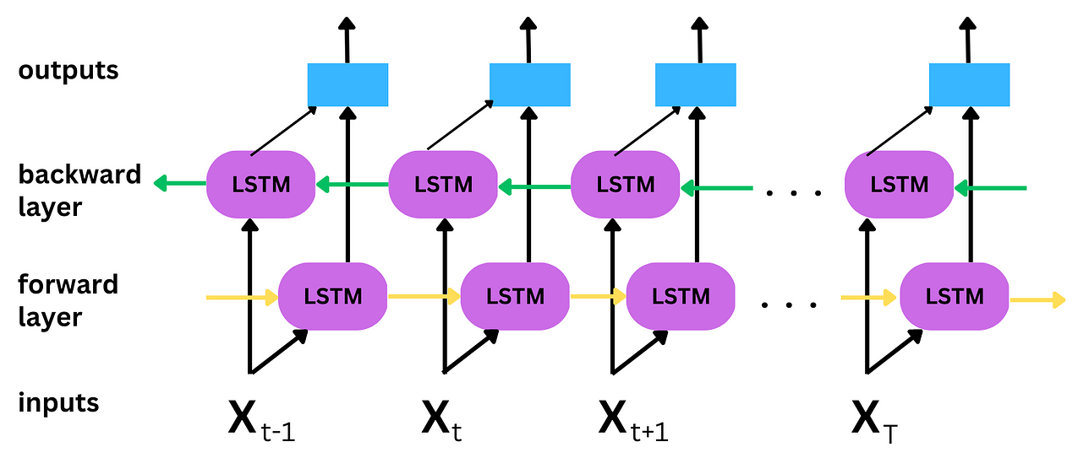
BiLSTM
SYSTEM ARCHITECTURE

Slide 10
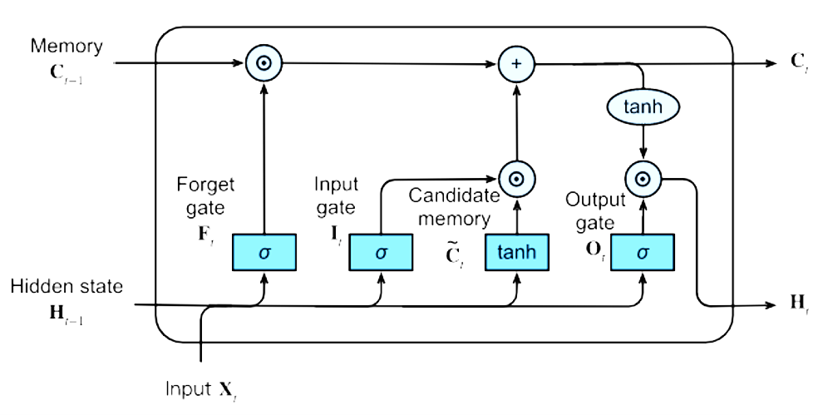
LSTM
SYSTEM ARCHITECTURE

Slide 11
ALGORITHM/METHODOLOGY
Bidirectional Processing:
BiLSTM, an extension of the traditional LSTM, processes input sequences in both forward and backward directions simultaneously.
This bidirectional processing is crucial for capturing dependencies and patterns that may be missed in a unidirectional model.
Memory Cells:
Similar to LSTM, BiLSTM includes memory cells that can store and retrieve information over long sequences.
These memory cells are equipped with gates to control the flow of information, preventing irrelevant data from being stored.
Forward Pass:
In the forward pass, the input sequence is processed from the beginning to the end, capturing dependencies and patterns in the forward direction.
Information is stored in the memory cells, allowing the model to retain relevant context.

Slide 12
ALGORITHM/METHODOLOGY
Backward Pass:
Simultaneously, in the backward pass, the input sequence is processed in reverse order, capturing dependencies and patterns in the backward direction.
This bidirectional processing ensures a more comprehensive understanding of the contextual information.
Combining Information:
The information captured from both the forward and backward passes is combined, providing a holistic representation of the input sequence.
This combination enables the model to capture long-range dependencies and understand the context of the input data.
Output Generation:
The final output is generated based on the combined information, allowing the model to make predictions or classifications.
The bidirectional nature of BiLSTM enhances its ability to capture intricate patterns and dependencies in sequential data.

Slide 13
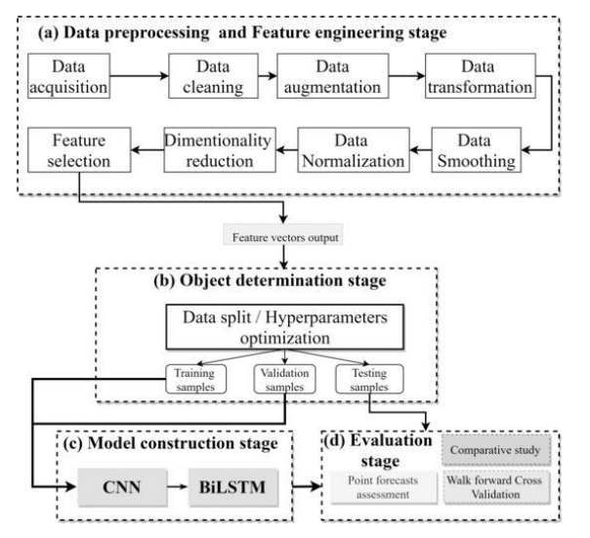

Slide 14
H/w and S/w Requirements
Dataset Requirement:
Relevant social media dataset across different source like Kaggle, etc.
Python 3.x and necessary libraries
Python 3.x and necessary libraries
IDE (Jupyter Notebook, Visual Studio, etc)
Hardware Requirements:
Linux- Ubuntu 16.04 to 17.10, or Windows 7 to 10, with 2GB RAM (4GB preferable)
You have to install Python 3.6 and related packages, and follow the installation instructions given below as per your operating system.
GPU (Optional but recommended) for faster training of deep learning models, especially for larger dataset

Slide 15
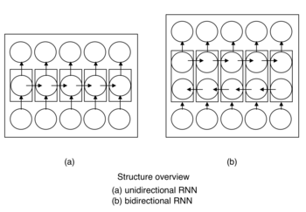
COMPARISON

Slide 16
COMPARISON
Aspect | Unidirectional LSTM | Bidirectional LSTM
Processing Direction | Processes information sequentially from one direction. | Processes information simultaneously in both forward and backward directions.
Context Consideration | Considers dependencies only in the past or future. | Captures dependencies from both past and future elements, providing a more comprehensive context.
Reading Analogy | Similar to reading a book from start to finish. | Like reading a book from both ends simultaneously, comprehending the narrative in a richer manner.
Applications | Suitable for tasks where dependencies are primarily in one direction, e.g., time series prediction. | Effective in tasks requiring a holistic understanding of context, such as sentiment analysis or translation.

Slide 17
COMPARISON
Aspect | Unidirectional LSTM | Bidirectional LSTM
Computational Complexity | Lower computational complexity compared to bidirectional. | Higher computational complexity due to simultaneous processing in both directions.
Training Time | Typically, faster training time. | May have longer training time due to increased complexity.
Prediction Accuracy | May miss capturing complex dependencies that span both directions. | Better accuracy in capturing long-range dependencies and understanding context comprehensively.
Flexibility in Learning | Limited flexibility in adapting to bidirectional patterns. | Enhanced flexibility, making it adaptable to a wider range of sequential patterns.

Slide 18
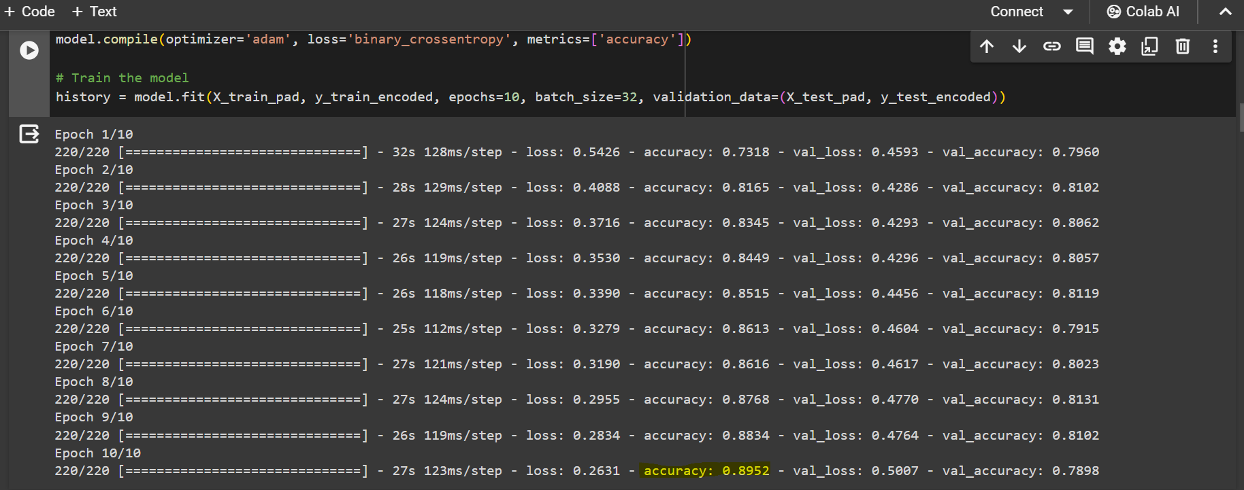
OUTCOMES
- Training the BiLSTM Model

Slide 19
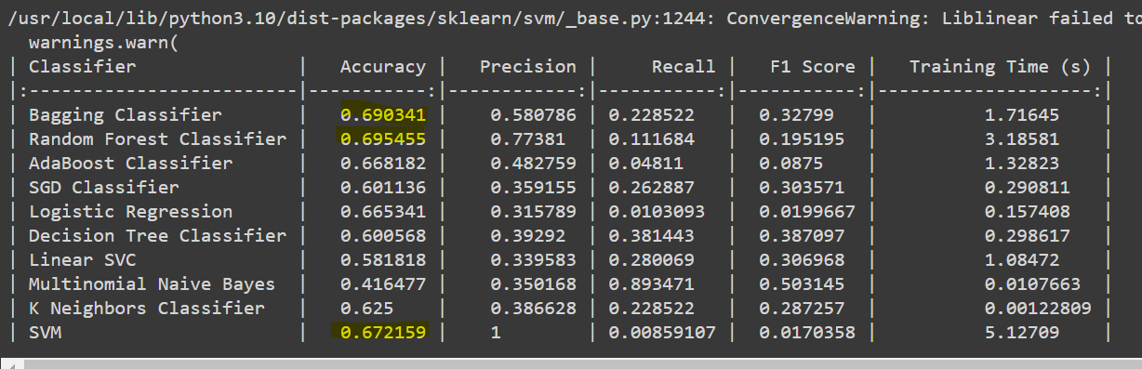
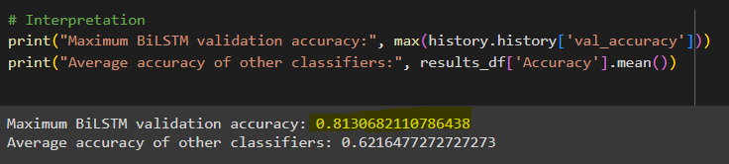
OUTCOMES
- Comparing against other Classifiers

Slide 20
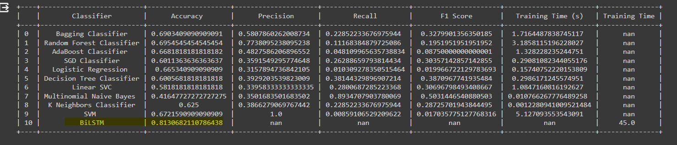
OUTCOMES
- Comparison

Slide 21
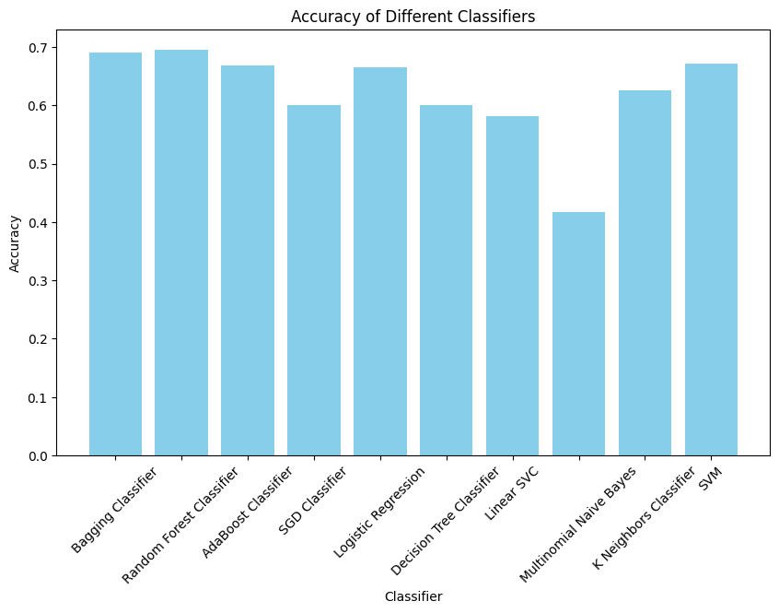
OUTCOMES
- Comparing against other Classifiers

Slide 22
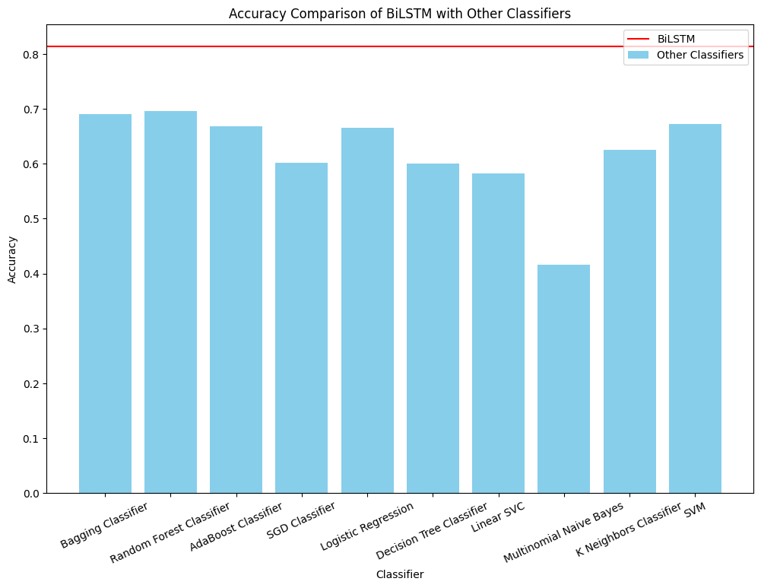
OUTCOMES
- Comparing against other Classifiers

Slide 23
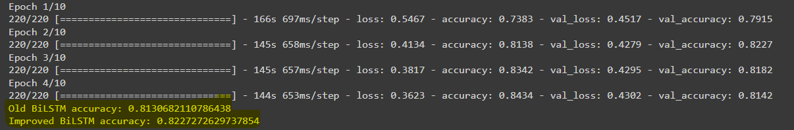
OUTCOMES
- Improving BiLSTM Accuracy

Slide 24
OUTCOMES
- Improving BiLSTM Accuracy
https://colab.research.google.com/drive/1guNTw3cjDiA0sbYT48n6fjbC-t0gm68w#scrollTo=i_aiXQAdJEqs

Slide 25
EXPECTED OUTCOMES
Improved Accuracy:
Anticipate a significant improvement in the accuracy of cyberbullying detection.
Enhanced precision in identifying linguistic patterns associated with online harassment.
Reduced False Positives:
Expect a reduction in false positive rates, minimizing instances of misclassification.
Improved specificity in distinguishing between cyberbullying and non-harmful content.
Efficient Long-Range Dependency Recognition:
Aim for the system to efficiently recognize long-range dependencies in text.
Enhanced ability to capture subtle nuances indicative of cyberbullying over extended sequences.
Tangible Results:
Showcase tangible results that highlight the effectiveness of our BiLSTM-based Cyberbullying Detection System.
Provide empirical evidence of the system's capabilities through comprehensive evaluation metrics.

Slide 26
APPLICATION
Real-time Social Media Monitoring:
Implementing our system for continuous monitoring of social media platforms.
Prompt detection and prevention of cyberbullying incidents in real-time.
Email Filtering:
Extending the application to filter potentially harmful content in emails.
Enhancing user safety in digital communication channels.
Securing Online Chatrooms:
Integrating the system into online chat platforms to create a safer virtual environment.
Identifying and mitigating cyberbullying instances in chat conversations.
Fostering Safer Educational Spaces:
Implementing the system in educational settings to safeguard students from online harassment.
Creating a conducive and secure digital learning environment.

Slide 27
CONCLUSION
In summary, the integration of Bidirectional Long Short-Term Memory (BiLSTM) marks a pivotal step forward in enhancing cyberbullying detection. BiLSTM's bidirectional processing addresses limitations, providing a nuanced understanding of online harassment patterns. This technological edge ensures adaptability and resilience against evolving cyberbullying tactics, emphasizing our commitment to creating a safer digital space through innovative solutions.

Slide 28
REFERENCES
[1] D. M A and D. K. Daniel, "Cyberbullying Detection on Social Networks using LSTM Model," 2022 International Conference on Innovations in Science and Technology for Sustainable Development (ICISTSD), Kollam, India, 2022, pp. 293-296, doi: 10.1109/ICISTSD55159.2022.10010559.
[2] M. Gada, K. Damania and S. Sankhe, "Cyberbullying Detection using LSTM-CNN architecture and its applications," 2021 International Conference on Computer Communication and Informatics (ICCCI), Coimbatore, India, 2021, pp. 1-6, doi: 10.1109/ICCCI50826.2021.9402412.
[3] Alam, Kazi & Bhowmik, Shovan & Prosun, Priyo. (2021). Cyberbullying Detection: An Ensemble Based Machine Learning Approach. 710-715. 10.1109/ICICV50876.2021.9388499.
[4] Luo, Y., Zhang, X., Hua, J., Shen, W.: Multifeatured cyberbullying detection based on deep learning. In: 2021 16th International Conference on Computer Science & Education (ICCSE), pp. 746–751 (2021). IEEE
[5] Ahmed, Md.Tofael & Rahman, Maqsudur & Nur, Shafayet & Islam, Azm & Das, Dipankar. (2021). Deployment of Machine Learning and Deep Learning Algorithms in Detecting Cyberbullying in Bangla and Romanized Bangla text: A Comparative Study. 1-10. 10.1109/ICAECT49130.2021.9392608.
[6] Alam, K.S., Bhowmik, S., Prosun, P.R.K.: Cyberbullying detection: an ensemble-based machine learning approach. In: 2021 Third International Conference on Intelligent Communication Technologies and Virtual Mobile Networks (ICICV), pp. 710–715 (2021)
[7] J. Yadav, D. Kumar and D. Chauhan, Cyberbullying Detection using Pre-Trained BERT Model, ICESC, pp. 1096-1100, doi: 10.1109/ICESC48915.2020.9155700. (2020)
[8] R. R. Dalvi, S. Baliram Chavan and A. Halbe, Detecting A Twitter Cyberbullying Using Machine Learning, ICICCS, pp. 297-301, doi: 10.1109/ICICCS48265.2020.9120893. (2020)
[9] Trana R.E., Gomez C.E., Adler R.F. (2021) Fighting Cyberbullying: An Analysis of Algorithms Used to Detect Harassing Text Found on YouTube. In: Ahram T. (eds) Advances in Artificial Intelligence, Software and Systems Engineering. AHFE 2020.
Advances in Intelligent Systems and Computing, vol 1213. Springer, Cham. https://doi.org/10.1007/978-3-030-51328-3_2.(2020)

Slide 29
THANK YOU

